Slide 1
Lecture 13: Dynamic Programming

Slide 2
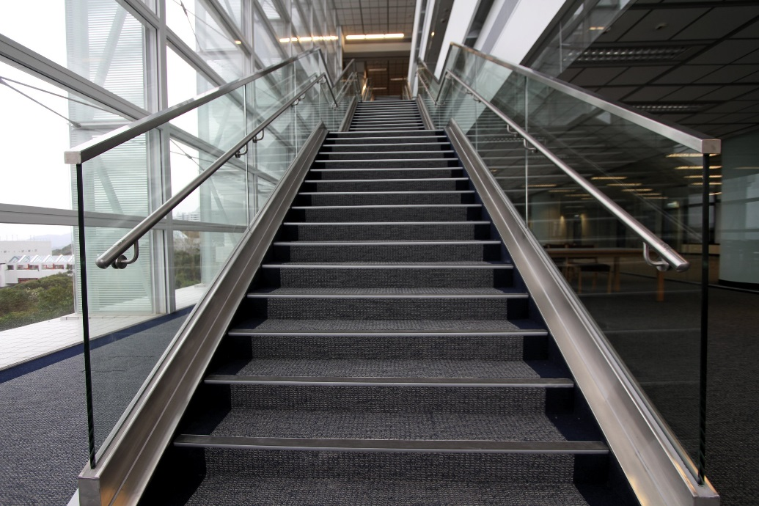
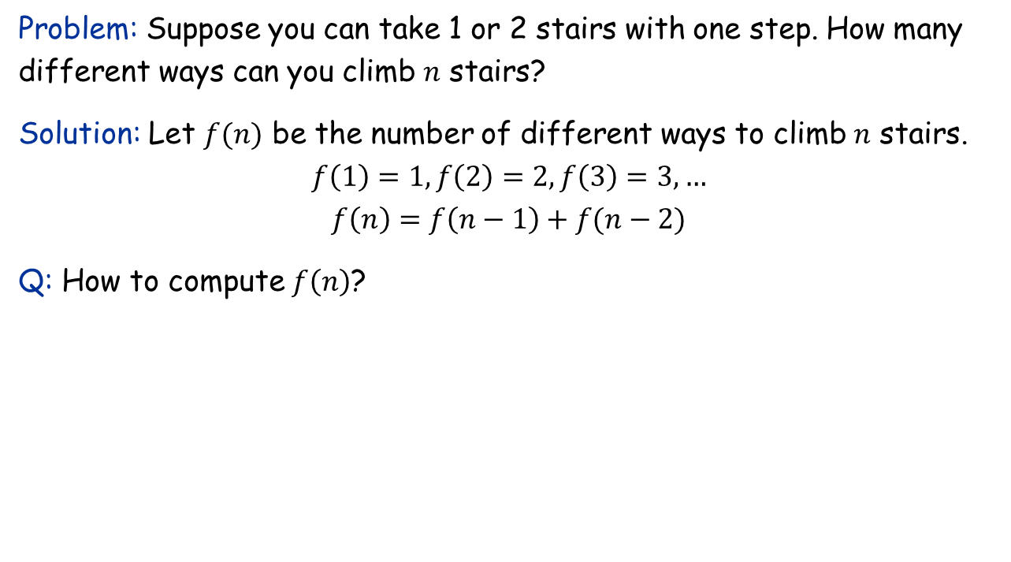
First Example: Stairs Climbing
Problem: Suppose you can take 1 or 2 stairs with one step. How many different ways can you climb $n$ stairs?
Solution: Let $f(n)$ be the number of different ways to climb $n$ stairs.
$$f\left(1\right)=1,f\left(2\right)=2,f\left(3\right)=3,…$$
$$f\left(n\right)=f\left(n−1\right)+f(n−2)$$
Q: How to compute $f\left(n\right)$?

Slide 3




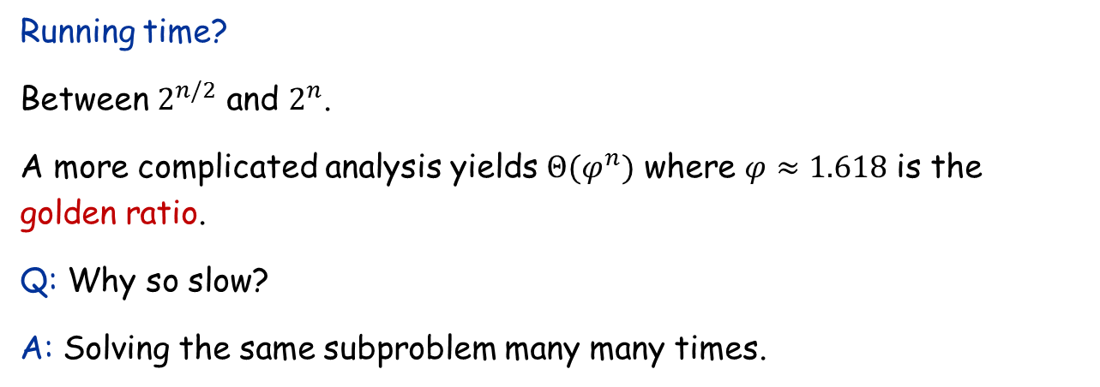




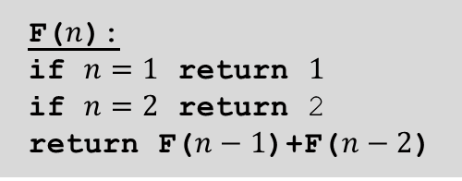

Solving the recurrence by recursion
$$f\left(1\right)=1,f\left(2\right)=2,f\left(3\right)=3,…$$
$$f\left(n\right)=f\left(n−1\right)+f(n−2)$$
F($n$):
if $n=1$ return $1$
if $n=2$ return 2
return F($n−1$)+F($n−2$)
$$F(n)$$
$$F(n−1)$$
$$F(n−2)$$
Running time?
Between $2^{n/2}$ and $2^{n}$.
A more complicated analysis yields $Θ(φ^{n})$ where $φ≈1.618$ is the golden ratio.
Q: Why so slow?
A: Solving the same subproblem many many times.
$$F(n−2)$$
$$F(n−3)$$
$$F(n−3)$$
$$F(n−4)$$
…
$$n$$

Slide 4
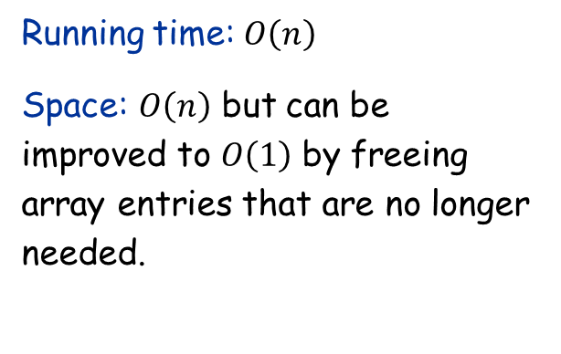
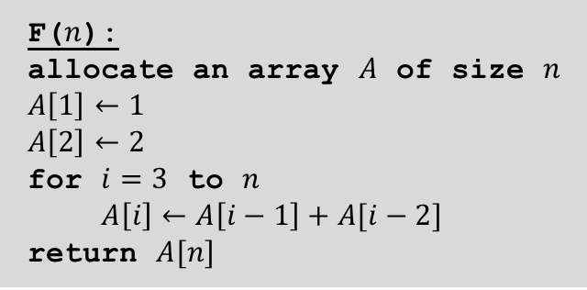
Solving the recurrence by recursion
$$f\left(1\right)=1,f\left(2\right)=2,f\left(3\right)=3,…$$
$$f\left(n\right)=f\left(n−1\right)+f(n−2)$$
F($n$):
allocate an array $A$ of size $n$
$A\left[1\right]←1$
$A\left[2\right]←2$
for $i=3$ to $n$
$A\left[i\right]←A\left[i−1\right]+A[i−2]$
return $A[n]$
Dynamic programming:
Used to solve recurrences
Avoid solving a subproblem more than once by memorization
Can be either top-down or bottom-up
Bottom-up is usually more efficient in practice
“Programming” here means “planning”, not coding!
Running time: $O\left(n\right)$
Space: $O\left(n\right)$ but can be improved to $O\left(1\right)$ by freeing array entries that are no longer needed.

Slide 5
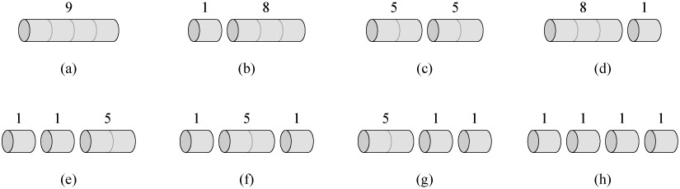
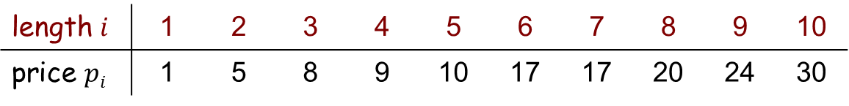

The Rod Cutting Problem
Problem: Given a rod of length $n$ and prices $p_{i}$ for $i=1,…,n$, where $p_{i}$ is the price of a rod of length $i$. Find a way to cut the rod to maximize total revenue.
length $i$ | 1 | 2 | 3 | 4 | 5 | 6 | 7 | 8 | 9 | 10
price $pi$ | 1 | 5 | 8 | 9 | 10 | 17 | 17 | 20 | 24 | 30
✓

Slide 6



Rod Cutting: The Algorithm
Define: Let $r_{n}$ be the maximum revenue obtainable from cutting a rod of length $n$.
Recurrence: $r_{n}=\max{\{p_{n},p_{1}+r_{n−1},p_{2}+r_{n−2},…,p_{n−1}+r_{1}\}}, r_{0}=0$
$p_{n}$ if we do not cut at all
$p_{1}+r_{n−1}$ if the first piece has length $1$
$p_{2}+r_{n−2}$ if the first piece has length $2$
…
let $r[0 .. n]$ be a new array
$r\left[0\right]←0$
for $j←1$ to $n$
$q←−∞$
for $i←1$ to $j$
$q←\max{(q, p[i]+r[j−i])}⁡$
$r\left[j\right]←q$
return $r[n]$
Running time: $O(n^{2})$

Slide 7
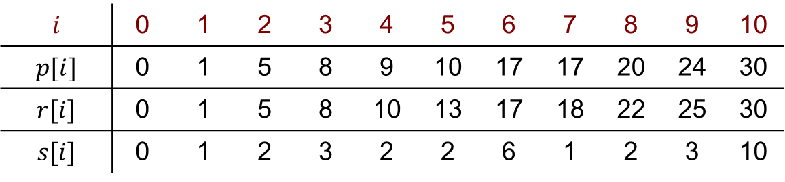

Reconstructing the Solution
Idea: Remember the optimal decision for each subproblem.
let $r[0 .. n]$ and $s[0 .. n]$ be new arrays
$r\left[0\right]←0$
for $j←1$ to $n$
$q←−∞$
for $i←1$ to $j$
if $q<p[i]+r[j−i]$ then
$q← p[i]+r[j − i]$
$s\left[j\right]←i⁡$
$r\left[j\right]←q$
$j=n$
while $j>0$ do
print $s[j]$
$j←j−s[j]$
$$i$$ | 0 | 1 | 2 | 3 | 4 | 5 | 6 | 7 | 8 | 9 | 10
$$p[i]$$ | 0 | 1 | 5 | 8 | 9 | 10 | 17 | 17 | 20 | 24 | 30
$$r[i]$$ | 0 | 1 | 5 | 8 | 10 | 13 | 17 | 18 | 22 | 25 | 30
$$s[i]$$ | 0 | 1 | 2 | 3 | 2 | 2 | 6 | 1 | 2 | 3 | 10

Slide 8
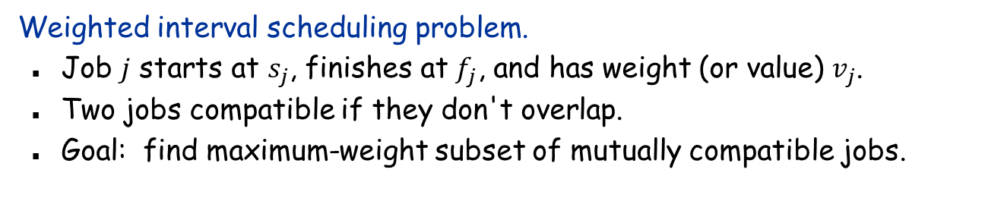
Weighted Interval Scheduling
Weighted interval scheduling problem.
Job $j$ starts at $s_{j}$, finishes at $f_{j}$, and has weight (or value) $v_{j}$.
Two jobs compatible if they don't overlap.
Goal: find maximum-weight subset of mutually compatible jobs.
a
b
c
d
e
f
g
h
Time
0
1
2
3
4
5
6
7
8
9
10
11

Slide 9
Unweighted Interval Scheduling Review
Recall. Greedy algorithm works if all weights are 1.
Consider jobs in ascending order of finish time.
Add job to subset if it is compatible with previously chosen jobs.
Observation. Greedy algorithm can fail miserably if arbitrary weights are allowed.
weight = 999
b
weight = 1
a
Time
0
1
2
3
4
5
6
7
8
9
10
11

Slide 10


Weighted Interval Scheduling
Notation. Label jobs by finishing time: $f_{1}≤f_{2}≤…≤f_{n}$.
Def. $p(j)=$ largest index $i<j$ such that job $i$ is compatible with $j$.
Ex: $p(8)=5, p(7)=3, p(2)=0.$
Q: How to compute $p(j)$?
A: Build a BST on jobs with finish time as the key, and then query with $s_{j}$ in $O(\log{n)}$ time.
1
2
3
4
5
6
7
8
Time
0
1
2
3
4
5
6
7
8
9
10
11

Slide 11
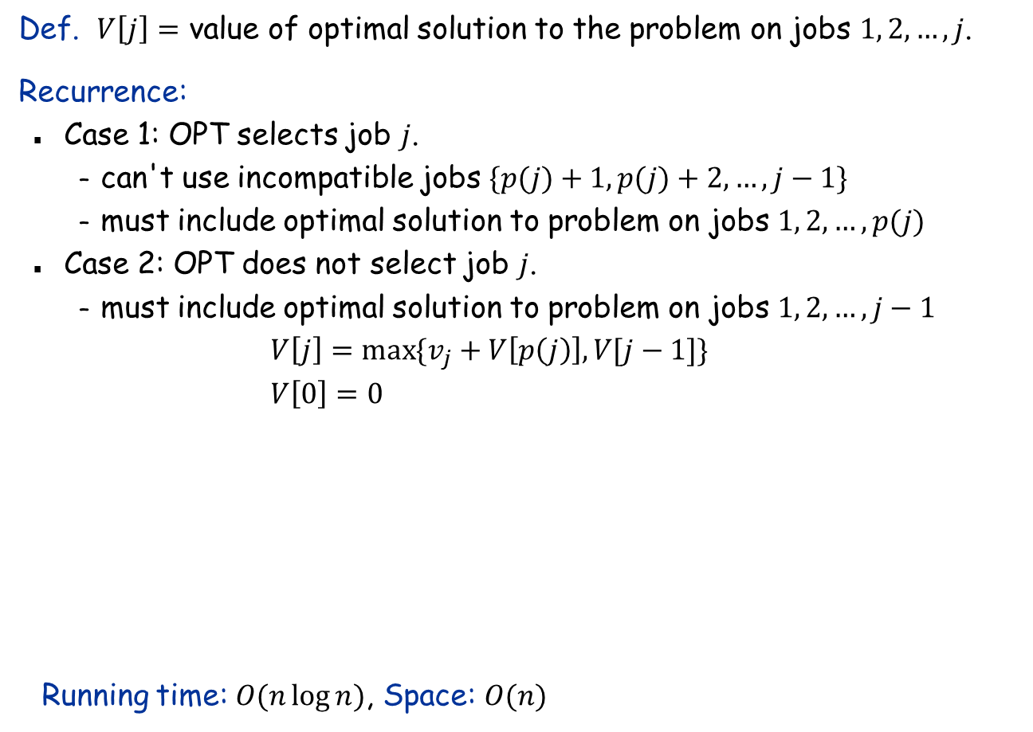
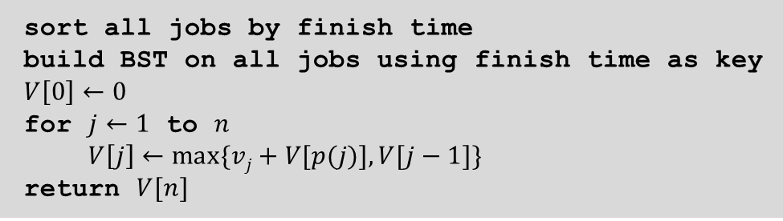
The Recurrence
Def. $V\left[j\right]=$ value of optimal solution to the problem on jobs $1, 2, …, j$.
Recurrence:
Case 1: OPT selects job $j$.
can't use incompatible jobs $\{p(j)+1, p(j)+2, …, j−1\}$
must include optimal solution to problem on jobs $1, 2, …, p(j)$
Case 2: OPT does not select job $j$.
must include optimal solution to problem on jobs $1, 2, …, j−1$
$$V\left[j\right]=\max{\{v_{j}+V\left[p\left(j\right)\right],V[j−1]\}} \\ V\left[0\right]=0$$
Running time: $O(n\log{n})$, Space: $O(n)$
sort all jobs by finish time
build BST on all jobs using finish time as key
$V\left[0\right]←0$
for $j←1$ to $n$
$V\left[j\right]←max⁡\{vj+V[p(j)], V[j−1]\}$
return $V[n]$

Slide 12
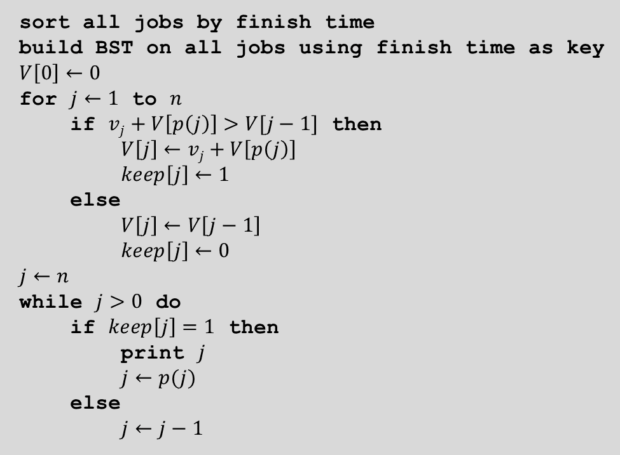

Reconstruct the Solution
sort all jobs by finish time
build BST on all jobs using finish time as key
$V\left[0\right]←0$
for $j←1$ to $n$
if $vj+V\left[p\left(j\right)\right]>V[j−1]$ then
$V\left[j\right]←vj+V\left[p\left(j\right)\right]$
$keep\left[j\right]←1$
else
$V\left[j\right]←V\left[j−1\right]$
$keep\left[j\right]←0$
$j←n$
while $j>0$ do
if $keep\left[j\right]=1$ then
print $j$
$j←p(j)$
else
$j←j−1$
Running time: $O(n\log{n})$

Slide 13
Dynamic Programming: Summary
Structure: Analyze structure of an optimal solution, and thereby choose a definition of subproblems.
Recurrence: Establish the relationship between the optimal value of the problem and those of some subproblems (optimal substructure).
Bottom-up computation: Compute the optimal values of the smallest subproblems first, save them in the table. Then compute optimal values of larger subproblems, and so on, until the optimal value of the original problem is computed.
Construction of optimal solution: Record the optimal decisions made for each subproblem. At the end, assemble the optimal solution by tracing the back computation in the previous step.
Remark: The first two steps are interdependent. And they are the most important steps. The last two steps are usually straightforward.

