Slide 1
Lecture 15: Optimal Binary Search Trees

Slide 2
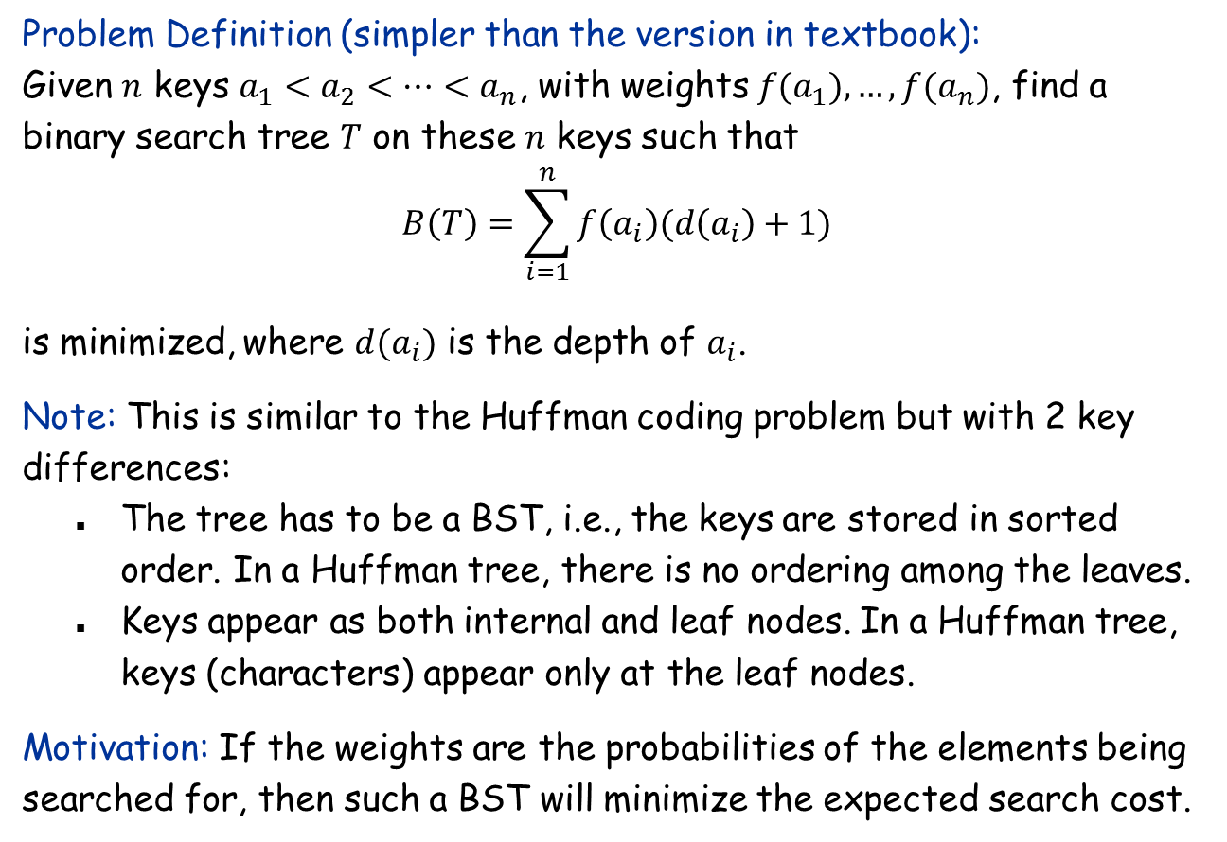
The Optimal Binary Search Tree Problem
Problem Definition (simpler than the version in textbook): Given $n$ keys $a_{1}<a_{2}<…<a_{n}$, with weights $f(a_{1}),…, f(a_{n})$, find a binary search tree $T$ on these $n$ keys such that $$B\left(T\right)=\sum_{i=1}^{n}{f\left(a_{i}\right)(d\left(a_{i}\right)+1)}$$ is minimized, where $d(a_{i})$ is the depth of $a_{i}$.
Note: This is similar to the Huffman coding problem but with 2 key differences:
The tree has to be a BST, i.e., the keys are stored in sorted order. In a Huffman tree, there is no ordering among the leaves.
Keys appear as both internal and leaf nodes. In a Huffman tree, keys (characters) appear only at the leaf nodes.
Motivation: If the weights are the probabilities of the elements being searched for, then such a BST will minimize the expected search cost.

Slide 3
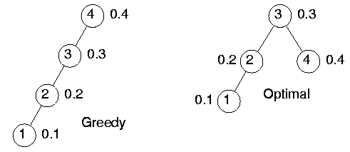
Greedy Won’t Work
Greedy strategy: Always pick the heaviest key as root, then recursively build the tree top-down.
$$B\left(T\right)=0.4⋅2+0.3⋅1+0.2⋅2+0.1⋅3=1.8$$
$$B\left(T\right)=0.4⋅1+0.3⋅2+0.2⋅3+0.1⋅4=2$$

Slide 4

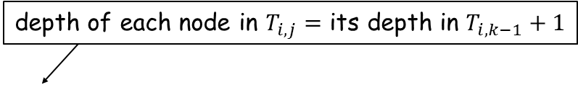

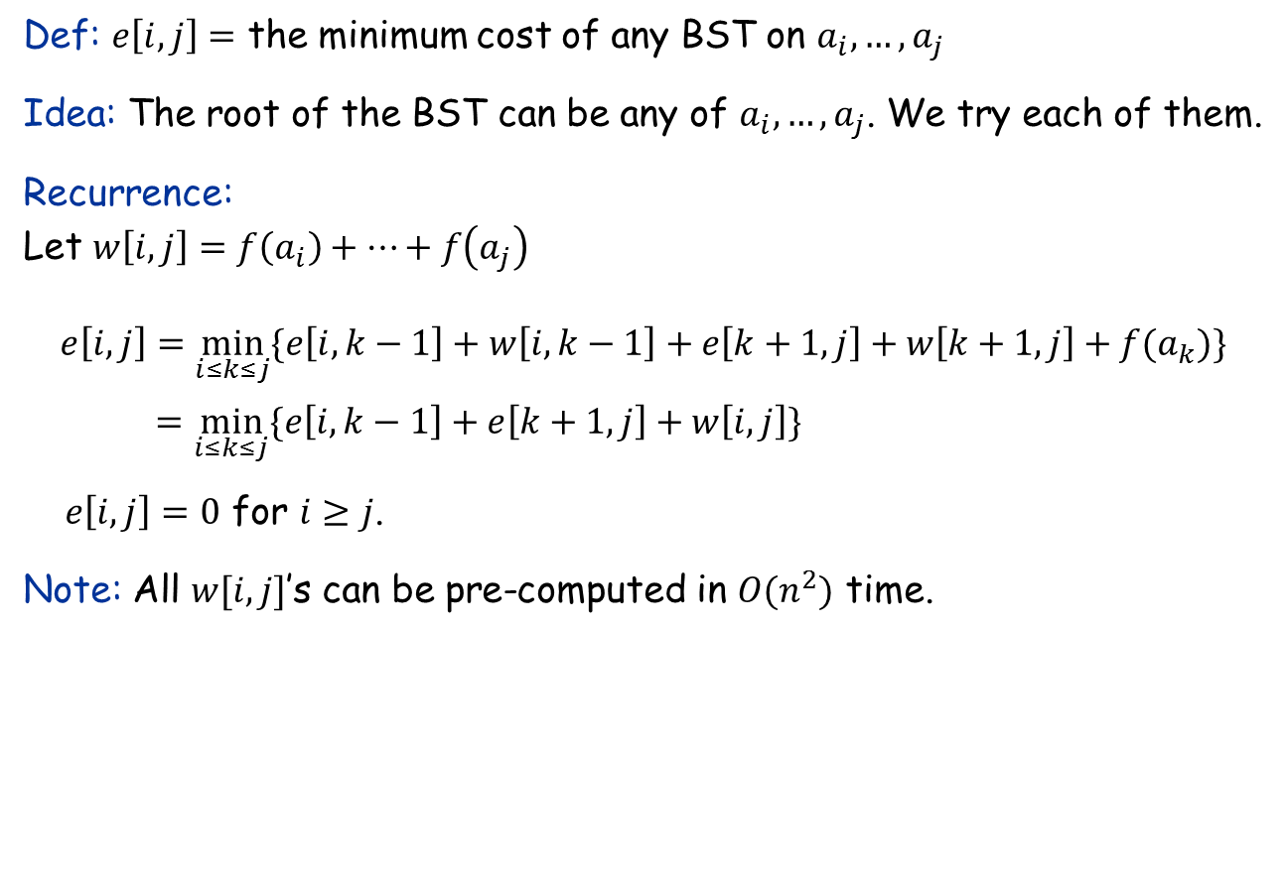






Dynamic Programming: The Recurrence
Def: $e\left[i,j\right]=$ the minimum cost of any BST on $a_{i},…,a_{j}$
Idea: The root of the BST can be any of $a_{i},…,a_{j}$. We try each of them.
Recurrence: Let $w\left[i,j\right]=f\left(a_{i}\right)+…+f\left(a_{j}\right)$ $$e\left[i,j\right]=\min_{i≤k≤j}{\{e\left[i,k−1\right]+w\left[i,k−1\right]+e\left[k+1,j\right]+w\left[k+1,j\right]+f(a_{k})\} }$$
$=\min_{i≤k≤j}{\{e\left[i,k−1\right]+e\left[k+1,j\right]+w\left[i,j\right]\} }$
$e\left[i,j\right]=0$ for $i≥j$.
Note: All $w[i,j]$’s can be pre-computed in $O(n^{2})$ time.
depth of each node in $T_{i,j}=$ its depth in $T_{i,k−1}+1$
$$T_{i,j}$$
$$ak$$
$$T_{i,k−1}$$
$$T_{k+1,j}$$
$$ai$$
$$a_{k−1}$$
$$a_{k+1}$$
$$aj$$

Slide 5

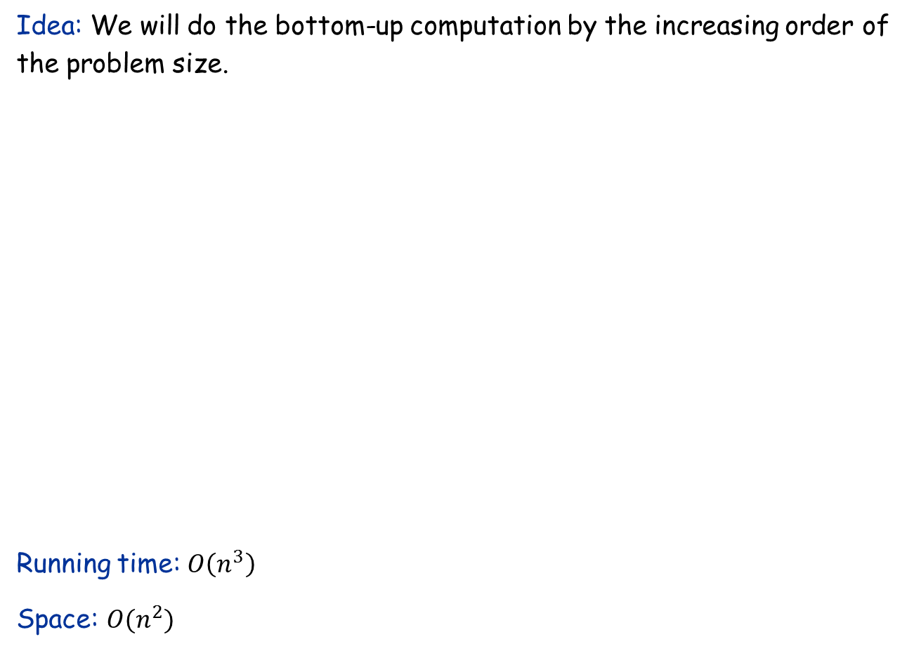
The Algorithm
Idea: We will do the bottom-up computation by the increasing order of the problem size.
Running time: $O\left(n^{3}\right)$
Space: $O(n^{2})$
let $e[1.. n, 1.. n], w[1.. n, 1.. n],root[1.. n, 1.. n]$ be new arrays of all $0$
for $i=1$ to $n$
$w\left[i,i\right]←f\left(a_{i}\right)$
for $j=i+1$ to $n$
$w\left[i,j\right]←w\left[i,j−1\right]+f(a_{j})$
for $l←1$ to $n$
for $i←1$ to $n−l+1$
$j←i+l−1$
$e\left[i, j\right]← ∞$
for $k←i$ to $j$
$t←e\left[i, k−1\right]+e[k+1, j]+w[i,j]$
if $t<e[i, j]$ then
$e\left[i, j\right]←t$
$root\left[i, j\right]←k$
return Construct-BST($root,1,n$)

Slide 6
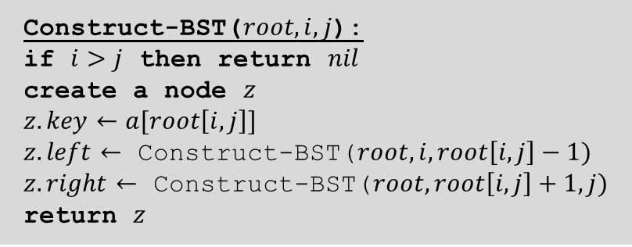

Construct the Optimal BST
Construct-BST($root,i,j$):
if $i>j$ then return $nil$
create a node $z$
$z.key←a[root\left[i,j\right]]$
$z.left←$ Construct-BST($root,i,root\left[i,j\right]−1)$
$z.right←$ Construct-BST($root,root\left[i,j\right]+1,j)$
return $z$
Running time of this part: $O(n)$

Slide 7

RNA Secondary Structure
RNA. String $B=b_{1}b_{2}b_{n}$ over alphabet { A, C, G, U }.
Secondary structure. RNA is single-stranded so it tends to loop back and form base pairs with itself. This structure is essential for understanding the behavior of molecules.
Ex: GUCGAUUGAGCGAAUGUAACAACGUGGCUACGGCGAGA
C
A
A
A
A
U
G
C
complementary base pairs: A-U, C-G
C
G
U
A
A
G
U
G
A
U
U
A
A
C
G
C
U
G
G
C
G
C
G
A
G
C
G
A
U
G

Slide 8


RNA Secondary Structure
Secondary structure. A set of pairs $S=\{(b_{i}, b_{j})\}$that satisfy:
[Watson-Crick.] $S$ is a matching and each pair in $S$ is a Watson-Crick complement: A-U, U-A, C-G, or G-C.
[No sharp turns.] The ends of each pair are separated by at least 4 intervening bases: If $\left(b_{i}, b_{j}\right)∈S$, then $i<j−4$.
[Non-crossing.] If $(b_{i}, b_{j})$ and $(b_{k}, b_{l})$ are two pairs in $S$, then we cannot have $i<k<j<l$.
G
G
G
G
G
C
U
G
G
C
U
C
G
C
G
C
U
A
U
A
U
A
G
U
A
U
A
U
A
A
U
G
U
G
G
C
C
A
U
A
U
G
G
G
G
C
A
U
A
G
U
U
G
G
C
C
A
U
$$≤4$$
ok
sharp turn
crossing

Slide 9

The Problem
Free energy. Usual hypothesis is that an RNA molecule will form the secondary structure with the optimum total free energy, which is proportional to the number of base pairs.
Goal. Given an RNA molecule $B=b_{1}b_{2}b_{n}$, find a secondary structure $S$ that maximizes the number of base pairs.

Slide 10
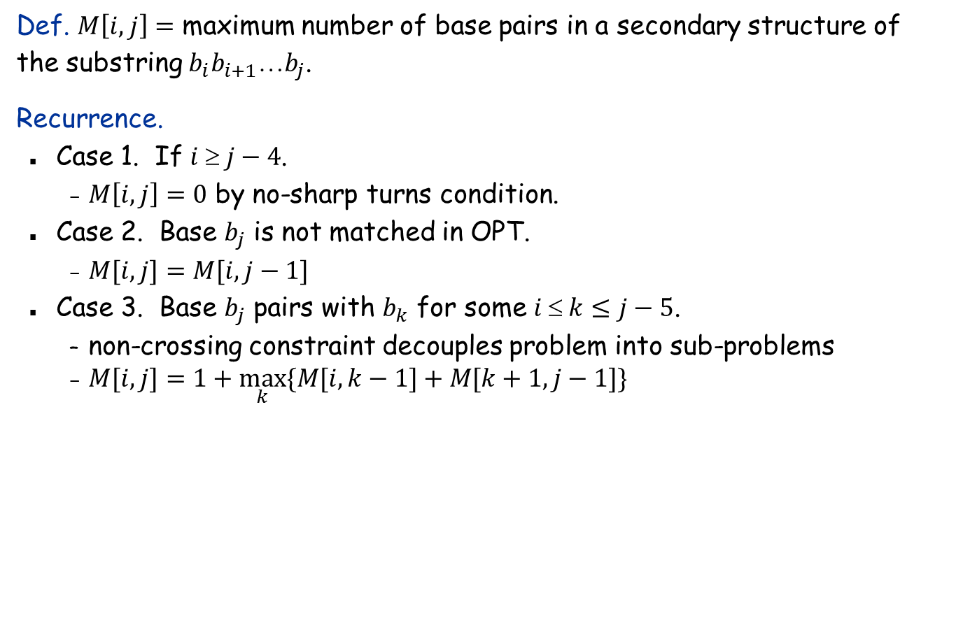
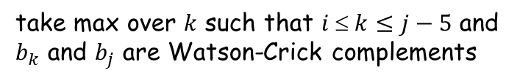
The Recurrence
Def. $M\left[i,j\right]=$ maximum number of base pairs in a secondary structure of the substring $b_{i}b_{i+1}b_{j}$.
Recurrence.
Case 1. If $i  j−4$.
$M\left[i,j\right]=0$ by no-sharp turns condition.
Case 2. Base $b_{j}$ is not matched in OPT.
$M[i,j]=M[i, j−1]$
Case 3. Base $b_{j}$ pairs with $b_{k}$ for some $i  k≤j−5$.
non-crossing constraint decouples problem into sub-problems
$M[i,j]=1+\max_{k}{\{M[i, k−1]+M[k+1, j−1]\}}$
take max over $k$ such that $i  k≤j−5$ and $b_{k}$ and $b_{j}$ are Watson-Crick complements

Slide 11
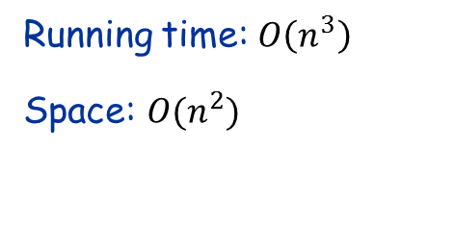
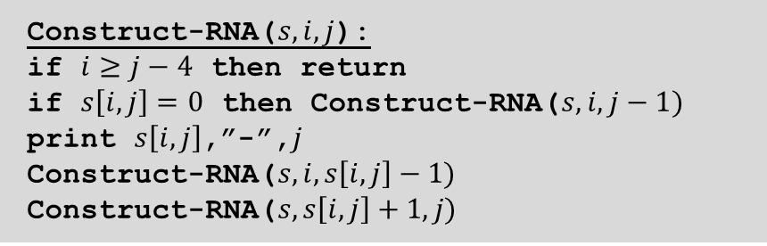
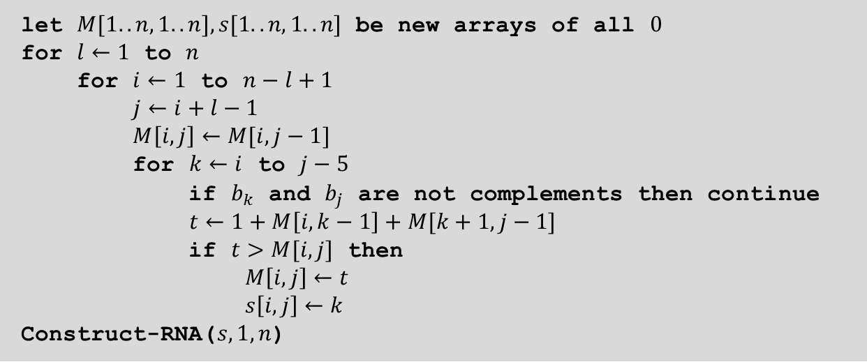
The Algorithm
let $M[1.. n, 1.. n], s[1.. n, 1.. n]$ be new arrays of all $0$
for $l←1$ to $n$
for $i←1$ to $n−l+1$
$j←i+l−1$
$M\left[i, j\right]←M[i,j−1]$
for $k←i$ to $j−5$
if $b_{k}$ and $b_{j}$ are not complements then continue
$t←1+M\left[i, k−1\right]+M[k+1, j−1]$
if $t>M[i, j]$ then
$M\left[i, j\right]←t$
$s\left[i, j\right]←k$
Construct-RNA($s,1,n$)
Running time: $O\left(n^{3}\right)$
Space: $O(n^{2})$
Construct-RNA($s,i,j$):
if $i≥j−4$ then return
if $s\left[i,j\right]=0$ then Construct-RNA($s,i,j−1)$
print $s\left[i,j\right]$,”-”,$j$
Construct-RNA($s,i,s\left[i,j\right]−1)$
Construct-RNA($s,s\left[i,j\right]+1,j)$

