Slide 1
Lecture 16: Introduction to Graphs

Slide 2
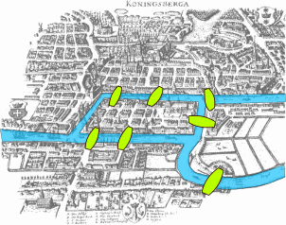
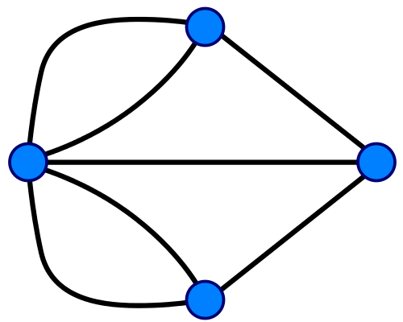
The Seven Bridges of Königsberg
Q: Can you find a tour to cross all seven bridges, each exactly once?
Q: (Reformulated as a graph problem) Can you find a path in the graph that includes every edge exactly once?
A: Not possible.
Theorem: A graph has such a path (known as an Euler path) iff there are 0 or 2 vertices with an odd degree.
Q: Can a graph have exactly one vertex with an odd degree?

Slide 3
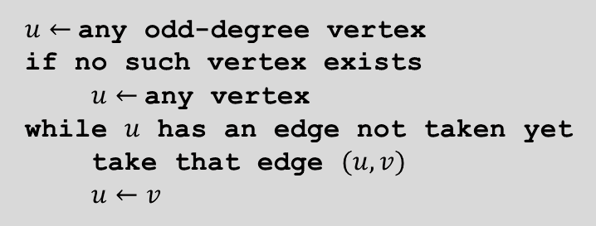
The Seven Bridges of Königsberg
Solution: Build one more bridge to remove 2 odd-degree vertices.
Algorithm:
$u←$any odd-degree vertex
if no such vertex exists
$u←$any vertex
while $u$ has an edge not taken yet
take that edge $(u,v)$
$u←v$
But, this algorithm may get stuck…

Slide 4
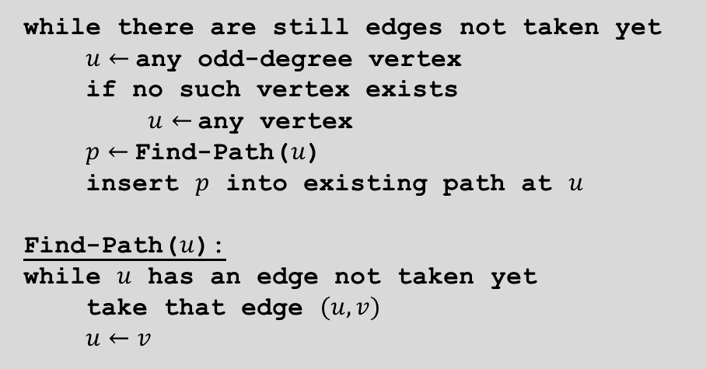
The Seven Bridges of Königsberg
Solution: Build one more bridge to remove 2 odd-degree vertices.
Algorithm:
while there are still edges not taken yet
$u←$any odd-degree vertex
if no such vertex exists
$u←$any vertex
$p←$Find-Path($u$)
insert $p$ into existing path at $u$
Find-Path($u$):
while $u$ has an edge not taken yet
take that edge $(u,v)$
$u←v$

Slide 5
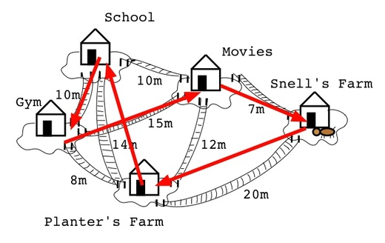
The Traveling Salesman Problem
Q: How to visit all places with the shortest total distance, and come back to origin?
Q: (Reformulated as a graph problem) Given a graph where edges have weights (lengths), how to find a cycle minimum total weight that includes all vertices with?
A: Don’t know.
Don’t have an algorithm that runs in polynomial time. (Conjecture is that such an algorithm doesn’t exist.)
This is actually equivalent to the P = NP problem (still open).

Slide 6
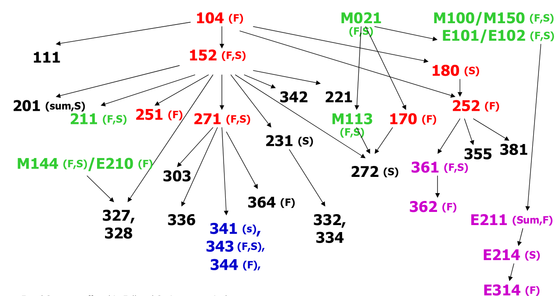

Course Dependency Chart
Q: Find an order to take all courses, while respecting all dependencies?
Q: (Reformulated as a graph problem) Given a directed graph, find an ordering of the vertices such that for any edge $u→v$, $u$ is ordered before $v$, or declare that there is a cycle in the graph.

Slide 7
Graph Applications
Graph
Nodes
Edges
transportation
street intersections
highways
communication
computers
fiber optic cables
World Wide Web
web pages
hyperlinks
social
people
relationships
food web
species
predator-prey
software systems
functions
function calls
scheduling
tasks
precedence constraints
circuits
gates
wires

Slide 8
World Wide Web
Web graph.
Node: web page.
Edge: hyperlink from one page to another (directed).
cnn.com
netscape.com
novell.com
cnnsi.com
timewarner.com
hbo.com
sorpranos.com

Slide 9
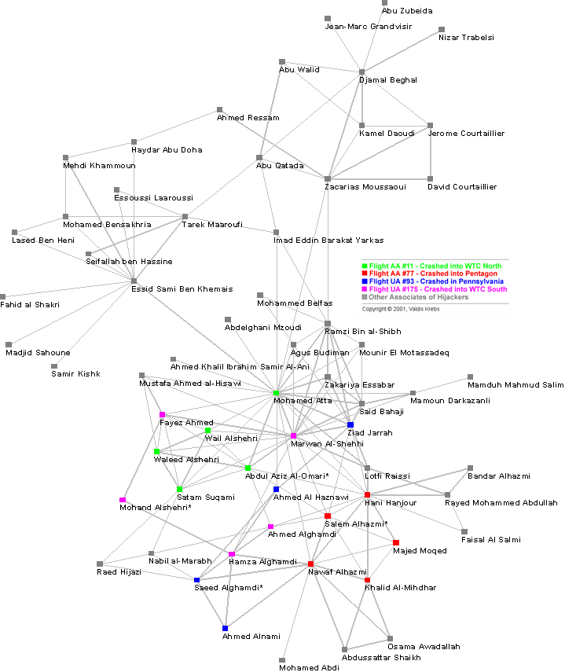
Social Networks
Social network graph.
Nodes: people.
Edges: relationship between two people
Can be directed or undirected
Reference: Valdis Krebs, http://www.firstmonday.org/issues/issue7_4/krebs

Slide 10
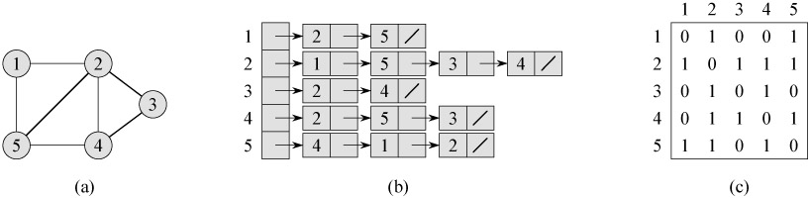
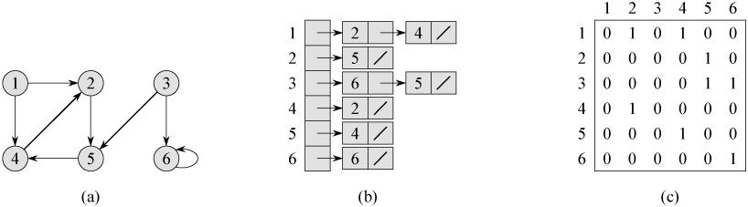
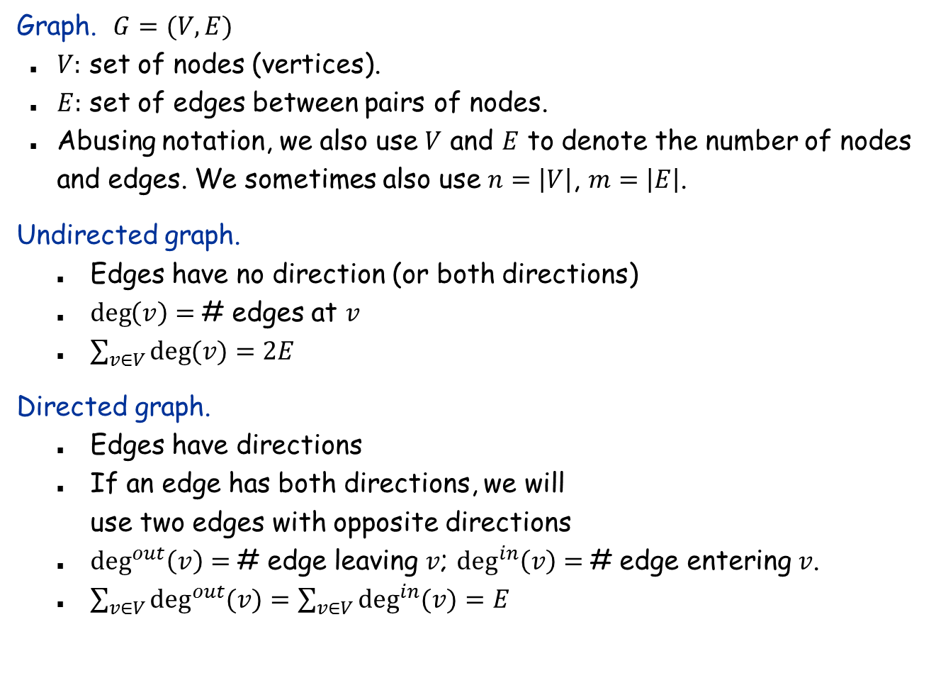
Undirected and Directed Graphs
Graph. $G=(V, E)$
$V:$ set of nodes (vertices).
$E:$ set of edges between pairs of nodes.
Abusing notation, we also use $V$ and $E$ to denote the number of nodes and edges. We sometimes also use $n=\left|V\right|$, $m=\left|E\right|$.
Undirected graph.
Edges have no direction (or both directions)
$\deg\left(v\right)=$# edges at $v$
$\sum_{v∈V}{\deg{(v)}}=2E$
Directed graph.
Edges have directions
If an edge has both directions, we will use two edges with opposite directions
$\deg^{out}\left(v\right)=$# edge leaving $v$; $\deg^{in}\left(v\right)=$# edge entering $v$.
$\sum_{v∈V}{\deg^{out}{(v)}}=\sum_{v∈V}{\deg^{in}{(v)}}=E$

Slide 11
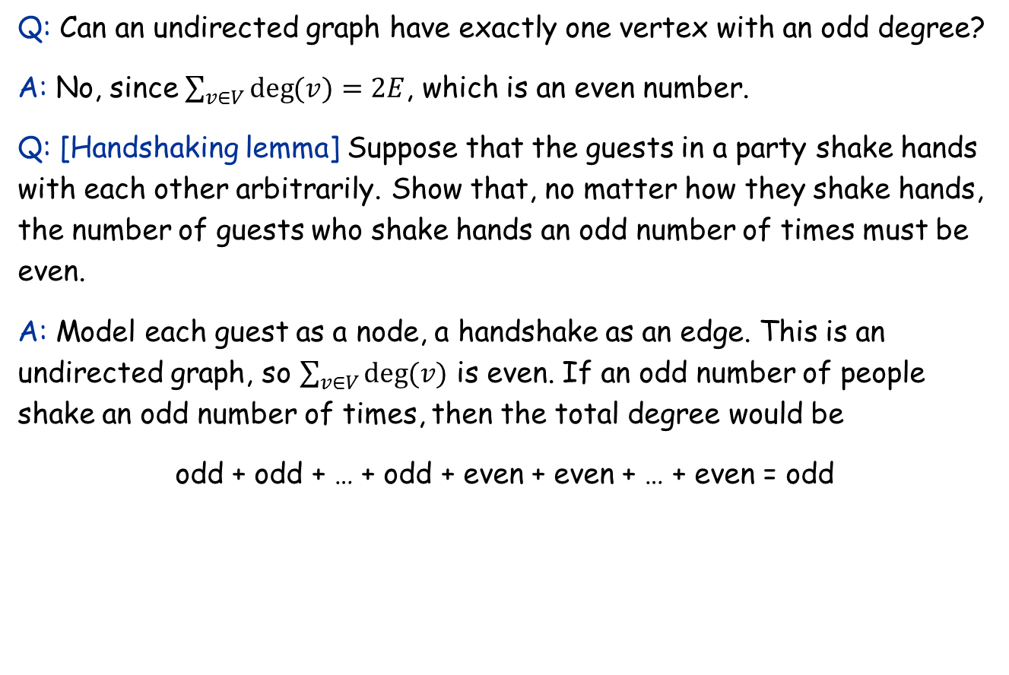
Exercises
Q: Can an undirected graph have exactly one vertex with an odd degree?
A: No, since $\sum_{v∈V}{\deg{(v)}}=2E$, which is an even number.
Q: [Handshaking lemma] Suppose that the guests in a party shake hands with each other arbitrarily. Show that, no matter how they shake hands, the number of guests who shake hands an odd number of times must be even.
A: Model each guest as a node, a handshake as an edge. This is an undirected graph, so $\sum_{v∈V}{\deg{(v)}}$ is even. If an odd number of people shake an odd number of times, then the total degree would be
odd + odd + … + odd + even + even + … + even = odd
odd
no matter how many

Slide 12
Graph Representation: Adjacency List and Adjacency Matrix

Slide 13
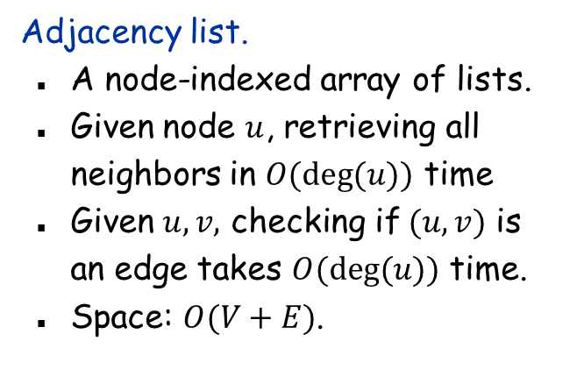
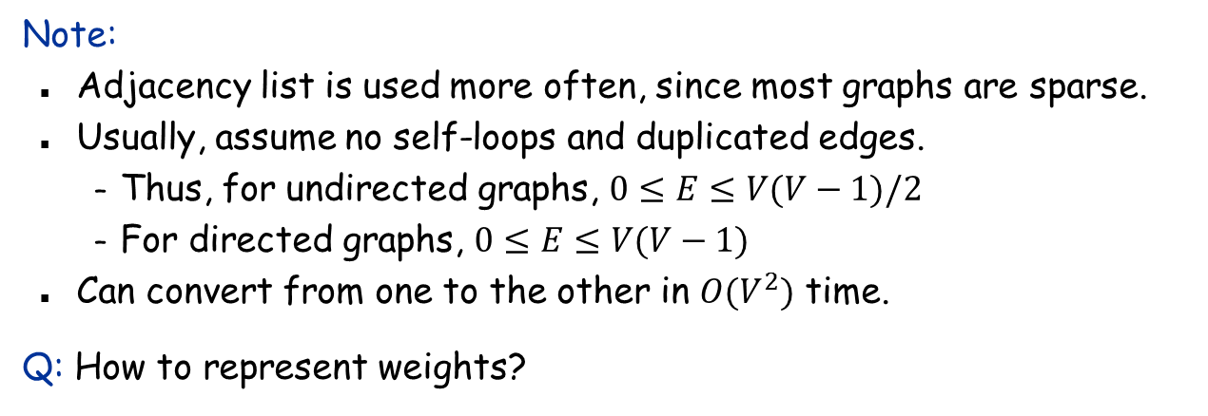
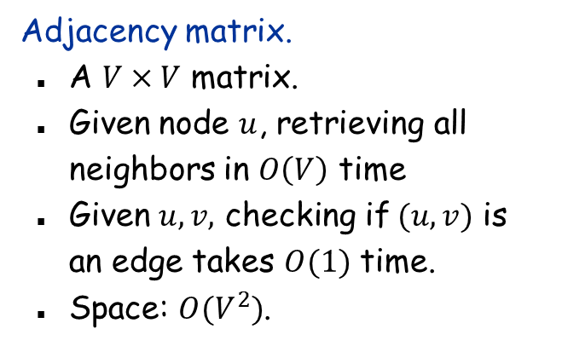
Graph Representation: Adjacency List and Adjacency Matrix
Adjacency list.
A node-indexed array of lists.
Given node $u$, retrieving all neighbors in $O(\deg{(u))}$ time
Given $u,v,$ checking if $(u, v)$ is an edge takes $O(deg⁡(u))$ time.
Space: $O(V+E)$.
Adjacency matrix.
A $V×V$ matrix.
Given node $u$, retrieving all neighbors in $O\left(V\right)$ time
Given $u,v,$ checking if $(u, v)$ is an edge takes $O(1)$ time.
Space: $O(V^{2})$.
Note:
Adjacency list is used more often, since most graphs are sparse.
Usually, assume no self-loops and duplicated edges.
Thus, for undirected graphs, $0≤E≤V(V−1)/2$
For directed graphs, $0≤E≤V(V−1)$
Can convert from one to the other in $O(V^{2})$ time.
Q: How to represent weights?

Slide 14
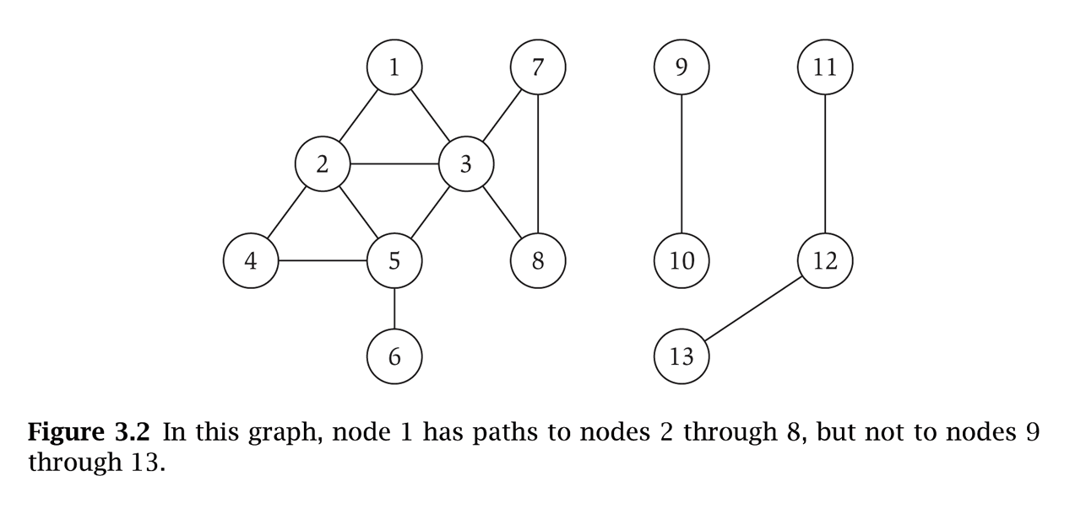
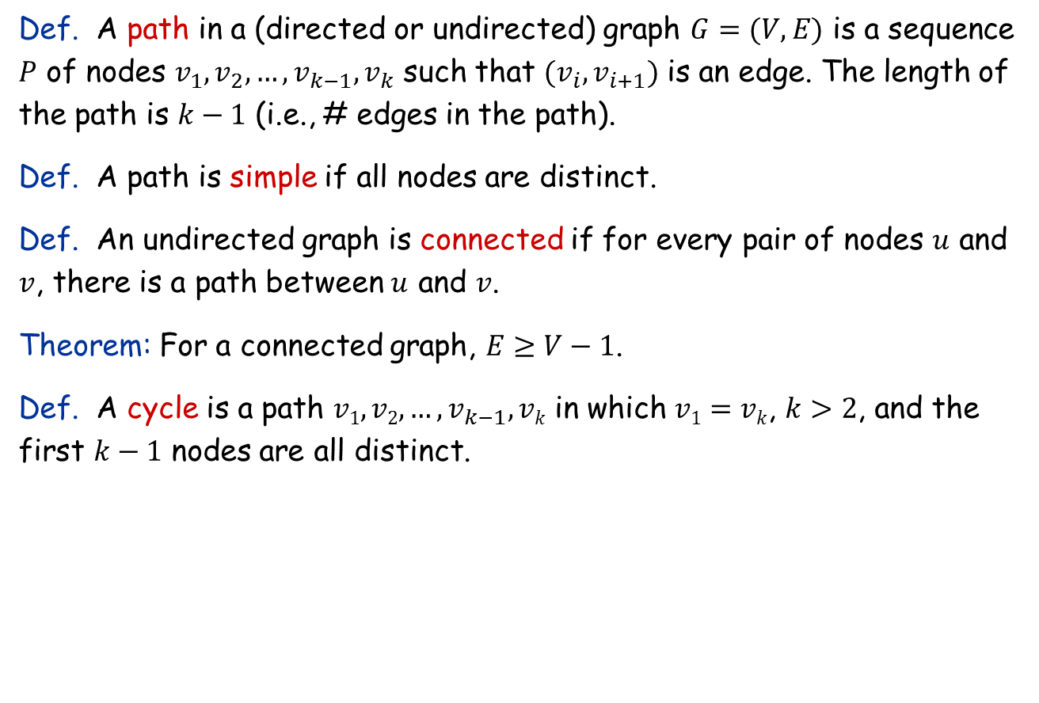
Paths and Connectivity
Def. A path in a (directed or undirected) graph $G=(V, E)$ is a sequence $P$ of nodes $v_{1}, v_{2}, …, v_{k−1}, v_{k}$ such that ${(v}_{i}, v_{i+1})$ is an edge. The length of the path is $k−1$ (i.e., # edges in the path).
Def. A path is simple if all nodes are distinct.
Def. An undirected graph is connected if for every pair of nodes $u$ and $v$, there is a path between $u$ and $v$.
Theorem: For a connected graph, $E≥V−1$.
Def. A cycle is a path $v1, v2, …, v_{k−1},vk$ in which $v1=vk$, $k>2$, and the first $k−1$ nodes are all distinct.

Slide 15
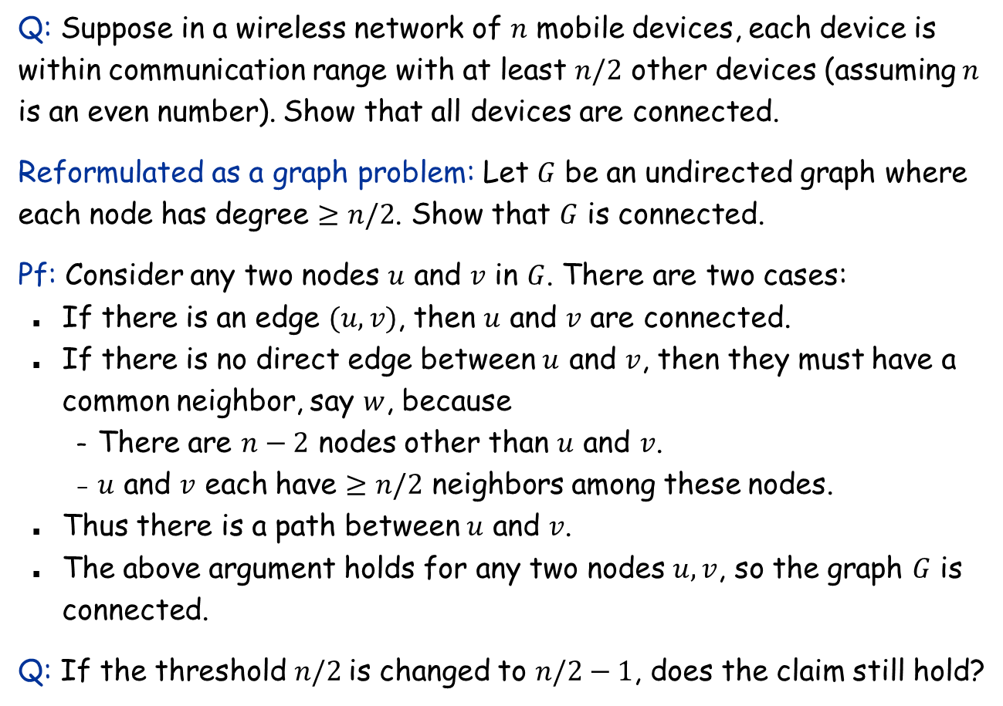
Exercise
Q: Suppose in a wireless network of $n$ mobile devices, each device is within communication range with at least $n/2$ other devices (assuming $n$ is an even number). Show that all devices are connected.
Reformulated as a graph problem: Let $G$ be an undirected graph where each node has degree $≥n/2$. Show that $G$ is connected.
Pf: Consider any two nodes $u$ and $v$ in $G$. There are two cases:
If there is an edge $(u,v)$, then $u$ and $v$ are connected.
If there is no direct edge between $u$ and $v$, then they must have a common neighbor, say $w$, because
There are $n−2$ nodes other than $u$ and $v$.
$u$ and $v$ each have $≥n/2$ neighbors among these nodes.
Thus there is a path between $u$ and $v$.
The above argument holds for any two nodes $u,v$, so the graph $G$ is connected.
Q: If the threshold $n/2$is changed to $n/2−1$, does the claim still hold?

Slide 16
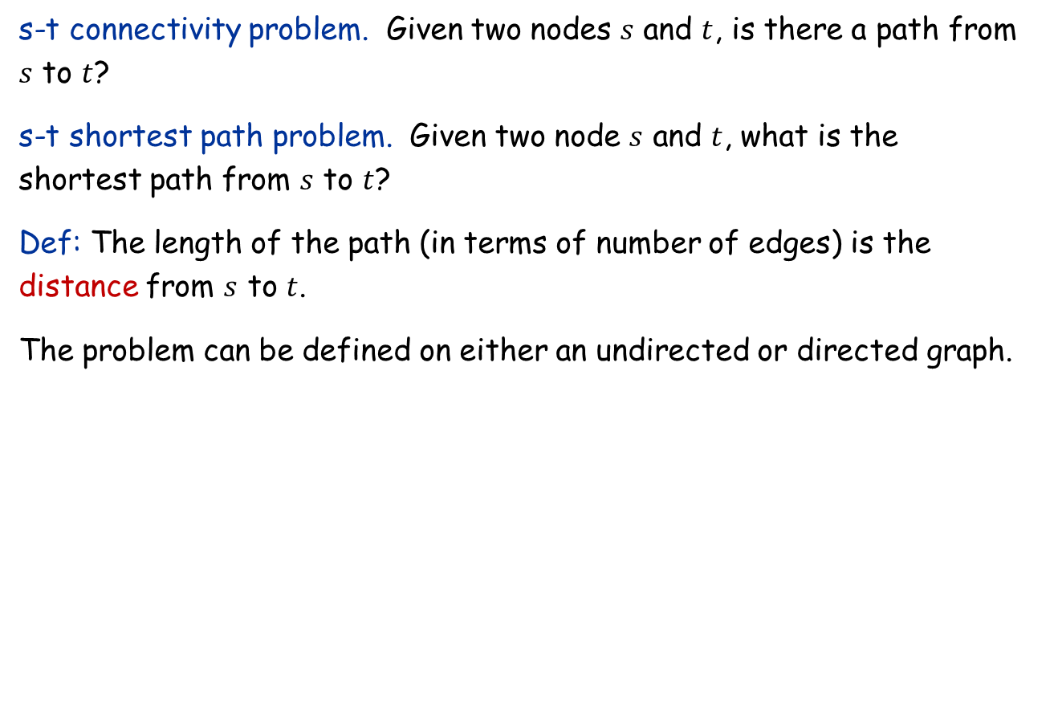
Connectivity and Shortest Path
s-t connectivity problem. Given two nodes $s$ and $t$, is there a path from $s$ to $t$?
s-t shortest path problem. Given two node $s$ and $t$, what is the shortest path from $s$ to $t$?
Def: The length of the path (in terms of number of edges) is the distance from $s$ to $t$.
The problem can be defined on either an undirected or directed graph.

Slide 17
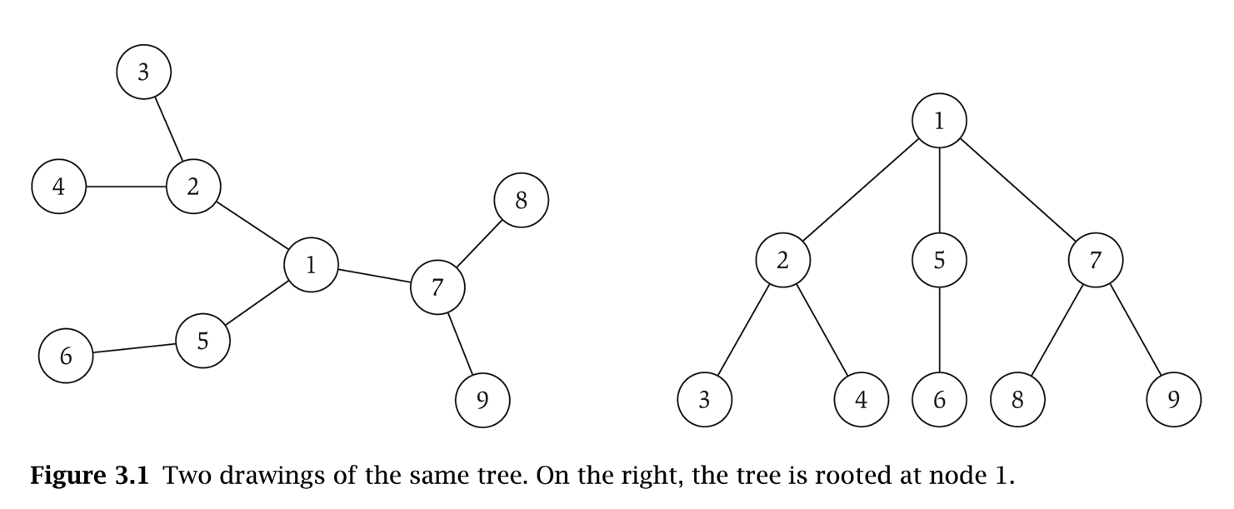
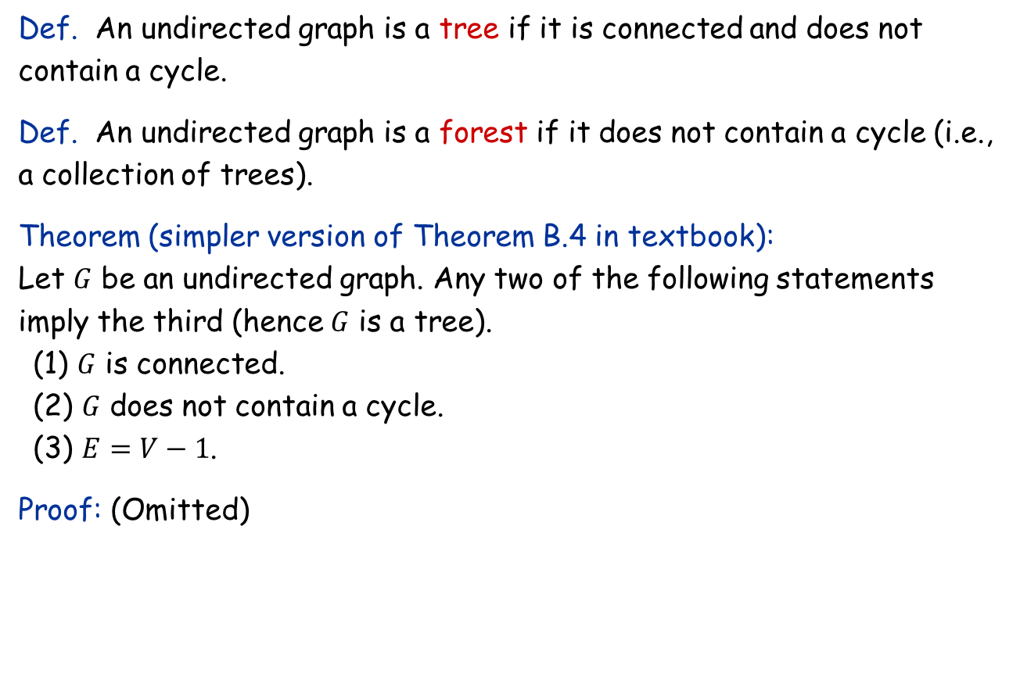
Trees
Def. An undirected graph is a tree if it is connected and does not contain a cycle.
Def. An undirected graph is a forest if it does not contain a cycle (i.e., a collection of trees).
Theorem (simpler version of Theorem B.4 in textbook): Let $G$ be an undirected graph. Any two of the following statements imply the third (hence $G$ is a tree).
(1) $G$ is connected.
(2) $G$ does not contain a cycle.
(3) $E=V−1$.
Proof: (Omitted)

Slide 18





Rooted Trees
Rooted tree. Given a tree $T$, choose a root node $r$ and orient each edge away from $r$.
root $r$
parent of $v$
$$v$$
child of $v$
a tree
the same tree, rooted at 1

