Slide 1
Lecture 17: Basic Graph Algorithms

Slide 2

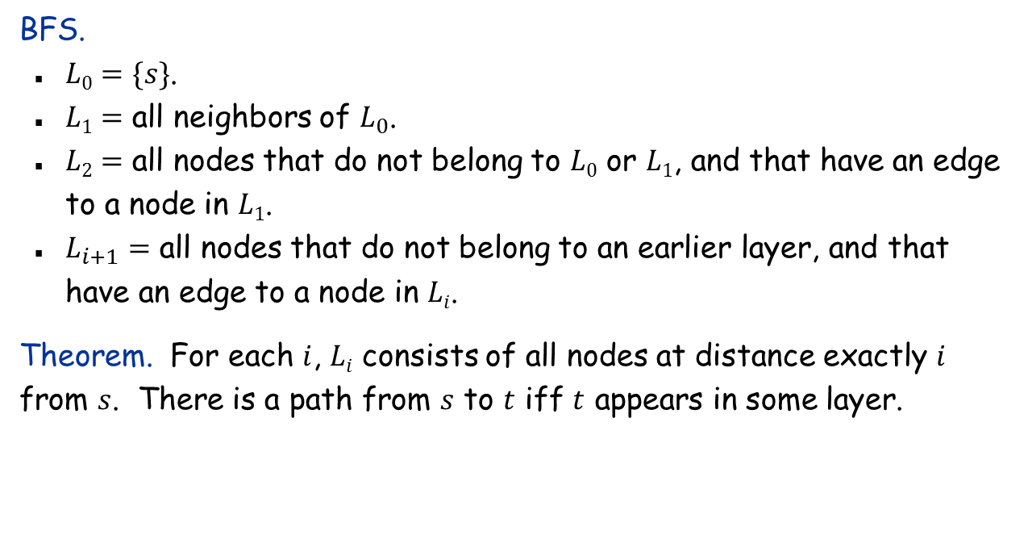




Breadth First Search
BFS idea. Explore outward from $s$ in all possible directions, adding nodes one “layer” at a time.
$$s$$
$$L1$$
$$L2$$
$$L_{k}$$
BFS.
$L0=\{s\}$.
$L1=$ all neighbors of $L_{0}$.
$L2=$ all nodes that do not belong to $L0$ or $L1$, and that have an edge to a node in $L1$.
$L_{i+1}=$ all nodes that do not belong to an earlier layer, and that have an edge to a node in $Li$.
Theorem. For each $i$, $Li$ consists of all nodes at distance exactly $i$ from $s$. There is a path from $s$ to $t$ iff $t$ appears in some layer.

Slide 3
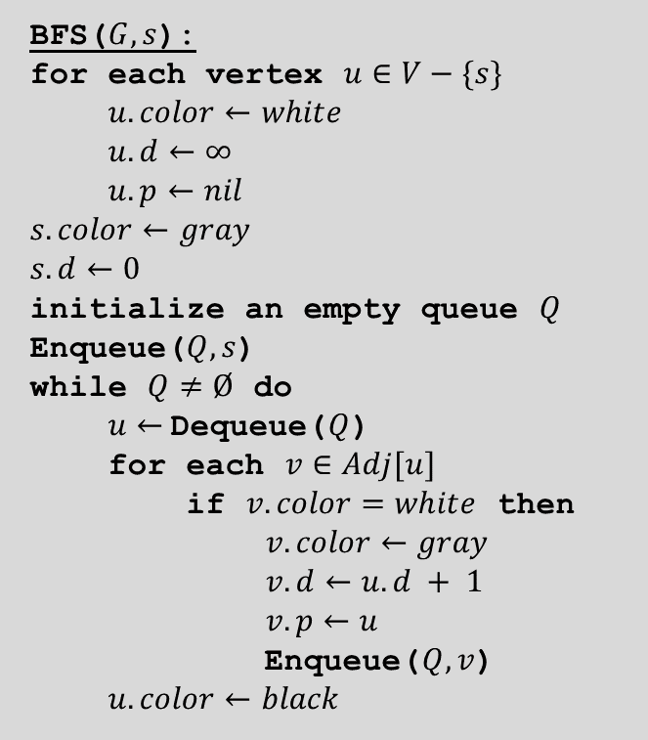
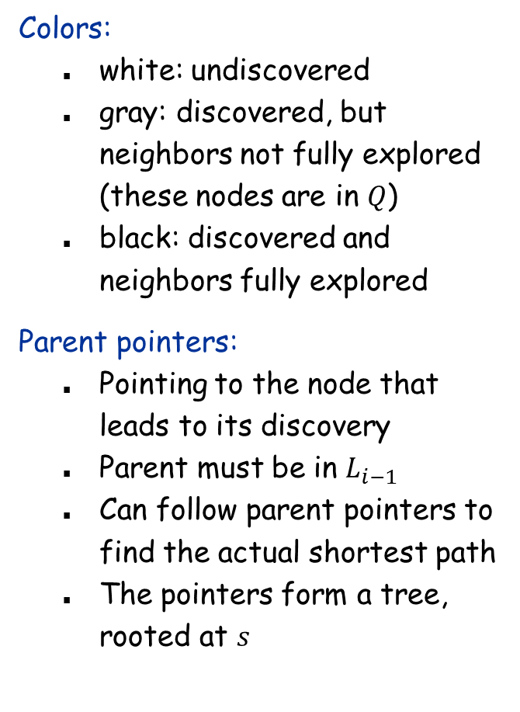
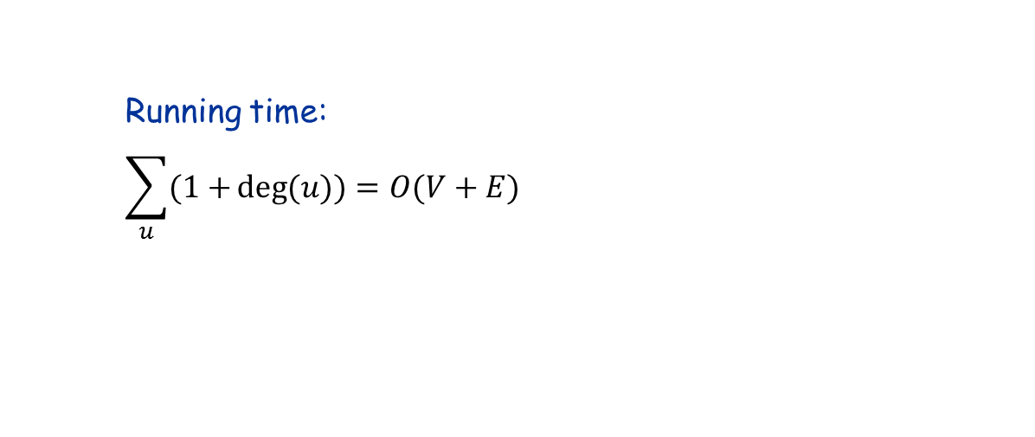
BFS Algorithm
BFS($G,s$):
for each vertex $u∈V−\{s\}$
$u.color←white$
$u.d←∞$
$u.p←nil$
$s.color←gray$
$s.d←0$
initialize an empty queue $Q$
Enqueue($Q, s$)
while $Q≠Ø$ do
$u←$Dequeue($Q$)
for each $v∈Adj[u]$
if $v.color=white$ then
$v.color←gray$
$v.d←u.d + 1$
$v.p←u$
Enqueue($Q, v$)
$u.color←black$
Colors:
white: undiscovered
gray: discovered, but neighbors not fully explored (these nodes are in $Q$)
black: discovered and neighbors fully explored
Parent pointers:
Pointing to the node that leads to its discovery
Parent must be in $L_{i−1}$
Can follow parent pointers to find the actual shortest path
The pointers form a tree, rooted at $s$
Running time: $$\sum_{u}{(1+}deg⁡(u))=O(V+E)$$

Slide 4
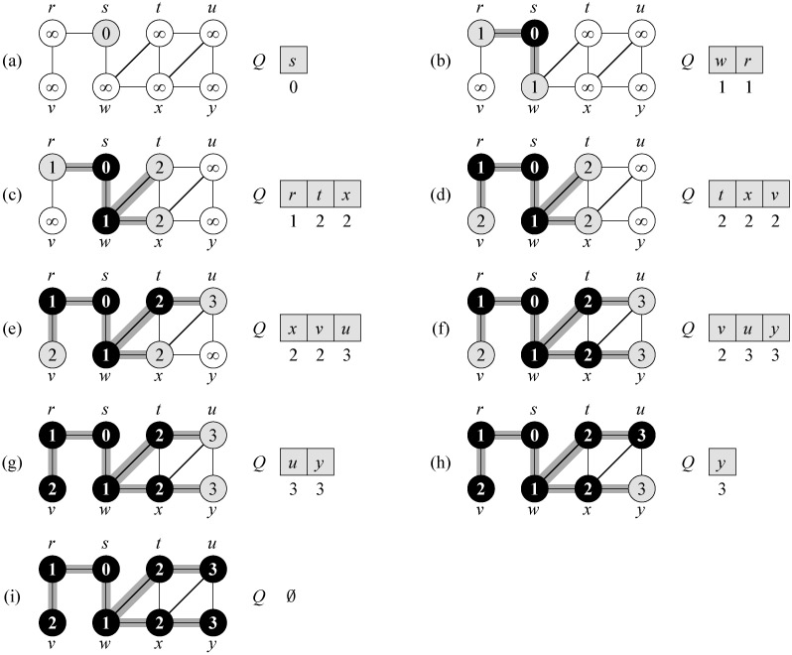

BFS Tree
Note: BFS finds the shortest path from $s$ to every other node.

Slide 5
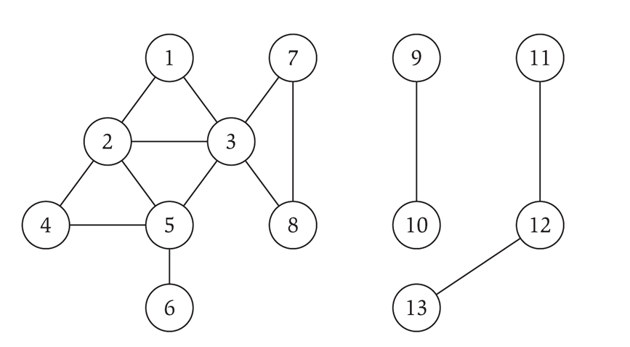
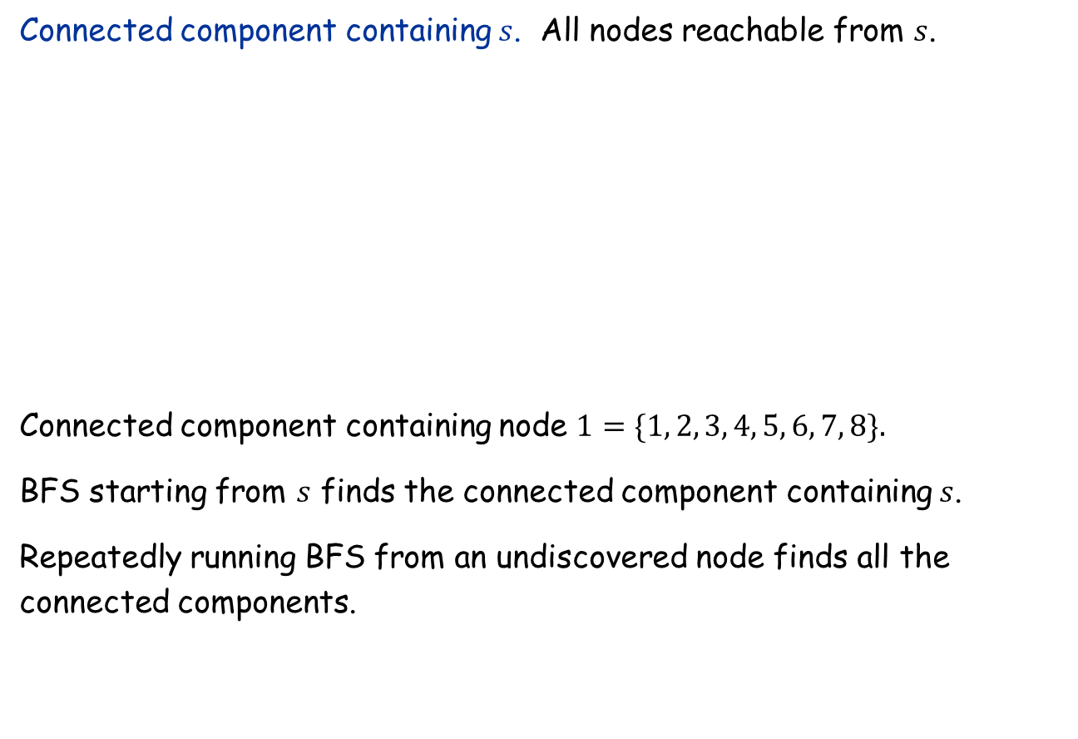
Connected Component
Connected component containing $s$. All nodes reachable from $s$.
Connected component containing node $1=\{1, 2, 3, 4, 5, 6, 7, 8\}.$
BFS starting from $s$ finds the connected component containing $s$.
Repeatedly running BFS from an undiscovered node finds all the connected components.

Slide 6

Flood Fill
Flood fill. Given lime green pixel in an image, change color of entire blob of neighboring lime pixels to blue.
Node: pixel.
Edge: two neighboring lime pixels.
Blob: connected component of lime pixels.
recolor lime green blob to blue

Slide 7

Flood Fill
Flood fill. Given lime green pixel in an image, change color of entire blob of neighboring lime pixels to blue.
Node: pixel.
Edge: two neighboring lime pixels.
Blob: connected component of lime pixels.
recolor lime green blob to blue

Slide 8
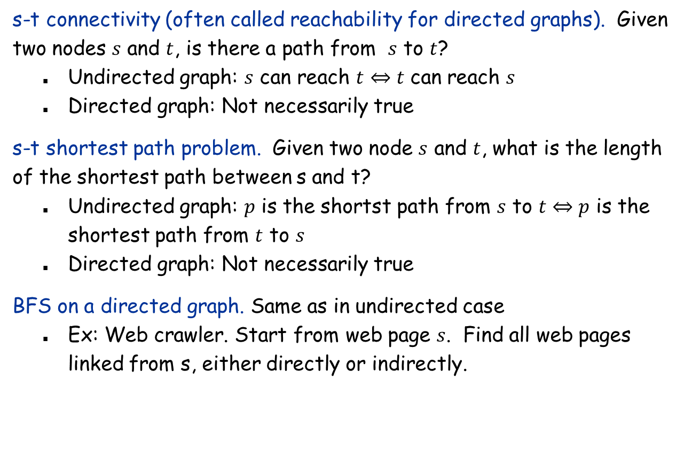
s-t connectivity and shortest path in directed graphs
s-t connectivity (often called reachability for directed graphs). Given two nodes $s$ and $t$, is there a path from $s$ to $t$?
Undirected graph: $s$ can reach $t⇔t$ can reach $s$
Directed graph: Not necessarily true
s-t shortest path problem. Given two node $s$ and $t$, what is the length of the shortest path between s and t?
Undirected graph: $p$ is the shortst path from $s$ to $t⇔p$ is the shortest path from $t$ to $s$
Directed graph: Not necessarily true
BFS on a directed graph. Same as in undirected case
Ex: Web crawler. Start from web page $s$. Find all web pages linked from s, either directly or indirectly.

Slide 9
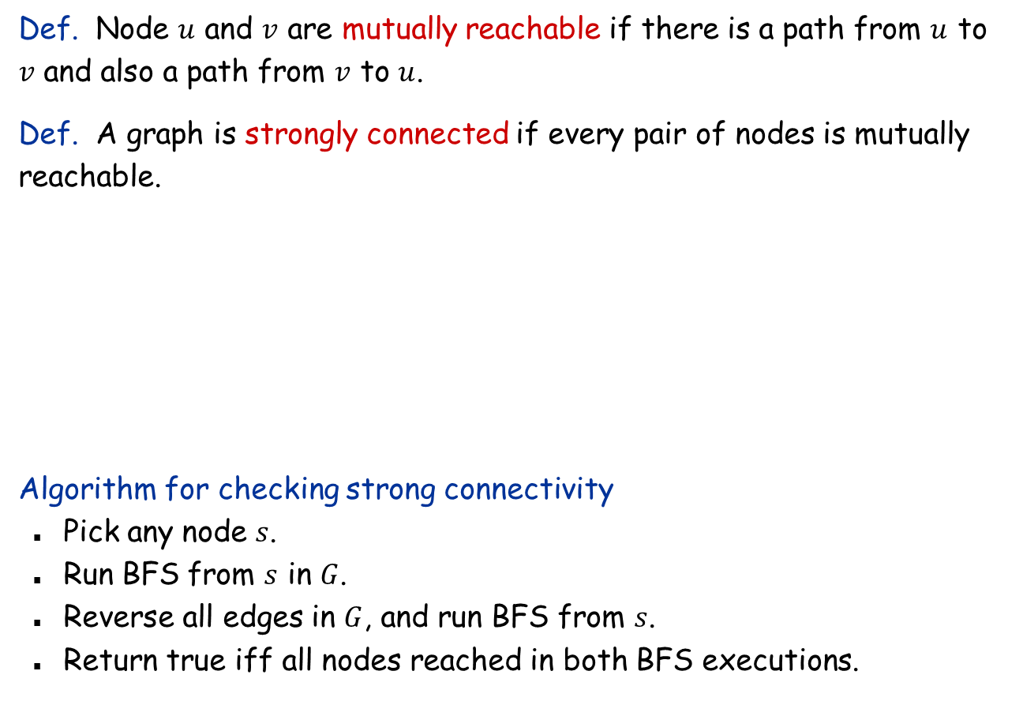
Strong Connectivity in Directed Graphs
Def. Node $u$ and $v$ are mutually reachable if there is a path from $u$ to $v$ and also a path from $v$ to $u$.
Def. A graph is strongly connected if every pair of nodes is mutually reachable.
Algorithm for checking strong connectivity
Pick any node $s$.
Run BFS from $s$ in $G$.
Reverse all edges in $G$, and run BFS from $s$.
Return true iff all nodes reached in both BFS executions.
strongly connected
not strongly connected

Slide 10
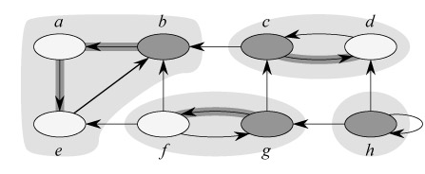

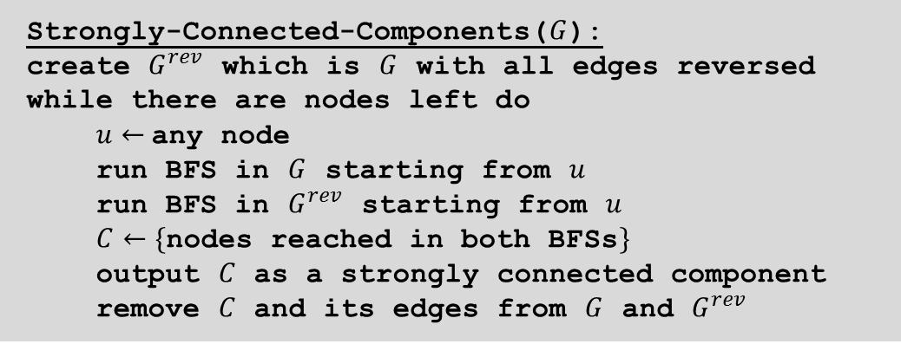
Strongly Connected Components
Strongly-Connected-Components($G$):
create $G^{rev}$ which is $G$ with all edges reversed
while there are nodes left do
$u←$any node
run BFS in $G$ starting from $u$
run BFS in $G^{rev}$ starting from $u$
$C←\{$nodes reached in both BFSs$\}$
output $C$ as a strongly connected component
remove $C$ and its edges from $G$ and $G^{rev}$
Analysis: $O(V\left(V+E\right))$ time
See text book for an $O(V+E)$ algorithm (not required)

Slide 11
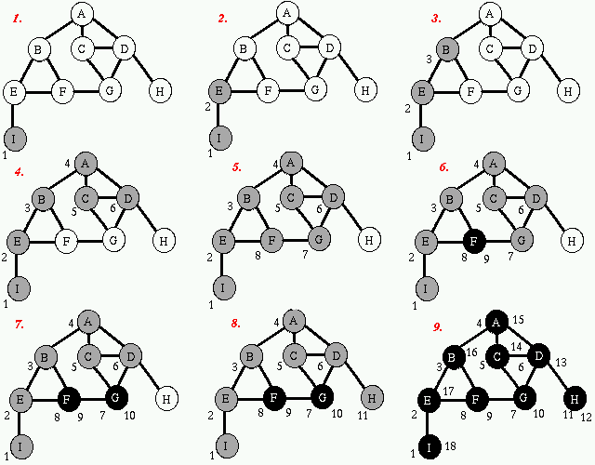
Depth First Search and DFS Tree

Slide 12
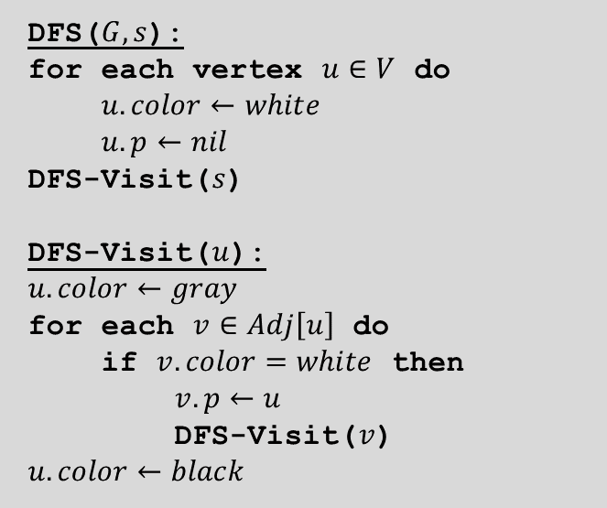
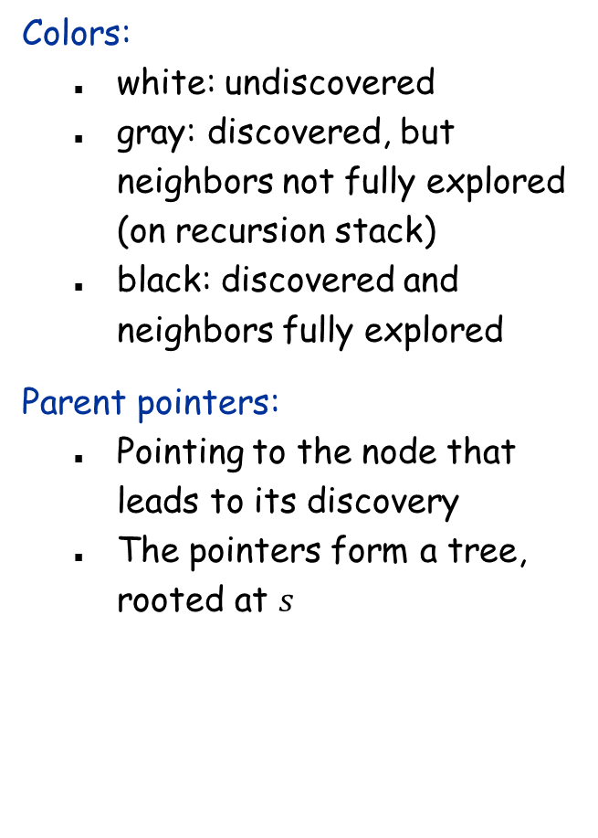

DFS Algorithm
DFS($G,s$):
for each vertex $u∈V$ do
$u.color←white$
$u.p←nil$
DFS-Visit($s$)
DFS-Visit($u$):
$u.color←gray$
for each $v∈Adj\left[u\right]$ do
if $v.color=white$ then
$v.p←u$
DFS-Visit($v$)
$u.color←black$
Colors:
white: undiscovered
gray: discovered, but neighbors not fully explored (on recursion stack)
black: discovered and neighbors fully explored
Parent pointers:
Pointing to the node that leads to its discovery
The pointers form a tree, rooted at $s$
Running time: $O(V+E)$

Slide 13

Application: Cycle Detection
Problem: Given an undirected graph $G=\left(V,E\right)$, check if it contains a cycle.
Idea:
A tree (connected and acyclic) has exactly $V−1$ edges.
If it has less edges, it cannot be connected.
If it has more edges, it must contain a cycle.
Algorithm:
Run BFS/DFS to find all the connected components of $G$.
For each connected component, count the number of edges.
If # edges $≥$ # vertices, return “cycle detected”.
Running time: $O(V+E)$
Q: What if we also want to find a cycle (any is OK) if it exists?

Slide 14
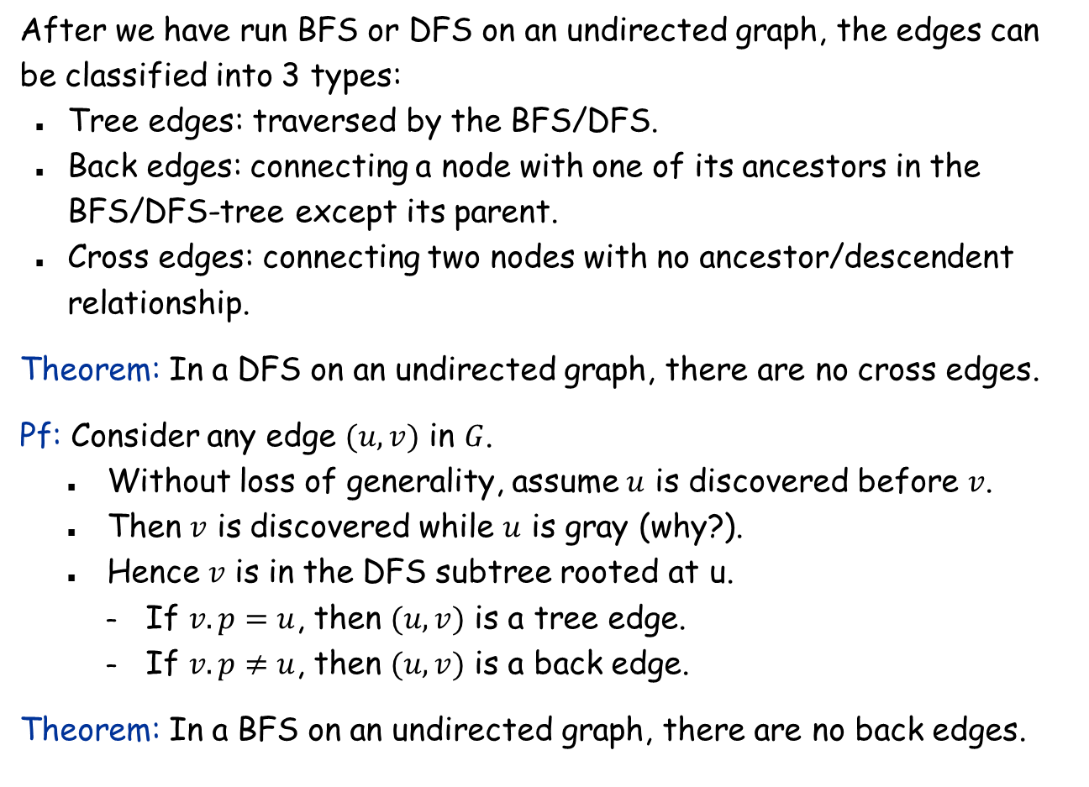
Tree edges, back edges, and cross edges
After we have run BFS or DFS on an undirected graph, the edges can be classified into 3 types:
Tree edges: traversed by the BFS/DFS.
Back edges: connecting a node with one of its ancestors in the BFS/DFS-tree except its parent.
Cross edges: connecting two nodes with no ancestor/descendent relationship.
Theorem: In a DFS on an undirected graph, there are no cross edges.
Pf: Consider any edge $(u,v)$ in $G$.
Without loss of generality, assume $u$ is discovered before $v$.
Then $v$ is discovered while $u$ is gray (why?).
Hence $v$ is in the DFS subtree rooted at u.
If $v.p=u$, then $(u,v)$ is a tree edge.
If $v.p≠u$, then $(u,v)$ is a back edge.
Theorem: In a BFS on an undirected graph, there are no back edges.

Slide 15

DFS for cycle detection
Idea: Run DFS on each connected component of $G$.
If there is a back edge $(u,v)$. Then, $v$ is an ancestor (but not parent) of $u$ in the DFS trees. There is thus a path from $v$ to $u$ in the DFS-tree , and the back edge $(u,v)$ completes a cycle.
If there is no back edge, then there are only tree edges, so the graph is a forest, and hence is acyclic.

Slide 16
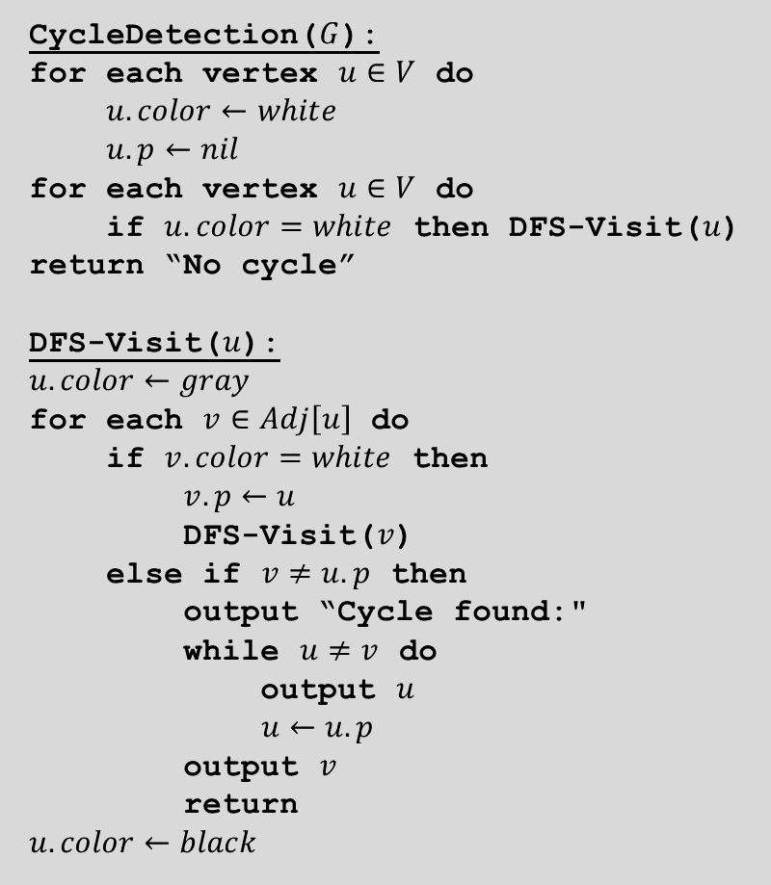
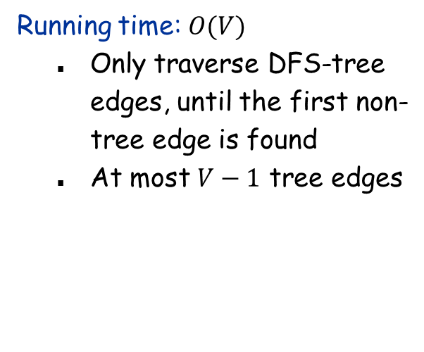
DFS for cycle detection
CycleDetection($G$):
for each vertex $u∈V$ do
$u.color←white$
$u.p←nil$
for each vertex $u∈V$ do
if $u.color=white$ then DFS-Visit($u$)
return “No cycle”
DFS-Visit($u$):
$u.color←gray$
for each $v∈Adj\left[u\right]$ do
if $v.color=white$ then
$v.p←u$
DFS-Visit($v$)
else if $v≠u.p$ then
output “Cycle found:"
while $u≠v$ do
output $u$
$u←u.p$
output $v$
return
$u.color←black$
Running time: $O(V)$
Only traverse DFS-tree edges, until the first non-tree edge is found
At most $V−1$ tree edges

Slide 17
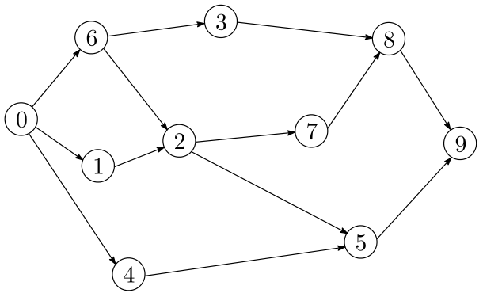
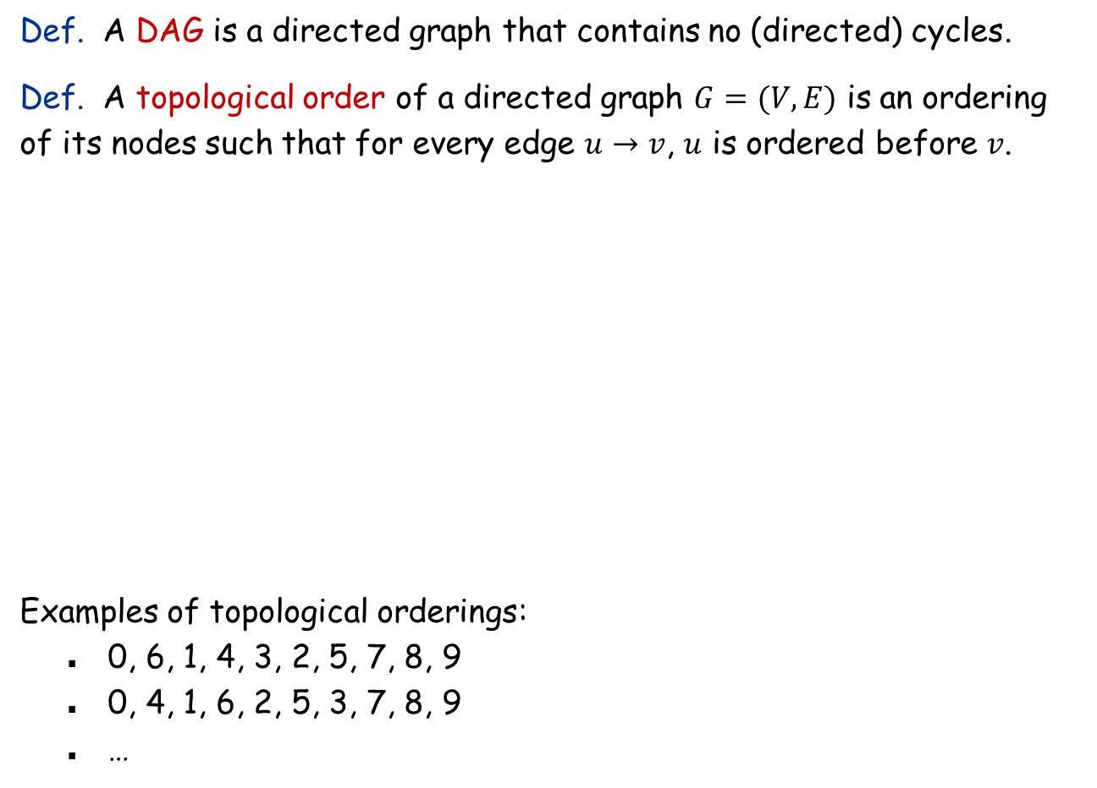
Directed Acyclic Graphs and Topological Ordering
Def. A DAG is a directed graph that contains no (directed) cycles.
Def. A topological order of a directed graph $G=(V, E)$ is an ordering of its nodes such that for every edge $u→v$, $u$ is ordered before $v$.
Examples of topological orderings:
0, 6, 1, 4, 3, 2, 5, 7, 8, 9
0, 4, 1, 6, 2, 5, 3, 7, 8, 9
…

Slide 18

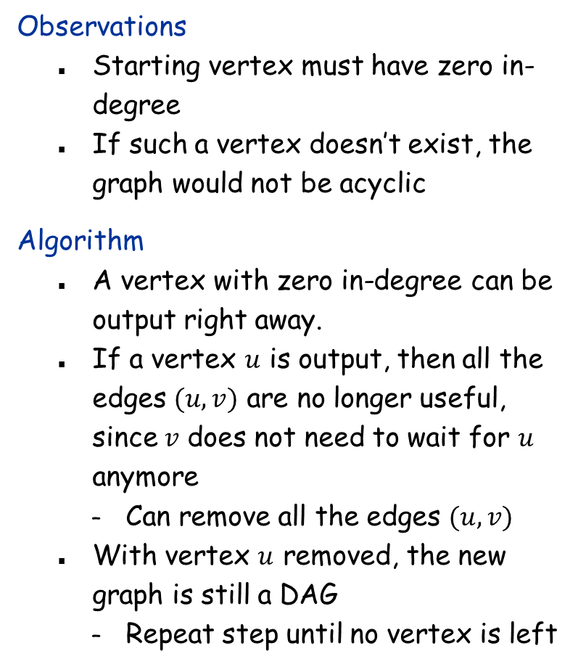

Topological Sort Algorithm
Observations
Starting vertex must have zero in-degree
If such a vertex doesn’t exist, the graph would not be acyclic
Algorithm
A vertex with zero in-degree can be output right away.
If a vertex $u$ is output, then all the edges $(u,v)$ are no longer useful, since $v$ does not need to wait for $u$ anymore
Can remove all the edges $(u,v)$
With vertex $u$ removed, the new graph is still a DAG
Repeat step until no vertex is left
TopologicalSort($G$):
compute $deg^{in}(u)$ for all $u$
let $Q$ be an empty queue
for each $u∈V$ do
if $deg^{in}\left(u\right)=0$ then
Enqueue($Q,u$)
while $Q≠∅$ do
$u←$Dequeue($Q$)
output $u$
for each $v∈Adj(u)$ do
$deg^{in}\left(v\right)←deg^{in}\left(v\right)−1$
if $deg^{in}\left(v\right)=0$ then
Enqueue($Q,v$)
Running time: $O(V+E)$

