Slide 1

Programming
Functions

Slide 2

Function Prototype
The function prototype declares the interface, or input and output parameters of the function, leaving the implementation for the function definition.
The function prototype has the following syntax:
  <type> <function name>(<type list>);
Example: A function that prints the card (J) given the card number (11) as input:
  void printcard(int);
  (This is a void function - a function that does not return a value)

Slide 3

Function Definition
The function definition can be placed anywhere in the program after the function prototypes.
You can place a function definition in front of main(). In this case there is no need to provide a function prototype for the function, since the function is already defined before its use.
A function definition has following syntax:
<type> <function name>(<parameter list>){
<local declarations>
<sequence of statements>
}

Slide 4

Function Call
A function call has the following syntax:
<function name>(<parameter list>);
e.g. int square_root = sqrt(2);
  There is a one-to-one correspondence between the parameters in a function call and the parameters in the function definition.

Slide 5

Printing Cards
The main() program which calls printcard()
  #include <iostream>
  using namespace std;
  void printcard(int); // function prototype
  int main(){
  int c1, c2, c3, c4, c5;
  // pick cards
  . . .
  // print cards
  printcard(c1);
  printcard(c2);
  printcard(c3);
  printcard(c4);
  printcard(c5);
  // find score
  // print score
  }

Slide 6
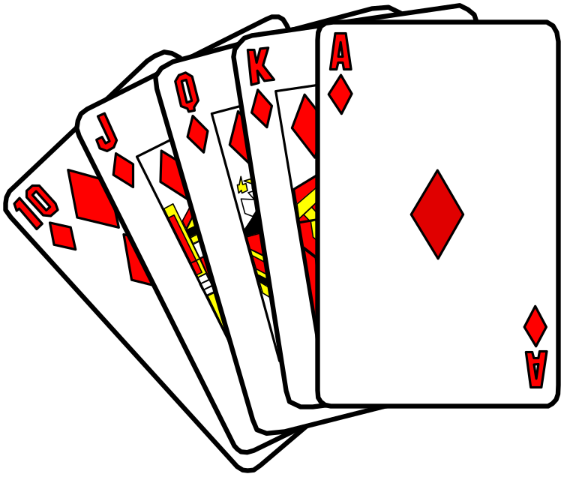
Printing Cards
A function that prints the card (J) given the card number (11) as input:
  void printcard(int cardnum){
  if(cardnum==1)
  cout << "A";
  else if(cardnum>=2 && cardnum<=10)
  cout << cardnum;
  else if(cardnum==11)
  cout << "J";
  else if(cardnum==12)
  cout << "Q";
  else if(cardnum==13)
  cout << "K";
  }

Slide 7
Adding Numbers
Consider the following function:
int add(int a, int b){
int result = a+b;
return result;
}
We might call the function using the syntax:
int main(){
int sum;
sum = add(5, 3);
return 0;
}
This would result in variable sum being assigned the value 8.

Slide 8
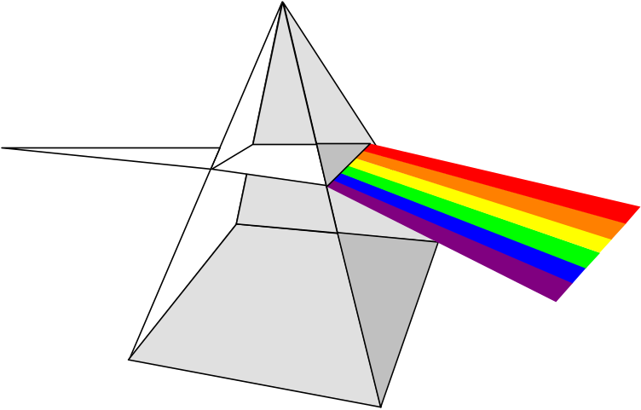
Three-Point Distance
#include <iostream>
#include <cmath>
using namespace std;
double dist(double, double, double, double);
int main(){
double x1, y1, // coordinates for point 1
x2, y2, // coordinates for point 2
x3, y3; // coordinates for point 3
cout << "Enter x & y coordinates of the 1st point: ";
cin >> x1 >> y1;
cout << "Enter x & y coordinates of the 2nd point: ";
cin >> x2 >> y2;
cout << "Enter x & y coordinates of the 3rd point: ";
cin >> x3 >> y3;

Slide 9
Three-Point Distance
cout <<"The distance from point 1 to 2 is: "
<< dist(x1,y1,x2,y2) << endl;
cout <<"The distance from point 2 to 3 is: "
<< dist(x2,y2,x3,y3) << endl;
cout <<"The distance from point 1 to 3 is: "
<< dist(x1,y1,x3,y3) << endl;
return 0;
}
// Function for computing the distance between 2 pts
double dist(double x1, double y1, double x2, double y2) {
double dist;
dist = sqrt( (x2-x1)*(x2-x1) + (y2-y1)*(y2-y1) );
return dist;
}

Slide 10


Passing Parameters by Value
A function returns a single result (assuming the function is not a void function)
One of the statements in the function body should have the form:
return <expression>;
The value passed back by return should have the same type as the function.

Slide 11
Pass by Value
An important fact to remember about parameter passing by value is that changes to the parameters inside the function body have no effect outside of the function.

Slide 12

Pass by Value: Example 0
For example, consider the following code:
int sum(int x, int y){
x = x + y;
return x;
}
void main(){
int x, y, z;
x = 3; y = 5;
z = sum(x,y);
}
What is the value of x, y, and z at the end of the main() program?

Slide 13
Pass by Value: Example 0
void main(){
int x, y, z;
x = 3; y = 5;
z = sum(x,y);
}
x
y
int sum(int x, int y){
x = x + y;
return x;
}
3
5
y
x
3
5
x
y
8
5

Slide 14
Pass by Value: Example 0
The answer: 3, 5, and 8.
Even though the value of function parameter x is changed, the corresponding value in variable x in the main function does not change.
This is why this is called pass by value.
The value of the original variable is copied to the parameter, but changes to the value of the parameter do not affect the original variable.
In fact, all information in local variables declared within the function will be lost when the function terminates.
The only information saved from a pass by value function is in the return statement.

Slide 15

Pass by Value: Example 1
An example to show how the function does not affect a variable which is used as a parameter:
// Test the effect of a function
// on its parameter
#include <iostream>
using namespace std;
void Increment(int Number) {
Number = Number + 1;
cout << "The parameter Number is: "
<< Number << endl;
}

Slide 16
Pass by Value: Example 1
void main() {
int I = 10;
//parameter is a variable
Increment(I);
cout << "The variable I is: "
<< I << endl;
//parameter is a constant
Increment(35);
cout << "The variable I is: "
<< I << endl;
//parameter is an expression
Increment(I+26);
cout << "The variable I is: "
<< I << endl;
}

Slide 17
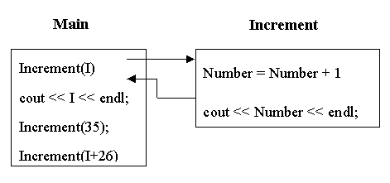
Pass by Value: Example 1

Slide 18

Pass by Value: Example 2
// Print the sum and average of two numbers
// Input: two numbers x & y
// Output: sum - the sum of x & y
// average - the average of x & y
#include <iostream>
using namespace std;
void PrintSumAve ( double, double );
void main ( ) {
double x, y;
cout << "Enter two numbers: ";
cin >> x >> y;
PrintSumAve ( x , y );
}

Slide 19
Pass by Value: Example 2
void PrintSumAve (double no1, double no2) {
double sum, average;
sum = no1 + no2;
average = sum / 2;
cout << "The sum is " << sum << endl;
cout << "The average is " << average << endl;
}

Slide 20
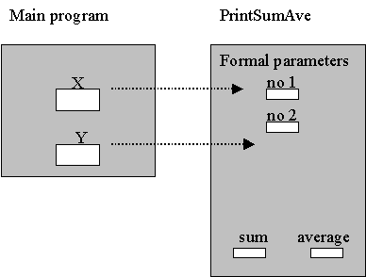

Pass by Value: Example 2
Data areas after call to PrintSumAve() :

Slide 21
Pass by Value: Example 3
//Compute new balance at a certain interest rate
//Inputs: A positive balance and
// a positive interest rate
//Output: The new balance after interest was posted
#include <iostream>
using namespace std;
double new_balance(double balance, double rate);
/*
Returns the balance in a bank account after adding
interest. For example, if rate is 5.0, then the
interest rate is 5% and so new_balance(100, 5.0)
returns 105.00.
*/

Slide 22

Pass by Value: Example 3
int main(){
double interest, balance;
cout << "Enter balance (positive number): ";
cin >> balance;
if (balance <= 0.0)
cout <<"Balance not positive; stopping" << endl;
else {
cout <<"Enter interest rate (positive number): ";
cin >> interest;
if (interest <= 0.0)
cout << "Interest not positive; stopping" << endl;
else
cout <<"New balance = $"
<< new_balance(balance, interest)<< endl;
}
return 0;
}

Slide 23

Pass by Value: Example 3
// New balance is computed as balance + balance * %rate
double new_balance(double balance, double rate) {
double interest_fraction, interest;
interest_fraction = rate / 100;
interest = interest_fraction * balance;
return (balance + interest);
}
/* New balance is computed as balance * (1 + %rate)
double new_balance(double balance, double rate) {
double interest_fraction, updated_balance;
interest_fraction = rate / 100;
updated_balance = balance * (1 + interest_fraction);
return updated_balance;
} */

Slide 24

Pass by Value: Example 4
// Input: inches
// Output: feet and inches
#include <iostream>
using namespace std;
// Function prototypes
int feet(int);
int rinches(int);

Slide 25
Pass by Value: Example 4
void main() {
int inches; // Number of inches
cout << "Enter number of inches to convert: ";
cin >> inches;
cout << "Result is " << feet(inches) << " feet "
<< rinches(inches) << " inches"
<< endl;
}
int feet(int inches) {
return inches / 12;
}
int rinches(int inches) {
return inches % 12;
}

Slide 26

Pass by Value: Example 5
// File i2f.h
int feet(int);
int rinches(int);
// File i2f.cpp
// Functions for Converting inches to feet
int feet(int inches) {
return inches / 12;
}
int rinches(int inches) {
return inches % 12;
}

Slide 27
Pass by Value: Example 5
// File main.cpp
// Input inches
// Output feet and inches
#include <iostream>
using namespace std;
#include "i2f.h"
void main() {
int inches; // Number of inches
cout << "Enter number of inches to convert: ";
cin >> inches;
cout << "Result is " << feet(inches) << " feet "
<< rinches(inches) << " inches"
<< endl;
}

