Slide 1

Programming
Passing Arrays to Functions

Slide 2

Array Element Pass by Value
Individual array elements can be passed by value or by reference
Pass-by-value example:
void printcard(int c) {
if(c==1)
cout << "A";
...
}
void main() {
int cards[5] ;
...
for(int n=0; n<5; n++)
printcard(card[n]);
}

Slide 3

Array Element Pass by Reference
Pass-by-reference example:
void swap(int& x, int& y) {
int temp;
if (x > y){
temp = x;
x = y;
y = temp;
}
}
void main() {
int A[10] = {9,8,7,6,5,4,3,2,1,0};
swap(A[3], A[5]);
}

Slide 4


Array Element Pass by Reference
Before:
After:

Slide 5
Passing
Entire Arrays to Functions
Arrays can be passed to functions in their entirety.
All that is required is the address of the first element and dimensions of the array.
The remainder of the array will be passed by reference automatically.

Slide 6

Arrays to Functions: Example 1
//Find the largest value in an array
//input: n - number of elements to check
// a[ ] - array of elements
// output:index to the largest element
#include <iostream>
using namespace std;
int max_element(int n, const int a[]) {
int max_index = 0;
for (int i=1; i<n; i++)
if (a[i] > a[max_index])
max_index = i;
return max_index;
}
void main() {
int A[10] = {9,8,7,6,5,4,10,2,1,0};
cout << A[max_element(10,A)] << endl;
}

Slide 7

Arrays to Functions: Example 2
//Add a[i] and b[i] and store the sum in c[i]
//Array elements with subscripts ranging from
//0 to size-1 are added element by element
void add_array(int size, const double a[],
const double b[], double c[]){
for (int i=0; i<size; i++)
c[i] = a[i] + b[i];
}
In main():
add_array (5, x, y, z );

Slide 8
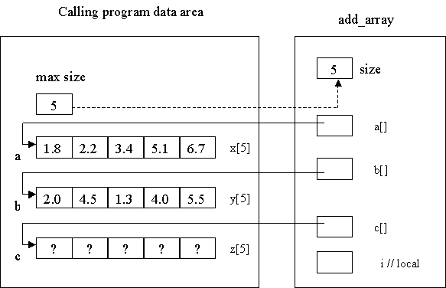
Arrays to
Functions: Example 2

Slide 9
Passing Multidimensional Arrays
How to pass a multidimensional array to a function:
void displayBoard(int b[][4]);
// function prototype requires variable name for arrays
void main(){
int board [4][4];
...
displayBoard(board);
...
}
void displayBoard(int b[][4]){
// could also be: void displayBoard(int b[4][4]){
// but NOT: void displayBoard(int b[][]){
...
}
When passing a multidimensional array, only the size of the 1st dimension is optional, the 2nd, 3rd, etc. dimensions must be specified.

