Slide 1
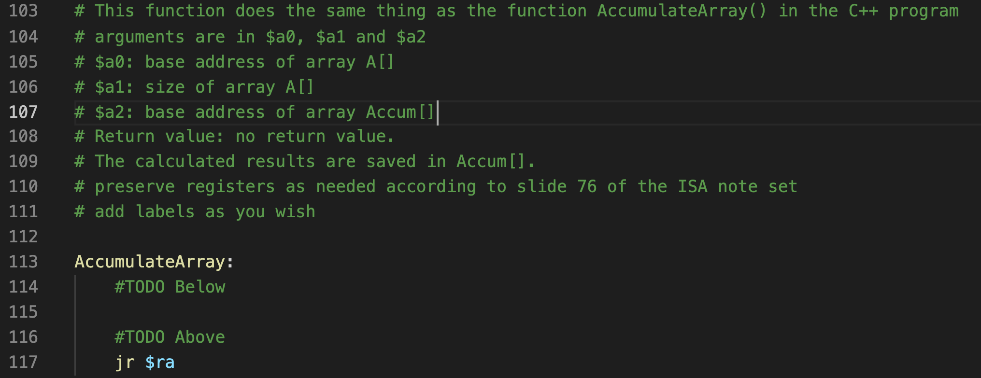
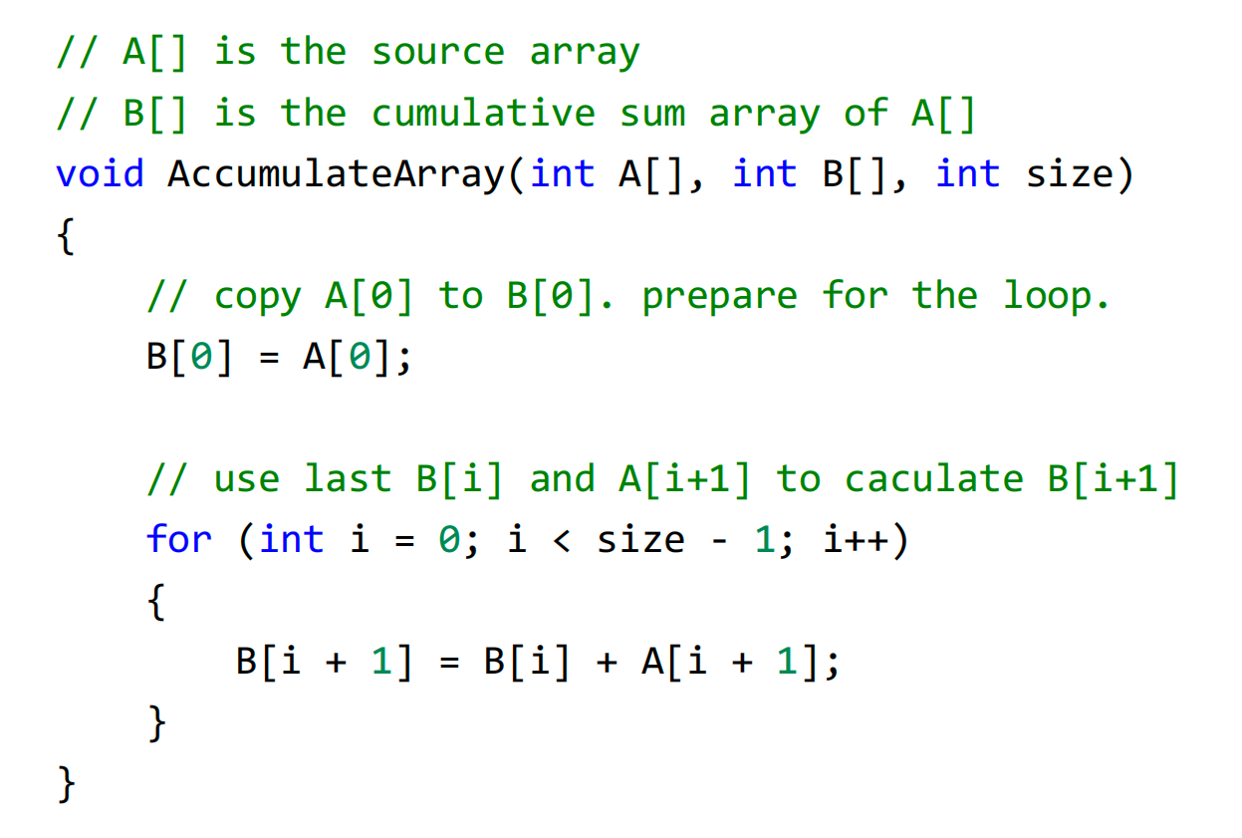
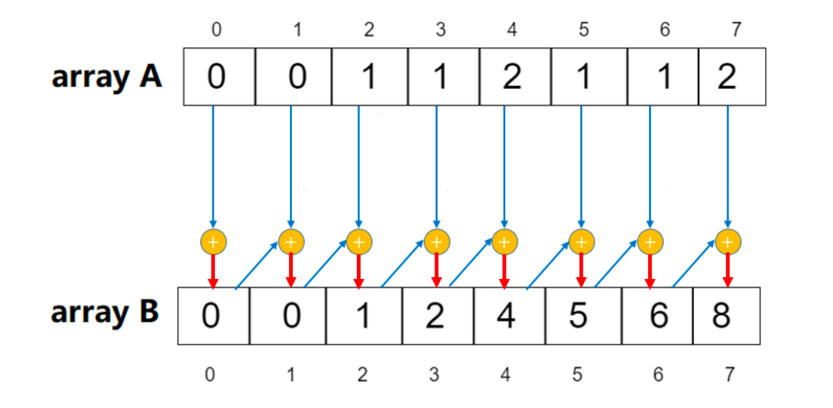
Q1. Cumulative Sum Array
Array access.
For loop.

Slide 2
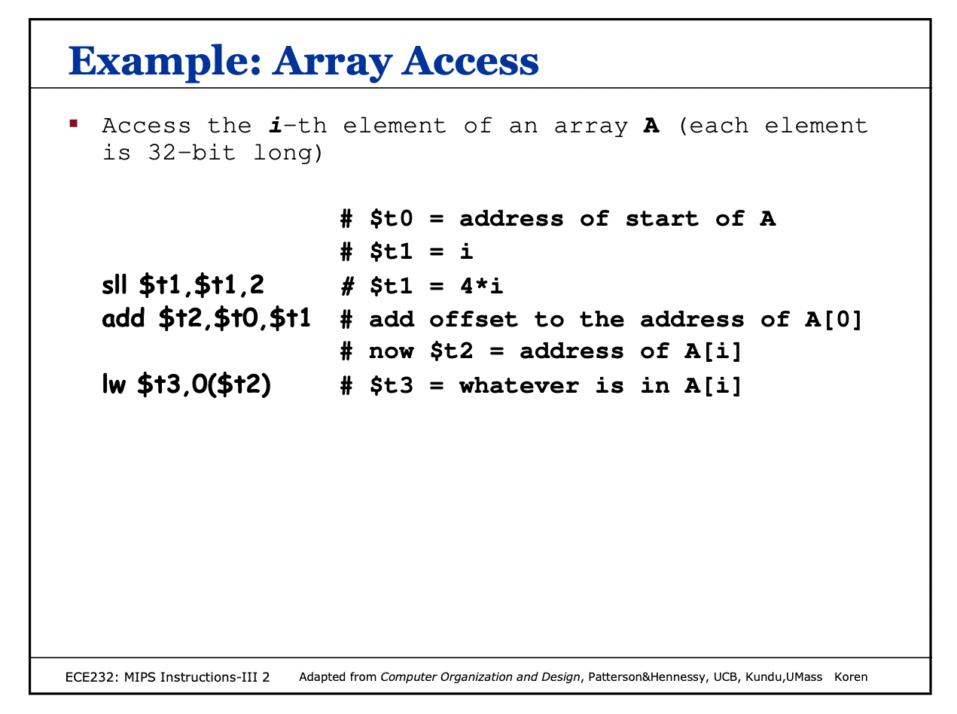
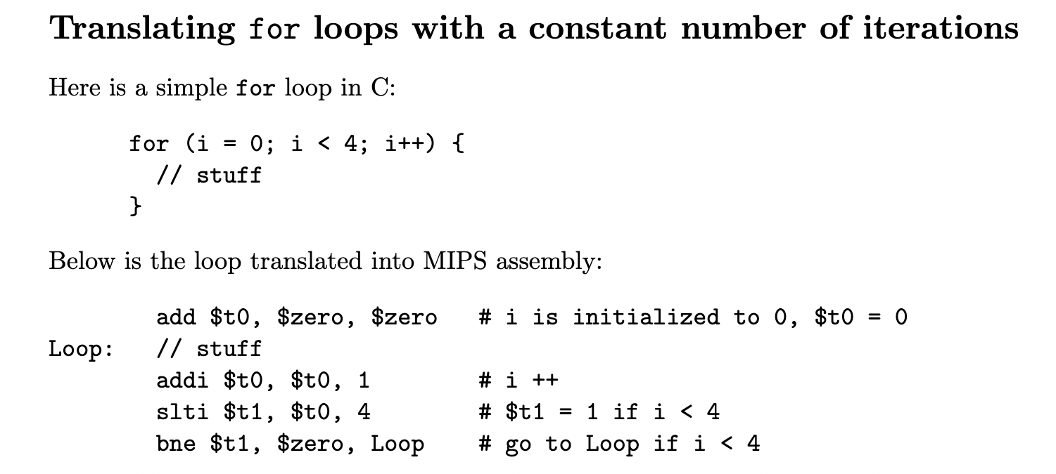
Q1. Cumulative Sum Array
Array access.
For loop.

Slide 3
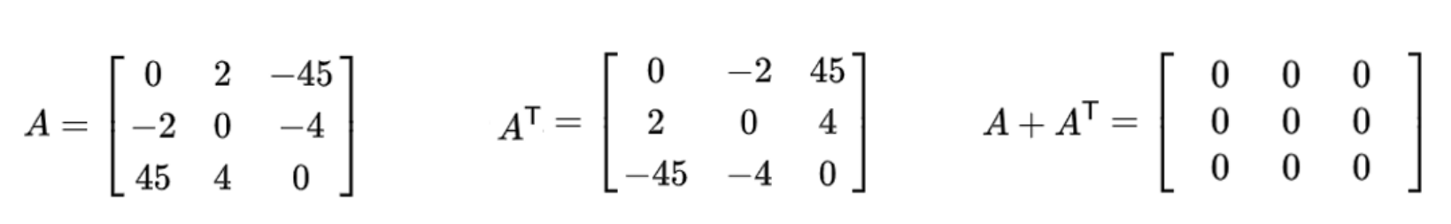

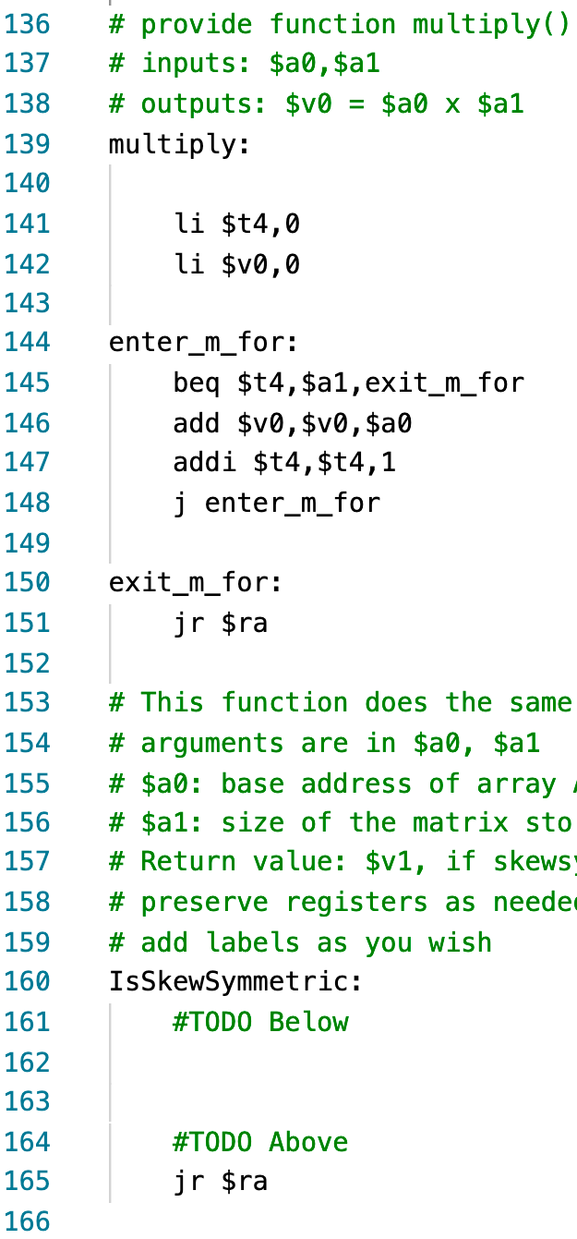
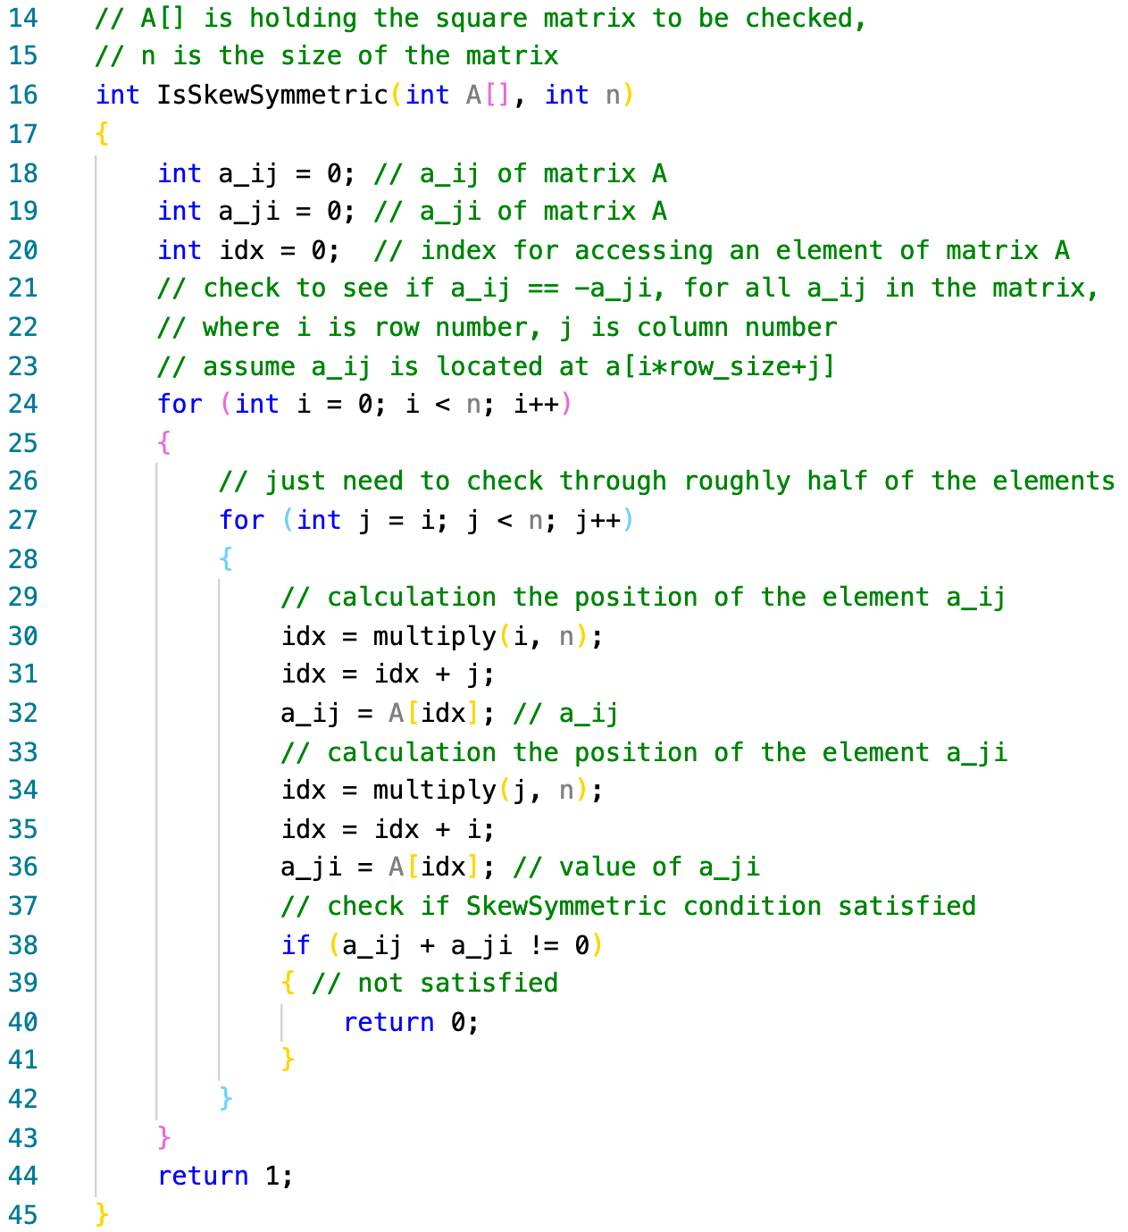
Q2. Skew-Symmetric Matrix
Array access.
For loop.
If statement.
Save register on stack (Nested function call).

Slide 4
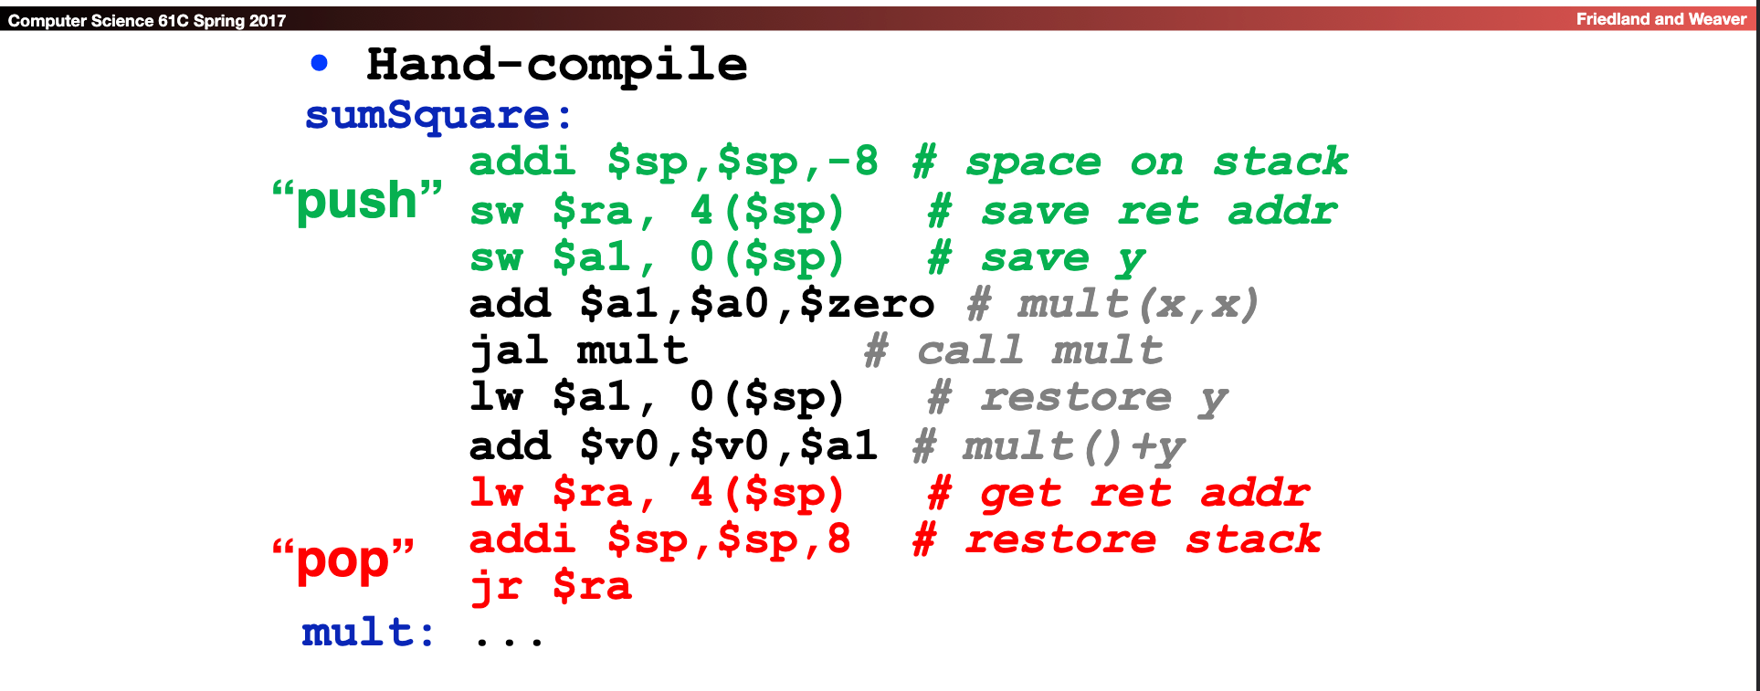
Q2. Skew-Symmetric Matrix
Array access.
For loop.
If statement.
Save register on stack (Nested function call).

Slide 5
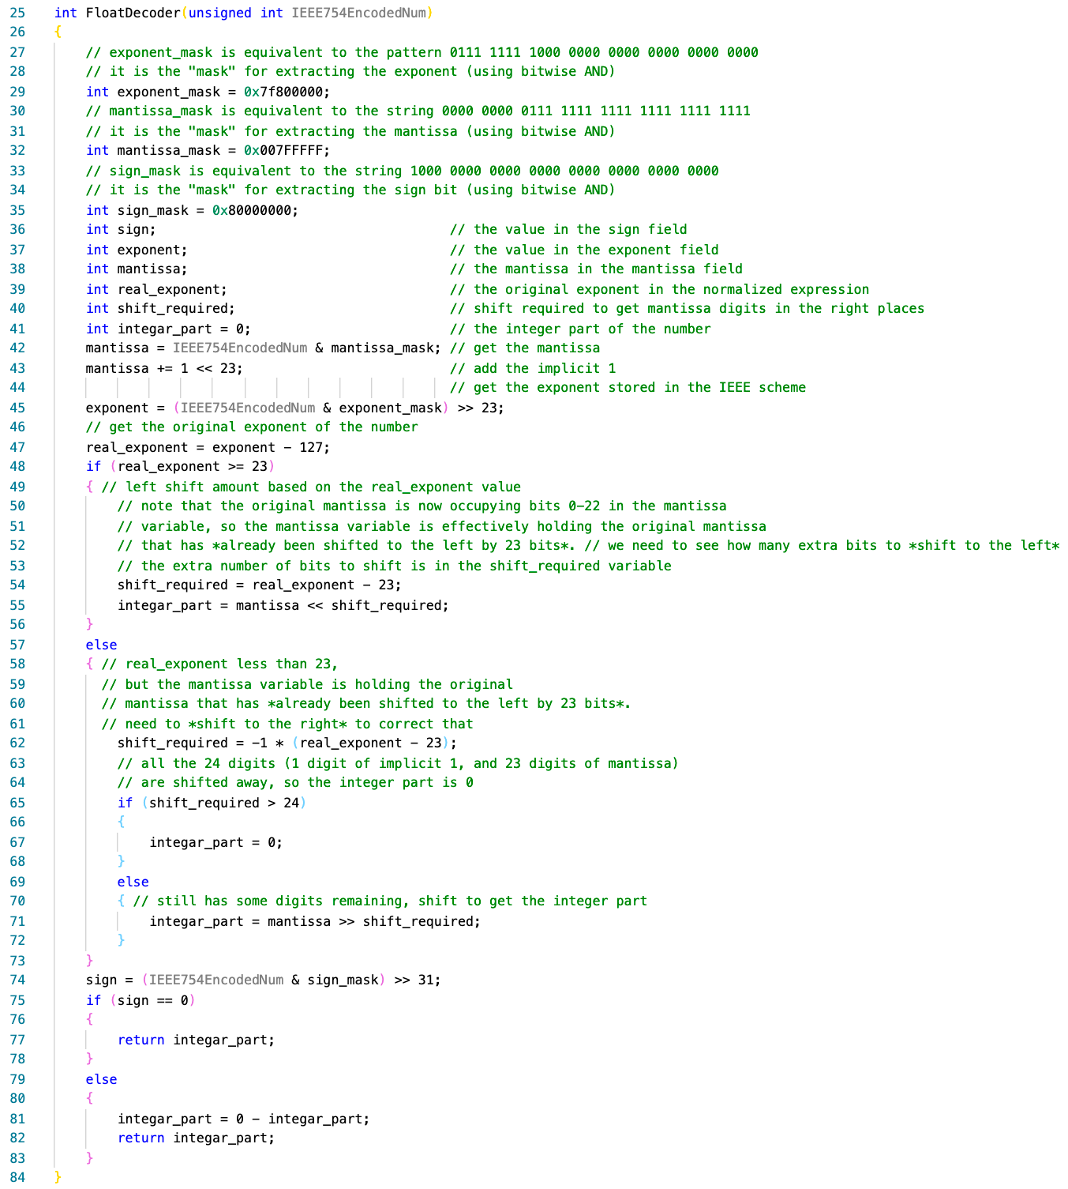
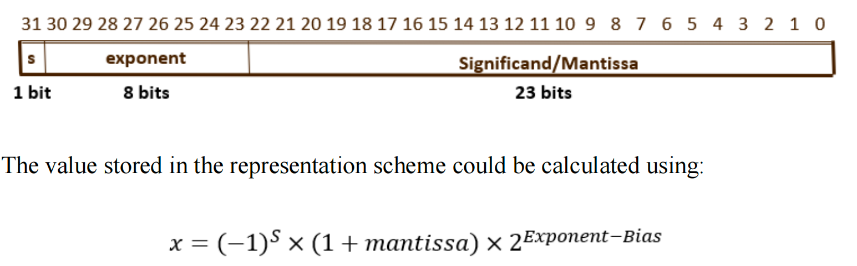
Q3. IEEE-754 Floating Point Number Decoder
Load 32-bit imm.
Left/right Shift.
Bit operations.
If else.

Slide 6
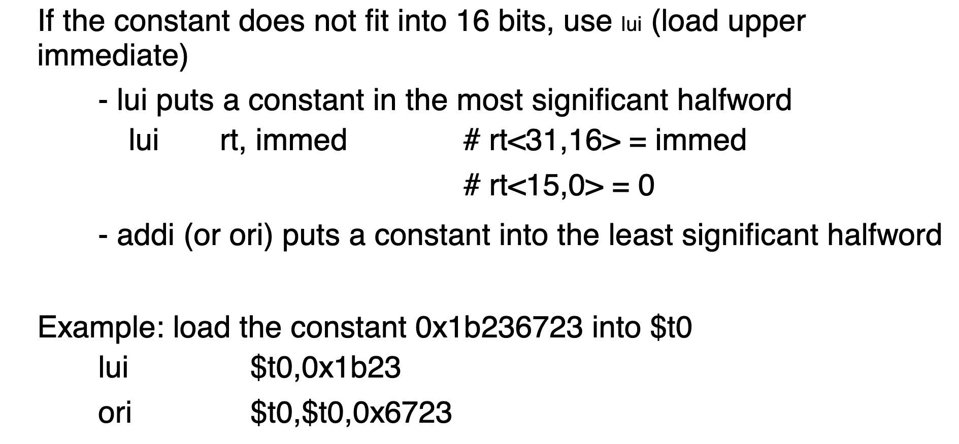
Q3. IEEE-754 Floating Point Number Decoder
Load 32-bit imm.
Left/right Shift.
Bit operations.
If else.

Slide 7
Take-away
Coding in mips is just converting some common statements from cpp.
If you don not know how to convert, google is a good teacher.

