Slide 1
COMP2711H Tutorial 5 Fermat’s Little Theorem & Chinese Remainder Theorem
Henry, CHAK Hon Hing
hhchak@connect.ust.hk
Starting at 6:00 p.m.

Slide 2
QB2-5

Slide 3
QB2-5
If a|x, b|x, c|x, then abc|x.
(a, b, c) are co-primes
Prove that 2730|(n¹³ - n).

Slide 4
QB2-5
If a|x, b|x, c|x, then abc|x.
(a, b, c) are co-primes
Prove that 2730|(n¹³ - n).
2730 = 2 × 3 × 5 × 7 × 13

Slide 5
QB2-5
If a|x, b|x, c|x, then abc|x.
(a, b, c) are co-primes
Prove that 2730|(n¹³ - n).
2730 = 2 × 3 × 5 × 7 × 13
2|(n¹³– n)
3|(n¹³– n)
5|(n¹³– n)
2730|(n¹³– n)
7|(n¹³– n)
13|(n¹³– n)
Strategy

Slide 6
QB2-5
Fermat’s Little Theorem (prime p):
x^{p-1} ≡ 1 (mod p) if p∤x
Prove that 2730|(n¹³ - n).
2730 = 2 × 3 × 5 × 7 × 13
2|(n¹³– n)
If p|n, it is obvious that (n¹³ - n).
For p∤n, we can apply the theorem:
n¹³ – n ≡ n (n²⁻¹)¹² – n ≡ n – n ≡ 0 (mod 2)
∴ 2|(n¹³ – n)

Slide 7
QB2-5
Fermat’s Little Theorem (prime p):
x^{p-1} ≡ 1 (mod p) if p∤x
Prove that 2730|(n¹³ - n).
2730 = 2 × 3 × 5 × 7 × 13
2|(n¹³– n)
If p|n, it is obvious that (n¹³ - n).
For p∤n, we can apply the theorem:
3|(n¹³– n)
n¹³ – n ≡ n (n³⁻¹)⁶ – n ≡ n – n ≡ 0 (mod 3)
∴ 3|(n¹³ – n)

Slide 8
QB2-5
Fermat’s Little Theorem (prime p):
x^{p-1} ≡ 1 (mod p) if p∤x
Prove that 2730|(n¹³ - n).
2730 = 2 × 3 × 5 × 7 × 13
2|(n¹³– n)
If p|n, it is obvious that (n¹³ - n).
For p∤n, we can apply the theorem:
3|(n¹³– n)
5|(n¹³– n)
n¹³ – n ≡ n (n⁵⁻¹)³ – n ≡ n – n ≡ 0 (mod 5)
∴ 5|(n¹³ – n)

Slide 9
QB2-5
Fermat’s Little Theorem (prime p):
x^{p-1} ≡ 1 (mod p) if p∤x
Prove that 2730|(n¹³ - n).
2730 = 2 × 3 × 5 × 7 × 13
2|(n¹³– n)
If p|n, it is obvious that (n¹³ - n).
For p∤n, we can apply the theorem:
3|(n¹³– n)
5|(n¹³– n)
n¹³ – n ≡ n (n⁷⁻¹)² – n ≡ n – n ≡ 0 (mod 7)
∴ 7|(n¹³ – n)
7|(n¹³– n)

Slide 10
QB2-5
Fermat’s Little Theorem (prime p):
x^{p-1} ≡ 1 (mod p) if p∤x
Prove that 2730|(n¹³ - n).
2730 = 2 × 3 × 5 × 7 × 13
2|(n¹³– n)
If p|n, it is obvious that (n¹³ - n).
For p∤n, we can apply the theorem:
3|(n¹³– n)
5|(n¹³– n)
n¹³ – n ≡ n (n¹³⁻¹)¹ – n ≡ n – n ≡ 0 (mod 13)
∴ 13|(n¹³ – n)
7|(n¹³– n)
13|(n¹³– n)
∴ 2730|(n¹³ - n).

Slide 11
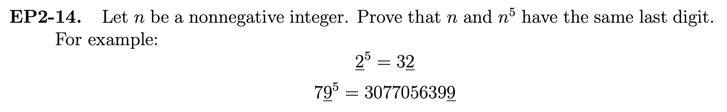
EP2-14

Slide 12
EP2-14
Prove that n⁵ ≡ n (mod 10).

Slide 13
EP2-14
Same as proving 10|(n⁵ – n), just like last question
Prove that n⁵ ≡ n (mod 10).
10 = 2 × 5
n⁵ ≡ n ⋅ (n²⁻¹)⁴ ≡ n (mod 2)
n⁵ ≡ n ⋅ (n⁵⁻¹)¹ ≡ n (mod 5)

Slide 14
EP2-14
Same as proving 10|(n⁵ – n), just like last question
Prove that n⁵ ≡ n (mod 10).
10 = 2 × 5
n⁵ ≡ n ⋅ (n²⁻¹)⁴ ≡ n (mod 2)
n⁵ ≡ n ⋅ (n⁵⁻¹)¹ ≡ n (mod 5)
(n⁵ – n) ≡ 0 (mod 2×5=10)
∴ n⁵ ≡ n (mod 10).
∴ n and n⁵ have the same last digit.

Slide 15
QB2-6

Slide 16
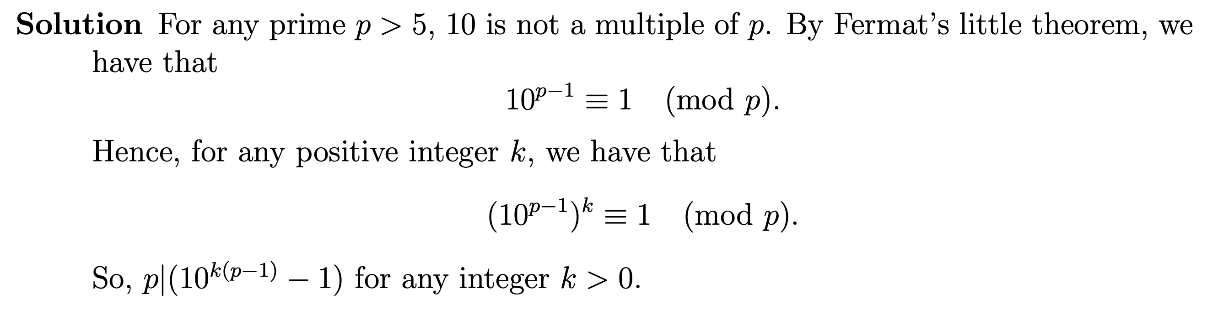
QB2-6

Slide 17
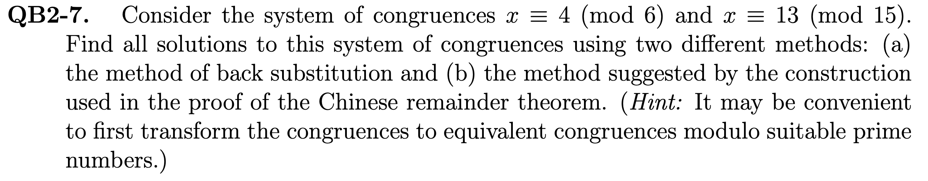
QB2-7

Slide 18
QB2-7
6, 15 are NOT coprime, can’t directly use Chinese Remainder Theorem
x ≡ 4 (mod 6)
Solve
x ≡ 13 (mod 15)

Slide 19
QB2-7
6, 15 are NOT coprime, can’t directly use Chinese Remainder Theorem
x ≡ 4 (mod 6)
Solve
x ≡ 13 (mod 15)
x ≡ 0 (mod 2)
x ≡ 1 (mod 3)
x ≡ 0 (mod 2)
x ≡ 4 (mod 6)
x ≡ 1 (mod 3)
x ≡ 13 (mod 15)
x ≡ 3 (mod 5)
x ≡ 1 (mod 3)
x ≡ 3 (mod 5)

Slide 20
QB2-7
x ≡ 4 (mod 6)
Solve
x ≡ 13 (mod 15)
x ≡ 0 (mod 2)
Equivalent
x ≡ 4 (mod 6)
x ≡ 1 (mod 3)
x ≡ 13 (mod 15)
x ≡ 3 (mod 5)
Forward: Left can deduce the right
Backward: Chinese Remainder Theorem

Slide 21
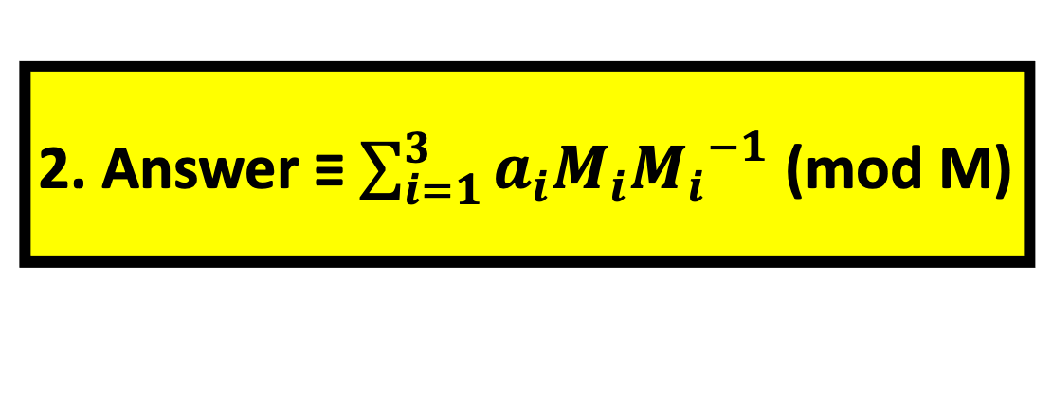
QB2-7
a₁ = 0, a₂ = 1, a₃ = 3
m₁ = 2, m₂ = 3, m₃ = 5, M=30
M₁ = 15, M₂ = 10, M₃ = 6
x ≡ 0 (mod 2)
Solve
x ≡ 1 (mod 3)
x ≡ 3 (mod 5)
1. Calculate M_{i}⁻¹ (mod m_{i}) with Ext. GCD algorithm
2. Answer ≡ $\sum_{i=1}^{3}{a_{i}M_{i}{M_{i}}^{−1}}$ (mod M)
15⁻¹ ≡ 1 (mod 2)
x ≡ 0×15×1+1×10×1+3×6×1 ≡ 28 (mod 30)
10⁻¹ ≡ 1 (mod 3)
i.e. solutions are x=28+30k (k ∈ ℤ)
6⁻¹ ≡ 1 (mod 5)

Slide 22
QB2-7
x ≡ 0 (mod 2)
Solve
x ≡ 1 (mod 3)
Let u,s,t ∈ ℤ
x ≡ 3 (mod 5)
x ≡ 0 (mod 2)
x = 2u
2u ≡ 1 (mod 3)
u ≡ 2 (mod 3)
u = 3s + 2
x = 6s + 4
6s + 4 ≡ 3 (mod 5)
s ≡ 4 (mod 5)
s = 5t + 4
x = 30t + 28

Slide 23
QB2-8

Slide 24
QB2-8
Prove: (n-1)! ≡ -1 (mod n) → n is prime
(n-1)! ≡ -1 (mod n)
↔ (n-1)! (n-1) ≡ -1(n-1) ≡ 1-n ≡ 1 (mod n)
↔ 1 × 2 × … × (n-1) × (n-1) ≡ 1 (mod n)
Pick one of these, the rest is mul. inv. !
∴ Inverses of {2, …, (n-1)} exists, i.e. {2, …, (n-1)} not divides n.
∴ n is prime.

Slide 25
QB2-8
Example: n=7
{2=4⁻¹, 4=2⁻¹}
{3=5⁻¹, 5=3⁻¹}
Prove: n is prime → (n-1)! ≡ -1 (mod n)
a
a⁻¹
n = 2 is obvious.
1
1
For prime n>2, n is odd.
2
2
Want to prove that {2, …, (n-2)} (even #)
form pairs that are inv. of each other
3
3
4
4
This let us show 1 × [2 × … (n-2)] × (n-1)
≡ 1 × (n-1) ≡ -1
5
5
Each pair cancel out
6
6

Slide 26
QB2-8
Prove: n is prime → (n-1)! ≡ -1 (mod n)
1. In a,b ∈ {2, …, n-2}, b = a⁻¹ is unique (a = b⁻¹ also)
Assume not true, i.e. ab ≡ ac ≡ 1 (mod n), b<c.
Then, ac-ab ≡ a(c-b) ≡ 0, i.e. a|n (since (c-b)>0).
∴ Contradiction, since n has a factor a ∈ {2, …, n-2}.

Slide 27
QB2-8
Prove: n is prime → (n-1)! ≡ -1 (mod n)
✓
1. In a,b ∈ {2, …, n-2}, b = a⁻¹ is unique (a = b⁻¹ also)
2. In a ∈ {2, …, n-2}, a ≠ a⁻¹
Assume a ≠ a⁻¹, i.e. a² ≡ 1 (mod n).
-> a² – 1 ≡ (a-1)(a+1) ≡ 0 (mod n).
Either (a-1) or (a+1) is in {2, …, n-2}, which is also a factor of n.
∴ Contradiction again.

Slide 28
QB2-8
Prove: n is prime → (n-1)! ≡ -1 (mod n)
✓
1. In a,b ∈ {2, …, n-2}, b = a⁻¹ is unique (a = b⁻¹ also)
✓
2. In a ∈ {2, …, n-2}, a ≠ a⁻¹
Each a pairs with exactly one another b in {2, …, n-2},
forming (n-3)/2 pairs.
So, (n-1)! ≡ 1 × [2 × … (n-2)] × (n-1) ≡ 1 × (n-1) ≡ -1 (mod n)

Slide 29
Appendix 1: Numerical Example of RSA
Given 2 primes: p=11 and q=17. Let n=pq, Φ(n)=(p-1)(q-1). We choose public key e=7 relatively prime to Φ(n). Find secret key d. Then encrypt and decrypt message M=4.
Φ(n)=(11-1)(17-1) = 160
Extended GCD Algorithm to find inverse e⁻¹ mod Φ(n)
…
d = e⁻¹ mod Φ(n) = 23

Slide 30
Appendix 1: Numerical Example of RSA
Given 2 primes: p=11 and q=17. Let n=pq, Φ(n)=(p-1)(q-1). We choose public key e=7 relatively prime to Φ(n). Find secret key d. Then encrypt and decrypt message M=4.
d = 23
Let encrypted message be X, i.e. X=Me mod n.
Repeated squaring to find 4⁷ mod 187
…
X = 115

Slide 31
Appendix 1: Numerical Example of RSA
Given 2 primes: p=11 and q=17. Let n=pq, Φ(n)=(p-1)(q-1). We choose public key e=7 relatively prime to Φ(n). Find secret key d. Then encrypt and decrypt message M=4.
d = 23, X = 115
Find decrypted message by computing X^{d} mod n.
Repeated squaring to find 115²³ mod 187
…
115²³ mod 187 = 4 = M.

Slide 32
Appendix 2: Repeated Squaring
Calculate 5²³ mod 11.
First, calculate exponents with powers of 2 that are at most 23.
5¹ ≡ 5 (mod 11)
5² ≡ 5¹ × 5¹ ≡ 25 ≡ 3 (mod 11)
5⁴ ≡ 5² × 5² ≡ 3 × 3 ≡ -2 ≡ 9 (mod 11)
5⁸ ≡ 5⁴ × 5⁴ ≡ -2 × -2 ≡ 4 (mod 11)
5¹⁶ ≡ 5⁸ × 5⁸ ≡ 4 × 4 ≡ 16 ≡ 5 (mod 11)

Slide 33
Appendix 2: Repeated Squaring
Calculate 5²³ mod 11.
First, calculate exponents with powers of 2 that are at most 23.
5¹ ≡ 5 (mod 11); 5² ≡ 3 (mod 11); 5⁴ ≡ 9 (mod 11); 5⁸ ≡ 4 (mod 11);
5¹⁶ ≡ 5 (mod 11)
Then, multiply the above exponents to get 5²³ (23 = 16 + 4 + 2 + 1).
5²³ ≡ 5¹⁶ × 5⁴ × 5² × 5¹ ≡ 5 × 9 × 3 × 5 ≡ 45 × 15 ≡ 1 × 4 ≡ 4 (mod 11)
So, 5²³ mod 11 = 4.

