Slide 1
Chapter 13: File-System Interface

Slide 2
Chapter 13: File System Interface
File Concept
Access Methods
Disk and Directory Structure
File-System Mounting
File Sharing
Protection

Slide 3
Objectives
To explain the functions of file systems
To describe the interfaces to file systems
To discuss file-system design tradeoffs, including access methods, file sharing, and directory structures
To explore file-system protection

Slide 4
File Concept
Contiguous logical address space
Types:
  Data
    numeric
    character
    binary
  Program
Contents defined by the file’s creator
  Many types, consider text file, source file, executable file

Slide 5
File Attributes
Name – only information kept in human-readable form
Identifier – unique tag (number) identifies files within a file system
Type – needed by systems that support different types
Location – pointer to file location on device
Size – current file size
Protection – controls who can do reading, writing, executing, etc.
Time, date, and user identification – data for protection, security, and usage monitoring
Information about files are kept in a directory structure, maintained on the disk - part of which can be cached in main memory for fast access
Many variations, including extended file attributes such as file checksum

Slide 6
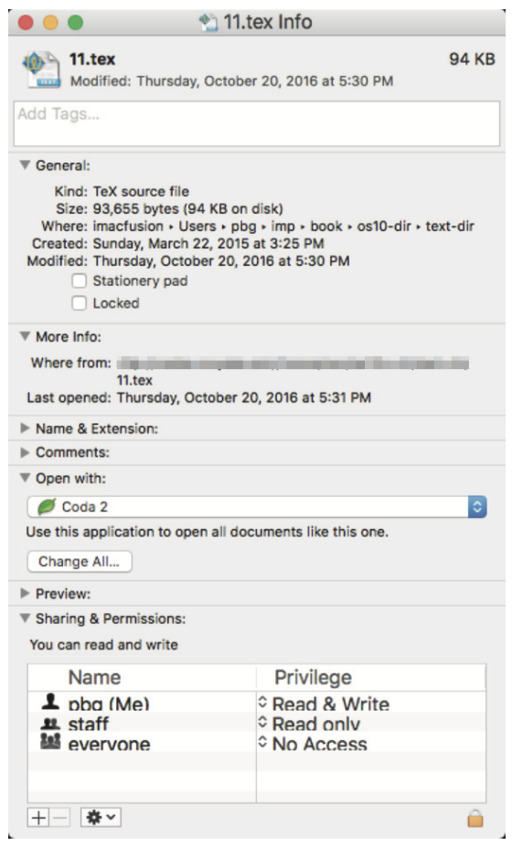
File info Window on Mac OS X

Slide 7
File Operations
File is an ADT or abstract data type
Create – create a file
Write – at write pointer location
Read – at read pointer location
Reposition within file - seek
Delete
Truncate
Open(F_{i}) – search the directory structure on disk for entry F_{i}, and move the content of entry to memory, preparing file for subsequent access
Close (F_{i}) – move the content of entry F_{i} in memory to directory structure on disk
Such operations involve the changes of various OS kernel data structures

Slide 8
Open Files
Several data structures are needed to manage open files:
  Open-file tables: tracks open files, system-wide open-file table, and per-process open-file table
  File pointer: pointer to last read/write location, per process that has the file open
  File-open count: counting the number of times (processes) that the file has been opened – to allow removal of data from the open-file table when the last processes closes it (when file-open count is zero)
  Disk location of the file: cache of data access information
  Access rights: per-process access mode information

Slide 9

File Types – Name, Extension

Slide 10
Access Methods
Sequential Access – simplest access method
read next
write next
reset
no read after last write
(rewrite)
Direct Access – file is fixed length logical records
read n
write n
position to n
read next
write next
rewrite n
n = relative block number
Relative block numbers allow OS to decide where file should be placed
  See disk block allocation problem in Chapter 14

Slide 11

Other Access Methods
Other file access methods can be built on top of a direct-access method
Generally, involve creation of an index for the file
  Keep index in memory for fast location of the data to be operated on
  If too large, index (in memory) of the index (on disk)
IBM indexed sequential-access method (ISAM) is an example
  Small master index, points to disk blocks of secondary index
  File kept sorted on a defined key
  All done by the OS
VMS operating system provides index and relative files as another example

Slide 12
Directory Structure
A collection of nodes containing information about all files
Directory
Files
F 1
F 2
F 3
F 4
F n
Both the directory structure and files reside on disk

Slide 13
Disk Structure
Disk can be subdivided into partitions
Disks or partitions can be RAID protected against failure
Disk or partition can be used raw – without a file system, or formatted with a file system
Partitions also known as minidisks, slices
An entity on a disk containing a file system known as a volume
Each volume containing a file system also keeps track of the file system info in device directory or volume table of contents
Other than general-purpose file systems, there are many special-purpose file systems, frequently within the same operating system or computing systems

Slide 14

A Typical File-system Organization

Slide 15
Operations Performed on Directory
Search for a file
Create a file
Delete a file
List a directory
Rename a file
Traverse the file system

Slide 16
Organize the Directory (Logically) to Obtain
Efficiency – locating a file quickly
Naming – convenient to users
  Two users can have same name for different files
  The same file can have several different names
Grouping – logical grouping of files by properties, (e.g., all Java programs, all games, my comp3511, …)

Slide 17

Single-Level Directory
A single directory for all users
Naming problem
Grouping problem

Slide 18

Two-Level Directory
Separate directory for each user
Path name – need a pathname to identify a file/dir, e.g., /user1/cat
Can have the same file name under different users (paths)
More efficient searching than single-level directory
No grouping capability

Slide 19

Tree-Structured Directories

Slide 20
Tree-Structured Directories (Cont.)
Efficient searching
Grouping Capability
Current directory (working directory)
  cd /spell/mail/prog
  type list

Slide 21
Tree-Structured Directories (Cont)
Absolute or relative path name
Creating a new file is done in the current directory
Delete a file in the current directory
rm <file-name>
Creating a new subdirectory is done in current directory
  mkdir <dir-name>
  Example: if in current directory /mail
  mkdir count
mail
prog
copy
prt
exp
count
Deleting “mail” ⇒ deleting the entire subtree rooted by “mail”

Slide 22

Acyclic-Graph Directories
Have shared subdirectories and files – more flexible and complex

Slide 23
Acyclic-Graph Directories (Cont.)
New directory entry type
  Link – another name (pointer) to an existing file
  Resolve the link – follow pointer to locate the file
Two different (path) names (aliasing)
  Ensure not traversing shared structures more than once
Deletion might lead to that dangling pointers that point to empty files or even wrong files
There is also difficulty ensuring there is no cycles in a graph – complexity associated with it

Slide 24

General Graph Directory

Slide 25
General Graph Directory (Cont.)
How do we guarantee no cycles?
  Allow only links to file not subdirectories – sometime not convenient
  Every time a new link is added use a cycle detection algorithm to determine whether there is a cycle or not – time consuming

Slide 26

File System Mounting
A file system must be mounted before it can be accessed – just like a file must be opened before it is used
A unmounted file system (i.e., Fig. (b)), to be mounted at a mount point

Slide 27

Mount Point
Volume is mounted at /users

Slide 28
File Sharing
Sharing of files in multi-user systems is desirable
Sharing may be done through a protection scheme
In distributed systems, files may be shared across a network
  Network File System (NFS) is a common distributed file-sharing method
With a multi-user system
  User IDs identify users, allowing permissions and protections to be per-user
  Group IDs allow users to be in groups, permitting group access rights
  Owner of a file / directory
  Group of a file / directory

Slide 29
Protection
File owner/creator of the file should be able to control:
  what can be done
  by whom
Types of access
  Read
  Write
  Execute
  Append
  Delete
  List

Slide 30
Access Lists and Groups
Mode of access: read, write, execute
Three classes of users on Unix / Linux
RWX
a) owner access 7 ⇒ 1 1 1
RWX
b) group access 6 ⇒ 1 1 0
RWX
c) public access 1 ⇒ 0 0 1
Ask manager to create a group (unique name), say G, and add some users to the group.
For a particular file or subdirectory, define an appropriate access.
owner
group
public
chmod
761
game
Attach a group to a file
chgrp G game

Slide 31
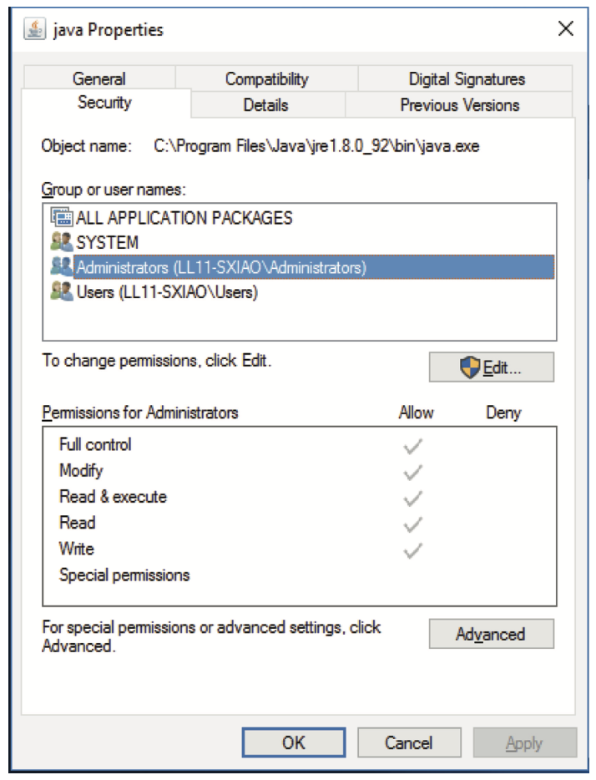
Windows 10 Access-Control List Management

Slide 32

A Sample UNIX Directory Listing

Slide 33
End of Chapter 13

