Slide 1
Spring 2022 COMP 3511 Review #6

Slide 2
Coverages
Deadlock
Memory Management – contiguous memory allocation

Slide 3
Deadlock

Slide 4
The Deadlock Problem
A set of blocked processes each holding resource(s) while waiting to acquire more resource(s) held by another process in the set.
Example 1
A system has 2 tape drives.
P₁ and P₂ each hold one tape drive and each needs another one.
Example 2
semaphores A and B, initialized to 1
P₀ P₁
wait (A); wait(B)
wait (B); wait(A)

Slide 5
Deadlock Characterization
If Deadlock occurs, four conditions must hold simultaneously
Mutual exclusion
only one process at a time can use a resource.
Hold and wait
a process holding at least one resource is waiting to acquire additional resources held by other processes.
No preemption
a resource can be released only voluntarily by the process holding it, after that process has completed its task.
Circular wait
there exists a set {P₀, P₁, …, P_{n}} of waiting processes such that P₀ is waiting for a resource that is held by P₁, P₁ is waiting for a resource that is held by P₂, …, P_{n–1} is waiting for a resource that is held by P_{n}, and P_{n} is waiting for a resource that is held by P₀.

Slide 6
Methods for Handling Deadlocks
Ensure that the system will never enter a deadlock state:
Deadlock prevention: it provides a set of methods to ensure at least one of the necessary conditions cannot hold
Deadlock avoidance: this requires additional information given in advance concerning which resources a process will request and use during its lifetime. Within such knowledge, the OS can decide for each resource request whether or not a process should wait
Deadlock detection - allow the system to enter a deadlock state， periodically detect deadlock and then recover from it
Many OSes just ignore the problem and pretend that deadlocks never occur in the system

Slide 7
Deadlock Prevention
Mutual Exclusion – not required for sharable resources; must hold for non-sharable resources.
Hold and Wait – must guarantee that whenever a process requests a resource, it does not hold any other resources.
Process to request and be allocated all its resources before it begins execution, or allow process to request resources only when the process has none.
Low resource utilization; starvation possible
No Preemption –
If a process holding some resources requests another resource that cannot be immediately allocated to it, then all resources currently being held are released.
Preempted resources are added to the list of resources for which the process is waiting.
Process will be restarted only when it can regain its old resources, as well as the new ones that it is requesting.
Circular Wait – impose a total ordering of all resource types, and require that each process requests resources in an increasing order of enumeration. This might not be practically feasible

Slide 8
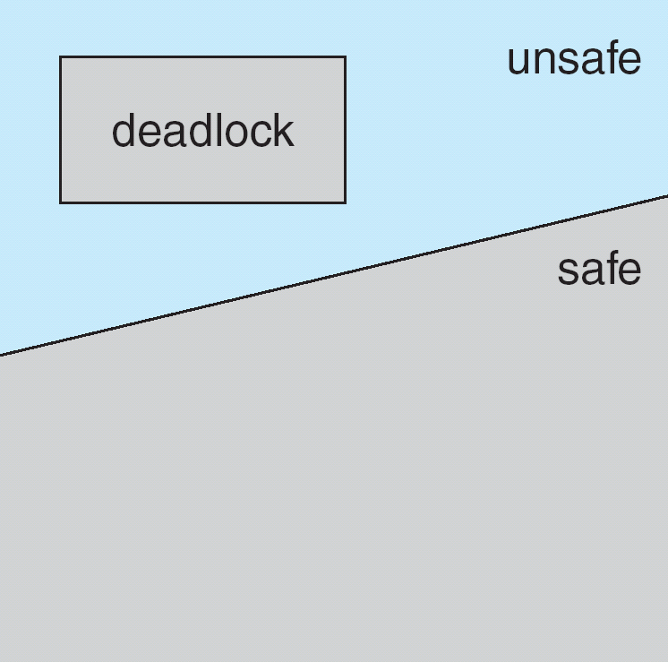
Deadlock Avoidance
Avoidance ⇒ ensure that a system
never enters an unsafe state.
The deadlock-avoidance algorithm dynamically examines the resource-allocation state to ensure that there can never be a circular-wait condition
Resource-allocation state is defined by the number of available and allocated resources, and the maximum demands of the processes.
System is in safe state if there exists a safe sequence of all processes:
sequence <P₁, P₂, …, P_{n}> is safe if for each P_{i}, the resources that P_{i} can still request can be satisfied by currently available resources + resources held by all the P_{j}, with j<i.
If P_{i} resource needs are not immediately available, then P_{i} can wait until all P_{j} have finished.
When P_{j} is finished, P_{i} can obtain needed resources, execute, return allocated resources, and terminate.
When P_{i} terminates, P_{i+1} can obtain its needed resources, and so on.

Slide 9
Resource-Allocation Graph
A set of vertices V and a set of edges E.
V is partitioned into two types:
P = {P₁, P₂, …, P_{n}}, the set consisting of all the processes in the system.
R = {R₁, R₂, …, R_{m}}, the set consisting of all resource types in the system
Each resource type R_{i} has W_{i} instances.
Each process utilizes a resource as follows: request, use, release
Request edge – directed edge P_{i} → R_{j}
Assignment edge – directed edge R_{j} → P_{i}

Slide 10
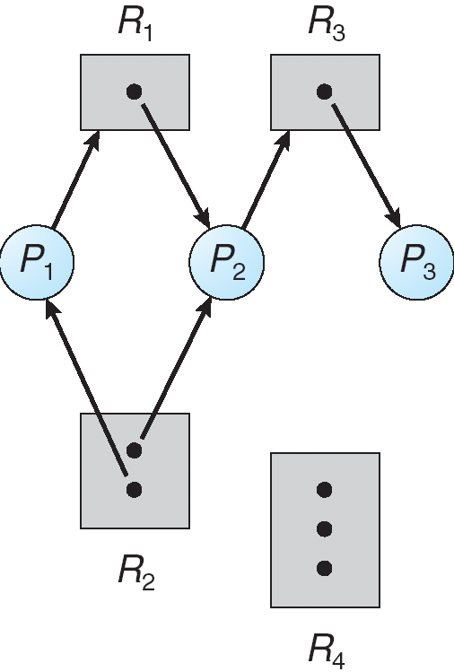
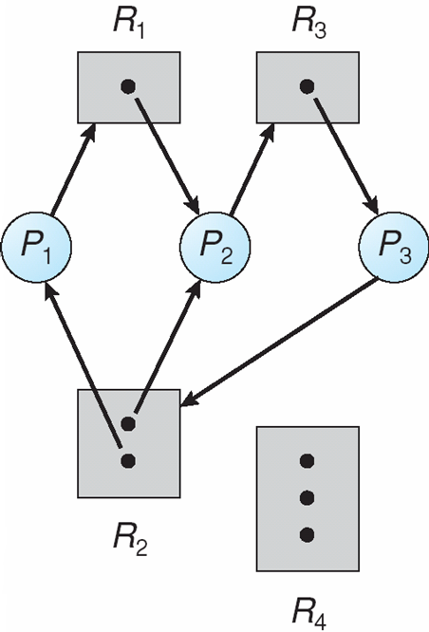
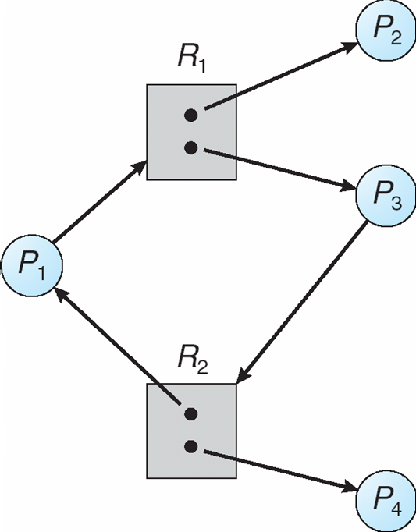
Resource Allocation Graph: Examples
A resource allocation graph with no cycle no deadlock
A resource allocation graph with a deadlock - cycle
A resource allocation graph with a cycle but no deadlock

Slide 11
Basic Facts & Limitation
If graph contains no cycles ⇒ no deadlock.
If graph contains a cycle ⇒
if each resource has only one instance, then deadlock.
if several instances per resource type, possibility of deadlock.
Resource-Allocation-Graph is useful to detect deadlock if there is only one instance of each resource type
Resource-Allocation-Graph algorithm is not applicable to a resource-allocation system with multiple instances of each resource type
Thus, the banker’s algorithm is used to tackle a more general deadlock avoidance problem

Slide 12
Banker’s Algorithm Terminologies
We use capital letters (e.g. A, B, C) to represent resources
Each resource can have multiple instances
We use P0, P1, P2, to represent processes
The key idea of banker’s algorithm
Each process must declare a priori maximum usage
When a process requests a resource it may have to wait – check to see if this allocation results in a safe state or not
When a process gets all its resources it must return them in a finite amount of time after use
This is analogous to banking load system, which has a maximum amount, total, that can be loaned at one time to a set of businesses each with a credit line.

Slide 13
Data Structures for the Banker’s Algorithm
Let n = number of processes, and m = number of resources types
Available: Vector of length m. If available [j] = k, there are k instances of resource type R_{j} available
Max: n x m matrix. If Max [i,j] = k, then process P_{i} may request at most k instances of resource type R_{j}
Allocation: n x m matrix. If Allocation[i,j] = k then P_{i} is currently allocated k instances of R_{j}
Need: n x m matrix. If Need[i,j] = k, then P_{i} may need k more instances of R_{j} to complete its task
Need [i,j] = Max[i,j] – Allocation [i,j]

Slide 14
Usage of Banker’s Algorithm
Safety algorithm
Finding out whether a system is in a safe state
Resource-Request algorithm
Determine whether a request can be safely granted
Please note that resource-request algorithm will invoke safety algorithm
Nearly the SAME as Safety, except extra initialization and error checking
Detection algorithm
Very similar to banker’s algorithm
Initialization conditions are different, no need to compute the Need matrix…

Slide 15
Safety Algorithm
1. Let Work and Finish be vectors of length m and n, respectively
Initialize:
(a) Work = Available
(b) for i = 0, 1, …, n- 1
if Allocation_{i} = 0 or Need_{i} = 0: Finish[i] = true; Work = Work + Allocation_{i}
else: Finish[i] = false
2. Find an index i such that both:
(a) Finish[i] == false
(b) Need_{i} ≤ Work
If no such i exists, go to step 4.
3. Work = Work + Allocation_{i} Finish[i] = true go to step 2.
4. If Finish [i] == true for all i, then the system is in a safe state, otherwise, it is unsafe

Slide 16
Safety Algorithm - Example
Consider the following snapshot of a system, is this system safe?
 | Allocation |  |  |  |  | Max |  |  |  |  | Available
 | A | B | C | D |  | A | B | C | D |  | A | B | C | D
P0 | 0 | 0 | 1 | 2 |  | 0 | 0 | 3 | 2 |  | 2 | 1 | 2 | 0
P1 | 2 | 0 | 0 | 0 |  | 2 | 7 | 5 | 0
P2 | 0 | 0 | 3 | 4 |  | 6 | 6 | 5 | 6
P3 | 2 | 3 | 5 | 4 |  | 4 | 3 | 5 | 6
P4 | 0 | 3 | 3 | 2 |  | 0 | 6 | 5 | 2

Slide 17
Safety Algorithm - Example
What is the content of the matrix Need denoting the number of resources needed by each process?
Max – Allocation = Need (matrix)
 | Need
 | A | B | C | D
P0 | 0 | 0 | 2 | 0
P1 | 0 | 7 | 5 | 0
P2 | 6 | 6 | 2 | 2
P3 | 2 | 0 | 0 | 2
P4 | 0 | 3 | 2 | 0

Slide 18
Step 1
Sequence = <>
Initialize “Finish” and “Work”
 | Allocation |  |  |  |  | Need |  |  |  | Finish | Work
 | A | B | C | D |  | A | B | C | D |  | (2,1,2,0)
P0 | 0 | 0 | 1 | 2 |  | 0 | 0 | 2 | 0 | false
P1 | 2 | 0 | 0 | 0 |  | 0 | 7 | 5 | 0 | false
P2 | 0 | 0 | 3 | 4 |  | 6 | 6 | 2 | 2 | false
P3 | 2 | 3 | 5 | 4 |  | 2 | 0 | 0 | 2 | false
P4 | 0 | 3 | 3 | 2 |  | 0 | 3 | 2 | 0 | false

Slide 19
Step 2
Sequence = <P0>
Find an index i such that both:
(a) Finish[i] == false
(b) Need_{i} ≤ Work
i=0 satisfies the conditions
Work = Work + Allocation_{i} Finish[i] = true
 | Allocation |  |  |  |  | Need |  |  |  | Finish | Work
 | A | B | C | D |  | A | B | C | D |  | (2,1,2,0) (2,1,3,2)
P0 | 0 | 0 | 1 | 2 |  | 0 | 0 | 2 | 0 | false true
P1 | 2 | 0 | 0 | 0 |  | 0 | 7 | 5 | 0 | false
P2 | 0 | 0 | 3 | 4 |  | 6 | 6 | 2 | 2 | false
P3 | 2 | 3 | 5 | 4 |  | 2 | 0 | 0 | 2 | false
P4 | 0 | 3 | 3 | 2 |  | 0 | 3 | 2 | 0 | false

Slide 20
Step 3
Sequence = <P0,P3>
Find an index i such that both:
(a) Finish[i] == false
(b) Need_{i} ≤ Work
i=3 satisfies the conditions
Work = Work + Allocation_{i} Finish[i] = true
 | Allocation |  |  |  |  | Need |  |  |  | Finish | Work
 | A | B | C | D |  | A | B | C | D |  | (2,1,2,0) (2,1,3,2) (4,4,8,6)
P0 | 0 | 0 | 1 | 2 |  | 0 | 0 | 2 | 0 | true
P1 | 2 | 0 | 0 | 0 |  | 0 | 7 | 5 | 0 | false
P2 | 0 | 0 | 3 | 4 |  | 6 | 6 | 2 | 2 | false
P3 | 2 | 3 | 5 | 4 |  | 2 | 0 | 0 | 2 | false true
P4 | 0 | 3 | 3 | 2 |  | 0 | 3 | 2 | 0 | false

Slide 21
Step 4
Sequence = <P0,P3,P4>
Find an index i such that both:
(a) Finish[i] == false
(b) Need_{i} ≤ Work
i=4 satisfies the conditions
Work = Work + Allocation_{i} Finish[i] = true
 | Allocation |  |  |  |  | Need |  |  |  | Finish | Work
 | A | B | C | D |  | A | B | C | D |  | (2,1,2,0) (2,1,3,2) (4,4,8,6) (4,7,11,8)
P0 | 0 | 0 | 1 | 2 |  | 0 | 0 | 2 | 0 | true
P1 | 2 | 0 | 0 | 0 |  | 0 | 7 | 5 | 0 | false
P2 | 0 | 0 | 3 | 4 |  | 6 | 6 | 2 | 2 | false
P3 | 2 | 3 | 5 | 4 |  | 2 | 0 | 0 | 2 | true
P4 | 0 | 3 | 3 | 2 |  | 0 | 3 | 2 | 0 | false true

Slide 22
Step 5
Sequence = <P0,P3,P4,P1>
Find an index i such that both:
(a) Finish[i] == false
(b) Need_{i} ≤ Work
i=1 satisfies the conditions
Work = Work + Allocation_{i} Finish[i] = true
 | Allocation |  |  |  |  | Need |  |  |  | Finish | Work
 | A | B | C | D |  | A | B | C | D |  | (2,1,2,0) (2,1,3,2) (4,4,8,6) (4,7,11,8) (6,7,11,8)
P0 | 0 | 0 | 1 | 2 |  | 0 | 0 | 2 | 0 | true
P1 | 2 | 0 | 0 | 0 |  | 0 | 7 | 5 | 0 | false true
P2 | 0 | 0 | 3 | 4 |  | 6 | 6 | 2 | 2 | false
P3 | 2 | 3 | 5 | 4 |  | 2 | 0 | 0 | 2 | true
P4 | 0 | 3 | 3 | 2 |  | 0 | 3 | 2 | 0 | true

Slide 23
Step 6
Sequence = <P0,P3,P4,P1,P2>
Find an index i such that both:
(a) Finish[i] == false
(b) Need_{i} ≤ Work
i=2 satisfies the conditions
Work = Work + Allocation_{i} Finish[i] = true
 | Allocation |  |  |  |  | Need |  |  |  | Finish | Work
 | A | B | C | D |  | A | B | C | D |  | (2,1,2,0) (2,1,3,2) (4,4,8,6) (4,7,11,8) (6,7,11,8) (6,7,14,12)
P0 | 0 | 0 | 1 | 2 |  | 0 | 0 | 2 | 0 | true
P1 | 2 | 0 | 0 | 0 |  | 0 | 7 | 5 | 0 | true
P2 | 0 | 0 | 3 | 4 |  | 6 | 6 | 2 | 2 | false true
P3 | 2 | 3 | 5 | 4 |  | 2 | 0 | 0 | 2 | true
P4 | 0 | 3 | 3 | 2 |  | 0 | 3 | 2 | 0 | true

Slide 24
Safety Algorithm: Final Result
Is the system in a safe state? Why?
From the previous step, all Finish[i] become true
The allocation should be safe right now, with a sequence of process execution: <P0, P3, P4, P1, P2>
Note: There may be more than one possible sequence of process execution. It is because in step 2 of the safety algorithm, we may have more than one possible choices
 | Resources available after each process finished
 | A | B | C | D
P0 | 2 | 1 | 3 | 2
P3 | 4 | 4 | 8 | 6
P4 | 4 | 7 | 11 | 8
P1 | 6 | 7 | 11 | 8
P2 | 6 | 7 | 14 | 12

Slide 25
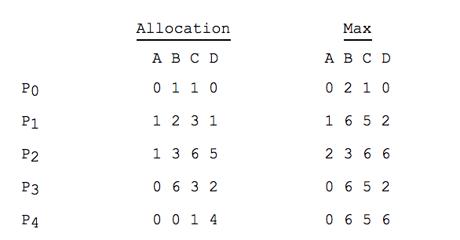
Another Example of Banker’s algorithm (Safety)
Consider the following snapshot of a system:
Using the Banker’s algorithm, determine whether each of the following states is safe or not. If the system is safe, specify one execution sequence in that all the processes may complete. Otherwise, briefly justify why the state is unsafe.
See part (a) and part (b) and the next few slides

Slide 26
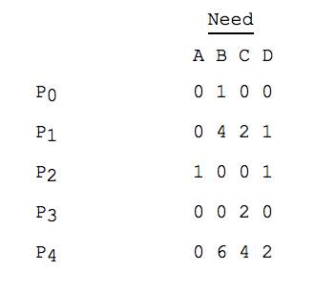
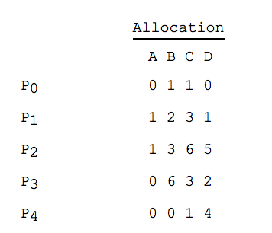
Another Example of Banker’s algorithm (Safety)
(a) Available = (0, 3, 0, 1).
Answer: It is unsafe.
Only P0 can be finished. With available vector (0, 4, 1, 1), which cannot satisfy remaining processes’ needs.

Slide 27
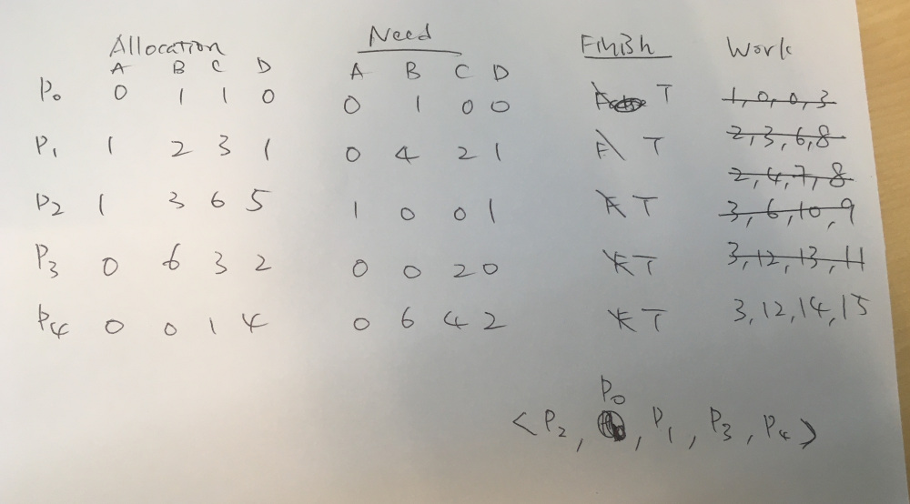
Another Example of Banker’s algorithm (Safety)
(b) Available = (1, 0, 0, 3)
In this example, we pick the smallest index if we have >1 choices
Answer: Yes. The order is P2, P0, P1, P3, P4

Slide 28
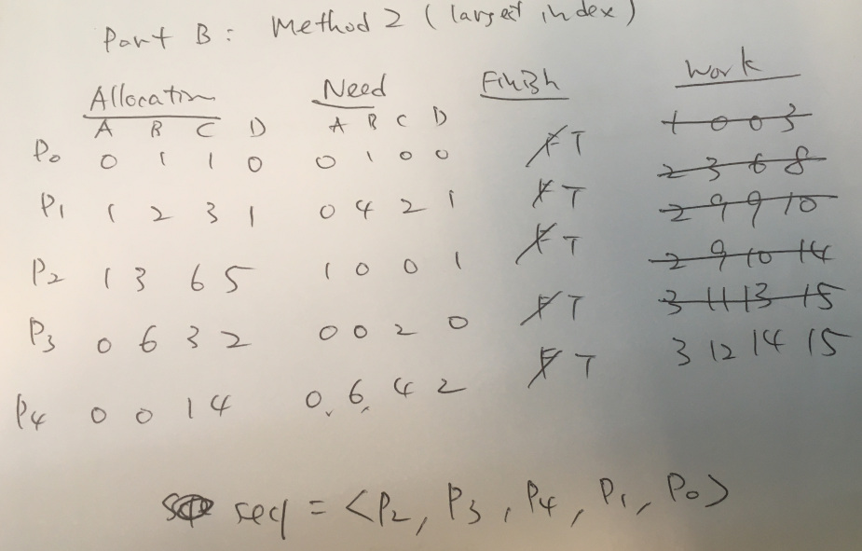
Another Example of Banker’s algorithm (Safety)
(b) Available = (1, 0, 0, 3).
In this example, we pick the largest index if we have >1 choices
Answer: An alternative solution: The order is P2, P3, P4, P1, P0
Banker’s algorithm may have more than one possible solutions.

Slide 29
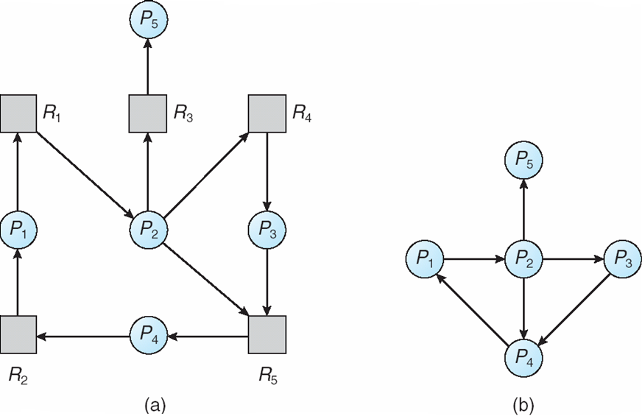
Deadlock Detection
Maintain wait-for graph if each resource has a single instance
Periodically invoke an algorithm that searches for a cycle in the graph. If there is a cycle => a deadlock
Resource-Allocation Graph
Corresponding wait-for graph

Slide 30
Detection Algorithm
Let Work and Finish be vectors of length m and n, respectively Initialize:
Work = Available
For i = 1,2, …, n, if Allocation_{i} ≠ 0, then Finish[i] = false;otherwise, Finish[i] = true.
Find an index i such that both:
(a) Finish[i] == false
(b) Request_{i} ≤ Work
If no such i exists, go to step 4.
Work = Work + Allocation_{i} Finish[i] = true go to step 2.
If Finish[i] == false, for some i, 1 ≤ i ≤ n, then the system is in deadlock state. Moreover, if Finish[i] == false, then P_{i} is deadlocked.
Algorithm requires an order of O(m x n²) operations to detect whether the system is in deadlocked state.
Very similar to banker’s algorithm
Initialization conditions are different, no need to compute the Need matrix…

Slide 31
Detection Algorithm - Example
Five processes: P₀ through P₄;
Three resource types: A (7 instances), B (2 instances), and C (6 instances).
Snapshot at time T₀:
Allocation Request Available
A B C A B C A B C
P₀ 0 1 0 0 0 0 0 0 0
P₁ 2 0 0 2 0 2
P₂ 3 0 3 0 0 0
P₃ 2 1 1 1 0 0
P₄ 0 0 2 0 0 2
Sequence <P₀, P₂, P₃, P₁, P₄> will result in Finish[i] = true for all i.

Slide 32
Detection Algorithm - Example
P₂ requests an additional instance of type C.
Allocation Request Available
A B C A B C A B C
P₀ 0 1 0 0 0 0 0 0 0
P₁ 2 0 0 2 0 2
P₂ 3 0 3 0 0 1
P₃ 2 1 1 1 0 0
P₄ 0 0 2 0 0 2
State of system?
Can reclaim resources held by process P₀, but insufficient resources to fulfill other processes; requests.
Deadlock exists, consisting of processes P₁, P₂, P₃, and P₄.

Slide 33
Contiguous Memory Allocation
Memory Management Part 1

Slide 34
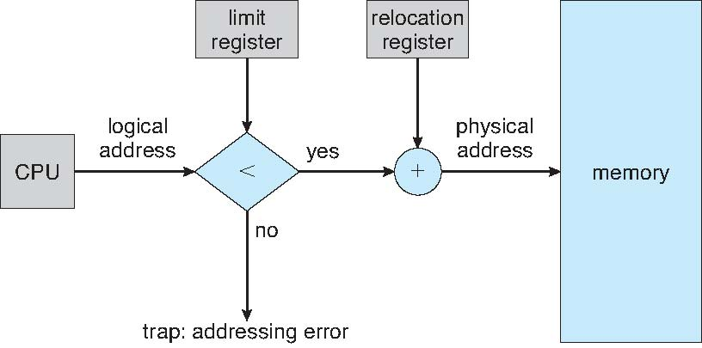
Contiguous Memory Allocation
In a multi-programmed OS, several user processes reside in memory at the same time.
In contiguous memory allocation, each process contained in a single section of memory that is contiguous to the section containing the next process.
Relocation register and limit register are used to protect user processes from each other and from OS
Relocation register contains value of the smallest physical address
Limit register contains range of logical addresses – each logical address must be less than the limit register
MMU maps logical address dynamically

Slide 35
Memory Hole
Hole – block of available memory; holes of various size are scattered throughout memory
Memory
Memory
Memory
Memory
Request
memory
#1 (200KB)
Release
memory #2
#1 (200KB)
Release
memory #4
#1 (200KB)
#2 (100KB)
100KB
100KB
#3 (500KB)
#3 (500KB)
#3 (500KB)
#4 (300KB)
#4 (300KB)
300KB
#5 (200KB)
#5 (200KB)
#5 (200KB)
Hole list:
100 KB
Hole list:
100 KB
300 KB

Slide 36
Dynamic Storage-Allocation Problem
How to satisfy a request of (variable) size n from a list of free holes?
First-fit: Allocate the first hole that is big enough
No need to searching the entire list
Best-fit: Allocate the smallest hole that is big enough
Must search entire list, unless ordered by size
Produces the smallest leftover hole – intended not use it
Worst-fit: Allocate the largest hole
Must also search entire list
Really?
Find the maximum element in a set
Remove the maximum element from a set
Insert a new element into a set
Produces the largest leftover hole – intended to reuse the remaining hole

Slide 37
Example Question
Given five memory partitions of 200 KB, 600 KB, 500 KB, 100 KB, and 400 KB (in order)
How would each of the first-fit, best-fit, and worst-fit algorithms place processes of 150 KB, 350 KB, 450 KB, and 550 KB (in order)?
Which algorithm makes the most efficient use of memory?

Slide 38
First-Fit Example
 | 200KB | 600KB | 500KB | 100KB | 400KB
150KB
350KB
450KB
550KB
√
√
√
wait

Slide 39
Best-Fit Example
 | 200KB | 600KB | 500KB | 100KB | 400KB
150KB
350KB
450KB
550KB
√
√
√
√

Slide 40
Worst-Fit Example
Best-Fit turns out to be the best in this case
 | 200KB | 600KB | 500KB | 100KB | 400KB
150KB
350KB
450KB
550KB
√
√
wait
wait

