Slide 1
COMP3511
Project Introduction: A simplified malloc/free

Slide 2
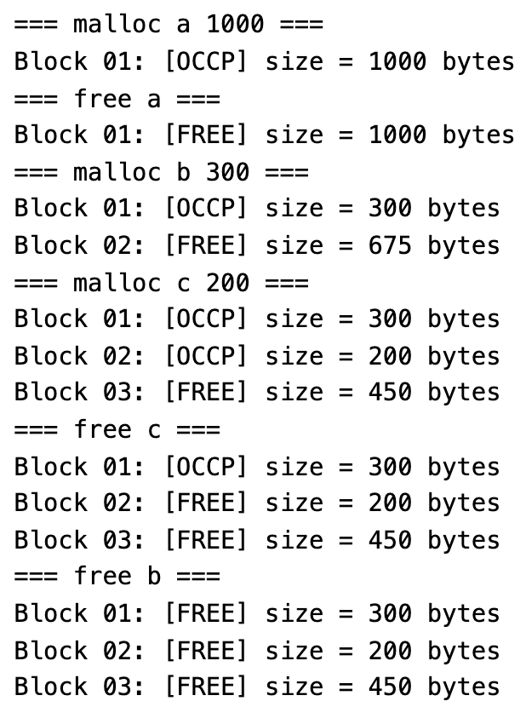
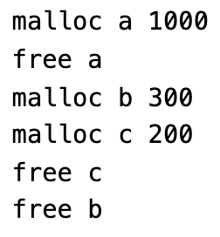
Overview
Implement a system program to simulate a sequence of memory allocation and deallocation
Example:
Sample Input
Sample Output

Slide 3
malloc and free in <stdlib.h>
void *malloc(size_t size);
The malloc function requests a block of memory from the heap
If the request is granted, the operating system will reserve the amount of memory (in bytes)
The function returns the pointer pointing to the start of the memory address
void free(void *ptr);
The free function frees the memory space pointed to by ptr
ptr must point to a previously allocated memory from malloc (or variants of malloc)
If ptr is NULL, no operation is performed.

Slide 4
Project Goal
The aim of this project is to help students understand virtual memory management in an operating system
In other words, we are going to develop our own malloc/free functions
Upon completion of the project, students should be able to write their own simplified memory management functions: mm_malloc and mm_free

Slide 5
Restrictions
Please note that you CANNOT invoke any dynamic memory allocation functions in the C standard library (<stdlib.h>), such as malloc(), calloc(), realloc(), free(),
because these library functions will change the heap implicitly and will affect our own memory management implementation
Zero marks will be given if the above functions are invoked anywhere in your code
For example, the grader can check whether you use malloc() by using regular expression
$> gcc -fpreprocessed -dD -E -P vmm.c | grep -n -E 'malloc[ \t]*\(' | grep -v 'mm_malloc'

Slide 6
Getting Started
A base code (vmm_skeleton.c) is provided
Necessary data structures, variables and several helper functions (e.g. mm_print) are already implemented in the provided base code
We will take a closer look at the base code together in the later slides

Slide 7
The starting point
You only need to complete the following missing parts
void *mm_malloc(size_t size) {
// TODO: Complete mm_malloc here
return NULL;
}
void mm_free(void *p) {
// TODO: Complete mm_free here
}

Slide 8
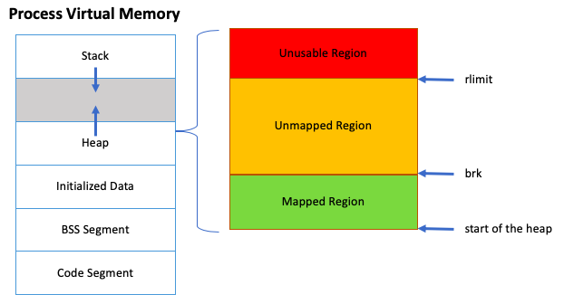
Virtual Memory Address Space
Each process has its own virtual memory address space
In order to build our own memory allocator, we need to understand how different parts of a process (e.g. heap, stack, …) are being mapped in the virtual address space
In PA2, we only focus on the mapped region (i.e. the green region)

Slide 9
Using sbrk()
To get the current break address, you can invoke sbrk(0)
You can use sbrk(size), where size is in bytes, to expand the mapped region
You can use sbrk(size), with a negative size value, to shrink the mapped region
However, it is not necessary in our project assignment

Slide 10
Data Structure Specification
In this assignment, we need to implement a linked list to keep track of the memory allocation
When we allocate a memory block, we need to first allocate the meta data and then fill in the details of the meta data
For each block, we should have
size: the number of bytes for the allocated memory
free:
‘f’ means the block is free, and
‘o’ means the block is occupied
prev: pointer to the previous block
next: pointer to the next block

Slide 11
Data Structure Implementation
The following data structure is given in the base code
Please DON’T make any changes on this data structure
// Data structure of meta_data
struct
__attribute__((__packed__)) // compiler directive, avoid "gcc" padding bytes to struct
meta_data {
size_t size; // 8 bytes (in 64-bit OS)
char free; // 1 byte ('f' or 'o’)
struct meta_data *next; // 8 bytes (in 64-bit OS)
struct meta_data *prev; // 8 bytes (in 64-bit OS)
};
// calculate the meta data size and store as a constant (exactly 25 bytes)
const size_t meta_data_size = sizeof(struct meta_data);

Slide 12
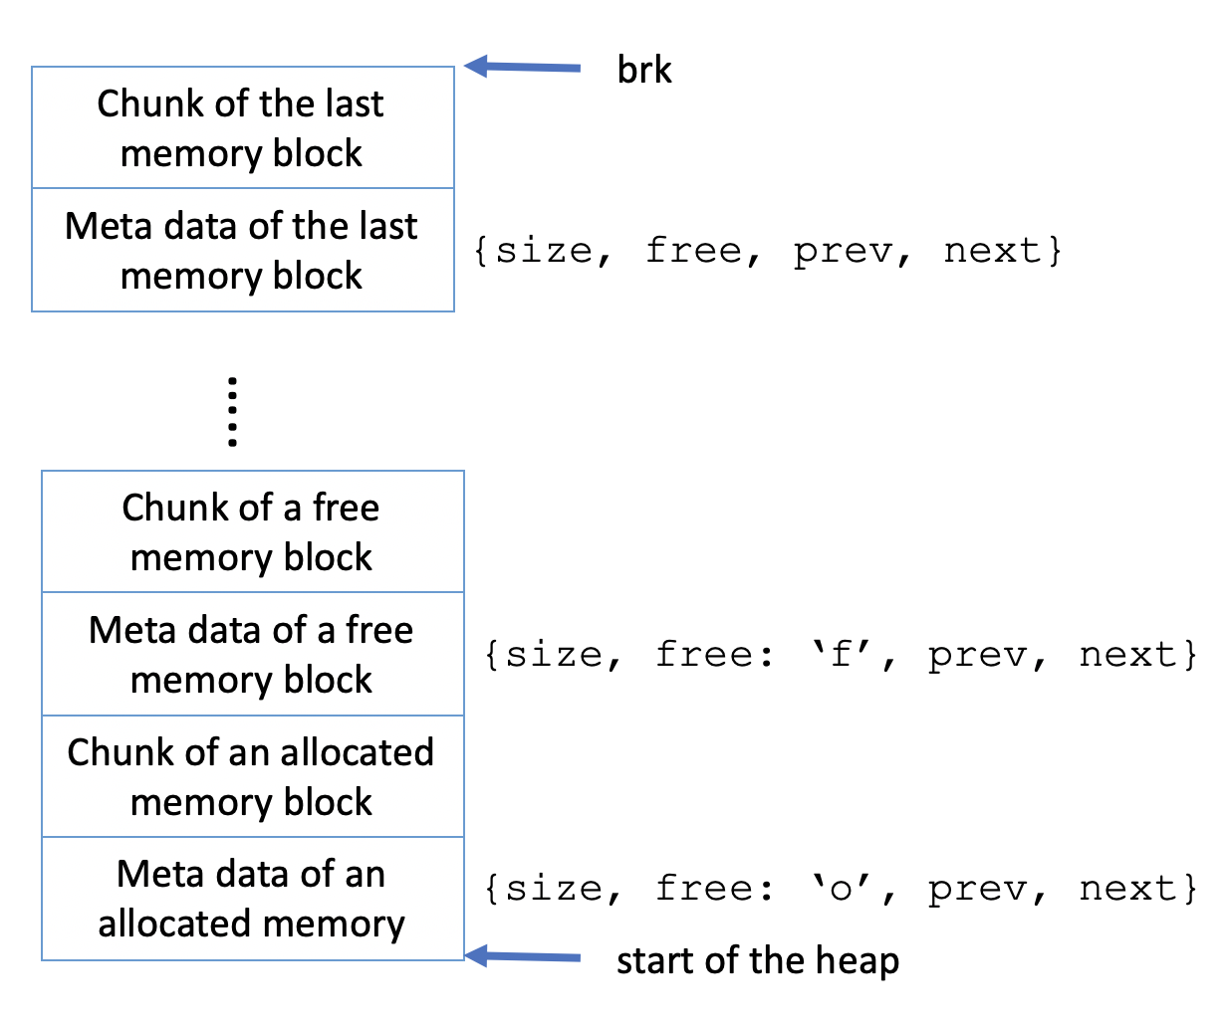
A sample memory layout
This example shows at least 3 memory blocks in the linked list
The meta data block stores the information related to the following allocated memory block
‘f’ means the block is free
‘o’ means the block is occupied

Slide 13
Do we need to implement a linked list?
No, the TA already implemented
A circular doubly-linked list with a dummy head node
Necessary functions to initialize and insert a node to the linked list
Why there is no linked list item deletion?
It is because the delete operation is not required in this project
// Global variables
void *start_heap = NULL; // pointing to the start of the heap, initialize in main()
struct meta_data dummy_head_node; // dummy head node of a doubly linked list
struct meta_data *head = &dummy_head_node;
// The implementation of the following functions are given:
void list_add(struct meta_data *new, struct meta_data *prev, struct meta_data *next);
void list_add_tail(struct meta_data *new, struct meta_data *head);
void init_list(struct meta_data *list);

Slide 14
void *mm_malloc(size_t size);
The input argument, size, is the number of bytes to be allocated from the heap
Please ensure that the returned pointer is pointing to the beginning of the allocated space, not the start address of the meta data block

Slide 15
Algorithm for mm_malloc
In this assignment, we iterate the linked list to find the first-fit free block. We may have the following situations:
If no sufficiently large free block is found
Use sbrk to allocate more space
After that, we fill in the meta data of the new block and then update the linked list
If the first free block is big enough to be split, we split it into 2 blocks:
One block holding the newly allocated memory block
The remaining bytes are assigned to a residual free block.
If the first free block is not big enough to be split,
Occupy the whole free block and don’t split
A few bytes will be wasted (i.e., internal fragmentation)
In this project, we don’t need to handle internal fragmentation

Slide 16
void mm_free(void *p);
Deallocate the input pointer p from the heap
Algorithm:
we iterate the linked list and compare the address of p with the address of the data block
If it matches, we mark the free attribute of struct meta_data from o(OCCP) to f(FREE) and return
To simplify the requirements of this project. We don’t need to release the actual memory back to the operating system (i.e., you don’t need to decrease the current break of the heap

Slide 17
A Step-by-Step Illustration
We use the following test case for a step-by-step illustration
Example:
Sample Input
Sample Output

Slide 18
Step 1: allocate 1000 bytes
Reason: no sufficiently large free block is found
malloc a 1000
Please note that the pointer should point to the allocated memory block (not the meta data block)
Otherwise, we will erase the meta data if we updating the data (e.g. *a = new value)
brk
a
Allocated memory for block 1 (1000 bytes)
Meta Data for block 1 (25 bytes)
free=‘o’ size=1000
heap_start

Slide 19
Step 2: free 1000 bytes
free a
Reason: free an occupied block from the heap
brk
Allocated memory for block 1 (1000 bytes)
Meta Data for block 1 (25 bytes)
free=‘f’ size=1000
heap_start

Slide 20
Step 3: allocate 300 bytes
Reason: first free block is big enough to be split
malloc b 300
brk
Allocated memory for block 2 (675 bytes)
Meta Data for block 2 (25 bytes)
free=‘f’ size=675
b
Allocated memory for block 1 (300 bytes)
Meta Data for block 1 (25 bytes)
free=‘o’ size=300
heap_start

Slide 21
Step 4: allocate 200 bytes
Reason: first free block is big enough to be split
malloc c 200
brk
Allocated memory for block 3 (450 bytes)
Meta Data for block 3 (25 bytes)
free=‘f’ size=450
c
Allocated memory for block 2 (200 bytes)
Meta Data for block 2 (25 bytes)
free=‘o’ size=200
b
Allocated memory for block 1 (300 bytes)
Meta Data for block 1 (25 bytes)
free=‘o’ size=300
heap_start

Slide 22
Step 5: free pointer c
free c
Reason: free an occupied block from the heap
brk
Allocated memory for block 3 (450 bytes)
Meta Data for block 3 (25 bytes)
free=‘f’ size=450
Allocated memory for block 2 (200 bytes)
Meta Data for block 2 (25 bytes)
free=‘f’ size=200
b
Allocated memory for block 1 (300 bytes)
Meta Data for block 1 (25 bytes)
free=‘o’ size=300
heap_start

Slide 23
Step 6: free pointer b
free b
Reason: free an occupied block from the heap
brk
Allocated memory for block 3 (450 bytes)
Meta Data for block 3 (25 bytes)
free=‘f’ size=450
Allocated memory for block 2 (200 bytes)
Meta Data for block 2 (25 bytes)
free=‘f’ size=200
Allocated memory for block 1 (300 bytes)
Meta Data for block 1 (25 bytes)
free=‘f’ size=300
heap_start

Slide 24
What if the first free block is not big enough to split?
After the previous step, we allocate 299 bytes to pointer ’d’
malloc d 299
299 bytes can be fitted in the first free block (300 bytes)
It is not enough to split to 2 blocks. Thus, the whole free block is occupied
brk
brk
Allocated memory for block 3 (450 bytes)
Allocated memory for block 3 (450 bytes)
Meta Data for block 3 (25 bytes)
free=‘f’ size=450
Meta Data for block 3 (25 bytes)
free=‘f’ size=450
Allocated memory for block 2 (200 bytes)
Allocated memory for block 2 (200 bytes)
Meta Data for block 2 (25 bytes)
free=‘f’ size=200
Meta Data for block 2 (25 bytes)
free=‘f’ size=200
Allocated memory for block 1 (300 bytes)
d
Allocated memory for block 1 (300 bytes)
Meta Data for block 1 (25 bytes)
free=‘f’ size=300
Meta Data for block 1 (25 bytes)
free=‘o’ size=300
heap_start
heap_start

Slide 25
Sample test cases
10 pair of test cases are provided
(i.e. inX.txt and outX.txt, where X=1-10)
The grader TA will probably write a grading script to mark the test cases
The helper print function (i.e. mm_print) is given in the base code to avoid text formatting problems
Please use the Linux diff command to compare your output with the sample output
$> diff --side-by-side your-outX.txt sample-outX.txt

Slide 26
Summary
Think carefully before you type ANY line of code
Good C programmers never do trial-and-error
A program that can compile does not mean that it can execute correctly
Check carefully to avoid runtime errors (i.e., Segmentation fault)
Read carefully the provided base code
Make sure you understand how to use the provided linked list related functions

Slide 27
Live Demo
The skeleton code
The sample Linux executable program

