Slide 1
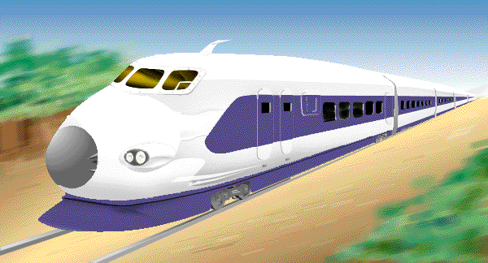
Programming
Dynamic Objects

Slide 2

Memory Management
Static Memory Allocation
  Memory is allocated at compilation time
Dynamic Memory
  Memory is allocated at running time

Slide 3
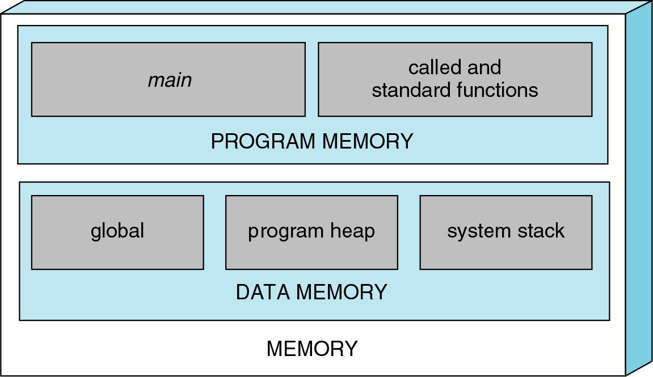
Conceptual View of Memory
(DYNAMIC MEMORY)

Slide 4

Static vs. Dynamic Objects
Static object
  Memory is acquired automatically
  Memory is returned automatically when object goes out of scope
Dynamic object
  Memory is acquired by program with an allocation request
    new operation
  Dynamic objects can exist beyond the function in which they were allocated
  Object memory is returned by a deallocation request
    delete operation

Slide 5
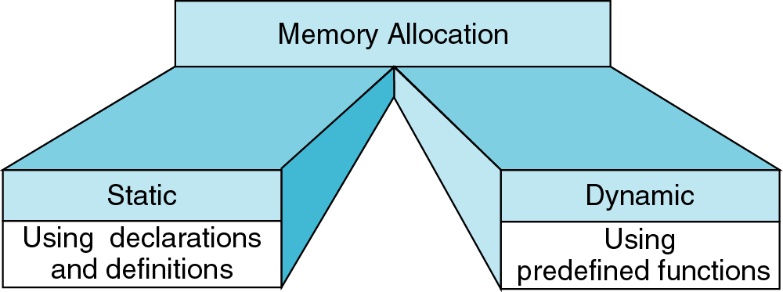
Memory Allocation
new
delete
{
int a[200];
…
}
int* ptr;
ptr = new int[200];
…
delete [] ptr;

Slide 6
Object (variable) creation: New
Syntax
ptr = new SomeType;
  where ptr is a pointer of type SomeType
Example
int* p = new int;
Uninitialized int variable
p

Slide 7
Object (variable) destruction: Delete
Syntax
  delete p;
  storage pointed to by p is returned to free store and p is now undefined
Example
int* p = new int;
*p = 10;
delete p;
p
10

Slide 8

Array of New: dynamic arrays
Syntax
P = new SomeType[Expression];
  Where
    P is a pointer of type SomeType
    Expression is the number of objects to be constructed -- we are making an array
Because of the flexible pointer syntax, P can be considered to be an array

Slide 9
Example
Dynamic Memory Allocation
  Request for “unnamed” memory from the
  Operating System
  int *p, n=10;
  p = new int;
  p = new int[100];
new
p
new
p
new
  p = new int[n];
p

Slide 10
Memory Allocation Example
Need an array of unknown size
main()
{
cout << “How many students? “;
cin >> n;
int *grades = new int[n];
for(int i=0; i < n; i++){
int mark;
cout << “Input Grade for Student” << (i+1) << “ ? :”;
cin >> mark;
grades[i] = mark;
}
. . .
printMean( grades, n ); // call a function with dynamic array
. . .
}

Slide 11
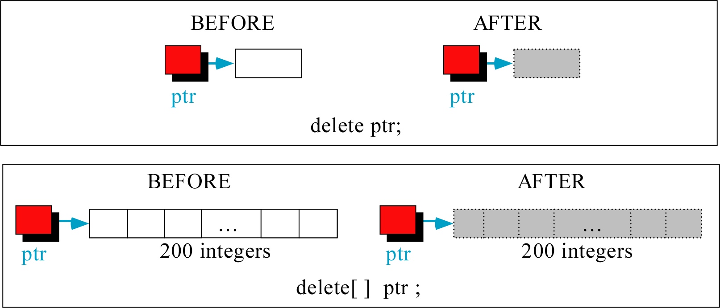
Freeing (or deleting) Memory

Slide 12
A Simple Dynamic List Example
cout << "Enter list size: ";
int n;
cin >> n;
int *A = new int[n];
if(n<=0){
cout << "bad size" << endl;
return 0;
}
initialize(A, n, 0);
print(A, n);
A = addElement(A,n,5);
print(A, n);
A = deleteFirst(A,n);
print(A, n);
selectionSort(A, n);
print(A, n);
delete [] A;

Slide 13
Initialize
void initialize(int list[], int size, int value){
for(int i=0; i<size; i++)
list[i] = value;
}

Slide 14
print()
  void print(int list[], int size) {
  cout << "[ ";
  for(int i=0; i<size; i++)
  cout << list[i] << " ";
  cout << "]" << endl;
  }

Slide 15
Delete the first element
// for deleting the first element of the array
int* deleteFirst(int list[], int& size){
if(size <= 1){
if(size==1) delete [] list;
size = 0;
return NULL;
}
int* newList = new int [size-1]; // make new array
if(newList==0){
cout << "Memory allocation error for deleteFirst!" << endl;
exit(0);
}
for(int i=0; i<size-1; i++) // copy and delete old array
newList[i] = list[i+1];
delete [] list;
size--;
return newList;
}

Slide 16
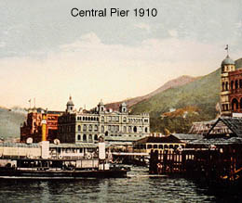
Adding Elements
// for adding a new element to end of array
int* addElement(int list[], int& size, int value){
int* newList = new int [size+1]; // make new array
if(newList==0){
cout << "Memory allocation error for addElement!" << endl;
exit(0);
}
for(int i=0; i<size; i++)
newList[i] = list[i];
if(size) delete [] list;
newList[size] = value;
size++;
return newList;
}

Slide 17
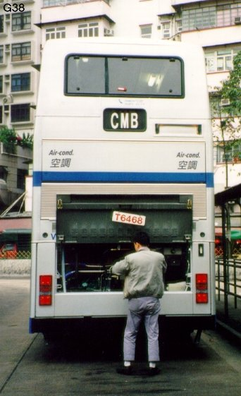
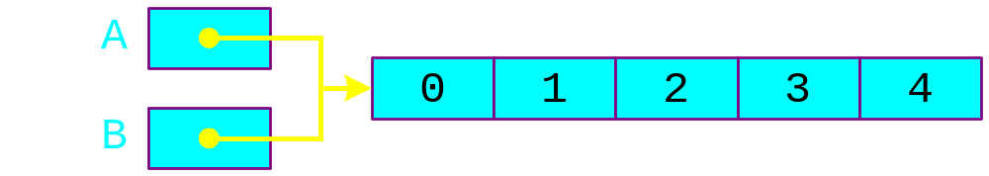
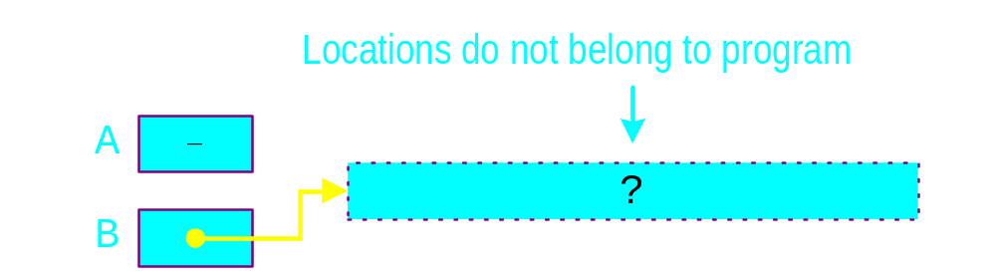
Dangling Pointer Problem
  int *A = new int[5];
  for(int i=0; i<5; i++)
  A[i] = i;
  int *B = A;
  delete [] A;
  B[0] = 1; // illegal!

Slide 18

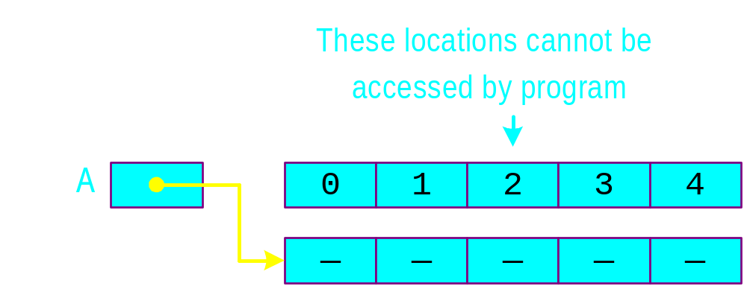
Memory Leak Problem
  int *A = new int [5];
  for(int i=0; i<5; i++)
  A[i] = i;
  A = new int [5];
1
2
3
A
0
2
4

Slide 19
A Dynamic 2D Array
A dynamic array is an array of pointers to save space when not all rows of the array are full.
int **table;
table
32
18
12
24
table[0]
table[1]
table[2]
table[3]
table[4]
table[5]
13
11
16
12
42
19
14
22
13
13
14
11
18
table = new int*[6];
…
table[0] = new int[4];
table[1] = new int[7];
table[2] = new int[1];
table[3] = new int[3];
table[4] = new int[2];
table[5] = NULL;

Slide 20

Memory Allocation
int **table;
table = new int*[6];
table[0]= new int[3];
table[1]= new int[1];
table[2]= new int[5];
table[3]= new int[10];
table[4]= new int[2];
table[5]= new int[6];
table[0][0] = 1; table[0][1] = 2; table[0][2] = 3;
table[1][0] = 4;
table[2][0] = 5; table[2][1] = 6; table[2][2] = 7; table[2][3] = 8; table[2][4] = 9;
table[4][0] = 10; table[4][1] = 11;
cout << table[2][4] << endl;

Slide 21

Memory Deallocation
Each row must be deleted individually
Be careful to delete each row before deleting the table pointer.
  for(int i=0; i<6; i++)
  delete [ ] table[i];
  delete [ ] table;

Slide 22
Create a matrix of any dimensions, m by n:
Put it into a function:
int m, n;
cin >> m >> n;
int** mat;
mat = new int*[m];
for (int i=0;i<m;i++)
mat[i] = new int[n];
int m, n;
cin >> m >> n;
int** mat;
mat = imatrix(m,n);
…
int** imatrix(nr, nc) {
int** m;
m = new int*[nr];
for (int i=0;i<nr;i++)
m[i] = new int[nc];
return m;
}

