Slide 1

Programming
Functions

Slide 2
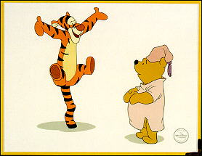
Introduction to Functions
A complex problem is often easier to solve by dividing it into several smaller parts, each of which can be solved by itself.
This is called top-down programming.
These parts are called functions in C++ (also sometimes called subprograms).
main() then executes these functions so that the original problem is solved.

Slide 3

Advantages of Functions
Functions separate the concept (what is done) from the implementation (how it is done).
Functions make programs easier to understand.
Functions make programs easier to modify.
Functions can be called several times in the same program, allowing the code to be reused.

Slide 4

Function Input and Output
Function
Result
Parameters

Slide 5

C++ Functions
C++ allows the use of both internal (user-defined) and external functions.
External functions (e.g., cin, cout, rand, etc.) are usually grouped into specialized libraries (e.g., iostream, cstdlib, cmath, etc.)

Slide 6
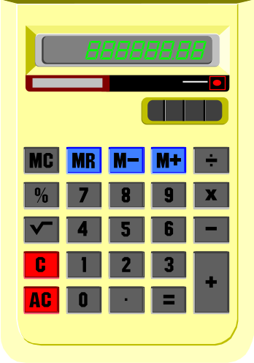
Mathematical Functions
#include <cmath>
double log(double x) natural logarithm
double log10(double x) base 10 logarithm
double exp(double x) e to the power x
double pow(double x, double y) x to the power y
double sqrt(double x) positive square root of x
double ceil(double x) smallest integer not less than x
double floor(double x) largest integer not greater than x
double sin(double x), cos(double x), tan(double x), etc...

Slide 7
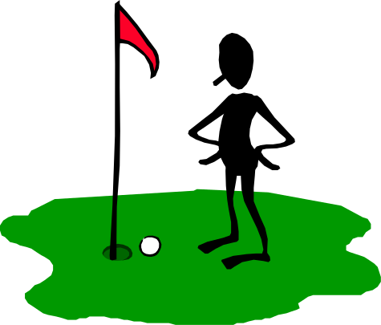
Distance Between Two Points
// Compute distance between two points
#include <iostream>
#include <cmath> // contains sqrt()
using namespace std;
int main(){
double x1, y1, x2, y2; // coordinates for point 1 & 2
double dist; // distance between points
cout << "Enter x & y coordinates of the 1st point: ";
cin >> x1 >> y1;
cout << "Enter x & y coordinates of the 2nd point: ";
cin >> x2 >> y2;
// Compute the distance between points 1 & 2
dist = sqrt((x2-x1)*(x2-x1) + (y2-y1)*(y2-y1));
cout << "The distance is " << dist << endl;
return 0;
}

Slide 8
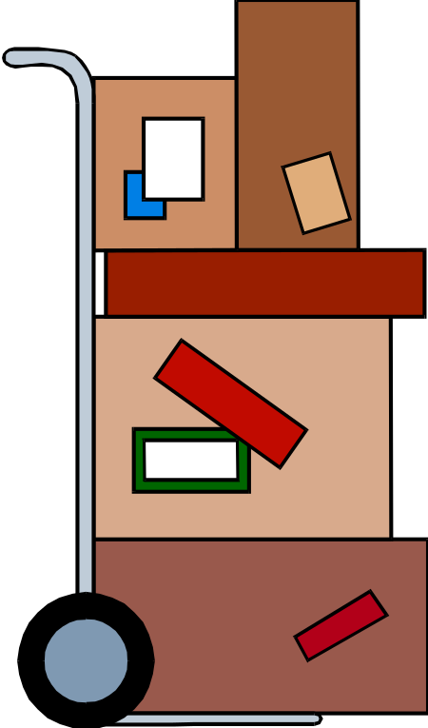
Functions in a Program
C++ programs usually have the following form:
  // include statements
  // function prototypes
  // main() function
  // user-defined functions

Slide 9

Function Prototype
The function prototype declares the interface, or input and output parameters of the function, leaving the implementation for the function definition.
The function prototype has the following syntax:
  <type> <function name>(<type list>);
Example: A function that prints the card (J) given the card number (11) as input:
  void printcard(int);
  (This is a void function - a function that does not return a value)

Slide 10

Function Definition
The function definition can be placed anywhere in the program after the function prototypes.
You can place a function definition in front of main(). In this case there is no need to provide a function prototype for the function, since the function is already defined before its use.
A function definition has following syntax:
<type> <function name>(<parameter list>){
<local declarations>
<sequence of statements>
}

Slide 11



Function Call
A function call has the following syntax:
<function name>(<parameter list>)
  There is a one-to-one correspondence between the parameters in a function call and the parameters in the function definition.

Slide 12

Printing Cards
The main() program which calls printcard()
  #include <iostream>
  using namespace std;
  void printcard(int); // function prototype
  int main(){
  int c1, c2, c3, c4, c5;
  // pick cards
  . . .
  // print cards
  printcard(c1);
  printcard(c2);
  printcard(c3);
  printcard(c4);
  printcard(c5);
  // find score
  // print score
  }

Slide 13
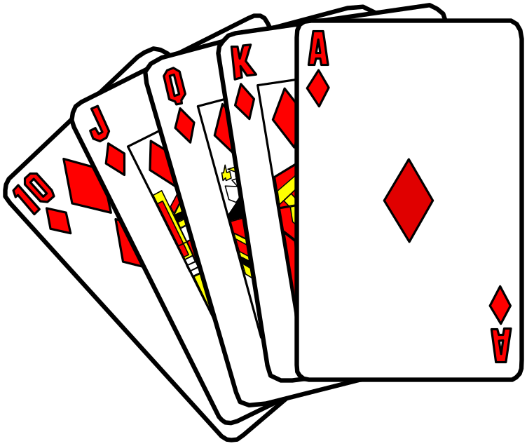
Printing Cards
A function that prints the card (J) given the card number (11) as input:
  void printcard(int cardnum){
  if(cardnum==1)
  cout << "A";
  else if(cardnum>=2 && cardnum<=10)
  cout << cardnum;
  else if(cardnum==11)
  cout << "J";
  else if(cardnum==12)
  cout << "Q";
  else if(cardnum==13)
  cout << "K";
  }

Slide 14
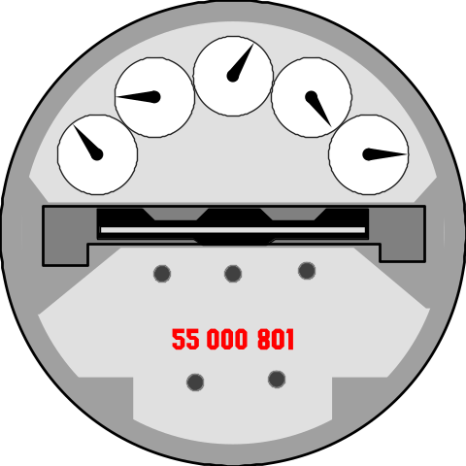
Absolute Value
#include <iostream>
using namespace std;
int absolute(int); // function prototype for absolute()
int main(){
int x, y, diff;
cout << "Enter two integers (separated by a blank): ";
cin >> x >> y;
diff = absolute( x - y);
cout << "The absolute difference between " << x
<< " and " << y << " is: " << diff << endl;
return 0;
}
// Define a function to take absolute value of an integer
int absolute(int x){
if (x >= 0) return x;
else return -x;
}

Slide 15
Absolute Value (alternative)
Note that it is possible to omit the function prototype if the function is placed before it is called.
#include <iostream>
using namespace std;
int absolute(int x){
if (x >= 0) return x;
else return -x;
}
int main(){
int x, y, diff;
cout << "Enter two integers (separated by a blank): ";
cin >> x >> y;
diff = absolute( x - y);
cout << "The absolute difference between " << x
<< " and " << y << " is: " << diff << endl;
return 0;
}

Slide 16

Adding Numbers
Consider the following function:
int add(int a, int b){
int result = a+b;
return result;
}
We might call the function using the syntax:
int main(){
int sum;
sum = add(5, 3);
return 0;
}
This would result in variable sum being assigned the value 8.

Slide 17
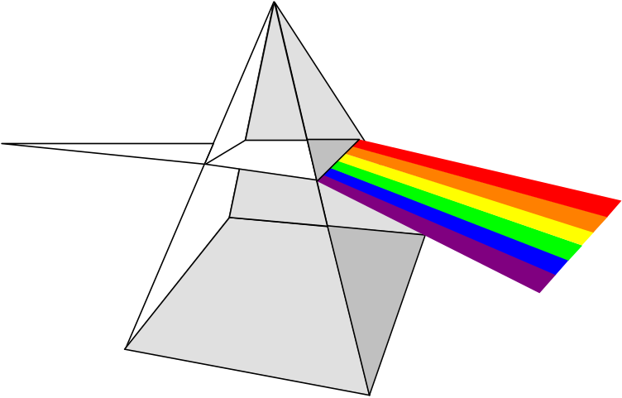
Three-Point Distance
#include <iostream>
#include <cmath>
using namespace std;
double dist(double, double, double, double);
int main(){
double x1, y1, // coordinates for point 1
x2, y2, // coordinates for point 2
x3, y3; // coordinates for point 3
cout << "Enter x & y coordinates of the 1st point: ";
cin >> x1 >> y1;
cout << "Enter x & y coordinates of the 2nd point: ";
cin >> x2 >> y2;
cout << "Enter x & y coordinates of the 3rd point: ";
cin >> x3 >> y3;

Slide 18

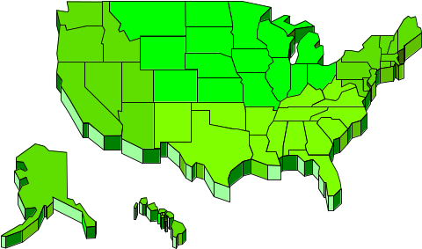
Three-Point Distance
cout <<"The distance from point 1 to 2 is: "
<< dist(x1,y1,x2,y2) << endl;
cout <<"The distance from point 2 to 3 is: "
<< dist(x2,y2,x3,y3) << endl;
cout <<"The distance from point 1 to 3 is: "
<< dist(x1,y1,x3,y3) << endl;
return 0;
}
// Function for computing the distance between 2 pts
double dist(double x1, double y1, double x2, double y2) {
double dist;
dist = sqrt( (x2-x1)*(x2-x1) + (y2-y1)*(y2-y1) );
return dist;
}

