Slide 1
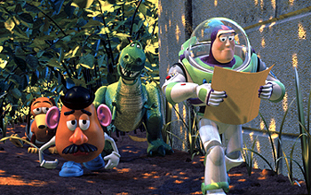
Programming
if Statements

Slide 2

Three Program Structures
Sequence - executable statements which the computer processes in the given order
Choice - sequence(s) selected depending on some condition
  if <condition exists>{
    <do P>
  }
Iteration - repetitively executed sequences
  while <condition exists>{
    <do P>
  }

Slide 3

Sequence
It is natural to write a program as a sequence of program structures such as sequences, choices, and iterations
Program
Structure 1
Program
Structure 2
Program
Structure 3

Slide 4

Choice Constructs
Provide
  Ability to control whether a statement list is executed
Two constructs
  if statement
    if
    if-else
    if-else-if
  switch statement

Slide 5

The Basic if Statement
Syntax
if(Expression)
Action
Example: absolute value
if(value < 0)
value = -value;
Expression
true
false
Action

Slide 6
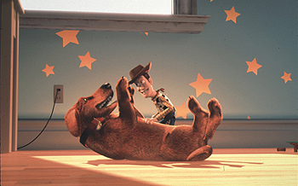
Absolute Value
// program to read number & print its absolute value
#include <iostream>
using namespace std;
int main(){
int value;
cout << "Enter integer: ";
cin >> value;
if(value < 0)
value = -value;
cout << "The absolute value is " << value << endl;
return 0;
}

Slide 7
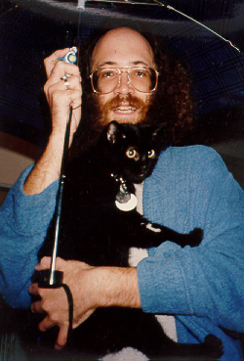

Choice (if)
Put multiple action statements within braces
  if <it's raining>{
    <take umbrella>
    <wear raincoat>
  }

Slide 8

Sorting Two Numbers
int value1;
int value2;
int temp;
cout << "Enter two integers: ";
cin >> value1 >> value2;
if(value1 > value2){
temp = value1;
value1 = value2;
value2 = temp;
}
cout << "The input in sorted order: "
<< value1 << " " << value2 << endl;

Slide 9


Relational Operators
Relational operators are used to compare two values
Math C++ Plain English
= == equals [example: if(a==b) ]
[ (a=b) means put the value of b into a ]
< < less than
≤ <= less than or equal to
> > greater than
≥ >= greater than or equal to
≠ != not equal to

Slide 10
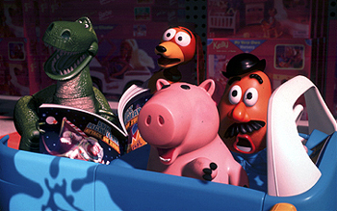
Relational Expressions
Examples:
numberOfStudents < 200
20 * j == 10 + i

Slide 11

Operator Precedence
Which comes first?
* / %
+ -
< <= >= >
== !=
=
Answer:

Slide 12

The if-else Statement
Syntax of if-else
if <it's sunny>{
    <walk cat>
  }
  else{
    <take cat with umbrella>
  }
Example
if(v == 0)
cout << "v is 0";
else
cout << "v is not 0";
Expression
true
false
Action₁
Action₂

Slide 13

Finding the Bigger One
int value1;
int value2;
int larger;
cout << "Enter two integers: ";
cin >> value1 >> value2;
if(value1 > value2)
larger = value1;
else
larger = value2;
cout << "Larger of inputs is: " << larger << endl;

Slide 14


Selection
Often we want to perform a particular action depending on the value of an expression
Two ways to do this
  if-else-if statement
    if-else statements “glued” together
  switch statement
    An advanced construct

Slide 15




if-else-if Statements
  if <Mon, Wed, or Fri AM>{
  <goto COMP104>
  }
  else if <Tues, Thurs AM>{
  <goto MATH>
  }
  else if <1PM or 7PM>{
  <eat>
  }
  else{
  <sleep>
  }
Top10

Slide 16


if-else-if Statement
Example
if(score >= 90)
cout << "Grade = A" << endl;
else if(score >= 80)
cout << "Grade = B" << endl;
else if(score >= 70)
cout << "Grade = C" << endl;
else if(score >= 60)
cout << "Grade = D" << endl;
else
cout << "Grade = F" << endl;

Slide 17
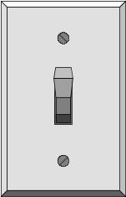



switch Statement
switch(int(score)/10){
case 10:
case 9: cout << "Grade = A" << endl;
break;
case 8: cout << "Grade = B" << endl;
break;
case 7: cout << "Grade = C" << endl;
break;
case 6: cout << "Grade = D" << endl;
break;
default: cout << "Grade = F" << endl;
}

Slide 18





int left;
int right;
char oper;
cout << "Enter simple expression: ";
cin >> left >> oper >> right;
cout << left << " " << oper << " " << right
<< " = ";
switch (oper) {
case '+' : cout << left + right << endl; break;
case '-' : cout << left - right << endl; break;
case '*' : cout << left * right << endl; break;
case '/' : cout << left / right << endl; break;
default: cout << "Illegal operation" << endl;
}

Slide 19



A Boolean Type
C++ contains a type named bool which can have one of two values
  true (corresponds to non-zero value)
  false (corresponds to zero value)
Boolean operators can be used to form more complex conditional expressions
  The and operator is &&
  The or operator is ||
  The not operator is !
Warning
  & and | are also operators

Slide 20

A Boolean Type
Example logical expressions
bool P = true;
bool Q = false;
bool R = true;
bool S = P && Q;
bool T = !Q || R;
bool U = !(R && !Q);

Slide 21

More Operator Precedence
Precedence of operators (from highest to lowest)
  Parentheses ( … )
  Unary operators !
  Multiplicative operators * / %
  Additive operators + -
  Relational ordering < <= >= >
  Relational equality == !=
  Logical and &&
  Logical or ||
  Assignment =

Slide 22


More Operator Precedence
Examples
5 != 6 || 7 <= 3
(5 !=6) || (7 <= 3)
5 * 15 + 4 == 13 && 12 < 19 || !false == 5 < 24

Slide 23



Nested if Statements
  Nested means that one complete statement is inside another
  Example:
  if <it is Monday>{
    if <it is time for class>{
    <go to COMP104>
    }
    <call your friends>
  }
Top10

Slide 24

“Dangling Else” Problem
Problem: Nested if statements can seem ambiguous in their meaning.
What is the value of c after the following is executed?
  int a=-1, b=1, c=1;
  if(a>0)
  if(b>0)
  c = 2;
  else
  c = 3;

Slide 25
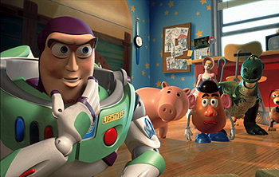
“Dangling Else” Problem
C++ groups a dangling else with the most recent if.
The following indentation shows how C++ would group this example (answer: c=1).
  int a=-1, b=1, c=1;
  if(a>0)
  if(b>0)
  c = 2;
  else // dangling else grouped to nearest if
  c = 3;

Slide 26

“Dangling Else” Problem
Use extra brackets { } to clarify the intended meaning, even if not necessary.
  int a=-1, b=1, c=1;
  if(a>0){
  if(b>0)
  c = 2;
  else // parenthesis avoid dangling else
  c = 3;
  }

