Slide 1

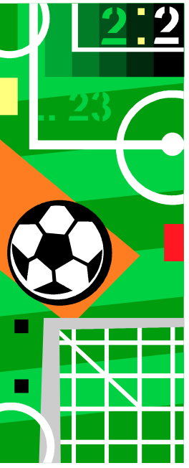

Programming
Pass by Value

Slide 2


Passing Parameters by Value
A function returns a single result (assuming the function is not a void function)
One of the statements in the function body should have the form:
return <expression>;
The value passed back by return should have the same type as the function.

Slide 3

Pass by Value
An important fact to remember about parameter passing by value is that changes to the parameters inside the function body have no effect
outside of the
function.

Slide 4

Pass by Value: Example 0
For example, consider the following code:
int sum(int a, int b){
a = a + b;
return a;
}
void main(){
int x, y, z;
x = 3; y = 5;
z = sum(x,y);
}
What is the value of x, y, and z at the end of the main() program?

Slide 5

Pass by Value: Example 0
The answer: 3, 5, and 8.
Even though the value of parameter a is changed, the corresponding value in variable x does not change.
This is why this is called pass by value.
The value of the original variable is copied to the parameter, but changes to the value of the parameter do not affect the original variable.
In fact, all information in local variables declared within the function will be lost when the function terminates.
The only information saved from a pass by value function is in the return statement.

Slide 6

Pass by Value: Example 1
An example to show how the function does not affect a variable which is used as a parameter:
// Test the effect of a function
// on its parameter
#include <iostream>
using namespace std;
void Increment(int Number) {
Number = Number + 1;
cout << "The parameter Number is: "
<< Number << endl;
}

Slide 7
Pass by Value: Example 1
void main() {
int I = 10;
//parameter is a variable
Increment(I);
cout << "The variable I is: "
<< I << endl;
//parameter is a constant
Increment(35);
cout << "The variable I is: "
<< I << endl;
//parameter is an expression
Increment(I+26);
cout << "The variable I is: "
<< I << endl;
}

Slide 8
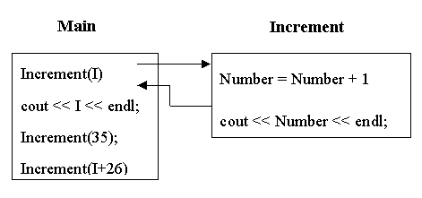

Pass by Value: Example 1

Slide 9

Pass by Value: Example 2
// Print the sum and average of two numbers
// Input: two numbers x & y
// Output: sum - the sum of x & y
// average - the average of x & y
#include <iostream>
using namespace std;
void PrintSumAve ( double, double );
void main ( ) {
double x, y;
cout << "Enter two numbers: ";
cin >> x >> y;
PrintSumAve ( x , y );
}

Slide 10
Pass by Value: Example 2
void PrintSumAve (double no1, double no2) {
double sum, average;
sum = no1 + no2;
average = sum / 2;
cout << "The sum is " << sum << endl;
cout << "The average is " << average << endl;
}

Slide 11
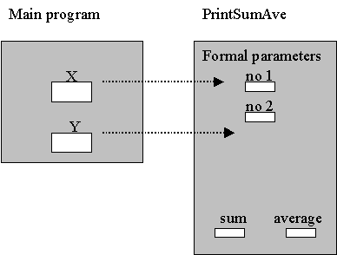

Pass by Value: Example 2
Data areas after call to PrintSumAve() :

Slide 12
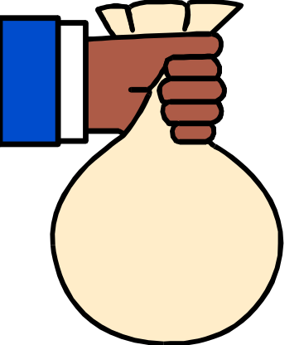
Pass by Value: Example 3
//Compute new balance at a certain interest rate
//Inputs: A positive balance and
// a positive interest rate
//Output: The new balance after interest was posted
#include <iostream>
using namespace std;
double new_balance(double balance, double rate);
/*
Returns the balance in a bank account after adding
interest. For example, if rate is 5.0, then the
interest rate is 5% and so new_balance(100, 5.0)
returns 105.00.
*/

Slide 13

Pass by Value: Example 3
int main(){
double interest, balance;
cout << "Enter balance (positive number): ";
cin >> balance;
if (balance <= 0.0)
cout <<"Balance not positive; stopping" << endl;
else {
cout <<"Enter interest rate (positive number): ";
cin >> interest;
if (interest <= 0.0)
cout << "Interest not positive; stopping" << endl;
else
cout <<"New balance = $"
<< new_balance(balance, interest)<< endl;
}
return 0;
}

Slide 14

Pass by Value: Example 3
// New balance is computed as balance + balance * %rate
double new_balance(double balance, double rate) {
double interest_fraction, interest;
interest_fraction = rate / 100;
interest = interest_fraction * balance;
return (balance + interest);
}
/* New balance is computed as balance * (1 + %rate)
double new_balance(double balance, double rate) {
double interest_fraction, updated_balance;
interest_fraction = rate / 100;
updated_balance = balance * (1 + interest_fraction);
return updated_balance;
} */

Slide 15

Pass by Value: Example 4
// Input: inches
// Output: feet and inches
#include <iostream>
using namespace std;
// Function prototypes
int feet(int);
int rinches(int);

Slide 16
Pass by Value: Example 4
void main() {
int inches; // Number of inches
cout << "Enter number of inches to convert: ";
cin >> inches;
cout << "Result is " << feet(inches) << " feet "
<< rinches(inches) << " inches"
<< endl;
}
int feet(int inches) {
return inches / 12;
}
int rinches(int inches) {
return inches % 12;
}

Slide 17

Pass by Value: Example 5
// File i2f.h
int feet(int);
int rinches(int);
// File i2f.cpp
// Functions for Converting inches to feet
int feet(int inches) {
return inches / 12;
}
int rinches(int inches) {
return inches % 12;
}

Slide 18
Pass by Value: Example 5
// File main.cpp
// Input inches
// Output feet and inches
#include <iostream>
using namespace std;
#include "i2f.h"
void main() {
int inches; // Number of inches
cout << "Enter number of inches to convert: ";
cin >> inches;
cout << "Result is " << feet(inches) << " feet "
<< rinches(inches) << " inches"
<< endl;
}

