Slide 1
Lecture 8: Event-Driven Programming (Chapter 16)
Adapted by Fangzhen Lin for COMP3021 from Y. Danial Liang’s PowerPoints for Introduction to Java Programming, Comprehensive Version, 9/E, Pearson, 2013.

Slide 2
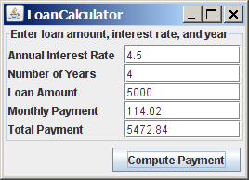
Motivations
Suppose you wish to write a GUI program that lets the user enter the loan amount, annual interest rate, and number of years, and click the Compute Loan button to obtain the monthly payment and total payment. How do you accomplish the task? You have to use event-driven programming to write the code to respond to the button-clicking event.
LoanCalculator

Slide 3
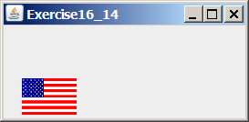
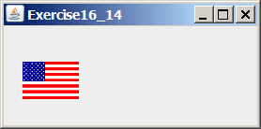
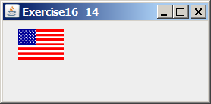
Motivations
Suppose you wish to write a program that animates a rising flag, as shown in Figure 16.1(b-d). How do you accomplish the task? There are several solutions to this problem. An effective way to solve it is to use a timer in event-driven programming, which is the subject of this lecture.

Slide 4
Objectives
To get a taste of event-driven programming (§16.1).
To describe events, event sources, and event classes (§16.2).
To define listener classes, register listener objects with the source object, and write the code to handle events (§16.3).
To define listener classes using inner classes (§16.4).
To define listener classes using anonymous inner classes (§16.5).
To explore various coding styles for creating and registering listener classes (§16.6).
To develop a GUI application for a loan calculator (§16.7).
To write programs to deal with MouseEvents (§16.8).
To simplify coding for listener classes using listener interface adapters (§16.9).
To write programs to deal with KeyEvents (§16.10).
To use the javax.swing.Timer class to control animations (§16.11).

Slide 5
Procedural vs. Event-Driven Programming
Procedural programming is executed in procedural order.
In event-driven programming, code is executed upon activation of events.

Slide 6
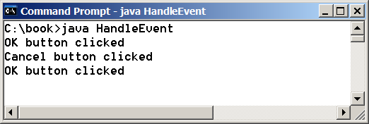
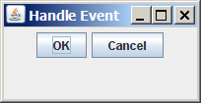
Taste of Event-Driven Programming
The example displays a button in the frame. A message is displayed on the console when a button is clicked.
HandleEvent

Slide 7
Handling GUI Events
Source object (e.g., button)
Listener object contains a method for processing the event.

Slide 8
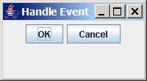
Trace Execution
animation
public class HandleEvent extends JFrame {
public HandleEvent() {
…
OKListenerClass listener1 = new OKListenerClass();
jbtOK.addActionListener(listener1);
…
}
public static void main(String[] args) {
…
}
}
class OKListenerClass implements ActionListener {
public void actionPerformed(ActionEvent e) {
System.out.println("OK button clicked");
}
}
1. Start from the main method to create a window and display it

Slide 9
Trace Execution
animation
public class HandleEvent extends JFrame {
public HandleEvent() {
…
OKListenerClass listener1 = new OKListenerClass();
jbtOK.addActionListener(listener1);
…
}
public static void main(String[] args) {
…
}
}
class OKListenerClass implements ActionListener {
public void actionPerformed(ActionEvent e) {
System.out.println("OK button clicked");
}
}
2. Click OK

Slide 10
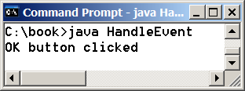
Trace Execution
animation
public class HandleEvent extends JFrame {
public HandleEvent() {
…
OKListenerClass listener1 = new OKListenerClass();
jbtOK.addActionListener(listener1);
…
}
public static void main(String[] args) {
…
}
}
class OKListenerClass implements ActionListener {
public void actionPerformed(ActionEvent e) {
System.out.println("OK button clicked");
}
}
3. Click OK. The JVM invokes the listener’s actionPerformed method

Slide 11
Events
An event can be defined as a type of signal to the program that something has happened.
The event is generated by external user actions such as mouse movements, mouse clicks, and keystrokes, or by the operating system, such as a timer.

Slide 12
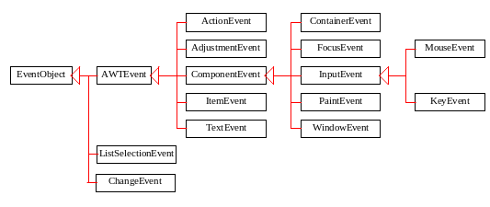
Event Classes

Slide 13
Event Information
An event object contains whatever properties are pertinent to the event. You can identify the source object of the event using the getSource() instance method in the EventObject class. The subclasses of EventObject deal with special types of events, such as button actions, window events, component events, mouse movements, and keystrokes. Next slide lists external user actions, source objects, and event types generated.

Slide 14
Selected User Actions
Source Event Type
User Action Object Generated
Click a button JButton ActionEvent
Click a check box JCheckBox ItemEvent, ActionEvent
Click a radio button JRadioButton ItemEvent, ActionEvent
Press return on a text field JTextField ActionEvent
Select a new item JComboBox ItemEvent, ActionEvent
Window opened, closed, etc. Window WindowEvent
Mouse pressed, released, etc. Component MouseEvent
Key released, pressed, etc. Component KeyEvent

Slide 15
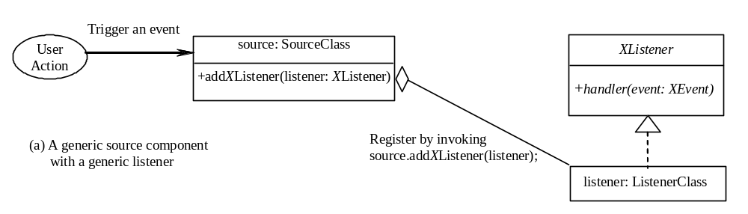
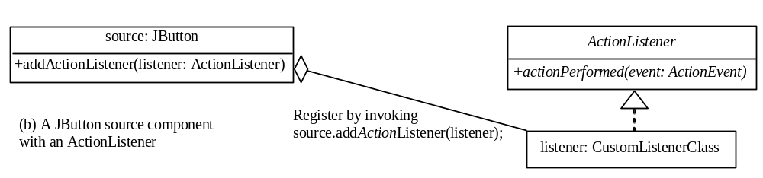
The Delegation Model

Slide 16
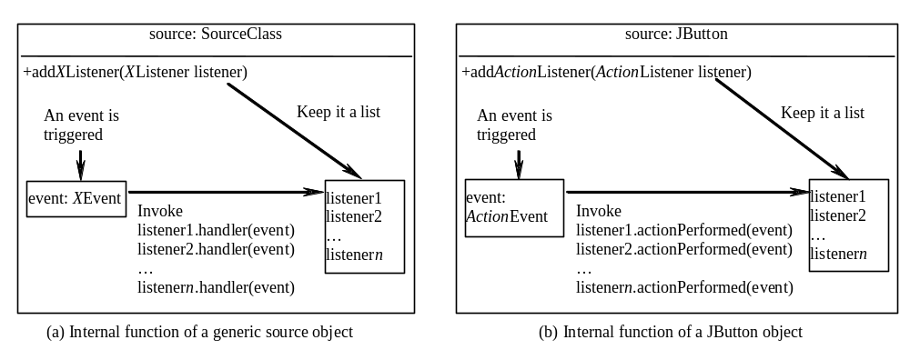
Internal Function of a Source Component

Slide 17
The Delegation Model: Example
JButton jbt = new JButton("OK");
ActionListener listener = new OKListener();
jbt.addActionListener(listener);

Slide 18
Selected Event Handlers
Event Class Listener Interface Listener Methods (Handlers)
ActionEvent ActionListener actionPerformed(ActionEvent)
ItemEvent ItemListener itemStateChanged(ItemEvent)
WindowEvent WindowListener windowClosing(WindowEvent)
windowOpened(WindowEvent)
windowIconified(WindowEvent)
windowDeiconified(WindowEvent)
windowClosed(WindowEvent)
windowActivated(WindowEvent)
windowDeactivated(WindowEvent)
ContainerEvent ContainerListener componentAdded(ContainerEvent)
componentRemoved(ContainerEvent)
MouseEvent MouseListener mousePressed(MouseEvent)
mouseReleased(MouseEvent)
mouseClicked(MouseEvent)
mouseExited(MouseEvent)
mouseEntered(MouseEvent)
KeyEvent KeyListener keyPressed(KeyEvent)
keyReleased(KeyEvent)
keyTypeed(KeyEvent)

Slide 19
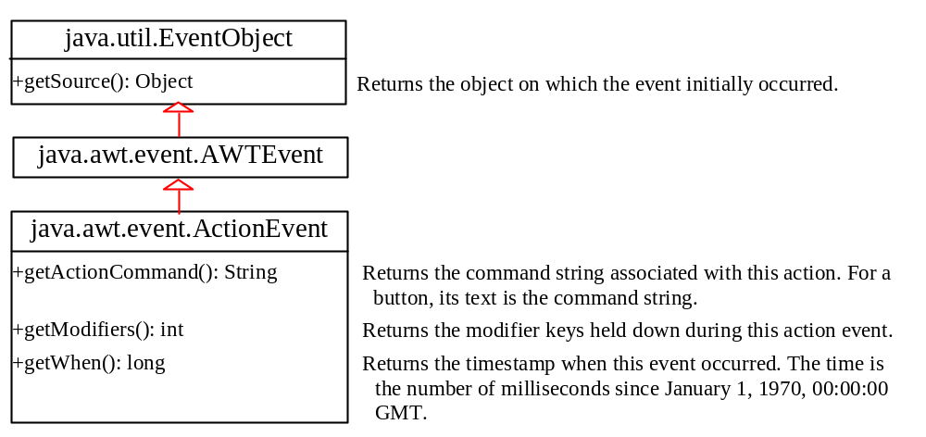
java.awt.event.ActionEvent

Slide 20
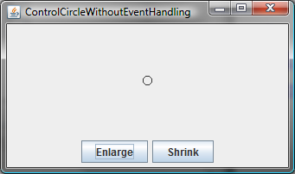
Example: First Version for ControlCircle (no listeners)
Now let us consider to write a program that uses two buttons to control the size of a circle.
ControlCircleWithoutEventHandling

Slide 21
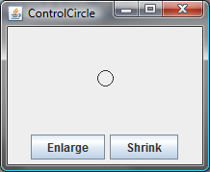
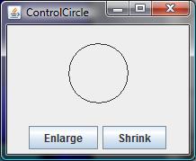
Example: Second Version for ControlCircle (with listener for Enlarge)
Now let us consider to write a program that uses two buttons to control the size of a circle.
ControlCircle

Slide 22
Inner Class Listeners
A listener class is designed specifically to create a listener object for a GUI component (e.g., a button). It will not be shared by other applications. So, it is appropriate to define the listener class inside the frame class as an inner class.

Slide 23
Inner Classes
Inner class: A class is a member of another class.
Advantages: In some applications, you can use an inner class to make programs simple.
An inner class can reference the data and methods defined in the outer class in which it nests, so you do not need to pass the reference of the outer class to the constructor of the inner class.
ShowInnerClass

Slide 24
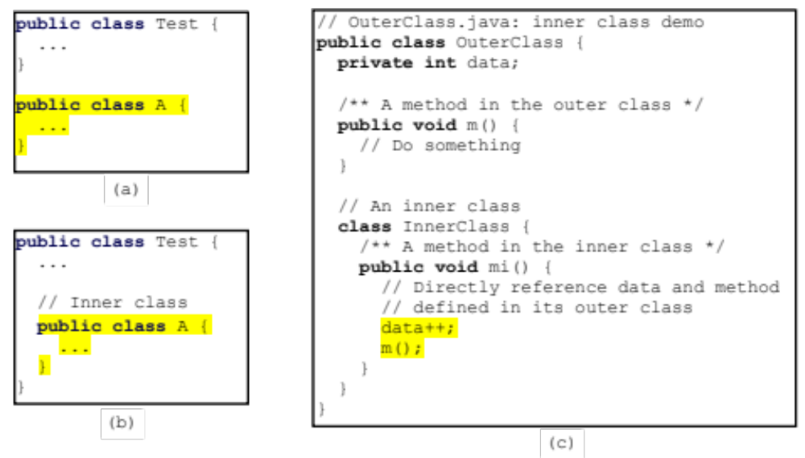
Inner Classes, cont.

Slide 25
Inner Classes (cont.)
Inner classes can make programs simple and concise.
An inner class supports the work of its containing outer class and is compiled into a class named OuterClassName$InnerClassName.class. For example, the inner class InnerClass in OuterClass is compiled into OuterClass$InnerClass.class.

Slide 26
Inner Classes (cont.)
An inner class can be declared public, protected, or private subject to the same visibility rules applied to a member of the class.
An inner class can be declared static. A static inner class can be accessed using the outer class name. A static inner class cannot access nonstatic members of the outer class

Slide 27
Anonymous Inner Classes
Inner class listeners can be shortened using anonymous inner classes. An anonymous inner class is an inner class without a name. It combines declaring an inner class and creating an instance of the class in one step. An anonymous inner class is declared as follows:
new SuperClassName/InterfaceName() {
// Implement or override methods in superclass or interface
// Other methods if necessary
}
AnonymousListenerDemo

Slide 28
Anonymous Inner Classes
An anonymous inner class must always extend a superclass or implement an interface, but it cannot have an explicit extends or implements clause.
An anonymous inner class must implement all the abstract methods in the superclass or in the interface.
An anonymous inner class always uses the no-arg constructor from its superclass to create an instance. If an anonymous inner class implements an interface, the constructor is Object().
An anonymous inner class is compiled into a class named OuterClassName$n.class. For example, if the outer class Test has two anonymous inner classes, these two classes are compiled into Test$1.class and Test$2.class.

Slide 29
Alternative Ways of Defining Listener Classes
There are many other ways to define the listener classes. For example, you may rewrite Anonymous Listener Demo by creating just one listener, register the listener with the buttons, and let the listener detect the event source, i.e., which button fires the event.
DetectSourceDemo

Slide 30
Alternative Ways of Defining Listener Classes
You may also define the custom frame class that implements ActionListener.
FrameAsListenerDemo

Slide 31
Problem: Loan Calculator
LoanCalculator

Slide 32
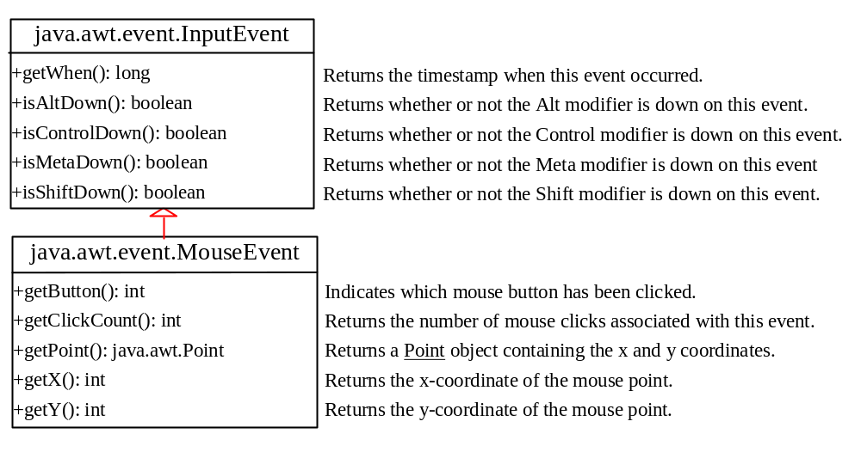
MouseEvent

Slide 33
Handling Mouse Events
Java provides two listener interfaces, MouseListener and MouseMotionListener, to handle mouse events.
The MouseListener listens for actions such as when the mouse is pressed, released, entered, exited, or clicked.
The MouseMotionListener listens for
actions such as dragging or moving the
mouse.

Slide 34
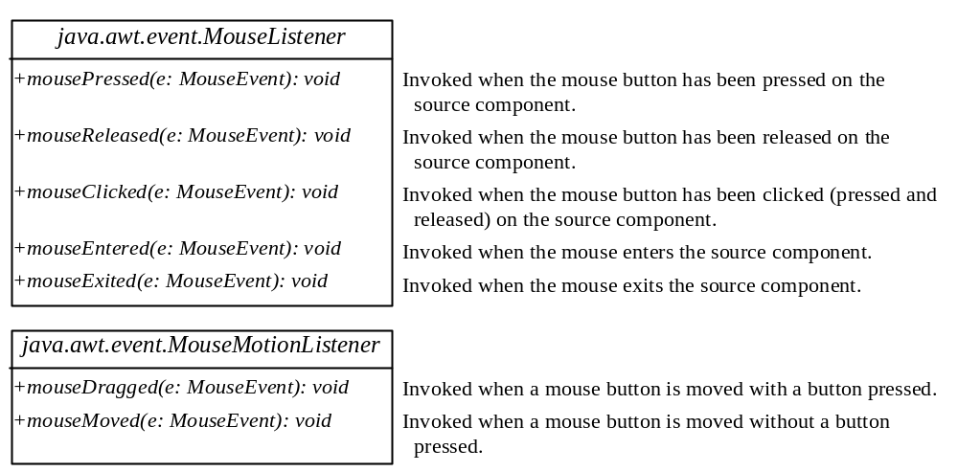
Handling Mouse Events

Slide 35
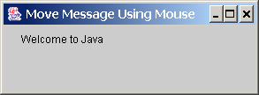
Example: Moving Message Using Mouse
Objective: Create a program to display a message in a panel. You can use the mouse to move the message. The message moves as the mouse drags and is always displayed at the mouse point.
MoveMessageDemo

Slide 36
Handling Keyboard Events
To process a keyboard event, use the following handlers in the KeyListener interface:
keyPressed(KeyEvent e)
Called when a key is pressed.
keyReleased(KeyEvent e)
Called when a key is released.
keyTyped(KeyEvent e)
Called when a key is pressed and then
released.

Slide 37
The KeyEvent Class
Methods:
getKeyChar() method
getKeyCode() method
Keys:
Home VK_HOME
End VK_END
Page Up VK_PGUP
Page Down VK_PGDN
etc...

Slide 38
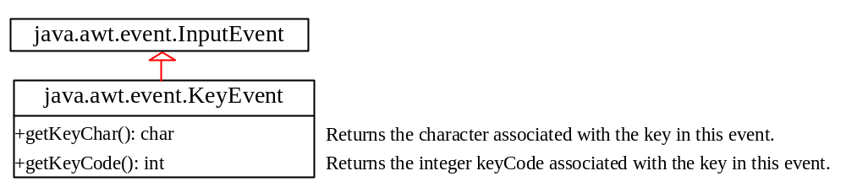
The KeyEvent Class, cont.

Slide 39
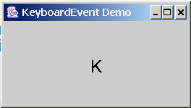
Example: Keyboard Events Demo
Objective: Display a user-input character. The user can also move the character up, down, left, and right using the arrow keys.
KeyEventDemo

Slide 40
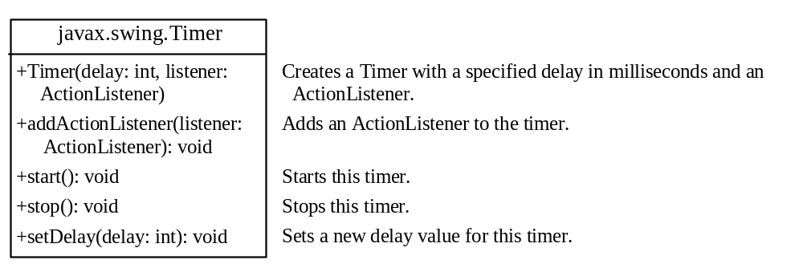
The Timer Class
Some non-GUI components can fire events. The javax.swing.Timer class is a source component that fires an ActionEvent at a predefined rate.
The Timer class can be used to control animations. For example, you can use it to display a moving message.
AnimationDemo

Slide 41
Clock Animation
The key to making the clock tick is to repaint it every second with a new current time. You can use a timer to control how to repaint the clock.
ClockAnimation

