Slide 1
Lecture 6: GUI Basics (Ch 12)
Adapted by Fangzhen Lin for COMP3021 from Y. Danial Liang’s PowerPoints for Introduction to Java Programming, Comprehensive Version, 9/E, Pearson, 2013.

Slide 2
Motivations
The design of the API for Java GUI programming is an excellent example of how the object-oriented principle is applied. Java GUI API and components are used to develop user-friendly interfaces for applications and applets.

Slide 3
Objectives
To distinguish between Swing and AWT (§12.2).
To describe the Java GUI API hierarchy (§12.3).
To create user interfaces using frames, panels, and simple GUI components (§12.4).
To understand the role of layout managers and use the FlowLayout, GridLayout, and BorderLayout managers to lay out components in a container (§12.5).
To use JPanel to group components in a subcontainer (§12.6).
To create objects for colors using the Color class (§12.7).
To create objects for fonts using the Font class (§12.8).
To apply common features such as borders, tool tips, fonts, and colors on Swing components (§12.9).
To decorate the border of GUI components (§12.9).
To create image icons using the ImageIcon class (§12.10).
To create and use buttons using the JButton class (§12.11).
To create and use check boxes using the JCheckBox class (§12.12).
To create and use radio buttons using the JRadioButton class (§12.13).
To create and use labels using the JLabel class (§12.14).
To create and use text fields using the JTextField class (§12.15).

Slide 4
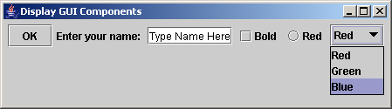
Creating GUI Objects
// Create a button with text OK
JButton jbtOK = new JButton("OK");
// Create a label with text "Enter your name: "
JLabel jlblName = new JLabel("Enter your name: ");
// Create a text field with text "Type Name Here"
JTextField jtfName = new JTextField("Type Name Here");
// Create a check box with text bold
JCheckBox jchkBold = new JCheckBox("Bold");
// Create a radio button with text red
JRadioButton jrbRed = new JRadioButton("Red");
// Create a combo box with choices red, green, and blue
JComboBox jcboColor = new JComboBox(new String[]{"Red",
"Green", "Blue"});
Label
Text field
Check Box
Radio Button
Button
Combo Box

Slide 5
Swing vs. AWT
So why do the GUI component classes have a prefix J? Instead of JButton, why not name it simply Button? In fact, there is a class already named Button in the java.awt package.
When Java was introduced, the GUI classes were bundled in a library known as the Abstract Windows Toolkit (AWT). For every platform on which Java runs, the AWT components are automatically mapped to the platform-specific components through their respective agents, known as peers. AWT is fine for developing simple graphical user interfaces, but not for developing comprehensive GUI projects. Besides, AWT is prone to platform-specific bugs because its peer-based approach relies heavily on the underlying platform. With the release of Java 2, the AWT user-interface components were replaced by a more robust, versatile, and flexible library known as Swing components. Swing components are painted directly on canvases using Java code, except for components that are subclasses of java.awt.Window or java.awt.Panel, which must be drawn using native GUI on a specific platform. Swing components are less dependent on the target platform and use less of the native GUI resource. For this reason, Swing components that don’t rely on native GUI are referred to as lightweight components, and AWT components are referred to as heavyweight components.

Slide 6
The Java GUI API
The GUI API contains classes that can be classified into three groups:
Component classes for creating user interface.
Container classes for grouping components.
Helper classes for supporting component classes

Slide 7
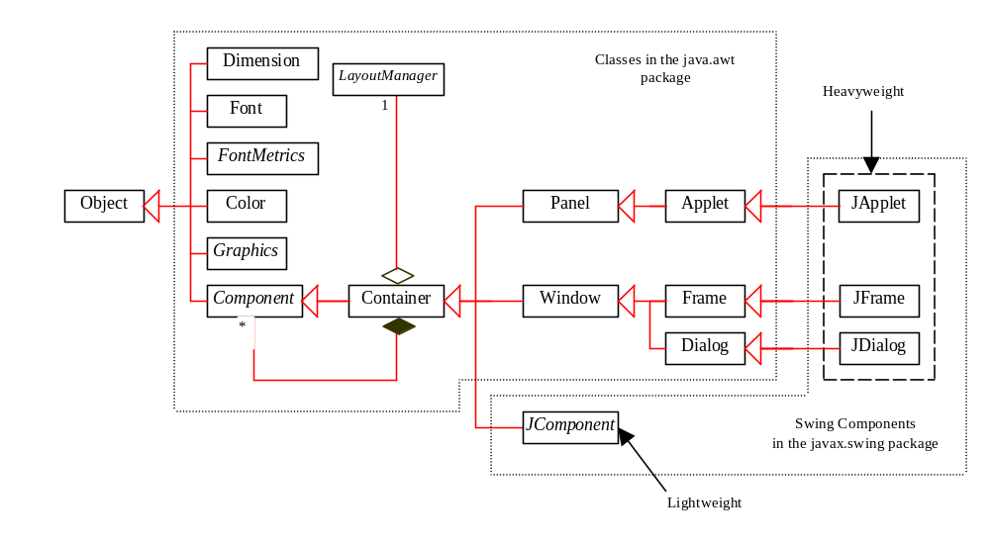
GUI Class Hierarchy (Swing)

Slide 8
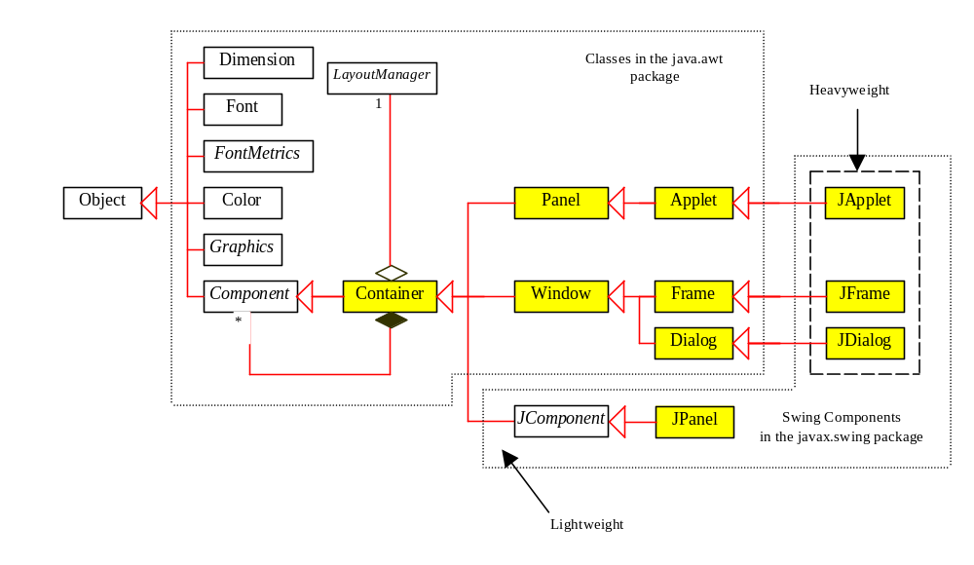
Container Classes
Container classes can contain other GUI components.

Slide 9
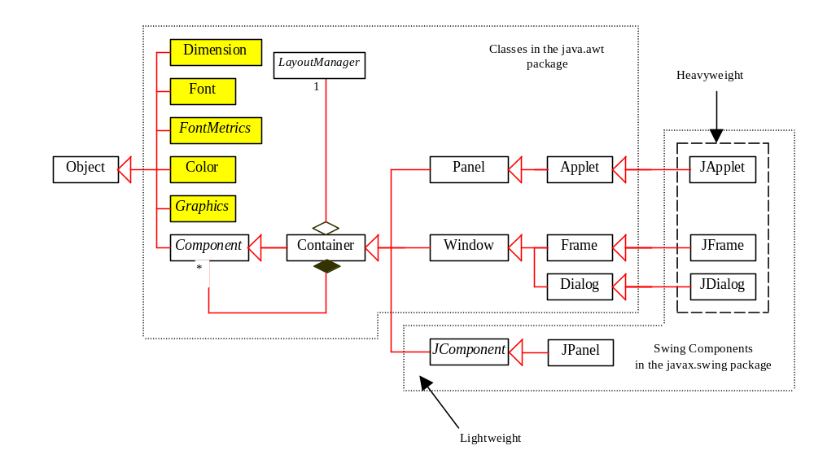
GUI Helper Classes
The helper classes are not subclasses of Component. They are used to describe the properties of GUI components such as graphics context, colors, fonts, and dimension.

Slide 10
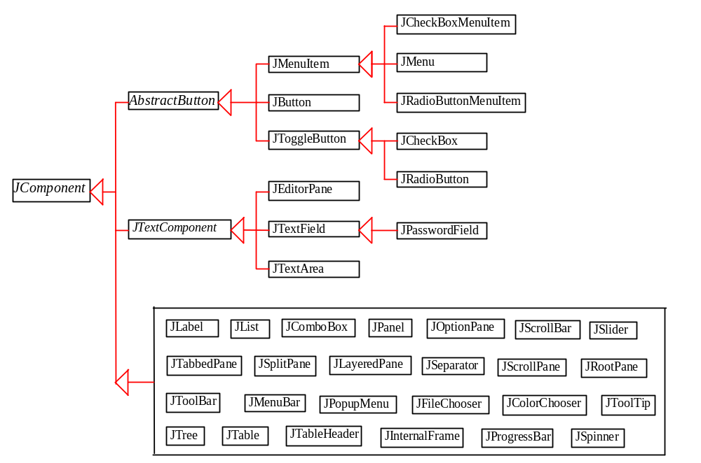
Swing GUI Components

Slide 11
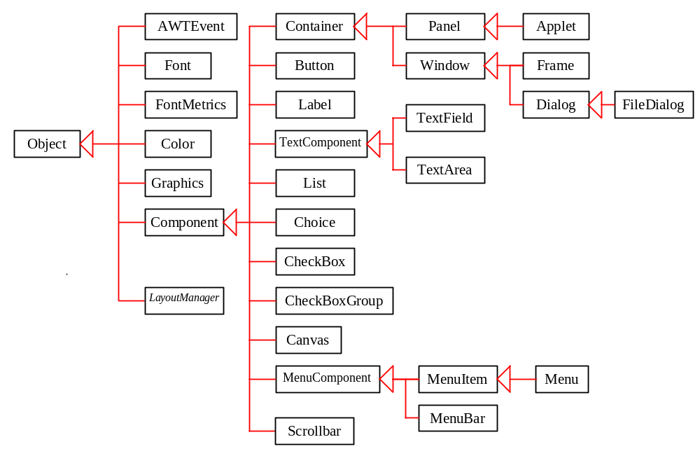
AWT (Optional)

Slide 12
Frames
Frame is a window that is not contained inside another window. Frame is the basis to contain other user interface components in Java GUI applications.
The JFrame class can be used to create windows.
For Swing GUI programs, use JFrame class to create widows.

Slide 13
Creating Frames
  import javax.swing.*;
  public class MyFrame {
  public static void main(String[] args) {
  JFrame frame = new JFrame("Test Frame");
  frame.setSize(400, 300);
  frame.setVisible(true);
  frame.setDefaultCloseOperation(
  JFrame.EXIT_ON_CLOSE);
  }
}
MyFrame

Slide 14
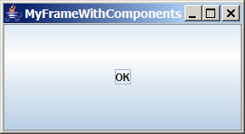
Adding Components into a Frame
// Add a button into the frame
frame.add(
new JButton("OK"));
Title bar
Content pane
MyFrameWithComponents

Slide 15
Content Pane Delegation in JDK 1.5
// Add a button into the frame
frame.getContentPane().add(
new JButton("OK"));
Title bar
// Add a button into the frame
frame.add(
new JButton("OK"));
Content pane

Slide 16
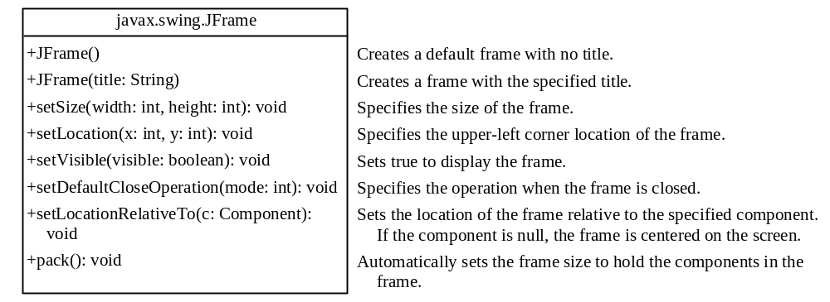
JFrame Class

Slide 17
Layout Managers
Java’s layout managers provide a level of abstraction to automatically map your user interface on all window systems.
The UI components are placed in containers. Each container has a layout manager to arrange the UI components within the container.
Layout managers are set in containers using the setLayout(LayoutManager) method in a container.

Slide 18
Kinds of Layout Managers
FlowLayout (this chapter)
GridLayout (this chapter)
BorderLayout (this chapter)
Several other layout managers will be introduced in bonus Chapter 37, “Containers, Layout Managers, and Borders”

Slide 19
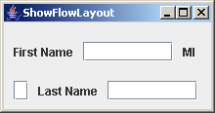
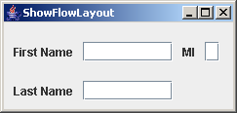
FlowLayout Example
Write a program that adds three labels and text fields into the content pane of a frame with a FlowLayout manager.
ShowFlowLayout

Slide 20
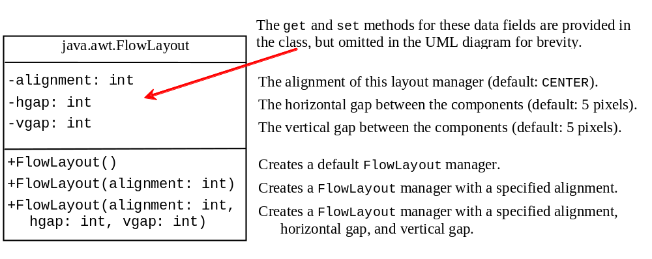
The FlowLayout Class

Slide 21
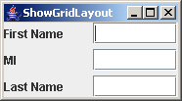
GridLayout Example
Rewrite the program in the preceding example using a GridLayout manager instead of a FlowLayout manager to display the labels and text fields.
ShowGridLayout

Slide 22
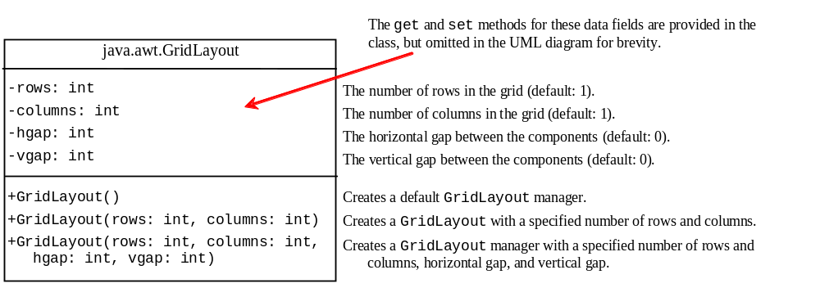
The GridLayout Class

Slide 23
The BorderLayout Manager
The BorderLayout manager divides the container into five areas: East, South, West, North, and Center. Components are added to a BorderLayout by using the add method.
add(Component, constraint), where constraint is BorderLayout.EAST, BorderLayout.SOUTH, BorderLayout.WEST, BorderLayout.NORTH, or BorderLayout.CENTER.

Slide 24
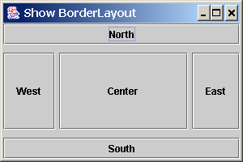
BorderLayout Example
ShowBorderLayout

Slide 25
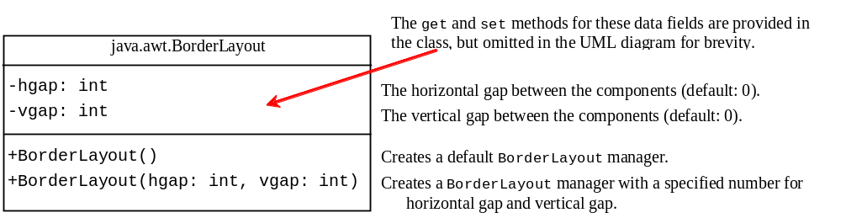
The BorderLayout Class

Slide 26
The Color Class
You can set colors for GUI components by using the java.awt.Color class. Colors are made of red, green, and blue components, each of which is represented by a byte value that describes its intensity, ranging from 0 (darkest shade) to 255 (lightest shade). This is known as the RGB model.
  Color c = new Color(r, g, b);
r, g, and b specify a color by its red, green, and blue components.
Example:
  Color c = new Color(228, 100, 255);

Slide 27
Standard Colors
Thirteen standard colors (black, blue, cyan, darkGray, gray, green, lightGray, magenta, orange, pink, red, white, yellow) are defined as constants in java.awt.Color.
The standard color names are constants, but they are named as variables with lowercase for the first word and uppercase for the first letters of subsequent words. Thus the color names violate the Java naming convention. Since JDK 1.4, you can also use the new constants: BLACK, BLUE, CYAN, DARK_GRAY, GRAY, GREEN, LIGHT_GRAY, MAGENTA, ORANGE, PINK, RED, WHITE, and YELLOW.

Slide 28
Setting Colors
You can use the following methods to set the component’s background and foreground colors:
  setBackground(Color c)
  setForeground(Color c)
Example:
  jbt.setBackground(Color.yellow);
  jbt.setForeground(Color.red);

Slide 29
The Font Class
Font Names
  Standard font names that are supported in all platforms are: SansSerif, Serif, Monospaced, Dialog, or DialogInput.
Font Style
  Font.PLAIN (0), Font.BOLD (1), Font.ITALIC (2), and Font.BOLD + Font.ITALIC (3)
Font myFont = new Font(name, style, size);
Example:
  Font myFont = new Font("SansSerif ", Font.BOLD, 16);
  Font myFont = new Font("Serif", Font.BOLD+Font.ITALIC, 12);
  JButton jbtOK = new JButton("OK“);
  jbtOK.setFont(myFont);

Slide 30
Finding All Available Font Names
GraphicsEnvironment e =
GraphicsEnvironment.getLocalGraphicsEnvironment();
String[] fontnames = e.getAvailableFontFamilyNames();
for (int i = 0; i < fontnames.length; i++)
System.out.println(fontnames[i]);

Slide 31
Using Panels as Sub-Containers
Panels act as sub-containers for grouping user interface components.
It is recommended that you place the user interface components in panels and place the panels in a frame. You can also place panels in a panel.
To add a component to JFrame, you actually add it to the content pane of JFrame. To add a component to a panel, you add it directly to the panel using the add method.

Slide 32
Creating a JPanel
You can use new JPanel() to create a panel with a default FlowLayout manager or new JPanel(LayoutManager) to create a panel with the specified layout manager. Use the add(Component) method to add a component to the panel. For example,
JPanel p = new JPanel();
p.add(new JButton("OK"));

Slide 33
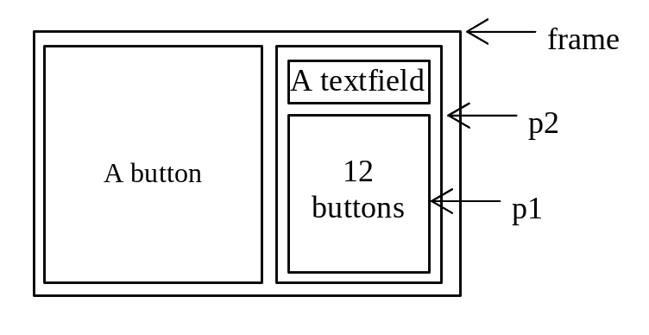
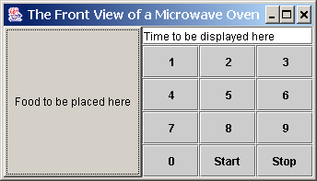
Testing Panels Example
This example uses panels to organize components. The program creates a user interface for a Microwave oven.
TestPanels

Slide 34
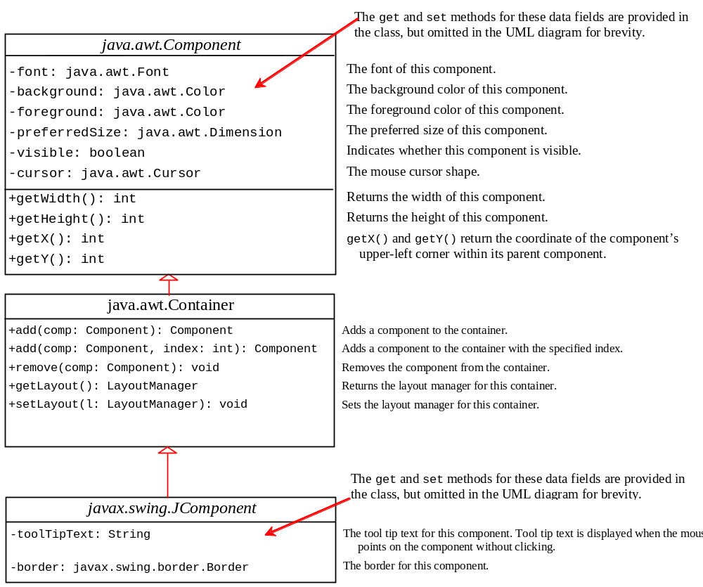
Common Features of Swing Components

Slide 35
Borders
You can set a border on any object of the JComponent class. Swing has several types of borders. To create a titled border, use
  new TitledBorder(String title).
To create a line border, use
  new LineBorder(Color color, int width),
where width specifies the thickness of the line. For example, the following code displays a titled border on a panel:
  JPanel panel = new JPanel();
  panel.setBorder(new TitleBorder(“My Panel”));

Slide 36
Test Swing Common Features
Component Properties
font
background
foreground
preferredSize
minimumSize
maximumSize
JComponent Properties
toolTipText
border
TestSwingCommonFeatures

Slide 37
Image Icons
Java uses the javax.swing.ImageIcon class to represent an icon. An icon is a fixed-size picture; typically it is small and used to decorate components. Images are normally stored in image files. You can use new ImageIcon(filename) to construct an image icon. For example, the following statement creates an icon from an image file us.gif in the image directory under the current class path:
ImageIcon icon = new ImageIcon("image/us.gif");
TestImageIcon

Slide 38
Splash Screen
A splash screen is an image that is displayed while the application is starting up. If your program takes a long time to load, you may display a splash screen to alert the user. For example, the following command:
  java –splash:image/us.gif TestImageIcon
displays an image while the program TestImageIcon is being loaded.

Slide 39
Buttons
A button is a component that triggers an action event when clicked. Swing provides regular buttons, toggle buttons, check box buttons, and radio buttons. The common features of these buttons are generalized in javax.swing.AbstractButton.

Slide 40
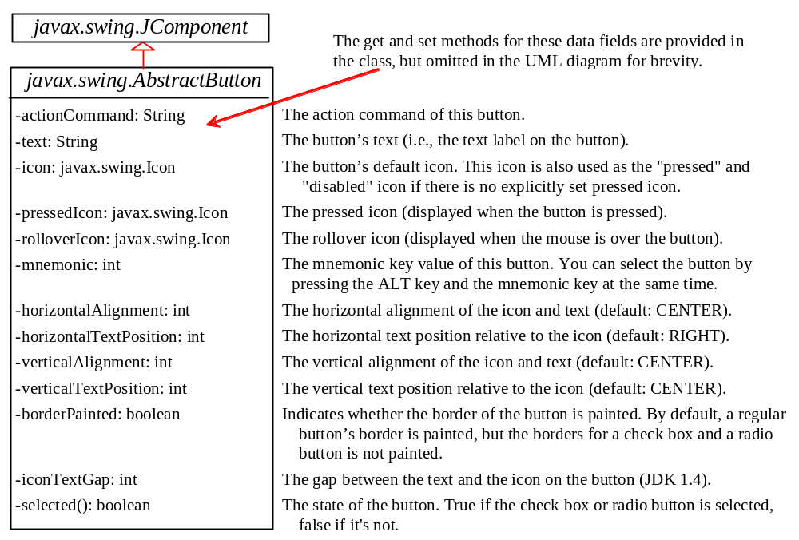
AbstractButton

Slide 41
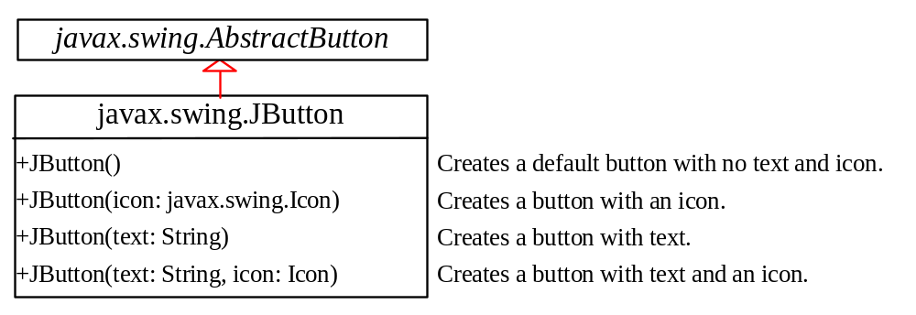
JButton
JButton inherits AbstractButton and provides several constructors to create buttons.

Slide 42
JButton Constructors
The following are JButton constructors:
JButton()
JButton(String text)
JButton(String text, Icon icon)
JButton(Icon icon)

Slide 43
JButton Properties
text
icon
mnemonic
horizontalAlignment
verticalAlignment
horizontalTextPosition
verticalTextPosition
iconTextGap

Slide 44

Default Icons, Pressed Icon, and Rollover Icon
A regular button has a default icon, pressed icon, and rollover icon. Normally, you use the default icon. All other icons are for special effects. A pressed icon is displayed when a button is pressed and a rollover icon is displayed when the mouse is over the button but not pressed.
(A) Default icon (B) Pressed icon (C) Rollover icon

Slide 45
Demo
TestButtonIcons

Slide 46
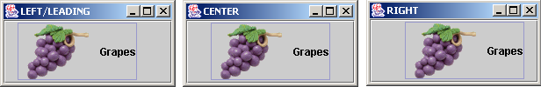
Horizontal Alignments
Horizontal alignment specifies how the icon and text are placed horizontally on a button. You can set the horizontal alignment using one of the five constants: LEADING, LEFT, CENTER, RIGHT, TRAILING. At present, LEADING and LEFT are the same and TRAILING and RIGHT are the same. Future implementation may distinguish them. The default horizontal alignment is SwingConstants.TRAILING.

Slide 47
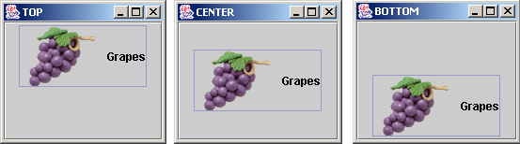
Vertical Alignments
Vertical alignment specifies how the icon and text are placed vertically on a button. You can set the vertical alignment using one of the three constants: TOP, CENTER, BOTTOM. The default vertical alignment is SwingConstants.CENTER.

Slide 48
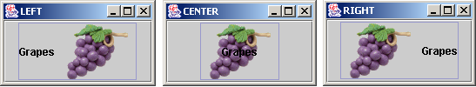
Horizontal Text Positions
Horizontal text position specifies the horizontal position of the text relative to the icon. You can set the horizontal text position using one of the five constants: LEADING, LEFT, CENTER, RIGHT, TRAILING. The default horizontal text position is SwingConstants.RIGHT.

Slide 49

Vertical Text Positions
Vertical text position specifies the vertical position of the text relative to the icon. You can set the vertical text position using one of the three constants: TOP, CENTER. The default vertical text position is SwingConstants.CENTER.

Slide 50
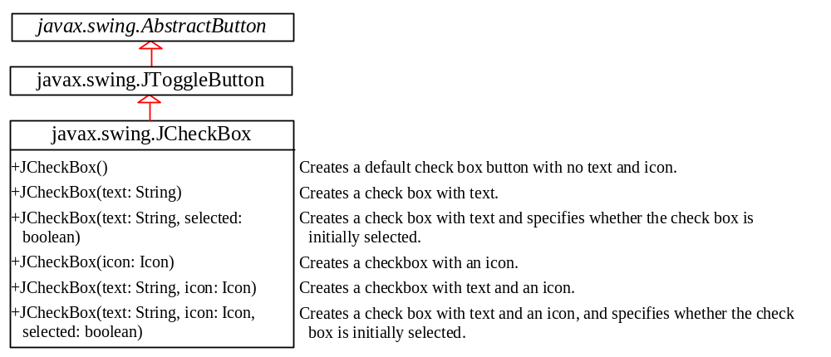
JCheckBox
JCheckBox inherits all the properties such as text, icon, mnemonic, verticalAlignment, horizontalAlignment, horizontalTextPosition, verticalTextPosition, and selected from AbstractButton, and provides several constructors to create check boxes.

Slide 51
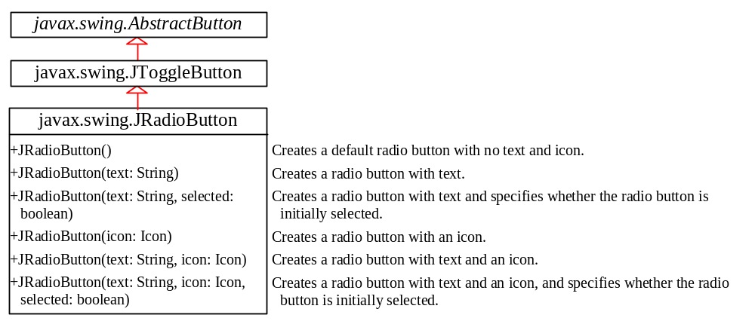
JRadioButton
Radio buttons are variations of check boxes. They are often used in the group, where only one button is checked at a time.

Slide 52
Grouping Radio Buttons
  ButtonGroup btg = new ButtonGroup();
  btg.add(jrb1);
  btg.add(jrb2);

Slide 53
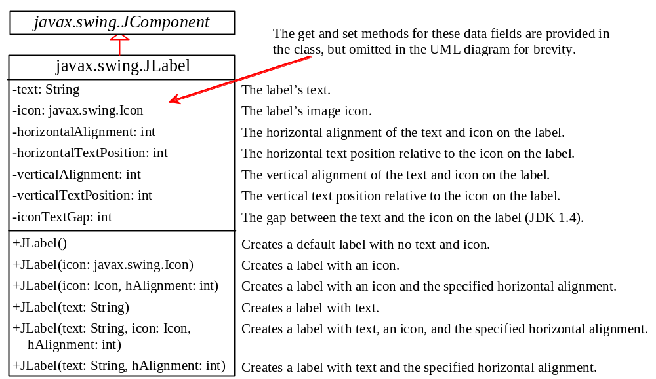
JLabel
A label is a display area for a short text, an image, or both.

Slide 54
JLabel Constructors
The constructors for labels are as follows:
JLabel()
JLabel(String text, int horizontalAlignment)
JLabel(String text)
JLabel(Icon icon)
JLabel(Icon icon, int horizontalAlignment)
JLabel(String text, Icon icon, int horizontalAlignment)

Slide 55
JLabel Properties
JLabel inherits all the properties from JComponent and has many properties similar to the ones in JButton, such as text, icon, horizontalAlignment, verticalAlignment, horizontalTextPosition, verticalTextPosition, and iconTextGap.

Slide 56
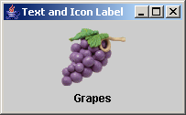
Using Labels
// Create an image icon from image file
ImageIcon icon = new ImageIcon("image/grapes.gif");
// Create a label with text, an icon,
// with centered horizontal alignment
JLabel jlbl = new JLabel("Grapes", icon, SwingConstants.CENTER);
// Set label's text alignment and gap between text and icon
jlbl.setHorizontalTextPosition(SwingConstants.CENTER);
jlbl.setVerticalTextPosition(SwingConstants.BOTTOM);
jlbl.setIconTextGap(5);

Slide 57
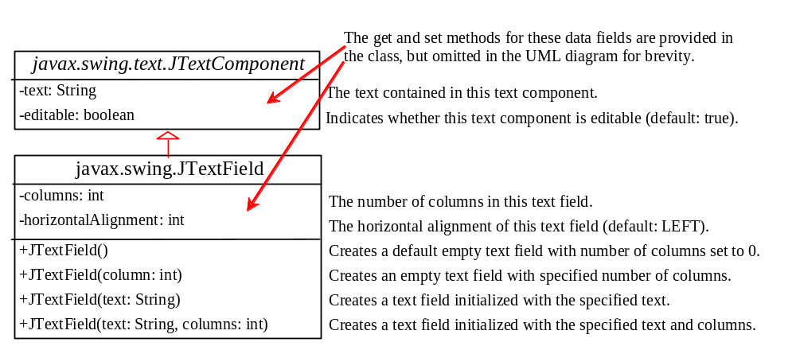
JTextField
A text field is an input area where the user can type in characters. Text fields are useful in that they enable the user to enter in variable data (such as a name or a description).

Slide 58
JTextField Constructors
JTextField(int columns)
Creates an empty text field with the specified number of columns.
JTextField(String text)
Creates a text field initialized with the specified text.
JTextField(String text, int columns)
Creates a text field initialized with the
specified text and the column size.

Slide 59
JTextField Properties
text
horizontalAlignment
editable
columns

Slide 60
JTextField Methods
getText()
Returns the string from the text field.
setText(String text)
Puts the given string in the text field.
setEditable(boolean editable)
Enables or disables the text field to be edited. By default, editable is true.
setColumns(int)
Sets the number of columns in this text field.
The length of the text field is changeable.

