Slide 1
Lecture 7: Abstract Classes and Interfaces (Ch 15)
Adapted by Fangzhen Lin for COMP3021 from Y. Danial Liang’s PowerPoints for Introduction to Java Programming, Comprehensive Version, 9/E, Pearson, 2013.

Slide 2
Objectives
To design and use abstract classes (§15.2).
To process a calendar using the Calendar and GregorianCalendar classes (§15.3).
To specify behavior for objects using interfaces (§15.4).
To define interfaces and declare classes that implement interfaces (§15.4).
To define a natural order using the Comparable interface (§15.5).
To enable objects to listen for action events using the ActionListener interface (§15.6).
To make objects cloneable using the Cloneable interface (§15.7).
To explore the similarities and differences between an abstract class and an interface (§15.8).
*To create objects for primitive values using the wrapper classes (Byte, Short, Integer, Long, Float, Double, Character, and Boolean) (§15.9).
*To create a generic sort method (§15.10).
*To simplify programming using automatic conversion between primitive types and wrapper class types (§15.11).
*To use the BigInteger and BigDecimal classes for computing very large numbers with arbitrary precisions (§15.12).

Slide 3
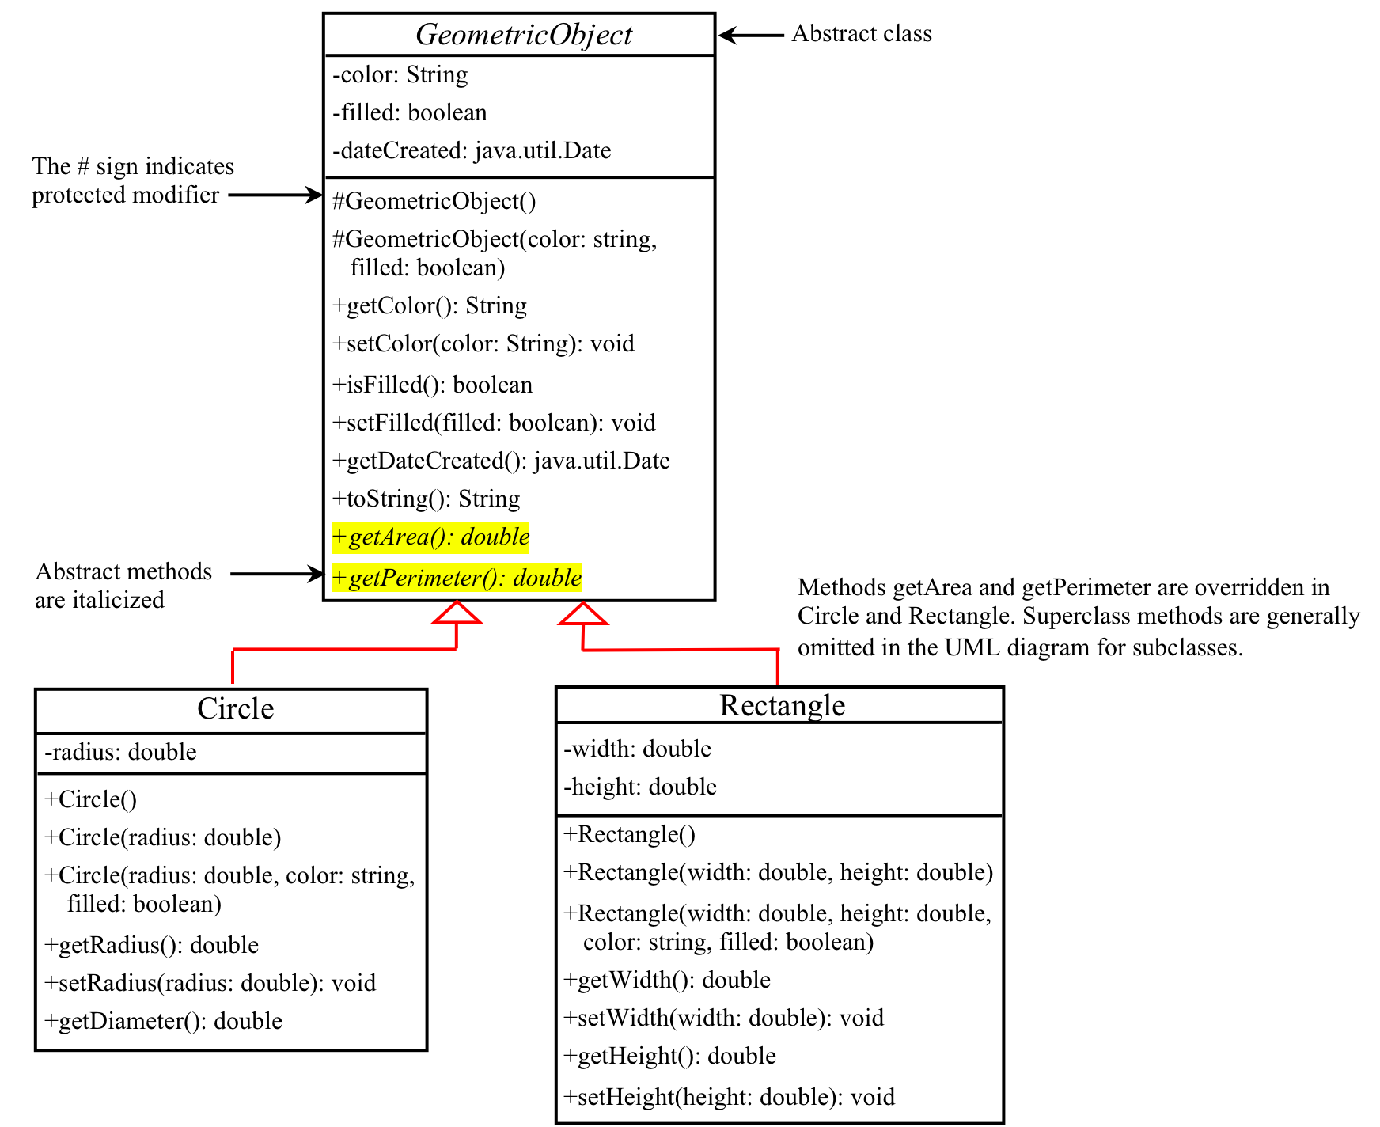
Abstract Classes and Abstract Methods
GeometricObject
Circle
Rectangle
TestGometricObject

Slide 4


What’s an abstract class?
It is a special kind of class solely used for sharing/reusing data/behavior for subclasses
Difference from the classes you have seen so far
Cannot be “newed”.
Can own “abstract methods”.
Analogy:
Special molds used to make other molds not to make cakes

Slide 5
What’s an abstract method?
We need “abstract classes” for reusing data/behavior for subclasses.
Often we only say what a method looks like and don’t provide any definition
No need → subclass will and must override
Impossible → depends on what subclass does
Such methods are “abstract” methods with the abstract modifier.

Slide 6
Interesting facts
Only abstract class can have abstract methods, regular class cannot.
Abstract classes don’t have to have abstract methods.
Subclasses must provide definitions for all abstract methods in parents unless themselves are abstract
Subclass can be abstract and its parent can be concrete.
Subclass can override a concrete method as abstract

Slide 7
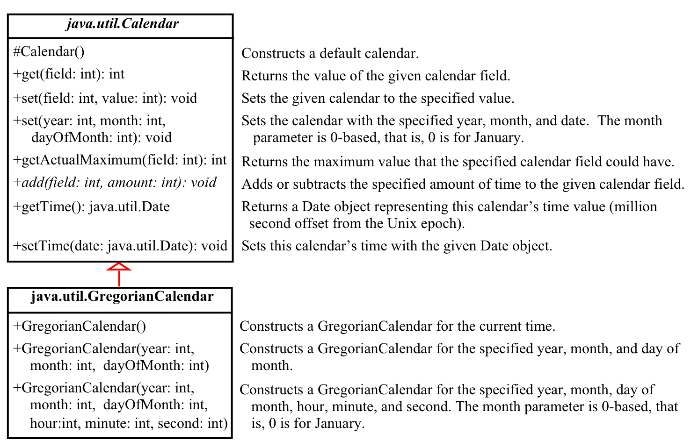
The Abstract Calendar Class and Its GregorianCalendar subclass

Slide 8
The Abstract Calendar Class and Its GregorianCalendar subclass
An instance of java.util.Date represents a specific instant in time with millisecond precision.
java.util.Calendar is an abstract base class for extracting detailed information such as year, month, date, hour, minute and second from a Date object.
Subclasses of Calendar can implement specific calendar systems such as Gregorian calendar, Lunar Calendar and Jewish calendar.
Currently, java.util.GregorianCalendar for the Gregorian calendar is supported in the Java API.

Slide 9
The GregorianCalendar Class
You can use new GregorianCalendar() to construct a default GregorianCalendar with the current time and use new GregorianCalendar(year, month, date) to construct a GregorianCalendar with the specified year, month, and date. The month parameter is 0-based, i.e., 0 is for January.
TestCalendar

Slide 10
Interfaces
What is an interface?
Why is an interface useful?
How do you define an interface?
How do you use an interface?

Slide 11
What’s an interface?
One of the most important concepts in the Java language:
To satisfy the need of multiple inheritance.
Key for building massive scale Java libraries
Similar to abstract classes:
Methods defined in a class can be used only by objects of this class and its subclasses.
Methods defined in an interface can be used by objects belong to different classes.

Slide 12
Define an Interface
To distinguish an interface from a class, Java uses the following syntax to declare an interface:
public interface InterfaceName {
constant declarations;
method signatures;
}
Example:
public interface Edible {
/** Describe how to eat */
public abstract String howToEat();
}

Slide 13
Conceptual Example
Chicken
An animal, belong to the class of Bird.
A type of poultry
Our favorite dish in LG1/7
Multiple roles of Chicken class
Latin name/Gene sequence/Origin
Origin (farm)/stock number/Weight
Price etc.

Slide 14
Code Example
abstract class Bird {};
interface Poultry {
public int getStockNumber();
}
interface Dish {
public void placeOrder();
}
class Chicken extends Bird implements Poultry, Dish{};
Chicken mychicken = new Chicken();
mychicken instanceof Bird ?
mychicken instanceof Dish;
mychicken instanceof Poultry;

Slide 15
Example
You can now use the Edible interface to specify whether an object is edible. This is accomplished by letting the class for the object implement this interface using the implements keyword.
Edible
TestEdible

Slide 16
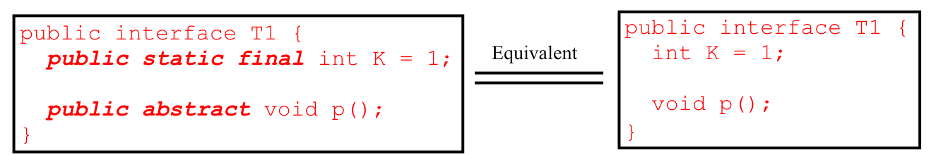
Omitting Modifiers in Interfaces
All data fields are public final static and all methods are public abstract in an interface. For this reason, these modifiers can be omitted, as shown below:
A constant defined in an interface can be accessed using syntax InterfaceName.CONSTANT_NAME (e.g., T1.K).
Notes:
Tuesday class stopped here

Slide 17
Example: The Comparable Interface
// This interface is defined in
// java.lang package
package java.lang;
public interface Comparable {
public int compareTo(Object o);
}

Slide 18
String and Date Classes
Many classes (e.g., String and Date) in the Java library implement Comparable to define a natural order for the objects. If you examine the source code of these classes, you will see the keyword implements used in the classes, as shown below:
new String() instanceof String
new String() instanceof Comparable
new java.util.Date() instanceof java.util.Date
new java.util.Date() instanceof Comparable

Slide 19
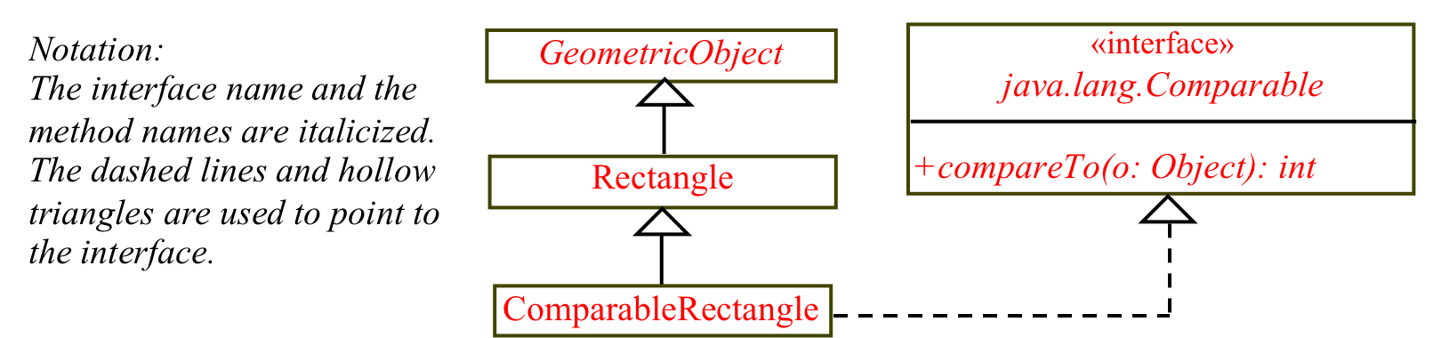
Declaring Classes to Implement Comparable
ComparableRectangle
You cannot use the max method to find the larger of two instances of Rectangle, because Rectangle does not implement Comparable. However, you can declare a new rectangle class that implements Comparable. The instances of this new class are comparable. Let this new class be named ComparableRectangle.
ComparableRectangle rectangle1 = new ComparableRectangle(4, 5);
ComparableRectangle rectangle2 = new ComparableRectangle(3, 6);
System.out.println(Max.max(rectangle1, rectangle2));
Notes:
Can we implement Comparable as public int compareTo(Rectangle o) { … }?

Slide 20
The Cloneable Interfaces
Marker Interface: An empty interface.
A marker interface does not contain constants or methods. It is used to denote that a class possesses certain desirable properties. A class that implements the Cloneable interface is marked cloneable, and its objects can be cloned using the clone() method defined in the Object class.
package java.lang;
public interface Cloneable {
}

Slide 21
Examples
Many classes (e.g., Date and Calendar) in the Java library implement Cloneable. Thus, the instances of these classes can be cloned. For example, the following code
Calendar calendar = new GregorianCalendar(2003, 2, 1);
Calendar calendarCopy = (Calendar)calendar.clone();
System.out.println("calendar == calendarCopy is " +
(calendar == calendarCopy));
System.out.println("calendar.equals(calendarCopy) is " +
calendar.equals(calendarCopy));
displays
calendar == calendarCopy is false
calendar.equals(calendarCopy) is true
Notes:
Deep and shallow copies

Slide 22
Implementing Cloneable Interface
To declare a custom class that implements the Cloneable interface, the class must override the clone() method in the Object class. The following code declares a class named House that implements Cloneable and Comparable.
House

Slide 23
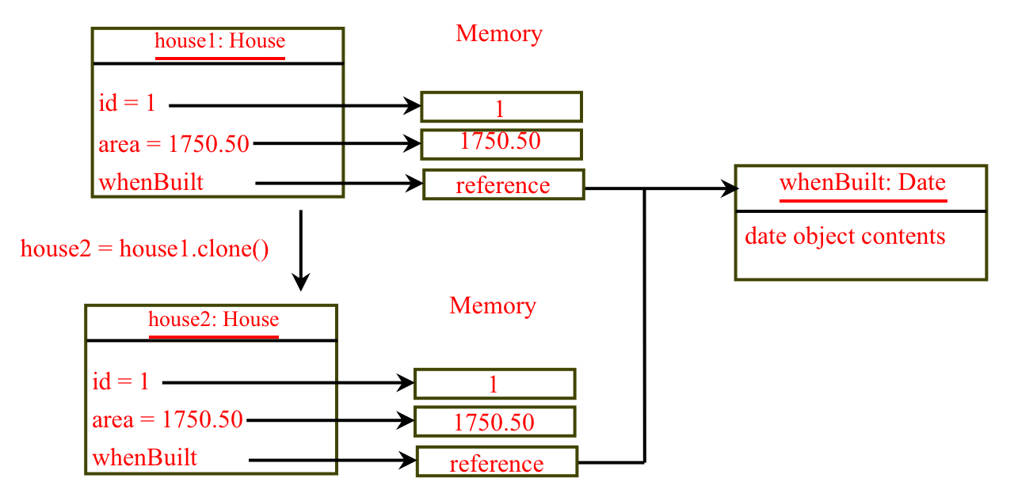
Shallow vs. Deep Copy
House house1 = new House(1, 1750.50);
House house2 = (House)house1.clone();

Slide 24
Interfaces vs. Abstract Classes
In an interface, the data must be constants; an abstract class can have all types of data.
Each method in an interface has only a signature without implementation; an abstract class can have concrete methods.
 | Variables | Constructors | Methods
Abstract class | No restrictions | Constructors are invoked by subclasses through constructor chaining. An abstract class cannot be instantiated using the new operator. | No restrictions.
Interface | All variables must be public static final | No constructors. An interface cannot be instantiated using the new operator. | All methods must be public abstract instance methods
Notes:
Thursday class stops here.

Slide 25
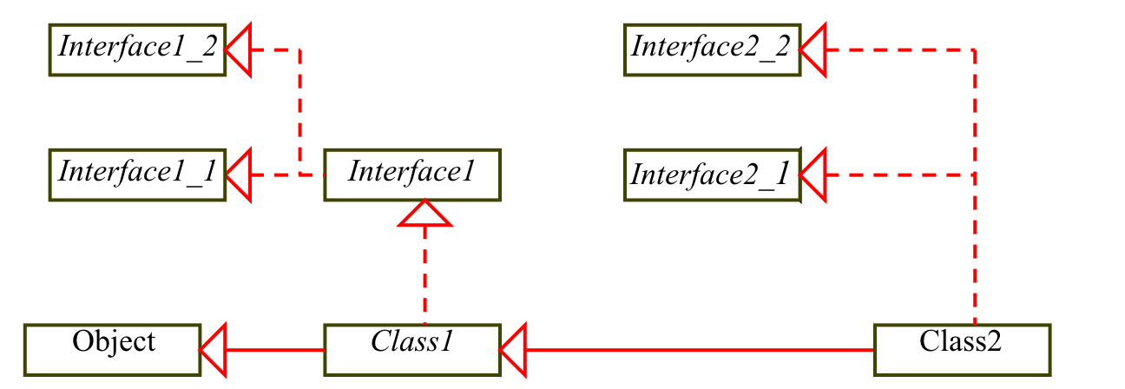
Interfaces vs. Abstract Classes, cont.
All classes share a single root, the Object class, but there is no single root for interfaces. Like a class, an interface also defines a type. A variable of an interface type can reference any instance of the class that implements the interface. If a class extends an interface, this interface plays the same role as a superclass. You can use an interface as a data type and cast a variable of an interface type to its subclass, and vice versa.
Suppose that c is an instance of Class2. c is also an instance of Object, Class1, Interface1, Interface1_1, Interface1_2, Interface2_1, and Interface2_2.

Slide 26
Caution: conflict interfaces
In rare occasions, a class may implement two interfaces with conflict information (e.g., two same constants with different values or two methods with same signature but different return type). This type of errors will be detected by the compiler.

Slide 27
The Rational Class
Rational
TestRationalClass
27

