Slide 1
Lecture 11: Networking in Java (Ch 33)
Adapted by Fangzhen Lin for COMP3021 from Y. Danial Liang’s PowerPoints for Introduction to Java Programming, Comprehensive Version, 9/E, Pearson, 2013.

Slide 2
Objectives
To explain terms: TCP, IP, domain name, domain name server, stream-based communications, and packet-based communications (§33.2).
To create servers using server sockets (§33.2.1) and clients using client sockets (§33.2.2).
To implement Java networking programs using stream sockets (§33.2.3).
To develop an example of a client/server application (§33.2.4).
To obtain Internet addresses using the InetAddress class (§33.3).
To develop servers for multiple clients (§33.4).
To develop applets that communicate with the server (§33.5).
To send and receive objects on a network (§33.6).
To develop an interactive tic-tac-toe game played on the Internet (§33.7).

Slide 3
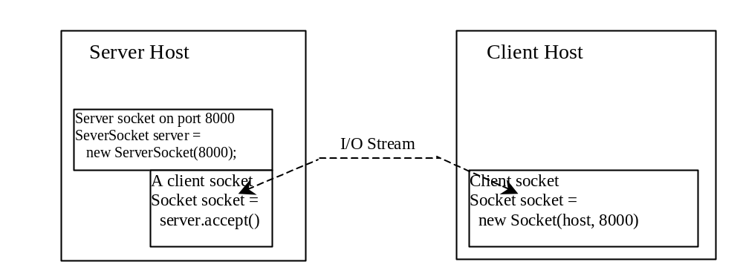
Client/Server Communications
The server must be running when a client starts. The server waits for a connection request from a client. To establish a server, you need to create a server socket and attach it to a port, which is where the server listens for connections.
After the server accepts the connection, communication between server and client is conducted the same as for I/O streams.
After a server socket is created, the server can use this statement to listen for connections.
The client issues this statement to request a connection to a server.

Slide 4
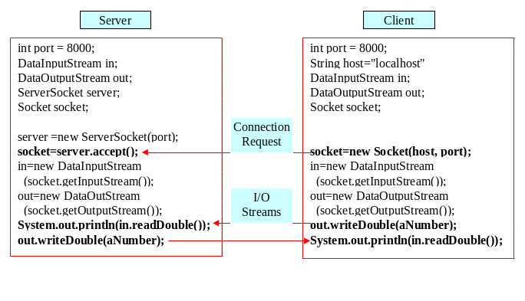
Data Transmission through Sockets
InputStream input = socket.getInputStream();
OutputStream output = socket.getOutputStream();

Slide 5
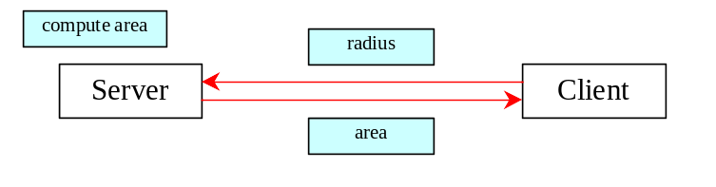
A Client/Server Example
Problem: Write a client to send data to a server. The server receives the data, uses it to produce a result, and then sends the result back to the client. The client displays the result on the console. In this example, the data sent from the client is the radius of a circle, and the result produced by
the server is the area of the circle.

Slide 6
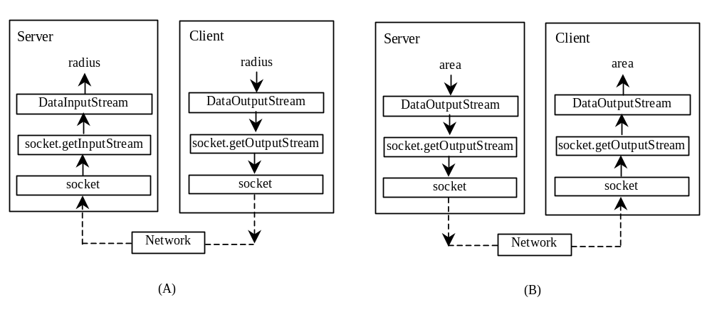
A Client/Server Example, cont.

Slide 7
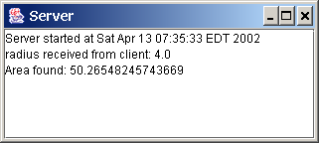
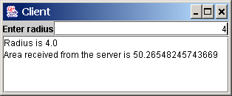
A Client/Server Example, cont.
Server Code
Client Code
Start Server
Start Client
Note: Start the server, then the client.

Slide 8
The InetAddress Class
Occasionally, you would like to know who is connecting to the server. You can use the InetAddress class to find the client's host name and IP address. The InetAddress class models an IP address. You can use the statement shown below to create an instance of InetAddress for the client on a socket.
  InetAddress inetAddress = socket.getInetAddress();
Next, you can display the client's host name and IP address, as follows:
  System.out.println("Client's host name is " +
  inetAddress.getHostName());
  System.out.println("Client's IP Address is " +
  inetAddress.getHostAddress());

Slide 9
Serving Multiple Clients
Multiple clients are quite often connected to a single server at the same time. Typically, a server runs constantly on a server computer, and clients from all over the Internet may want to connect to it. You can use threads to handle the server's multiple clients simultaneously. Simply create a thread for each connection. Here is how the server handles the establishment of a connection:
    while (true) {
    Socket socket = serverSocket.accept();
    Thread thread = new ThreadClass(socket);
    thread.start();
    }
The server socket can have many connections. Each iteration of the while loop creates a new connection. Whenever a connection is established, a new thread is created to handle communication between the server and the new client; and this allows multiple connections to run at the same time.

Slide 10
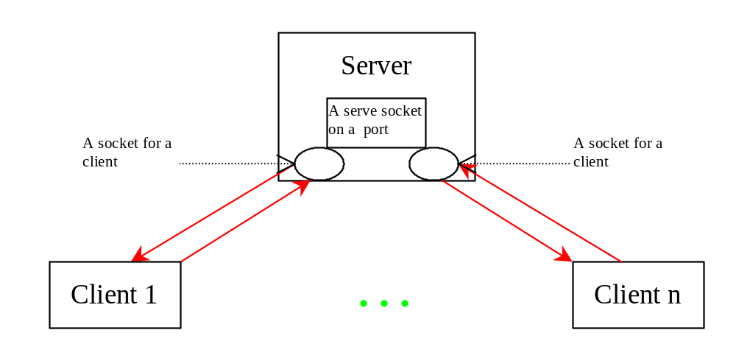
Example: Serving Multiple Clients
Server for Multiple Clients
Start Server
Start Client
Note: Start the server first, then start multiple clients.

Slide 11
Applet Clients
Due to security constraints, applets can only connect to the host from which they were loaded. Therefore, the HTML file must be located on the machine on which the server is running.

Slide 12

Example: Creating Applet Clients
Write an applet that shows the number of visits made to a Web page. The count should be stored in a file on the server side. Every time the page is visited or reloaded, the applet sends a request to the server, and the server increases the count and sends it to the applet. The applet then displays the new count in a message, such as You are visitor number 11.
CountServer
AppletClient
Start Server
Start Client

Slide 13
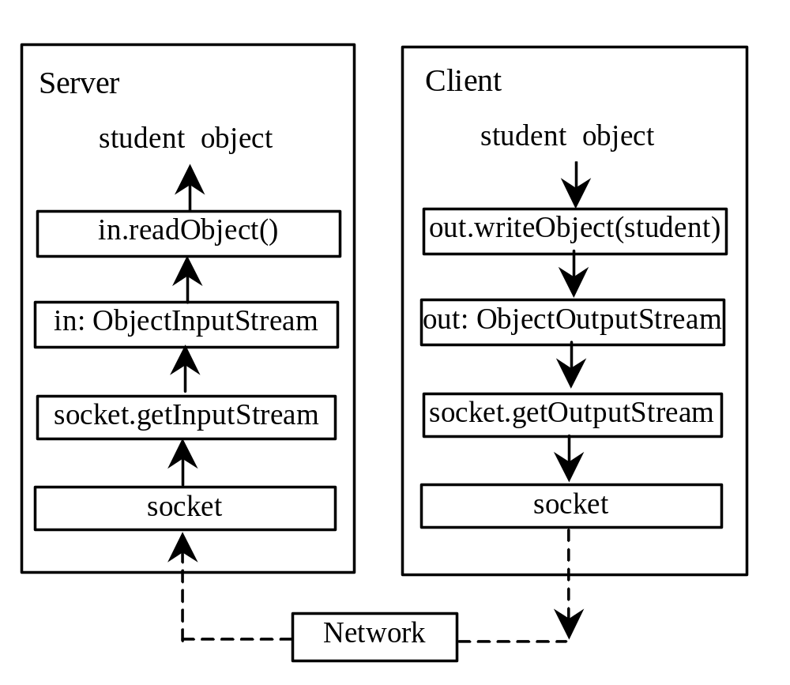
Example: Passing Objects in Network Programs
Write a program that collects student information from a client and send them to a server. Passing student information in an object.
Student Class
Student Sever
Student Client
Start Server
Start Client
Note: Start the server first, then the client.

Slide 14
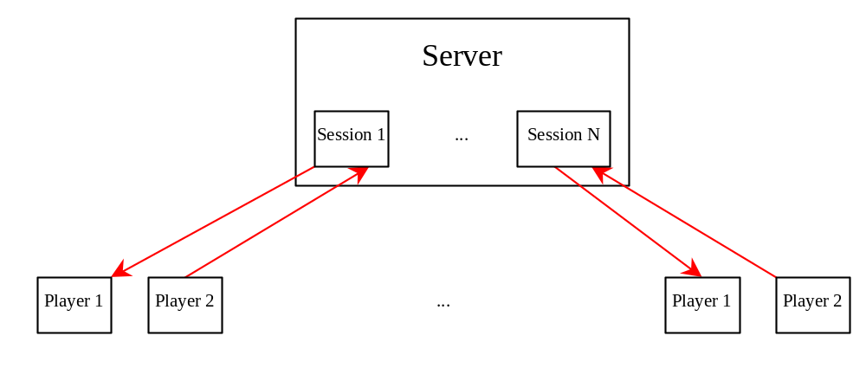
Case Studies: Distributed TicTacToe Games
TicTacToeServer
TicTacToeClient

Slide 15
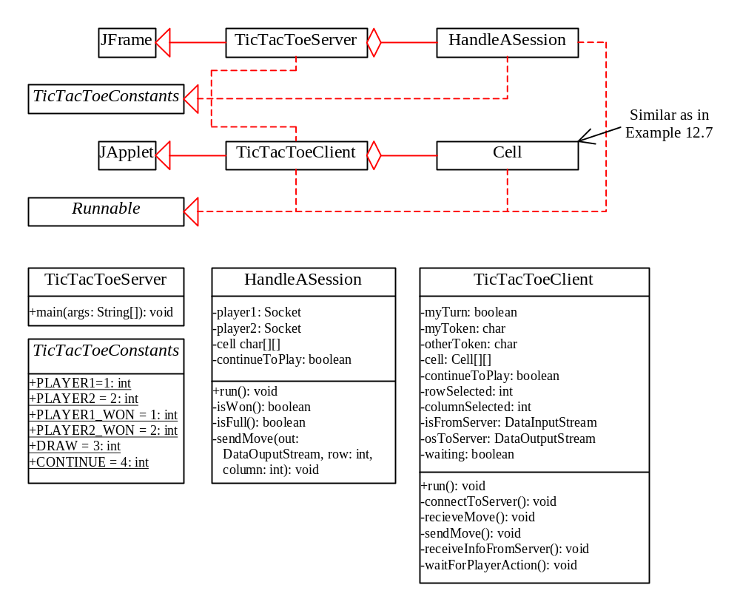
Distributed TicTacToe, cont.

Slide 16
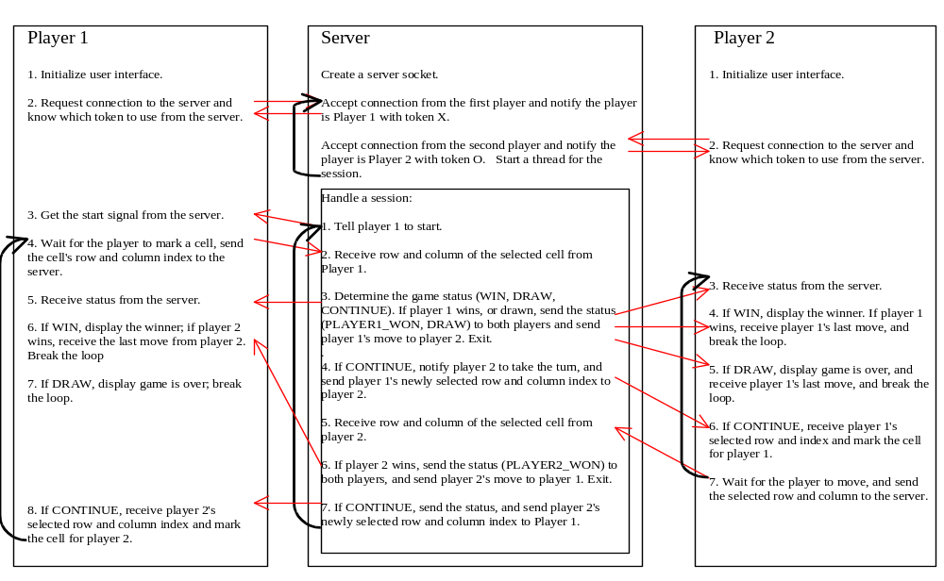
Distributed TicTacToe Game

Slide 17
public interface TicTacToeConstants {
public static int PLAYER1 = 1;
public static int PLAYER2 = 2;
public static int PLAYER1_WON = 1;
public static int PLAYER2_WON = 2;
public static int DRAW = 3;
public static int CONTINUE = 4;
}

Slide 18
JEditorPane
Swing provides a GUI component named javax.swing.JEditorPane that can be used to display plain text, HTML, and RTF files automatically. So you don’t have to write code to explicit read data from the files. JEditorPane is a subclass of JTextComponent. Thus it inherits all the behavior and properties of JTextComponent.
To display the content of a file, use the setPage(URL) method as follows:
  public void setPage(URL url) throws IOException
JEditorPane generates javax.swing.event.HyperlinkEvent when a hyperlink in the editor pane is clicked. Through this event, you can get the URL of the hyperlink and display it using the setPage(url) method.

Slide 19
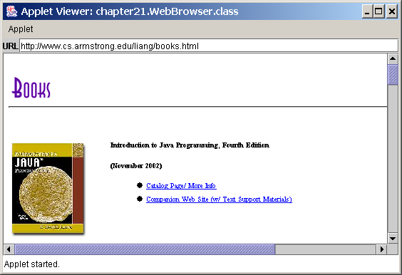
Example: Creating a Web Browser
Viewing HTML Files Using the JEditorPane. JEditorPane can be used to display HTML files.
WebBrowser

Slide 20
Stream Socket vs. Datagram Socket
Companion Website
Stream socket
Datagram socket
A dedicated point-to-point channel between a client and server.
Use TCP (Transmission Control Protocol) for data transmission.
Lossless and reliable.
Sent and received in the same order.
No dedicated point-to-point channel between a client and server.
Use UDP (User Datagram Protocol) for data transmission.
May lose data and not 100% reliable.
Data may not received in the same order as sent.

