Slide 1
Lecture 3: Strings (Ch 9),
This Pointer, and Wrapper Classes (Ch 10)
Adapted by Fangzhen Lin for COMP3021 from Y. Danial Liang’s PowerPoints for Introduction to Java Programming, Comprehensive Version, 9/E, Pearson, 2013.

Slide 2
Motivations
More on Java classes: variable scopes and the “this” pointer.
To learn some important build-in classes, especially those related to string processing which is very important in many programs: A majority of the programs process textual information
  Reports/Financial Information/Documents in general.
Two main functions
  Editing/Filtering
  Storing/Retrieving

Slide 3
Objectives
To determine the scope of variables in the context of a class (§10.3).
To use the keyword this to refer to the calling object itself (§10.4).
To use the String class to process fixed strings (§9.2).
To construct strings (§9.2.1).
To understand that strings are immutable and to create an interned string (§9.2.2).
To learn operators on strings (§9.2).
To check whether a string is a palindrome (§9.3).
To convert hexadecimal numbers to decimal numbers (§9.4).
To use the Character class to process a single character (§9.5).
To use the StringBuilder and StringBuffer classes to process flexible strings (§9.6).
To distinguish among the String, StringBuilder, and StringBuffer classes (§9.2–9.6).
To learn how to pass arguments to the main method from the command line (§9.7).
To create objects for primitive values using the wrapper classes (Byte, Short, Integer, Long, Float, Double, Character, and Boolean) (§10.12).
To simplify programming using automatic conversion between primitive types and wrapper class types (§10.13).
To use the BigInteger and BigDecimal classes for computing very large numbers with arbitrary precisions (§10.14).

Slide 4
Scope of Variables
The scope of instance and static variables is the entire class. They can be declared anywhere inside a class.
The scope of a local variable starts from its declaration and continues to the end of the block that contains the variable. A local variable must be initialized explicitly before it can be used.

Slide 5
The this Keyword
The this keyword is the name of a reference that refers to an object itself. One common use of the this keyword is reference a class’s hidden data fields.
Another common use of the this keyword to enable a constructor to invoke another constructor of the same class.

Slide 6

Reference the Hidden Data Fields

Slide 7

Calling Overloaded Constructor

Slide 8
The String Class
Constructing a String:
  String message = "Welcome to Java“;
  String message = new String("Welcome to Java“);
  String s = new String();
Obtaining String length and Retrieving Individual Characters in a string
String Concatenation (concat)
Substrings (substring(index), substring(start, end))
Comparisons (equals, compareTo)
String Conversions
Finding a Character or a Substring in a String
Conversions between Strings and Arrays
Converting Characters and Numeric Values to Strings

Slide 9
Constructing Strings
String newString = new String(stringLiteral);
String message = new String("Welcome to Java");
Since strings are used frequently, Java provides a shorthand initializer for creating a string:
String message = "Welcome to Java";

Slide 10
Strings Are Immutable
A String object is immutable; its contents cannot be changed. Does the following code change the contents of the string?
String s = "Java";
s = "HTML";

Slide 11

Trace Code
animation
String s = "Java";
s = "HTML";

Slide 12
Trace Code
animation
String s = "Java";
s = "HTML";

Slide 13
Interned Strings
Since strings are immutable and are frequently used, to improve efficiency and save memory, the JVM uses a unique instance for string literals with the same character sequence. Such an instance is called interned. For example, the following statements:

Slide 14
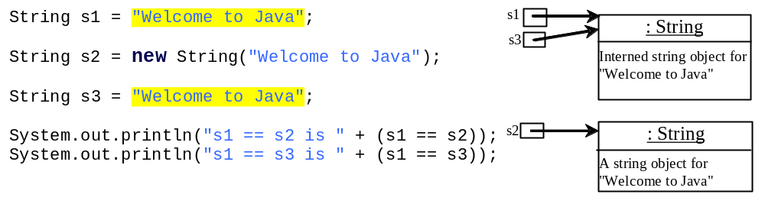
Examples
display
s1 == s2 is false
s1 == s3 is true
A new object is created if you use the new operator.
If you use the string initializer, no new object is created if the interned object is already created.

Slide 15
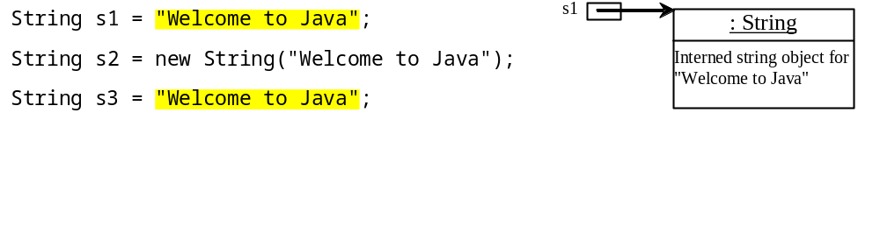
Trace Code
animation

Slide 16
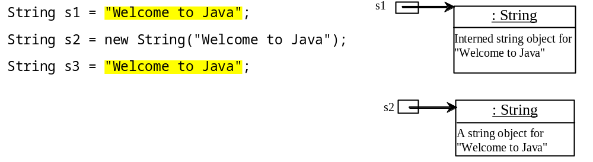
Trace Code

Slide 17
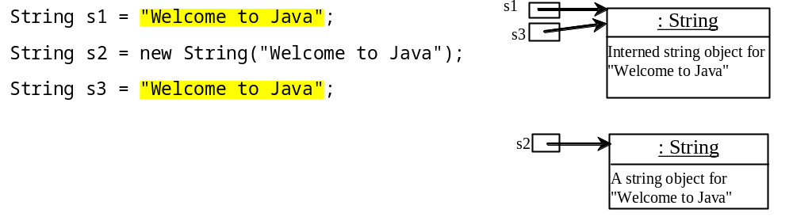
Trace Code

Slide 18
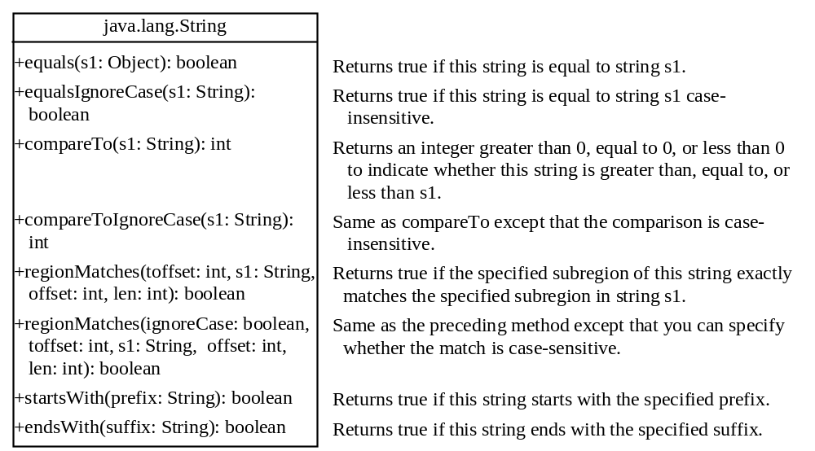
String Comparisons

Slide 19
String Comparisons
equals
String s1 = new String("Welcome“);
String s2 = “Welcome";
if (s1.equals(s2)){
// s1 and s2 have the same contents
}
if (s1 == s2) {
// s1 and s2 have the same reference
}

Slide 20
String Comparisons, cont.
compareTo(Object object)
String s1 = new String("Welcome“);
String s2 = “Welcome";
if (s1.compareTo(s2) > 0) {
// s1 is greater than s2
}
else if (s1.compareTo(s2) == 0) {
// s1 and s2 have the same contents
}
else
// s1 is less than s2

Slide 21
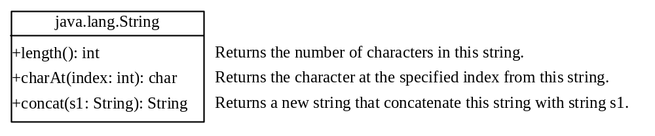
String Length, Characters, and Combining Strings

Slide 22
Finding String Length
Finding string length using the length() method:
message = "Welcome";
message.length() (returns 7)

Slide 23
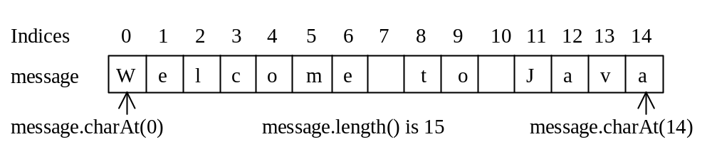
Retrieving Individual Characters in a String
Do not use message[0]
Use message.charAt(index)
Index starts from 0

Slide 24
String Concatenation
String s3 = s1.concat(s2);
String s3 = s1 + s2;
s1 + s2 + s3 + s4 + s5 same as
(((s1.concat(s2)).concat(s3)).concat(s4)).concat(s5);

Slide 25
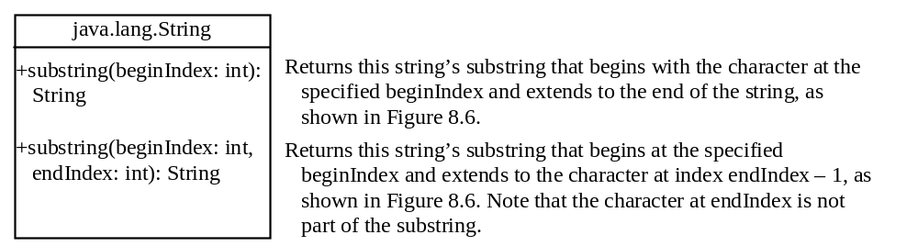
Extracting Substrings

Slide 26
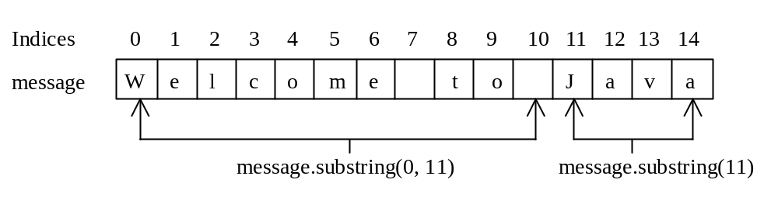
Extracting Substrings
You can extract a single character from a string using the charAt method. You can also extract a substring from a string using the substring method in the String class.
String s1 = "Welcome to Java";
String s2 = s1.substring(0, 11) + "HTML";

Slide 27
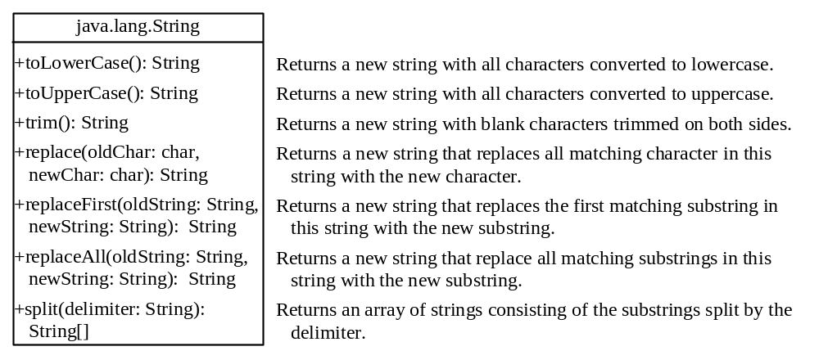
Converting, Replacing, and Splitting Strings

Slide 28
Examples
"Welcome".toLowerCase() returns a new string, welcome.
"Welcome".toUpperCase() returns a new string, WELCOME.
" Welcome ".trim() returns a new string, Welcome.
"Welcome".replace('e', 'A') returns a new string, WAlcomA.
"Welcome".replaceFirst("e", "AB") returns a new string, WABlcome.
"Welcome".replace("e", "AB") returns a new string, WABlcomAB.
"Welcome".replace("el", "AB") returns a new string, WABcome.

Slide 29
Splitting a String
String[] tokens = "Java#HTML#Perl".split("#", 0);
for (int i = 0; i < tokens.length; i++)
System.out.print(tokens[i] + " ");
displays
Java HTML Perl

Slide 30
Matching, Replacing and Splitting by Patterns
You can match, replace, or split a string by specifying a pattern. This is an extremely useful and powerful feature, commonly known as regular expression. Regular expression is complex to beginning students. For this reason, two simple patterns are used in this section. Please refer to Supplement III.F, “Regular Expressions,” for further studies.
"Java".matches("Java");
"Java".equals("Java");
"Java is fun".matches("Java.*");
"Java is cool".matches("Java.*");

Slide 31
Matching, Replacing and Splitting by Patterns
The replaceAll, replaceFirst, and split methods can be used with a regular expression. For example, the following statement returns a new string that replaces $, +, or # in "a+b$#c" by the string NNN.
String s = "a+b$#c".replaceAll("[$+#]", "NNN");
System.out.println(s);
Here the regular expression [$+#] specifies a pattern that matches $, +, or #. So, the output is aNNNbNNNNNNc.

Slide 32
Matching, Replacing and Splitting by Patterns
The following statement splits the string into an array of strings delimited by some punctuation marks.
String[] tokens = "Java,C?C#,C++".split("[.,:;?]");
for (int i = 0; i < tokens.length; i++)
System.out.println(tokens[i]);

Slide 33
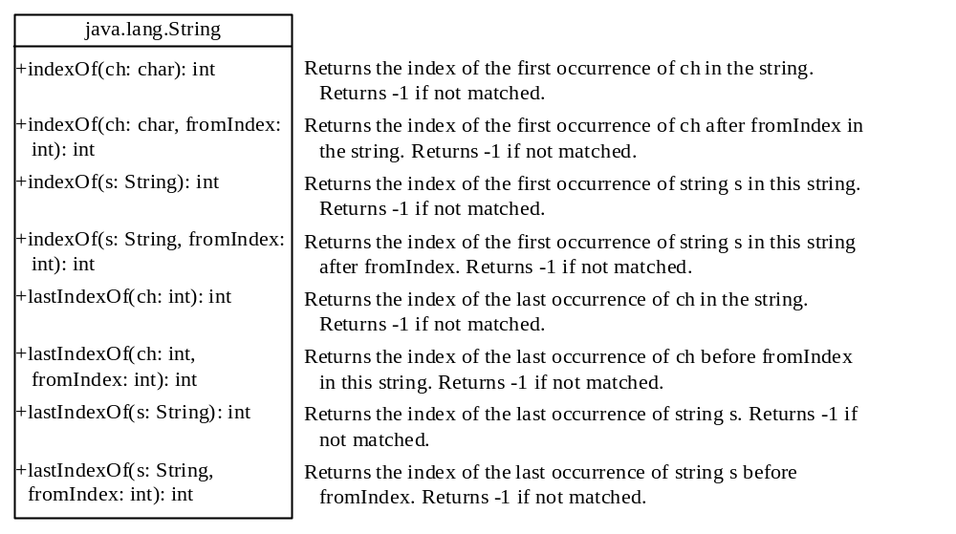
Finding a Character or a Substring in a String

Slide 34
Finding a Character or a Substring in a String
"Welcome to Java".indexOf('W') returns 0.
"Welcome to Java".indexOf('x') returns -1.
"Welcome to Java".indexOf('o', 5) returns 9.
"Welcome to Java".indexOf("come") returns 3.
"Welcome to Java".indexOf("Java", 5) returns 11.
"Welcome to Java".indexOf("java", 5) returns -1.
"Welcome to Java".lastIndexOf('a') returns 14.

Slide 35
Convert Character and Numbers to Strings
The String class provides several static valueOf methods for converting a character, an array of characters, and numeric values to strings. These methods have the same name valueOf with different argument types char, char[], double, long, int, and float. For example, to convert a double value to a string, use String.valueOf(5.44). The return value is string consists of characters ‘5’, ‘.’, ‘4’, and ‘4’.

Slide 36
Example: Finding Palindromes
Objective: Checking whether a string is a palindrome: a string that reads the same forward and backward.
CheckPalindrome

Slide 37
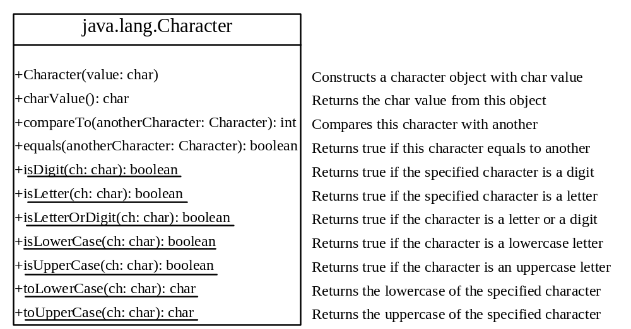
The Character Class

Slide 38
Examples
Character charObject = new Character('b');
charObject.compareTo(new Character('a')) returns 1
charObject.compareTo(new Character('b')) returns 0
charObject.compareTo(new Character('c')) returns -1
charObject.compareTo(new Character('d') returns –2
charObject.equals(new Character('b')) returns true
charObject.equals(new Character('d')) returns false

Slide 39
StringBuilder and StringBuffer
The StringBuilder/StringBuffer class is an alternative to the String class. In general, a StringBuilder/StringBuffer can be used wherever a string is used. StringBuilder/StringBuffer is more flexible than String. You can add, insert, or append new contents into a string buffer, whereas the value of a String object is fixed once the string is created.

Slide 40
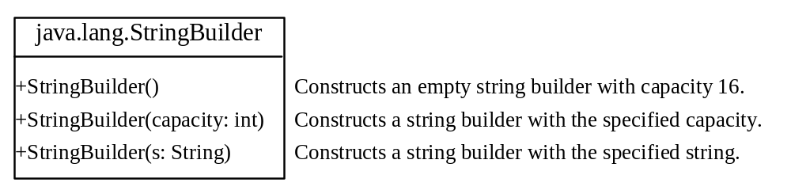
StringBuilder Constructors

Slide 41

Modifying Strings in the Builder

Slide 42
Examples
stringBuilder.append("Java");
stringBuilder.insert(11, "HTML and ");
stringBuilder.delete(8, 11) changes the builder to Welcome Java.
stringBuilder.deleteCharAt(8) changes the builder to Welcome o Java.
stringBuilder.reverse() changes the builder to avaJ ot emocleW.
stringBuilder.replace(11, 15, "HTML")
changes the builder to Welcome to HTML.
stringBuilder.setCharAt(0, 'w') sets the builder to welcome to Java.

Slide 43

The toString, capacity, length, setLength, and charAt Methods

Slide 44
Problem: Checking Palindromes Ignoring Non-alphanumeric Characters
PalindromeIgnoreNonAlphanumeric

Slide 45
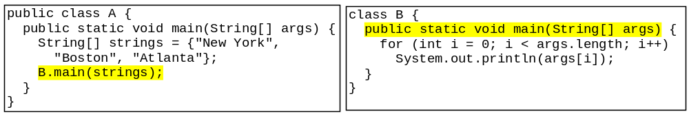
Main Method Is Just a Regular Method
You can call a regular method by passing actual parameters. Can you pass arguments to main? Of course, yes. For example, the main method in class B is invoked by a method in A, as shown below:

Slide 46
Command-Line Parameters
class TestMain {
public static void main(String[] args) {
...
}
}
java TestMain arg0 arg1 arg2 ... argn

Slide 47
Processing
Command-Line Parameters
In the main method, get the arguments from args[0], args[1], ..., args[n], which corresponds to arg0, arg1, ..., argn in the command line.
Notes:
Example 12.4

Slide 48
Problem: Calculator
Objective: Write a program that will perform binary operations on integers. The program receives three parameters: an operator and two integers.
java Calculator "2 + 3"
java Calculator "2 - 3"
Calculator
java Calculator "2 / 3"
java Calculator "2 * 3"

Slide 49
Wrapper Classes
Boolean
Character
Short
Byte
Integer
Long
Float
Double
NOTE: (1) The wrapper classes do not have no-arg constructors. (2) The instances of all wrapper classes are immutable, i.e., their internal values cannot be changed once the objects are created.

Slide 50
The toString, equals, and hashCode Methods
Each wrapper class overrides the toString, equals, and hashCode methods defined in the Object class. Since all the numeric wrapper classes and the Character class implement the Comparable interface, the compareTo method is implemented in these classes.

Slide 51
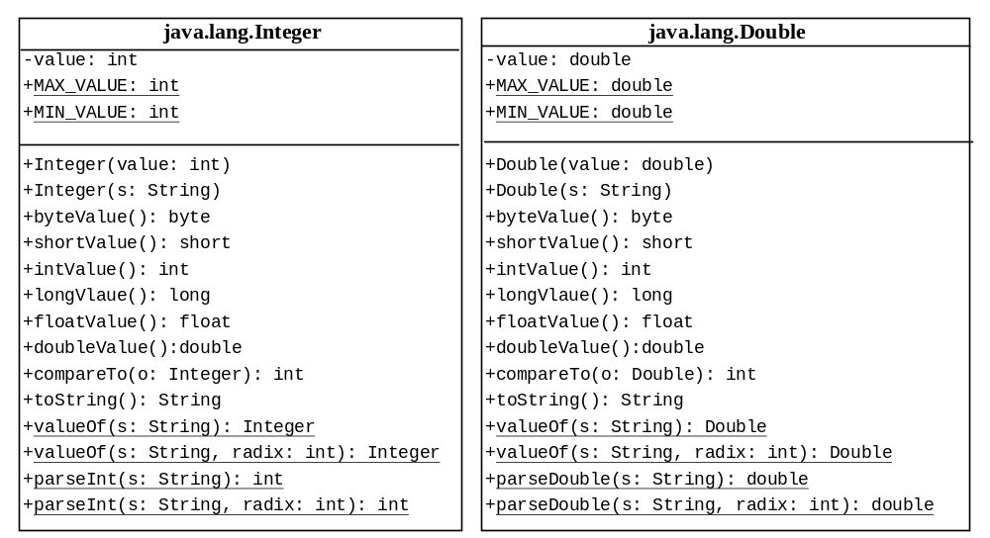
The Integer and Double Classes

Slide 52
The Integer Class and the Double Class
Constructors
Class Constants MAX_VALUE, MIN_VALUE
Conversion Methods

Slide 53
Numeric Wrapper Class Constructors
You can construct a wrapper object either from a primitive data type value or from a string representing the numeric value. The constructors for Integer and Double are:
  public Integer(int value)
  public Integer(String s)
  public Double(double value)
  public Double(String s)

Slide 54
Numeric Wrapper Class Constants
Each numerical wrapper class has the constants MAX_VALUE and MIN_VALUE. MAX_VALUE represents the maximum value of the corresponding primitive data type. For Byte, Short, Integer, and Long, MIN_VALUE represents the minimum byte, short, int, and long values. For Float and Double, MIN_VALUE represents the minimum positive float and double values. The following statements display the maximum integer (2,147,483,647), the minimum positive float (1.4E-45), and the maximum double floating-point number (1.79769313486231570e+308d).

Slide 55
Conversion Methods
Each numeric wrapper class implements the abstract methods doubleValue, floatValue, intValue, longValue, and shortValue, which are defined in the Number class. These methods “convert” objects into primitive type values.

Slide 56
The Static valueOf Methods
The numeric wrapper classes have a useful class method, valueOf(String s). This method creates a new object initialized to the value represented by the specified string. For example:
  Double doubleObject = Double.valueOf("12.4");
  Integer integerObject = Integer.valueOf("12");

Slide 57
The Methods for Parsing Strings into Numbers
You have used the parseInt method in the Integer class to parse a numeric string into an int value and the parseDouble method in the Double class to parse a numeric string into a double value. Each numeric wrapper class has two overloaded parsing methods to parse a numeric string into an appropriate numeric value.

Slide 58
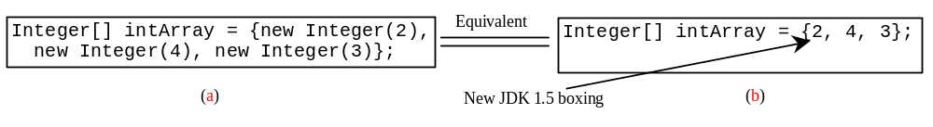
Automatic Conversion Between Primitive Types and Wrapper Class Types
JDK 1.5 allows primitive type and wrapper classes to be converted automatically. For example, the following statement in (a) can be simplified as in (b):
Integer[] intArray = {1, 2, 3};
System.out.println(intArray[0] + intArray[1] + intArray[2]);
Unboxing

Slide 59
BigInteger and BigDecimal
If you need to compute with very large integers or high precision floating-point values, you can use the BigInteger and BigDecimal classes in the java.math package. Both are immutable. Both extend the Number class and implement the Comparable interface.

Slide 60
BigInteger and BigDecimal
BigInteger a = new BigInteger("9223372036854775807");
BigInteger b = new BigInteger("2");
BigInteger c = a.multiply(b); // 9223372036854775807 * 2
System.out.println(c);
LargeFactorial
BigDecimal a = new BigDecimal(1.0);
BigDecimal b = new BigDecimal(3);
BigDecimal c = a.divide(b, 20, BigDecimal.ROUND_UP);
System.out.println(c);

