Slide 1
Tutorial 10: Q-Learning
COMP 4211
TA: Yimin Zheng
yzhengbs@connect.ust.hk

Slide 2
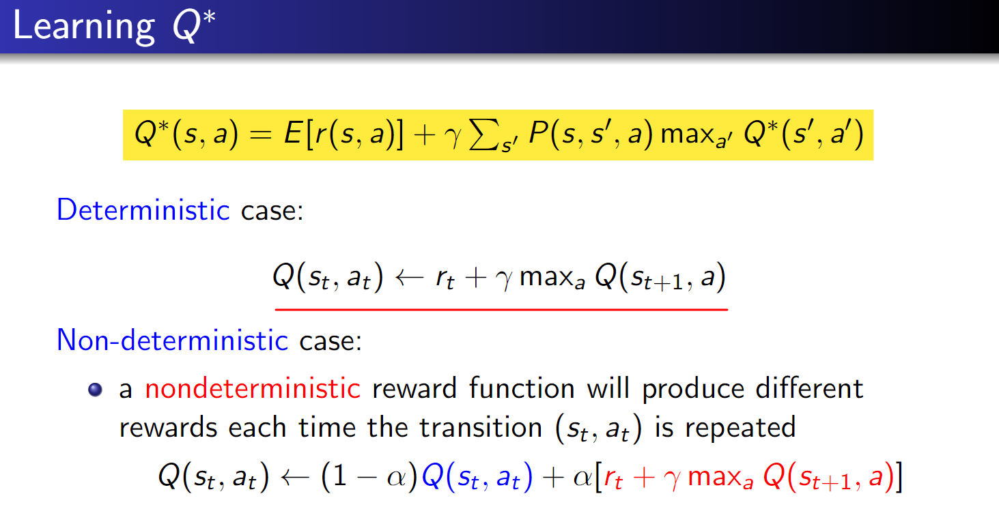
Q-table update rule

Slide 3
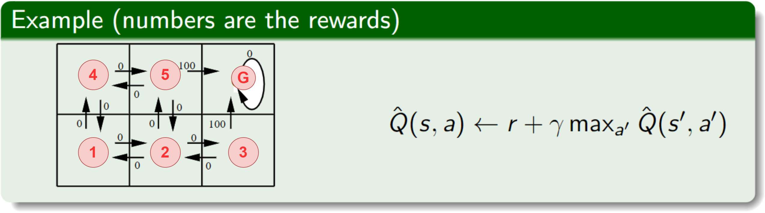
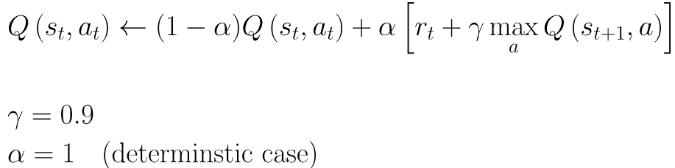
Deterministic example

Slide 4
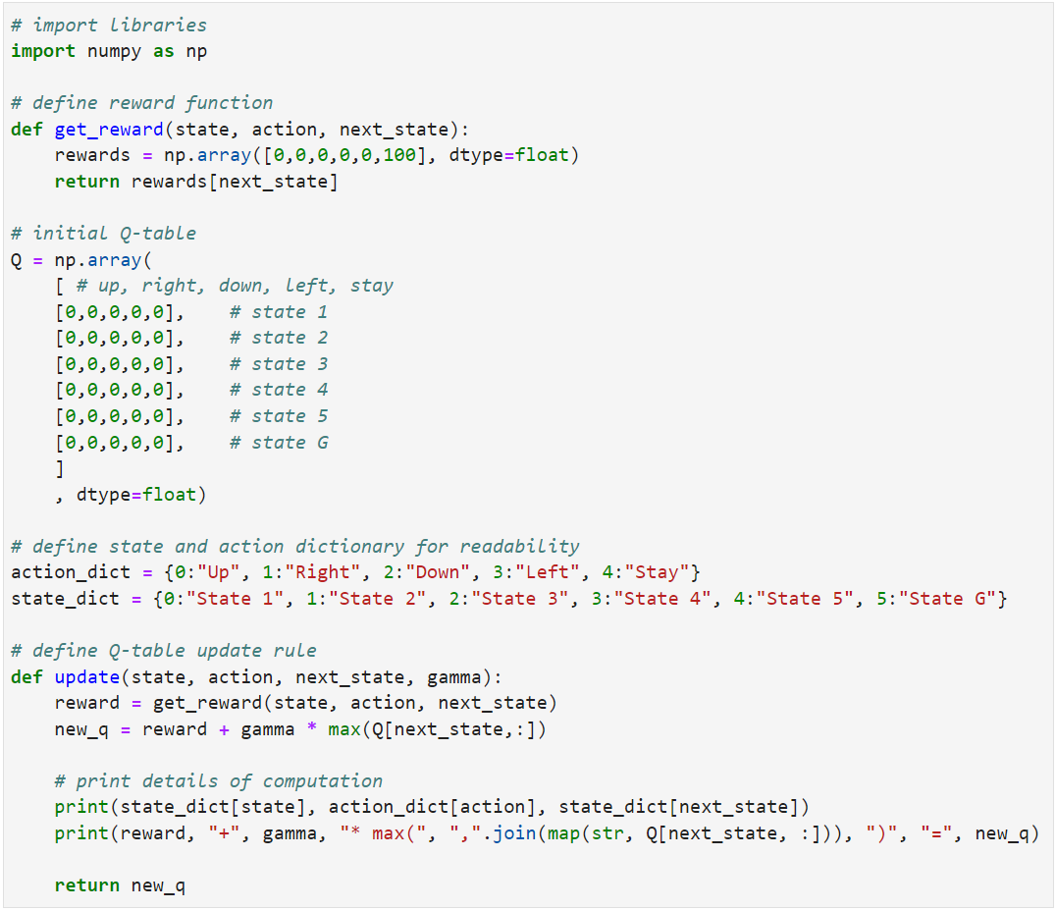
Code – define how to access rewards, Q-table
get 100 immediate reward only when reach state G
start as a zero matrix

Slide 5

Code – define Q-table update rule

Slide 6
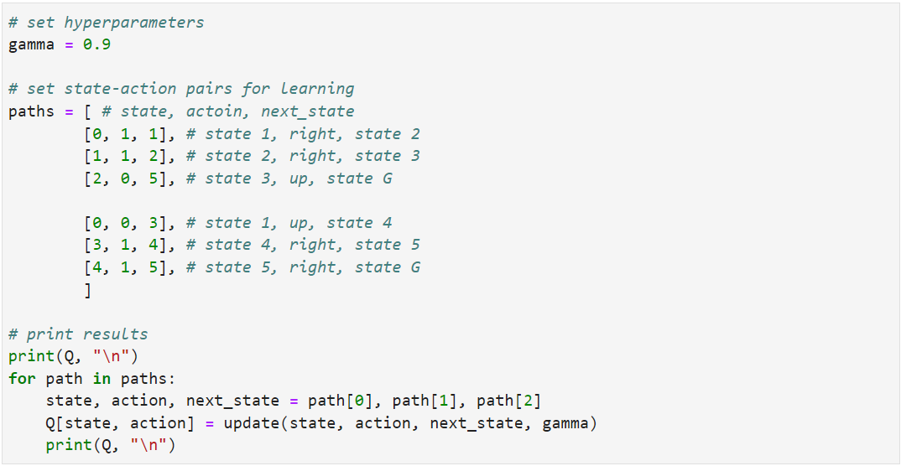
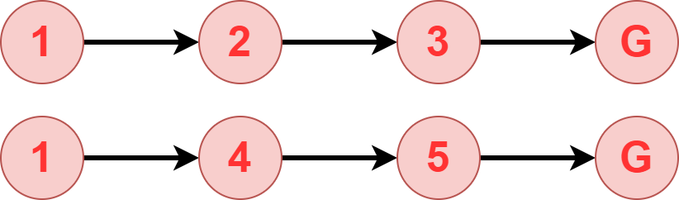
Code – set hyperparameters, state-action pairs and execute

Slide 7
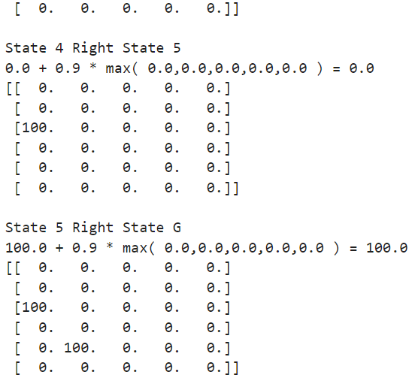
Results

Slide 8
Non-deterministic case
With some modification, the code can be used for non-deterministic case, and assignment 3 Q5.

Slide 9
Thanks!

Slide 10
Tutorial Code

