Slide 1

Additive Synthesis

Slide 2
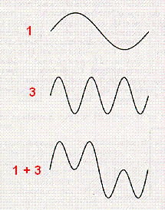
Additive Synthesis
Any periodic waveform can be expressed as the sum of one or more sine waves
  [i:44] If we have two sine waves, where one (3) repeats with 3 times the frequency of the other (1), and we add them together, the sum will be a new periodic wave (1+3)

Slide 3
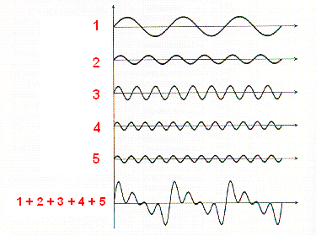
Additive Synthesis
[i:45] Another example, with 5 harmonic sine waves:

Slide 4
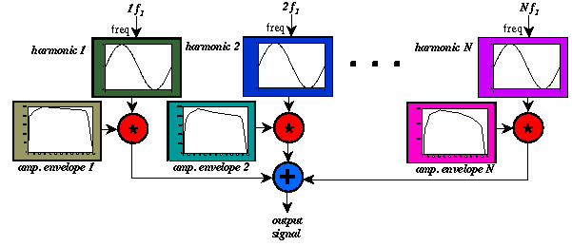
Additive Synthesis
add a weighted sum of harmonic sine waves — some harmonics are more important (louder)

Slide 5

Additive Synthesis
har = harmonic number
f₁ = fundamental frequency
_{har} = phase of the harmonic
  often 0
  usually doesn't affect the sound

Slide 6
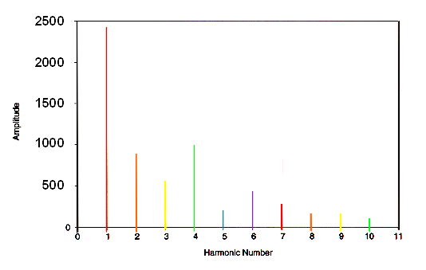
[i:46] Synthesizing the Following Spectrum

Slide 7
Additive Synthesis Example
10 note statements:
; st dur amp harm attk dec
i1 1 5 2400 1 .25 .05
i1 . 4.5 900 2 .28 .048
i1 . 4 600 3 .03 .047
i1 . 3.5 1000 4 .031 .044
i1 . 3.25 180 5 .032 .043
i1 . 3.1 400 6 .033 .039
i1 . 2.85 250 7 .034 .035
i1 . 2.55 90 8 .035 .031
i1 . 2.17 90 9 .036 .028
i1 . 2.1 55 10 .037 .025

Slide 8
Additive Synthesis Example
OR —1 note statement and 10 .orc statements
  the peak amps of the partials are proportional to the amplitude of lowest partial:
iamp1 = 2400
iamp2 = iamp1 * .375
iamp3 = iamp1 * .25
iamp4 = iamp1 * .4167
iamp5 = iamp1 * .075
iamp6 = iamp1 * .1667
iamp7 = iamp1 * .1042
iamp8 = iamp1 * .0375
iamp9 = iamp1 * .0375
iamp10 = iamp1 * .0229

Slide 9
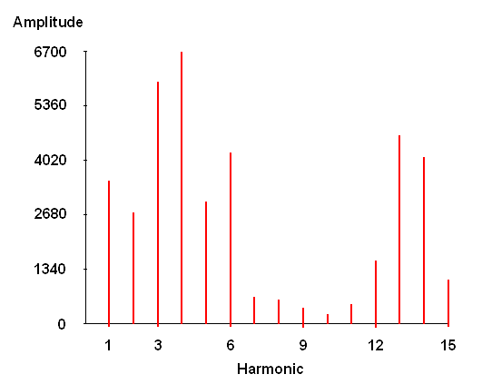
Additive Synthesis Instruments
[i:47] Tenor instrument design:
  the voice has harmonic partials
  additive synthesis — 15 harmonics

Slide 10
Additive Synthesis Instruments
tenor.sco: one wavetable:
; sine wave for fundamental and partials
f1 0 16385 10 1
tenor.orc: additive synthesis
instr 11 ; tenor voice
idur = p3 ; duration
iamp = p4 ; amplitude
ifreq = cpspch(p5) ; frequency

Slide 11
tenor.orc: Amplitudes and Enveloped Signals
iamp1 = 3400
iamp2 = 2700
iamp3 = 6000
iamp4 = 6700
iamp5 = 3000
iamp6 = 4200
iamp7 = 600
iamp8 = 510
iamp9 = 450
iamp10 = 350
iamp11 = 500
iamp12 = 1600
iamp13 = 4800
iamp14 = 4200
iamp15 = 1250
asig1 oscili iamp1, ifreq, iwt1
asig2 oscili iamp2, ifreq * 2, iwt1
asig3 oscili iamp3, ifreq * 3, iwt1
asig4 oscili iamp4, ifreq * 4, iwt1
asig5 oscili iamp5, ifreq * 5, iwt1
asig6 oscili iamp6, ifreq * 6, iwt1
asig7 oscili iamp7, ifreq * 7, iwt1
asig8 oscili iamp8, ifreq * 8, iwt1
asig9 oscili iamp9, ifreq * 9, iwt1
asig10 oscili iamp10, ifreq * 10, iwt1
asig11 oscili iamp11, ifreq * 11, iwt1
asig12 oscili iamp12, ifreq * 12, iwt1
asig13 oscili iamp13, ifreq * 13, iwt1
asig14 oscili iamp14, ifreq * 14, iwt1
asig15 oscili iamp15, ifreq * 15, iwt1

Slide 12
tenor.orc
add the signals:
ampenv linseg 0, iattack, 1, isus, 1, idecay, 0, 1, 0
asigs = (asig1+ asig2+ asig3+ asig4+ asig5+ asig6+ asig7+ asig8+ asig9+ asig10+ asig11+ asig12+ asig13+ asig14+ asig15)
out asigs * ampenv
endin

Slide 13
Additive Synthesis Advantages
Very flexible
  Can control each partial individually
  Can represent any harmonic or nearly-harmonic sound
    But not good for noisy tones (e.g., drums).
Can be used in combination with spectrum analysis to reconstruct musical instrument tones.

Slide 14
Additive Synthesis Disadvantages
Slow.
  Many instruments require summing 40-100 harmonics. Can’t play very many notes in real-time on current hardware.
  For example, the hardware may only be able to produce 4-note polyphony to keep up in real-time.

Slide 15
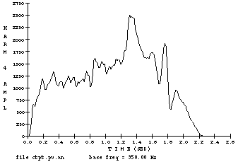
Additive Synthesis Disadvantages
Difficult to control group as a whole
Many parameters which are difficult to control:
  40-100 amplitude envelopes plus 40-100 frequency envelopes, where each envelope consists of about 1000 timepoints.

Slide 16
Solutions
Reduce number of parameters somehow
  E.g., simplify envelopes by using piecewise linear approximation

