Slide 1

All-Pass Filters

Slide 2
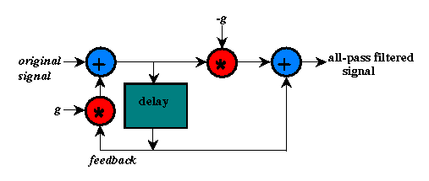
All-Pass Filters

Slide 3
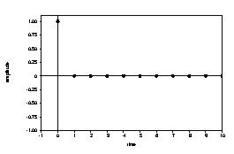
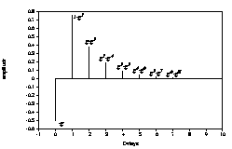
All-Pass Filters
output:
(scaling factor = .5)
impulse input:
faster exponentially-decaying sequences than comb filter

Slide 4
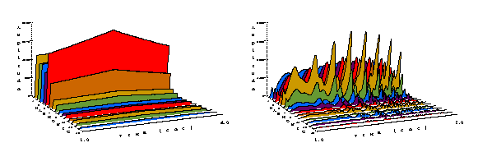
All-Pass Filters
Applying an all-pass filter to the oboe spectrum at the fundamental frequency produces amplitude peaks similar to that of a comb filter.
[iv:15] oboe at 261.6 Hz
[iv:44] with all-pass filter
at 261.6 Hz

Slide 5
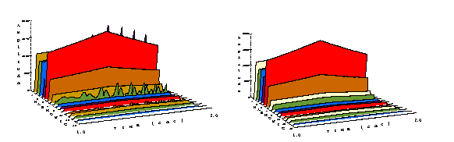
All-Pass Filters
When the all-pass filter is set to the 4th harmonic, it still gives amplitude peaks, but when it is set to the 5th harmonic, the spectrum resembles that of the original oboe.
[iv:45] a-p filter at 1046.4 Hz
[iv:46] a-p filter
at 1308 Hz

Slide 6
All-Pass Filter
; alpass arguments: signal, ring time, loop time
; where loop time = 1/allpassFreq
…
asig1 alpass asig, iring, 1/iapfreq
aenv linseg 0,iattack,iamp,isus,iamp,idecay,0,1,0
asig = asig1 * aenv
out asig ; output signal
endin

