Slide 1

Comb Filters

Slide 2
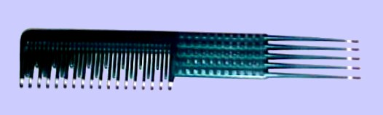
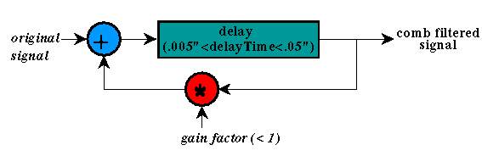
Comb Filters

Slide 3
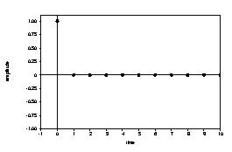
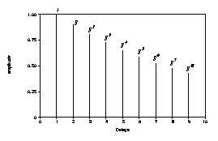
Comb Filters
output:
(scaling factor = .9)
impulse input:
Good model for exponentially decaying echoes

Slide 4
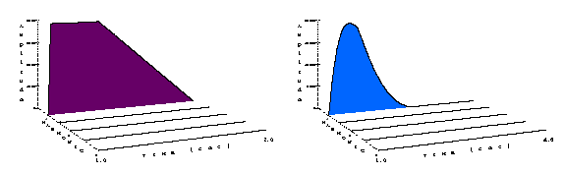
Comb Filters
Applying a comb filter to a sine wave at the fundamental frequency produces a sharper rolloff, but doesn't change the fundamental.
[iv:37] sine wave, 261.6 Hz
[iv:38] with comb filter
at 261.6 Hz

Slide 5
Comb Filters
Combing a sine wave produces only the fundamental frequency, no matter what the comb frequency, because the comb does not produce its own frequency.
However, it can change the amplitude and quality of the sound by giving a "metallic" ring.

Slide 6
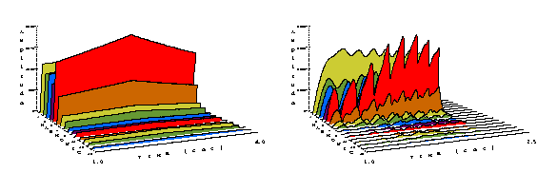
Comb Filters
Applying a comb filter to an oboe spectrum at the fundamental frequency produces a rich spectrum with amplitude peaks similar to the teeth of a comb.
[iv:15] oboe at 261.6 Hz
[iv:39] with comb filter
at 261.6 Hz

Slide 7
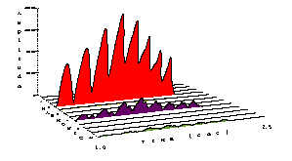
Comb Filters
At four times the fundamental frequency, the comb filter gives a metallic ring, and gives only three frequencies at harmonic intervals from itself.
The filter frequency is the loudest of these.
[iv:40] with comb filter at 1046.4 Hz

Slide 8
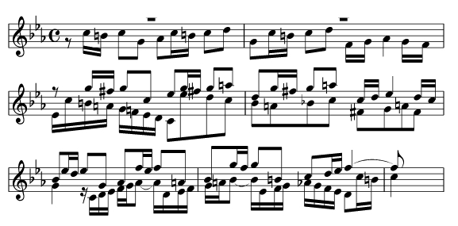
Musical Examples
Bach, Fugue #2 in C Minor
  [iv:41] with comb filter at 880 Hz
  [iv:42] with comb filter at 880 Hz, then lowpass filter frequency changing from 220 to 7040
  [iv:43] with a flickering bank of comb filters at 10 harmonic frequencies from 246.9

Slide 9
Comb Filter
score file
;comb.sco - use with comb.orc
; start dur
i2 1 2.0 ... ; note list
; comb percent
; st dur amp freq attk dec ring comb
;i94 1 2.0 1.0 261.6 0.45 0.15 1.5 1.0
i94 1 2.0 1.0 1046.4 0.45 0.15 1.5 1.0

Slide 10
Comb Filter
;comb.orc - use with comb.sco
gacomb init 0 ; initialize gacomb
;--------------------------------------------------
instr 2 ; regular instrument
...
; add the signal for this note to the global signal
gacomb = gacomb + asig
out asig ; don't output asig here
endin
;--------------------------------------------------

Slide 11
Comb Filter
instr 94 ; global comb filter
idur = p3
iamp = p4
icombfreq = p5 ; comb filter frequency
iattack = p6
idecay = p7
isus = idur - iattack - idecay
iring = p8 ; ring time for comb filter
icomb = p9 ; percent for combed signal
; make sure the values are between 0 and 1:
icomb = (icomb <= 0 ? .01 : icomb)
icomb = (icomb >= 1 ? .99 : icomb)
iacoustic = 1 - icomb ; rest of signal is acoustic
p3 = p3 + iring + .1 ; lengthen p3
iloop = 1/icombfreq ; loop time

Slide 12
Comb Filter
; comb arguments: signal, ring time, loop time
acomb comb gacomb, iring, iloop
aenv linseg 0,iattack,iamp,isus,iamp,idecay,0,1,0
acomb = acomb * aenv
; mix signal (percent acoustic and percent combed)
asig = (iacoustic * gacomb) + (icomb * acomb)
out asig ; output signal
gacomb = 0 ; reset gacomb to prevent feedback
endin

