Slide 1

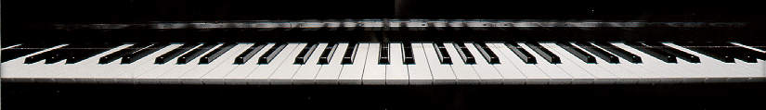
Introduction
to Csound

Slide 2
What is Csound?
a programming language for sound generation
uses software synthesis to compile user-defined orchestras and scores to produce music
allows users to program whatever synthesis method or tuning they like
challenges users to harness its power to produce music
no built-in instruments
only the basic building blocks, just like the C programming language

Slide 3
The Csound Orchestra
contains the instrument designs
naming convention: the .orc file contains Csound orchestra
begins with four header statements, most commonly the following:
sr = 22050
kr = 2205
ksmps = 10
nchnls = 1

Slide 4
The Header Statements
sr = 22050
kr = 2205
ksmps = 10
nchnls = 1
  first header line sets sampling rate
    number of digital samples for each second of sound
    44100 Hertz — high quality sampling rate of CDs
    22050 Hertz — medium quality sampling rate
    8192 Hertz — low quality telephone sampling rate

Slide 5
The Header Statements
sr = 22050
kr = 2205
ksmps = 10
nchnls = 1
  second header line sets control rate for more slowly varying functions such as amplitude envelopes
iamp
0
iattack
isustain
idecay

Slide 6
The Header Statements
sr = 22050
kr = 2205
ksmps = 10
nchnls = 1
  third header line sets number of samples for one control period
    control period = sampling rate/control rate
      number of digital samples for each second of sound
      specifying it makes it easier to remember this requirement

Slide 7
The Header Statements
sr = 22050
kr = 2205
ksmps = 10
nchnls = 1
  last header line sets number of audio channels
    1 — mono soundfiles
    2 — stereo soundfiles

