Slide 1
Music on Mobile Phones
Issues Overview

Slide 2
Mobile Music Formats
Common Music Formats used in Multimedia Messaging Services (MMS) are:
  MIDI
  SP-MIDI
  I-Melody
SP-MIDI is in principle a MIDI file with a special System Exclusive message.
I-Melody is a simple single polyphonic format which does not define any instruments.
Transcoding between MIDI, SP-MIDI, and I-Melody, in general is a problem of polyphony reduction

Slide 3
Problems
Mobile devices usually have a limitation on the Maximum Instantaneous Polyphony (MIP) the hardware can support.
Most MIDI were composed without the MIP consideration.
Problems when downloading these MIDI files into a mobile device:
  Some MIDI file cannot be played back at all
  Some play back with a poor quality
SP-MIDI is an attempt to solve the problem, but early SP-MIDI hardware introduce more problems:
  It may fail to play some SP-MIDI when the MIP in the SP-MIDI exceeds the hardware limitation
An even extreme case is I-Melody, which always has an MIP value of 1.

Slide 4
Experiment on N7250
Nokia 7250
  a representative of the Nokia Series 40 mobile phone platform
  supports a MIP of 4.
The MIDI to be tested is Canyon.mid
  An old midi file comes with MS Windows, since Windows 3.1
  Single Track, 11 Channels
  MIP was found to be 28
  The MIDI itself cannot be played on N7250 at all
Two approaches were used in an attempt to make it playable regardless of the quality
  Throwing away notes to guarantee MIP to be within a certain value
  Convert to a SP-MIDI

Slide 5
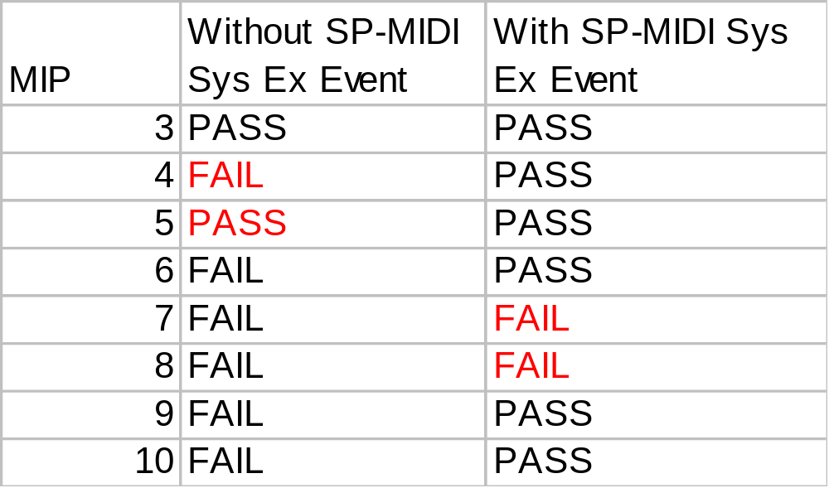
Experiment Results for N7250
SP-MIDI is not guaranteed to be playable!
MIDI within MIP is not guaranteed to be payable!

Slide 6
Solution
Due to buggy Hardware, to guarantee a MIDI be playable, a MIDI file must fulfill the following:
  The MIDI’s MIP be reduced to within the hardware MIP limitation
  Convert to SP-MIDI by adding a MIP table

Slide 7
A simple MIP reduction algorithm
Assign Channel priorities in the following manner:
  1,10,2,3,4,5,6,7,8,9,11,12,13,14,15,16
  Channel 10 is the Rhythm or Percussion channel defined in General MIDI spec.
Reduce every channel to single polyphonic by note-stealing in a FIFO manner
Now N channels will have a MIP of N
By simply grouping the 1st N channels into a MIDI file, the MIP of this new MIDI will be less than or equal to N
A MIP value of 1 corresponds to its I-Melody equivalent when transcoded.

Slide 8





Conversion Results
Original (28 MIP)
8 MIP – sounds OK
4 MIP – still acceptable
1 MIP – terrible

Slide 9




Example Conversion - Classical
Opus85.mid
  29 MIP
Results for 8 MIP, 4 MIP and 1 MIP respectively:
Sounds OK
Some sudden silent periods
e.g. 2:26 – 2:37
Many silent periods, only a flute part remains

Slide 10




Example Conversion - Modern
Epiphany.mid
  18 MIP
  The song begins with only two instruments with content getting richer and richer.
Results for 8 MIP, 4 MIP and 1 MIP respectively:
Sounds OK
A sudden silent period appears in around 28-33s
Many silent periods, sounds terrible

Slide 11




Example Conversion - Western
LetItBe.mid
  15 MIP
Results for 8 MIP, 4 MIP and 1 MIP respectively:
Sounds OK
Main theme completely lost with many silent periods
No sound at all!

Slide 12




Example Conversion - Chinese
1343.mid
  15 MIP
  The main theme of an old Chinese Kung-Fu TV program
Results for 8 MIP, 4 MIP and 1 MIP respectively:
Sounds OK
Main theme lost, instead a series of bass remains
Only basses remains!

Slide 13
Conversion Problems
Main theme lost
  The general priority that higher channel number will have higher priority is not always valid, although this has been specified in the MIDI specification
Silent Periods
  It may happen that the Main theme is elaborated by interlacing several instruments
  The instrument based algorithm may throw away a key instrument which resulted in the silent periods

Slide 14
Observations
Simple Polyphony reduction without Music Understanding is not enough to provide a good quality conversion form a higher MIP device to a lower MIP device.
The poor quality becomes noticeable especially when the MIP of the target device is less than or equal to 4.
The poor quality is in general shown in two ways :
  Main theme lost
  Sudden silent periods
Music Understanding technique to analysis the main theme of the piece of the Music seems to be a viable solution to this problem

Slide 15
A refined MIP reduction algorithm
Combine all notes into single channel
Use MIP=N for this single channel. Use note-stealing in FIFO manner.

Slide 16
Conversion Results - Canyon
Original (28 MIP)
8 MIP – very good
4 MIP – good
1 MIP – not bad for so cheap!
better than expected!

Slide 17
Example Conversion - Classical
Opus85.mid
  29 MIP
Results for 8 MIP, 4 MIP and 1 MIP respectively:
Very good
ok
Interesting!

Slide 18
Example Conversion - Modern
Epiphany.mid
  18 MIP
  The song begins with only two instruments with content getting richer and richer.
Results for 8 MIP, 4 MIP and 1 MIP respectively:
Very good
good
ok

Slide 19
Example Conversion - Western
LetItBe.mid
  15 MIP
Results for 8 MIP, 4 MIP and 1 MIP respectively:
Very good
good
ok

Slide 20
Example Conversion - Chinese
1343.mid
  15 MIP
  The main theme of an old Chinese Kung-Fu TV program
Results for 8 MIP, 4 MIP and 1 MIP respectively:
Very good
good
Strange, but want do you expect?

