Slide 1
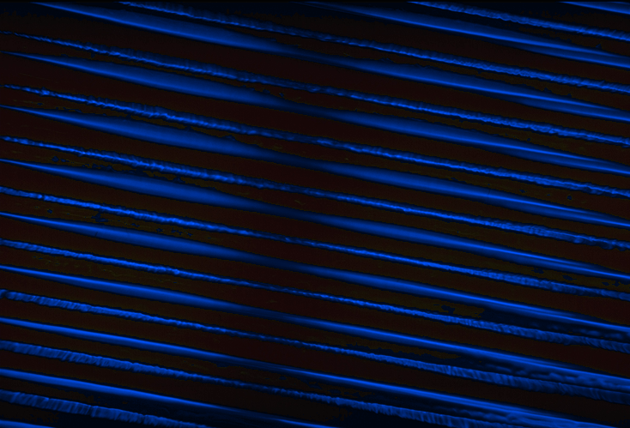
Reverb

Slide 2
Reverb
Reverberation is made up of many reflections.
Reverb simulation is more complex than the filters.
We need to consider the geometry of a concert hall and the speed of sound.
  Speed of sound: 350 meters/second

Slide 3
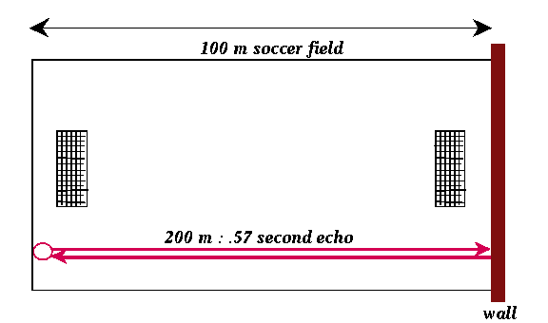
Reverb
  Speed of sound: 350 meters/second

Slide 4
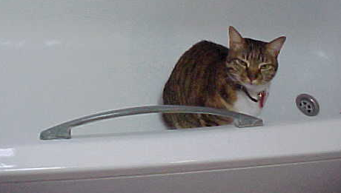
Reverb
With a .5 second reverberation time, a sound wave will travel about 175 meters
  that means that in a 3 meter bathroom sounds will bounce more than 58 times before being absorbed (more or less)

Slide 5
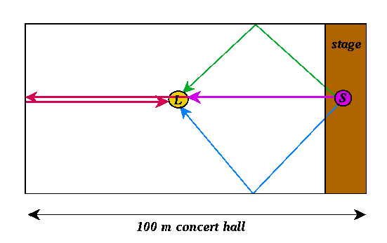
Reverb
Sound in a concert hall consists of:
  Direct sound
  1st order reflections (1 wall)
  2nd order reflections (2 walls)
  higher order reflections
Direct Sound and First Order Reflections

Slide 6
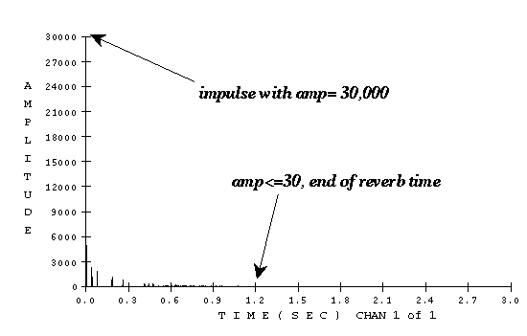
Reverberation Time
Definition:
  Time for a sound's reflections to decay to .1% (.001) of the source's amplitude.

Slide 7
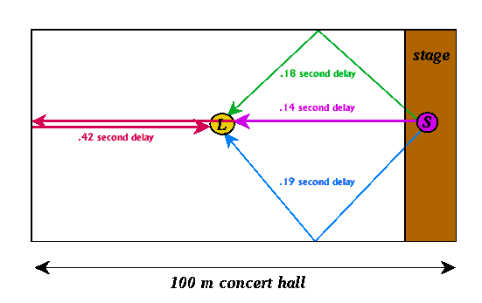
Parts of a Reverberated Sound
Direct sound (unreflected)
  travels in a straight path to the listener
Early reflections
  arrive .01-.1 seconds after the direct sound

Slide 8
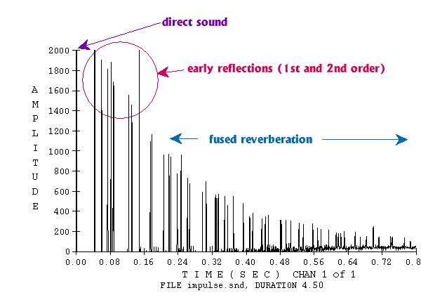
Parts of a Reverberated Sound
Fused reverberation
  contains thousands of later reflections.
Reverberation of an impulse signal (exponential decay)

Slide 9
Csound Reverb
[iv:47] Bach example, no reverb
[iv:48] same example, with Csound reverb
score file:
; csreverb.sco
; start dur
i2 1 2.0 ... ; note list
i2 13 2.0 ... ; maximum duration is 15
; p2 p3 p4 p5 p6
; rvb percent
; st dur gain time reverb
i96 1.0 15.0 1.0 1.5 .08 ; reverb dur is 15

Slide 10
Csound Reverb
orchestra file
;csreverb.orc - use with csreverb.sco
garev init 0 ; initialize garev
;--------------------------------------------------
instr 2 ; regular instrument
...
; add the signal for this note to the global signal
garev = garev + asig
out asig ; don't output asig here
endin
;--------------------------------------------------

Slide 11
Csound Reverb
instr 96 ; Csound global reverb instrument
idur = p3
igain = p4 ; gain to control amplitude
irevtime = p5 ; reverb time
ireverb = p6 ; percent reverberated signal
iacoustic = 1 - ireverb ; pct unreverberated
p3 = p3 + irevtime ; lengthen p3
inorm = .92117 ; normalize the tone

Slide 12
Csound Reverb
; reverberate the global signal with
; Csound's built-in reverberator
arev reverb garev, irevtime
; mix signal (percent acoustic and percent reverbed)
aout = (iacoustic * garev) + (ireverb * arev)
; attenuate and output the signal
out aout*igain/inorm
garev = 0 ; set garev to prevent feedback
endin

Slide 13
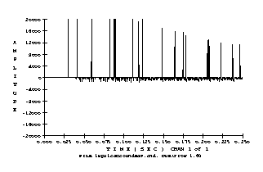
Schroeder Reverberator
Csound's reverberator was not implemented correctly:
Impulse Response to Csound's reverb

Slide 14
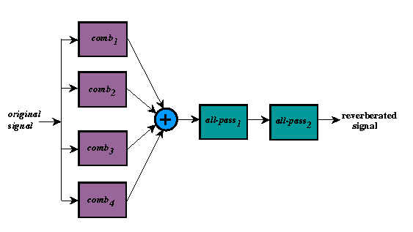
Schroeder Reverberator
Schroeder Reverberator uses comb and all-pass filters

Slide 15
Schroeder Reverberator
Comb delay times in range .03 - .05 seconds, and relatively prime to one another (e.g., .031, .037, .041, .043).
The all-pass filters (with delays of .005-.02 seconds) build up the echo density even though the amplitude decays.
  The first all-pass turns each comb echo into a string of echoes.
  The second all-pass adds another layer of echoes.

Slide 16
Schroeder Reverberator
How long is reverb time, given delay and gain factor g for the comb filter?
  1/1000 = g^{revTime/delayTime}
Example: delay = .05, g = .9
  .001 = .9^{revTime/.05}
  .05 log_{.9} .001 = revTime = 3.28 seconds

Slide 17
Schroeder Reverberator
Typical concert halls have reverb time ranging from 1.5 - 3 seconds.
Schroeder reverb time is about equal to the longest of the 4 comb filter reverb times.

Slide 18
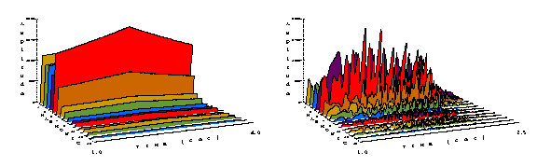
Schroeder Reverberator
Applying reverb to oboe spectra
[iv:15] oboe, 261.6 Hz
[iv:49] with reverb

Slide 19
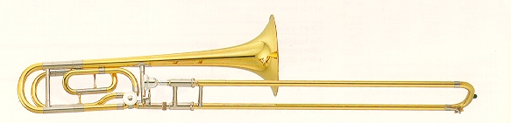
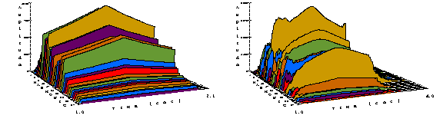
Schroeder Reverberator
Applying reverb to trombone spectra
[iv:50] trombone, 73.42 Hz
[iv:51] with reverb

Slide 20
Schroeder Reverb
score file
; reverb.sco
; start dur
i2 1 2.0 ... ; note list
i2 13 2.0 ... ; maximum duration is 15
; p2 p3 p4 p5 p6
; rvb percent
; st dur gain time reverb
i97 1.0 15.0 1.0 1.5 .08 ; reverb dur is 15

Slide 21
Schroeder Reverb
orchestra file
;reverb.orc - use with reverb.sco
garev init 0 ; initialize garev
;--------------------------------------------------
instr 2 ; regular instrument
...
; add the signal for this note to the global signal
garev = garev + asig
out asig ; don't output asig here
endin
;--------------------------------------------------

Slide 22
Schroeder Reverb
instr 97 ; Csound global reverb instrument
idur = p3
igain = p4 ; gain to control amplitude
irevtime = p5 ; reverb time
ireverb = p6 ; percent reverberated signal
iacoustic = 1 - ireverb ; pct unreverberated
p3 = p3+irevtime+.1 ; lengthen p3
inorm = .91999 ; normalize the tone
; make sure gain is between 0 and 1 (1 = 100%)
igain = (igain <= 0 ? .01 : igain)
igain = (igain > 1.0 ? 1.0 : igain)
; make sure % reverb between 0 and 1 (0 ok, 1=100%)
ireverb = (ireverb > .99 ? .99 : ireverb)
ireverb = (ireverb < 0 ? 0 : ireverb)
iacoustic = 1 - ireverb ; percent unreverberated

Slide 23
Schroeder Reverb
; reverberate the global signal with
; Schroeder reverberator
ac1 comb garev, irevtime, .0297
ac2 comb garev, irevtime, .0371
ac3 comb garev, irevtime, .0411
ac4 comb garev, irevtime, .0437
acomb = ac1 + ac2 + ac3 + ac4
ap1 alpass acomb, .09683, .005
arev alpass ap1, .03292, .0017
; mix signal (percent acoustic and percent reverbed)
aout = (iacoustic * garev) + (ireverb * arev)
; attenuate and output the signal
out aout*igain/inorm
garev = 0 ; set garev to prevent feedback
endin

Slide 24
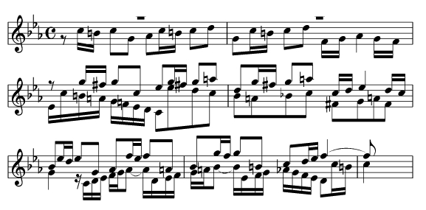
How Much Reverb?
Between 4% (.04) and 15% (.15) for the reverb amount.
Try different values and pick the one that sounds best for your music.
Examples: Bach, Fugue #2 in C Minor
  [iv:52] 4% reverb (.8 seconds reverb time)
  [iv:53] 15% reverb (.8 seconds reverb time)

Slide 25
How Long a Reverb Time?
Between .8 seconds and 1.5 seconds for the reverb time.
  This simulates a medium-sized concert hall.
  If the reverb time is too short, the sound is dry and lifeless.
  If the reverb time is too long, it sounds artificial, even metallic.
Examples: Bach, Fugue #2 in C Minor
  [iv:54] .8 seconds reverb time (10% reverb)
  [iv:55] 1.5 seconds reverb time (10% reverb)
  [iv:56] 3 seconds reverb time (10% reverb)
What happens to the sound as the reverb time increases?

Slide 26
Refinements
A lowpass filter at the end of the reverb code can damp high frequencies and make the sound less metallic.
  Example: Bach, Fugue #2 in C Minor
    [iv:57] filter freq = 2000 (decays to 500), 5 seconds reverb time, 15% reverb

Slide 27
Refinements
Even better, a lowpass filter inside the comb filter (in the feedback loop) can damp high frequencies as a wall absorbs high frequencies.
  Example: Bach, Fugue #2 in C Minor
    [iv:58] filter freq = 3000, 5 seconds reverb time, 15% reverb

Slide 28
Refinements
Adding a few early echoes by direct delay also helps make it sound more realistic.
  Example: Bach, Fugue #2 in C Minor
    [iv:59] filter freq = 3000, 5 seconds reverb time, 15% reverb

