Slide 1

Sampling

Slide 2
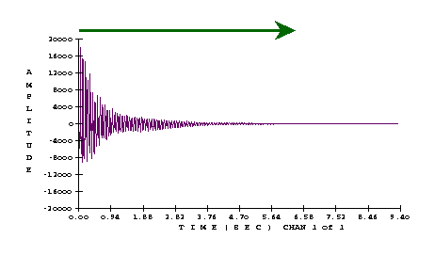
Sampling
plays back samples of the original tone.
  For simple decaying tones (e.g., piano, harp, marimba, guitar, plucked strings), playing back the samples from start to finish works well:
[iv:73] sample of piano Bb3 tone, 9.33 seconds

Slide 3
Sampling (Soundin)
soundin:
  Easiest for sounds which don't need to change pitch
    percussion (such as drums)
    [iv:74] speech and sound effects

Slide 4
Sampling (Soundin)
Find a sample or record a sound.
  To save disk space, change the sampling rate to 22050 (using a sound editor such as CoolEdit) and change the signal to mono
  Save the soundfile in Mac aiff format
    use the name soundin.# (where the # is some number you give the soundfile)

Slide 5
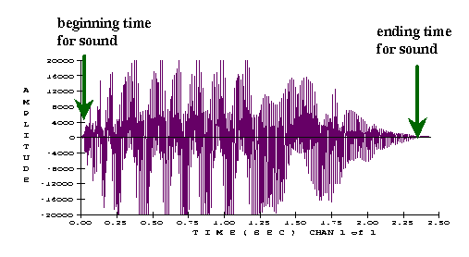
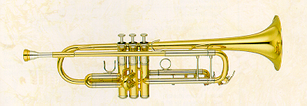
Sampling (Soundin)
Find a sample or record a sound.
  Using the sound editor, delete any long silences in the sound and find the beginning and ending times for the sound.
[iv:75] 2.43-second trumpet tone (ctpt03)

Slide 6
Sampling (Soundin)
In the Csound score file, the "skip" time is the beginning time for the sound, and the duration of the sound is the ending time minus the skip time.
The following code reads a mono soundfile:
asig soundin isoundfile, iskip, iformat
  0 is default format, 3 is mulaw
  soundfile should be in Mac aiff format

Slide 7
Sampling (Soundin)
Most of the signal-modifying effects can modify the sampled signal. These include spatialization (stereo, echo, reverb and amplitude control), ring modulation, flanging and chorus.
  Example: [iv:76] Ayers, Long Time No See
But we cannot loop soundin, and we cannot use it with effects involving frequency changes, such as vibrato, glissando and pitch transposition.

Slide 8
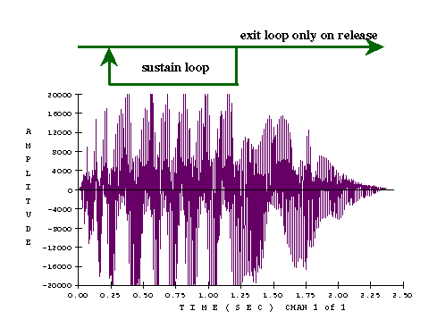
Looping
For sustaining instruments such as the winds and bowed strings (e.g., trumpet, flute, violin and organ), the samples must be looped to allow the tone to keep sustaining:
[iv:77] 2.43-second trumpet tone (ctpt03)

Slide 9
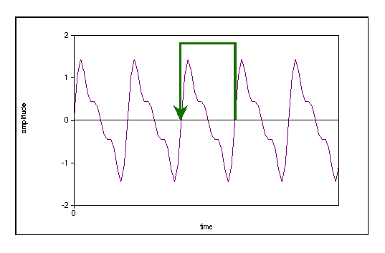
Looping
For a small loop of exactly one period of a waveform, sampling is equivalent to wavetable synthesis.

Slide 10
Looping
Making a good loop is not easy.
Criteria for good loop points:
  Loop points should be at zero-crossings to avoid discontinuities.
  Waveform at loop points should have similar peak amplitudes.
  Waveform at loop points should have similar shapes (and phases).
Pick loop points as far apart as possible where these criteria are still satisfied.

Slide 11
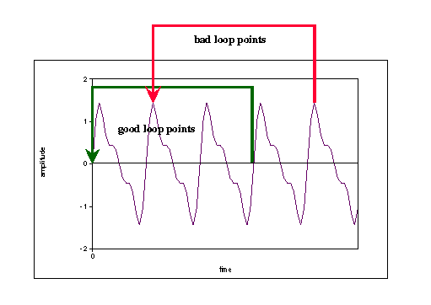
Picking Loop Points
Loop points should be at zero crossings to avoid discontinuities.

Slide 12
Picking Loop Points
Zero-crossings are easy to find, and the low amplitude makes it less likely there will be a "click" due to a discontinuity.
Even a small discontinuity can cause a "click" if the amplitude is large.

Slide 13
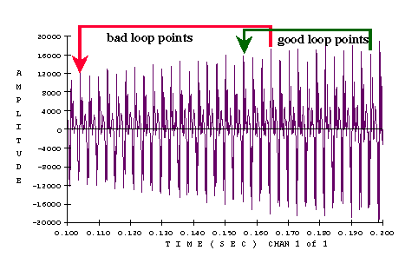
Picking Loop Points
Waveform at loop points should have similar peak amplitudes:
[iv:77] 2.43-second trumpet tone (ctpt03)

Slide 14
Picking Loop Points
Very different peak amplitudes indicate differences in the amplitudes of some of the harmonics, which result in an audible change in the spectrum if looped.

Slide 15
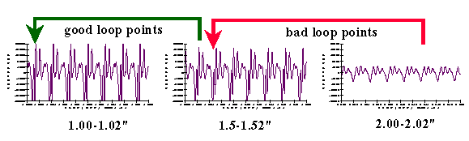
Picking Loop Points
Waveform at loop points should have similar shapes (and phases):
[iv:77] 2.43-second trumpet tone (ctpt03)

Slide 16
Picking Loop Points
A very different waveform shape indicates spectral differences, which result in an audible change in the spectrum if looped.
Pick loop points as far apart as possible where these criteria are still satisfied.
If the loop points are too close, there will not be enough change to make it sound like a real tone, and it may sound artificial.

Slide 17
Looping in Csound
The loscil unit generator reads a mono [or stereo] sound from a table (a soundfile), with optional sustain and release looping:
asig[,asig2] loscil iamp,ifreq,iwt,ibasef,0,0,1
loscil arguments:
  xamp — amplitude at i, k or a rate
  kcps — frequency at i or k rate
  iwt — the function number for an .aiff sampled sound segment

Slide 18
Looping in Csound
asig[,asig2] loscil iamp,ifreq,iwt,ibasef,0,0,1
optional loscil arguments:
  [, ibasef] — base frequency of recorded sound (in cycles per second)
  [, imode1,ibeg1,iend1][imode2,ibeg2,iend2]
    imode1, imode2 — play modes for the sustain and release loops — 0 denotes no looping
    ibeg1, iend1, ibeg2, iend2 — begin and end points for the sustain and release loops, measured in sample frames from the beginning of the file
  more details in Csound manual

Slide 19
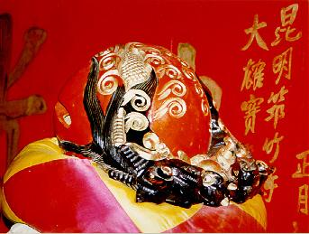
Looping in Csound
Csound example of the [iv:78] muyu:

Slide 20
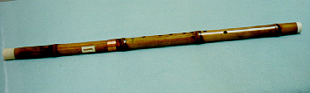
Looping in Csound
Csound [iv:79] sampled bawu:
(compare with [iv:80] wavetable bawu)
[iv:81] sampled voice with looping
[iv:82] same as previous example, with ring modulation effect

Slide 21
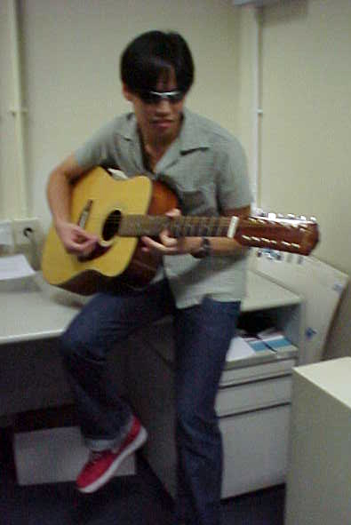
Example 1: Sampling the Guitar
Sound Example: the Eagles, Hotel California [iv:83] original performance and [iv:84] using sampling

Slide 22

Example 2: Sampling Vina
[iv:85] original pitch
[iv:86] looping Vina
sounded bad
when Vina sings [iv:87] catty-ok ....
  the cat as a percussion instrument, with pitch bend to straighten out the pitch

