Slide 1

Modeling
Voices

Slide 2
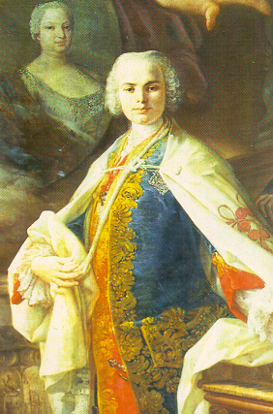
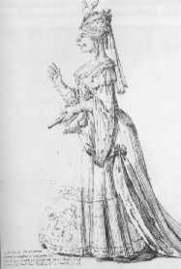
Farinelli
Baroque virtuoso singer
Castrato (male singer who had been castrated before puberty)
<c:12> synthesized Farinelli performing Ombra Fidele Anchi'o by his brother Riccardo Broschi in Farinelli: Il Castrato
Farinelli (Carlo Broschi, 1705-82)

Slide 3
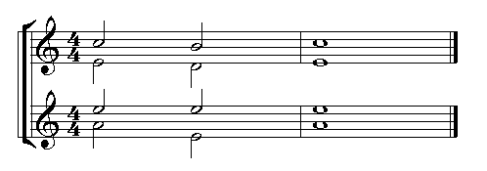
Voices
[iii:31] Four main voice types: soprano, alto, tenor and bass
soprano
alto
tenor
bass

Slide 4
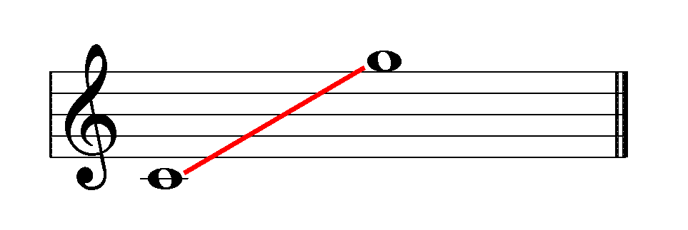
[iii:32] Soprano
most prominently heard, due to frequency range
basic soprano range:

Slide 5
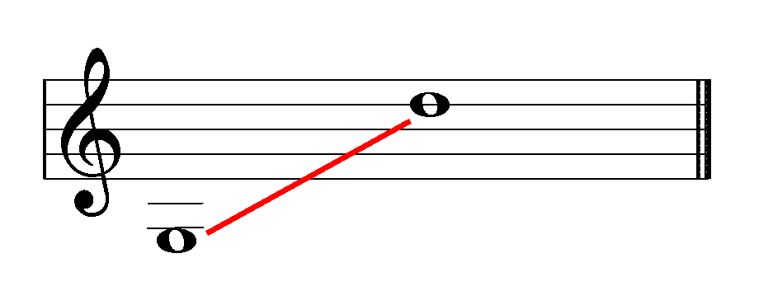
[iii:33] Alto
inner voice, moves calmly
basic alto range:

Slide 6
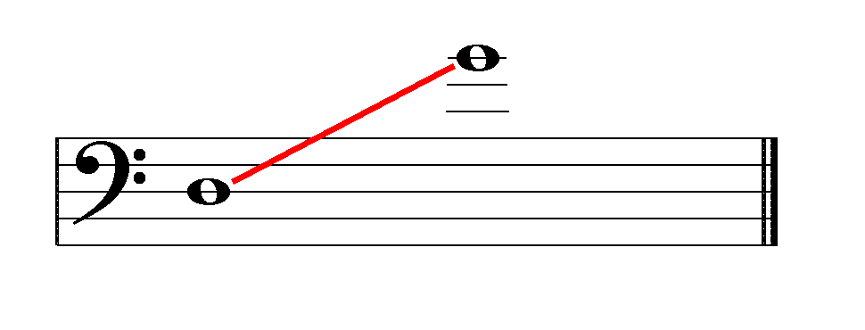
[iii:34] Tenor
inner voice, moves calmly
basic tenor range (actual pitch, as written in chorale parts):

Slide 7
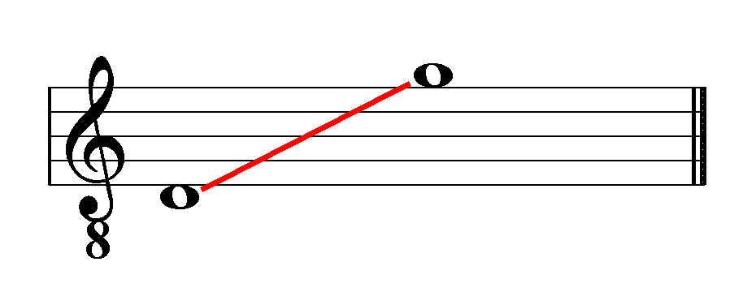
Tenor
the tenor part is usually written for the singer in treble clef, sounding an octave lower than written:

Slide 8
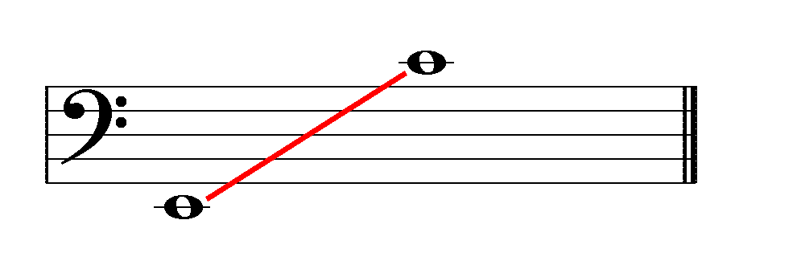
[iii:35] Bass
fundamental harmonic support
basic bass range:
professional soloists have larger ranges

Slide 9
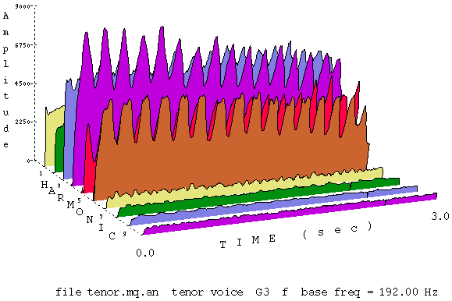
[iii:1] Voice Formants
singing voices have a vocal formant
  formant = a spectral peak in an absolute frequency region

Slide 10
Voice Formants
the color of the voice depends on the individual singer
the formant contributes to the color of the voice and the vowel
for women's voices, the easiest vowel for high notes is “a”
for men's voices, the easiest vowel for high notes is “o”

Slide 11
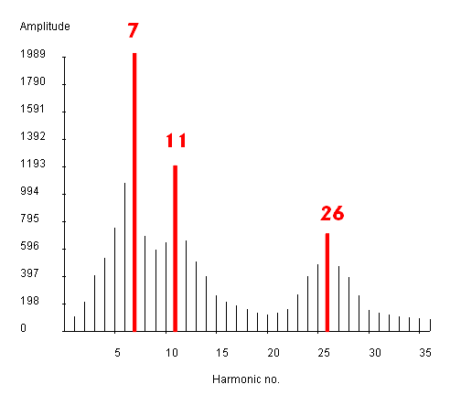
Voice Formants
Figure 19.5, Benade p. 371, shows the vowel "ah" sung at two frequencies, 100 and 220 Hertz
  100 Hertz — 3 formants: Harmonics: 7, 11 and 26
    700, 1100 and 2600 Hertz

Slide 12
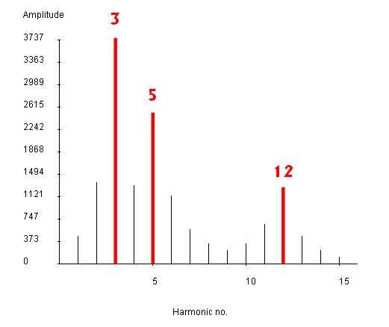
Voice Formants
  220 Hertz — 3 formants: Harmonics: 3, 5 and 12 (660, 1100 and 2640 Hertz)
  The formants shifted slightly to line up with the harmonics
  Note the harmonic roll-off curve between the formants

Slide 13
Voice Formants
Dodge (Figure 7.6, p. 230) shows a synthesized design for singing vowels using 5 formants
  Use gbuzz for the pulse generator for the fundamental with 12 dB/octave rolloff
    A 6dB rolloff cuts the amplitude in half in every octave
  He modeled the five formants with filters

Slide 14
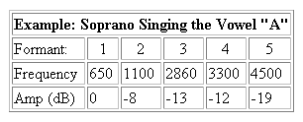
Voice Formants
Table 7.3, Dodge p. 231, shows the formants of a soprano singing five different vowels

Slide 15
Decibel (dB)
Definition:
  A logarithmic unit of amplitude.
  dB = 20 log₁₀(amp₁/amp_{ref})
Example:
  amp₁ = .001, amp_{ref} = 1
  dB = 20 log₁₀(.001/1) = 20(-3) = -60

Slide 16
Decibel Levels
with respect to threshold of audibility
  0 dB threshold of audibility
  40 dB whisper
  60 dB speech (English)
  80 dB shouting (Cantonese)
  90 dB classical concert
  Hong Kong Stadium
  100 dB concert with amplification
  120 dB pain (extra loud concert)
  140 dB brain damage
  Hong Kong International Airport

Slide 17
Decibels
to convert the amplitude to decibels in Csound:
idb = dbamp(iamp) ; convert amp to dB
iamp1 = ampdb(idb) ; convert dB to amp
iamp2 = ampdb(idb-6) ; convert -6 dB to amp

