Slide 1

Wavetable Synthesis

Slide 2
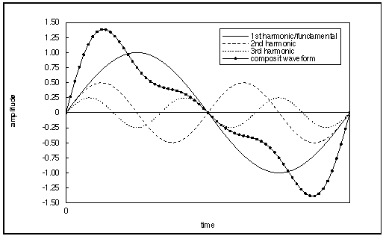
Introduction
Most musical sounds are periodic, and are composed of a collection of harmonic sine waves.

Slide 3
Wavetables
Harmonic sine waves are at integer multiples of some fundamental frequency.
For example, a fundamental frequency of 100 Hz has harmonics at 100 Hz, 200 Hz, 300 Hz, ...).

Slide 4
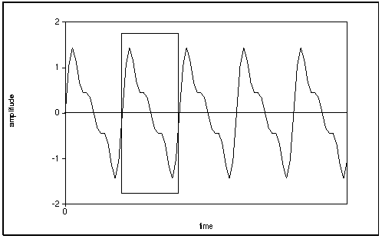
Wavetables
If a waveform is periodic, we can use a wavetable to store one period of the waveform to avoid having to re-compute it for every period, and instead we can use table lookup.

Slide 5
Wavetables
A wavetable is an array of waveform amplitude values.

Slide 6

Wavetables
We can generate a periodic waveform by summing a set of harmonic sine waves.
where:
  i is table location, 0<= i < tablength,
  tablamp[i] is amplitude at table location i,
  tablength is the size of the wavetable,
  Nhar is the number of harmonics,
  k is the harmonic number,
  amp_{k} is the amplitude of harmonic k.

Slide 7
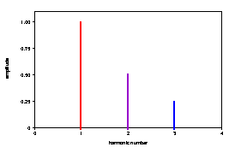

[ii:24] Example 1
f1 0 64 10 1 .5 .25
Nhar=3, tableLength=64, and amp1 = 1, amp2 = .5 and amp3 = .25

Slide 8
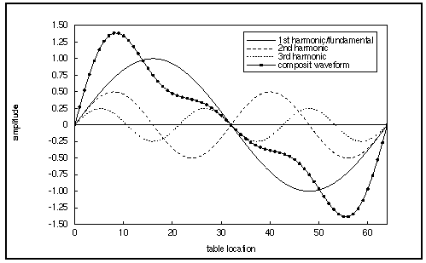
Example 1
f1 0 64 10 1 .5 .25
the values for tablamp[i] are shown in the composite waveform below:

Slide 9
[ii:25] Example 2
f1 0 64 10 1 2 4
Nhar=3, tableLength=64, and amp1 = 1, amp2 = 2 and amp3 = 4

Slide 10
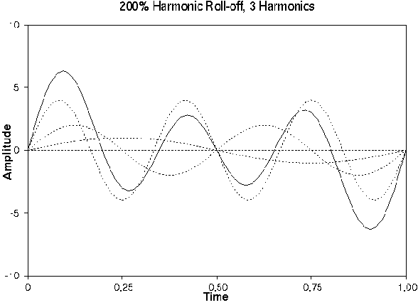
Example 2
f1 0 64 10 1 2 4
the values for tablamp[i] are shown in the composite waveform below:

Slide 11

[ii:26] Example 3
f1 0 64 10 1 .75 .5625 .4219 .3164 .2373 .178 .13348 .1001 .0751
Nhar=10, tableLength=64, and amp1 = 1, amp2 = .75 and amp3 = .75*.75, etc.

Slide 12
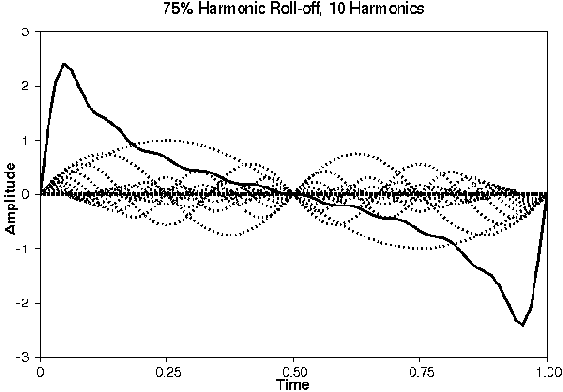
Example 3
f1 0 64 10 1 .75 .5625 .4219 .3164 .2373 .178 .13348 .1001 .0751
the values for tablamp[i] are shown in the composite waveform below:

Slide 13
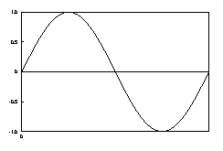
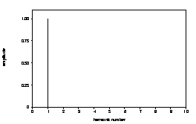
[ii:18] Sine Wave
f1 0 16385 10 1
Waveform
Spectrum

Slide 14
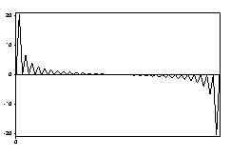
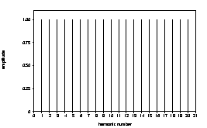
[ii:27] Pulse Wave
f1 0 16384 10 1 1 1 1 1 1 1 1 1 1 1 1 1 1 1 1 1 1 1 1
sounds like a door buzzer:
Waveform
Spectrum

Slide 15
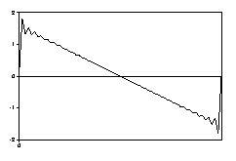
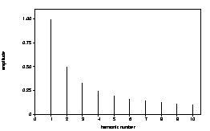
[ii:28] Sawtooth Wave
f1 0 16384 10 1 .5 .33 .25 .2 .167 .142 .125 .111 .1 .091 .083 .077 .071 .067 .0625 .059 .055 .053 .05
exponential spectrum
Waveform
Spectrum

Slide 16
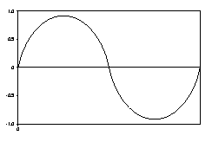
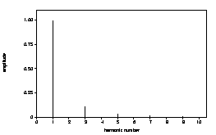
[ii:29] Sine Wave (flattened)
f1 0 16384 10 1 0 .111 0 .04 0 .02 0 .012 0 .008 0 .0059 0 .0044 0 .0035 0 .00277 0
squared exponential spectrum — clarinet-like with only odd harmonics
Waveform
Spectrum

Slide 17
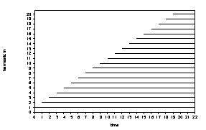
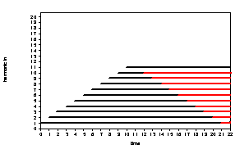
[ii:30] Wavetable Aliasing
Be careful to avoid wavetable aliasing.
  The highest harmonic frequency must be less than the Nyquist Frequency.
Harmonic aliasing
  Adding harmonics to 1000 Hz fundamental, with SR=22050.
Intended harmonics
Aliased harmonics

Slide 18
Sound Quality
Depends on:
  Sampling Rate Table Size
  Higher Rate is better Larger size is better
  Limit Limit
  Nyquist Frequency 16385 is large
  enough for most
  purposes

Slide 19
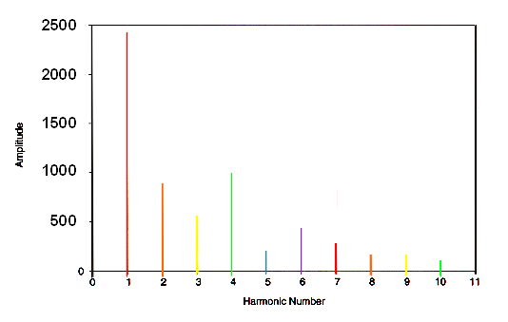
[ii:31] Synthesizing the Following Spectra

Slide 20
Wavetable Synthesis Example
wavetable 1: amp1 = 2400
f1 0 16385 -10 2400
wavetable 2: amp2 = 900, amp3 = 600
f2 0 16385 -10 0 900 600
wavetable 3: amp4 = 1000, amp5 = 180, amp6 = 400, amp7 = 250
f3 0 16385 -10 0 0 0 1000 180 400 250
wavetable 4: amp8 = 90, amp9 = 90, amp10 = 55
f4 0 16385 -10 0 0 0 0 0 0 0 90 90 55

Slide 21
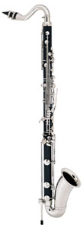
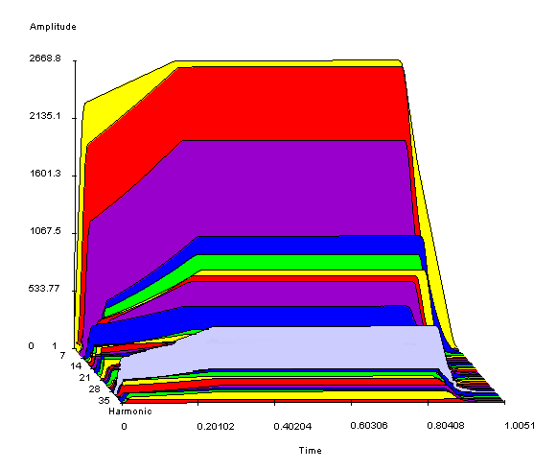
Bass Clarinet Example
[ii:32] G98, 35 harmonics, odd harmonics louder:

Slide 22
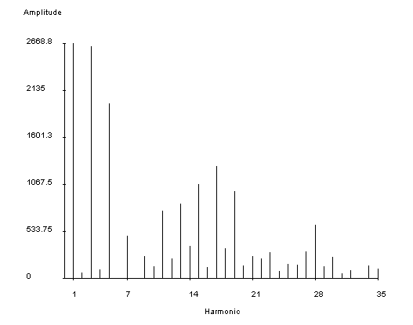
Bass Clarinet Example
G98, 35 harmonics, odd harmonics louder:

Slide 23
Bass Clarinet Example
G98, using 4 wavetables, with almost 35 harmonics (3 are left out):
f1 0 16385 -10 1
f2 0 16385 -10 0 0.024 0.985
f3 0 16385 -10 0 0 0 0.039 0.740 0 0.178
f4 0 16385 -10 0 0 0 0 0 0 0 0 0.093 0.050 0.285 0.083 0.317 0.137 0.400 0.047 0.476 0.128 0.370 0.054 0.093 0.083 0.110 0.030 0.061 0.056 0.113 0.225 0.050 0.091 0.022 0.034 0 0.055 0.039

Slide 24
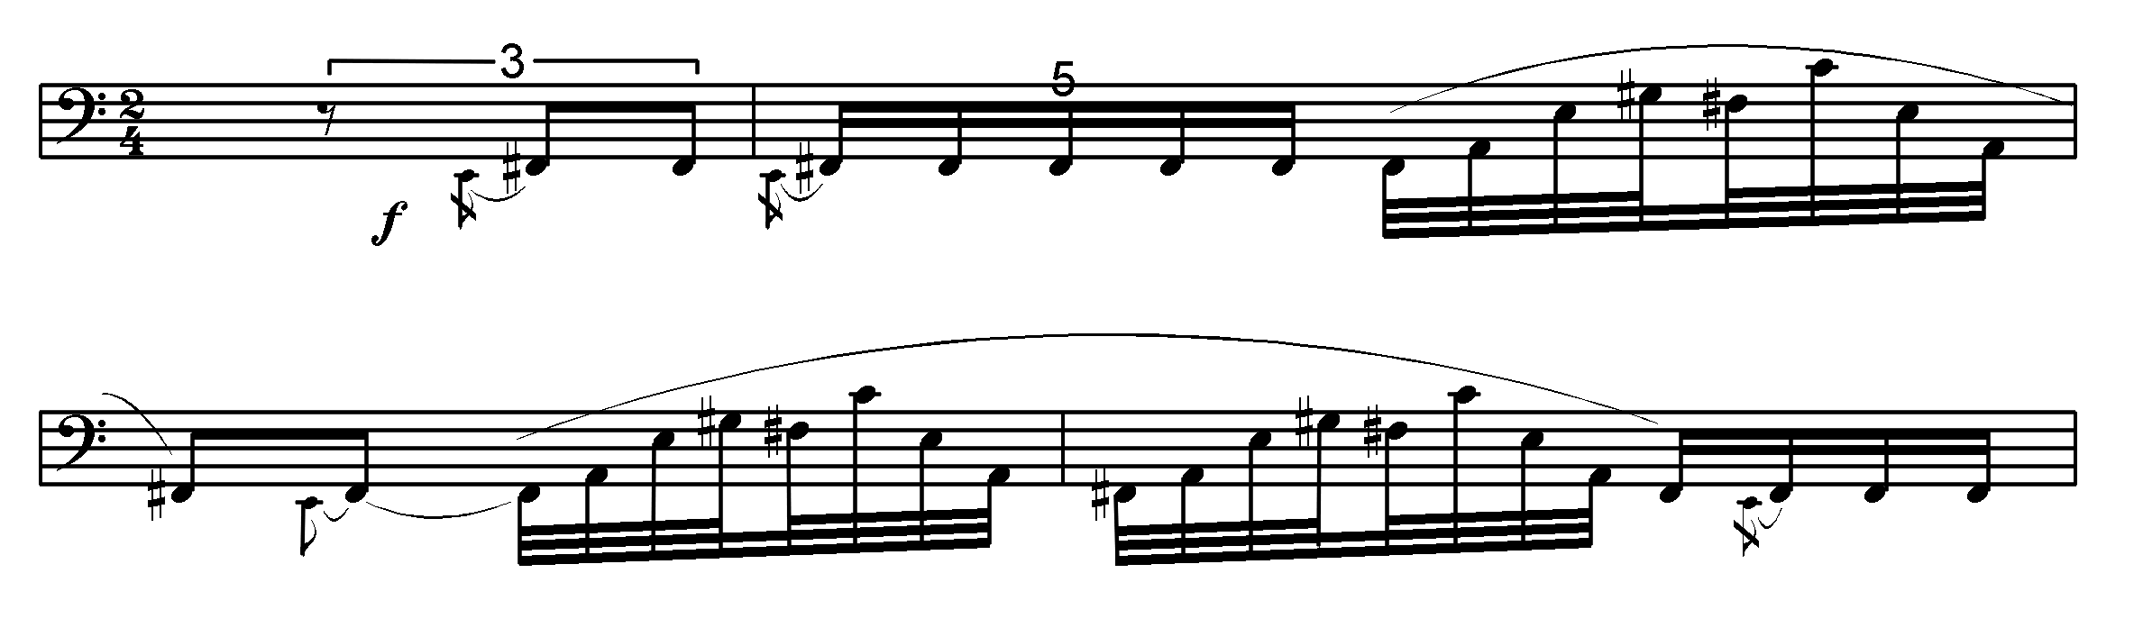
Bass Clarinet Example
add a little vibrato and play [ii:33] music!

Slide 25

Review Question
Which wavetable could represent this spectrum?
A. f1 0 16385 -10 1 .5 .25
B. f2 0 16385 -10 1 2 3
C. f3 0 16385 -10 3 2 1
D. f4 0 16385 -10 1 1 1
E. none of the above

