Slide 1
Introduction to
Analysis of Algorithms
COMP171
Fall 2005

Slide 2
Introduction
What is Algorithm?
  a clearly specified set of simple instructions to be followed to solve a problem
    Takes a set of values, as input and
    produces a value, or set of values, as output
  May be specified
    In English
    As a computer program
    As a pseudo-code
Data structures
  Methods of organizing data
Program = algorithms + data structures

Slide 3
Introduction
Why need algorithm analysis ?
  writing a working program is not good enough
  The program may be inefficient!
  If the program is run on a large data set, then the running time becomes an issue

Slide 4
An Example
A city has n stops. A bus driver wishes to follow the shortest path from one stop to another. Between very two stops, if a road exists, it may take a different time from other roads. Also, roads are one-way, i.e., the road from view point 1 to 2, is different from that from view point 2 to 1.
How to find the shortest path between any two pairs?
A Naïve approach:
List all the paths between a given pair of view points
Compute the travel time for each.
Choose the shortest one.
How many paths are there?

Slide 5
n! ≅ (n/e)^{n}
# of paths
Will be impossible to run your algorithm for n = 30
Need a way to compare two algorithms

Slide 6
Example: Selection Problem
Given a list of N numbers, determine the kth largest, where k ≤ N.
Algorithm 1:
  (1) Read N numbers into an array
  (2) Sort the array in decreasing order by some simple algorithm
  (3) Return the element in position k

Slide 7
Example: Selection Problem…
Algorithm 2:
  (1) Read the first k elements into an array and sort them in decreasing order
  (2) Each remaining element is read one by one
    If smaller than the kth element, then it is ignored
    Otherwise, it is placed in its correct spot in the array, bumping one element out of the array.
  (3) The element in the kth position is returned as the answer.

Slide 8
Example: Selection Problem…
Which algorithm is better when
  N =100 and k = 100?
  N =100 and k = 1?
What happens when N = 1,000,000 and k = 500,000?
There exist better algorithms

Slide 9
Algorithm Analysis
We only analyze correct algorithms
An algorithm is correct
  If, for every input instance, it halts with the correct output
Incorrect algorithms
  Might not halt at all on some input instances
  Might halt with other than the desired answer
Analyzing an algorithm
  Predicting the resources that the algorithm requires
  Resources include
    Memory
    Communication bandwidth
    Computational time (usually most important)

Slide 10
Algorithm Analysis…
Factors affecting the running time
  computer
  compiler
  algorithm used
  input to the algorithm
    The content of the input affects the running time
    typically, the input size (number of items in the input) is the main consideration
      E.g. sorting problem ⇒ the number of items to be sorted
      E.g. multiply two matrices together ⇒ the total number of elements in the two matrices
Machine model assumed
  Instructions are executed one after another, with no concurrent operations ⇒ Not parallel computers

Slide 11
Worst- / average- / best-case
Worst-case running time of an algorithm
  The longest running time for any input of size n
  An upper bound on the running time for any input
  ⇒ guarantee that the algorithm will never take longer
  Example: Sort a set of numbers in increasing order; and the data is in decreasing order
  The worst case can occur fairly often
    E.g. in searching a database for a particular piece of information
Best-case running time
  sort a set of numbers in increasing order; and the data is already in increasing order
Average-case running time
  May be difficult to define what “average” means

Slide 12
Running-time of algorithms
Bounds are for the algorithms, rather than programs
  programs are just implementations of an algorithm, and almost always the details of the program do not affect the bounds
Bounds are for algorithms, rather than problems
  A problem can be solved with several algorithms, some are more efficient than others

Slide 13
But, how to measure the time?
Multiplication and addition: which one takes longer?
How do we measure >=, assignment, &&, ||, etc etc
Machine dependent?
Slides courtesy of Prof. Saswati Sarkar

Slide 14
What is the efficiency of an algorithm?
Run time in the computer: Machine Dependent
Example: Need to multiply two positive integers a and b
Subroutine 1: Multiply a and b
Subroutine 2: V = a, W = b
While W > 1 V →V + a; W →W-1
Output V

Slide 15
Solution: Machine Independent Analysis
We assume that every basic operation takes constant time:
Example Basic Operations:
  Addition, Subtraction, Multiplication, Memory Access
Non-basic Operations:
  Sorting, Searching
Efficiency of an algorithm is the number of basic operations it performs
  We do not distinguish between the basic operations.

Slide 16
Subroutine 1 uses ? basic operation
Subroutine 2 uses ? basic operations
Subroutine ? is more efficient.
This measure is good for all large input sizes
In fact, we will not worry about the exact values, but will look at ``broad classes’ of values, or the growth rates
Let there be n inputs.
  If an algorithm needs n basic operations and another needs 2n basic operations, we will consider them to be in the same efficiency category.
  However, we distinguish between exp(n), n, log(n)

Slide 17
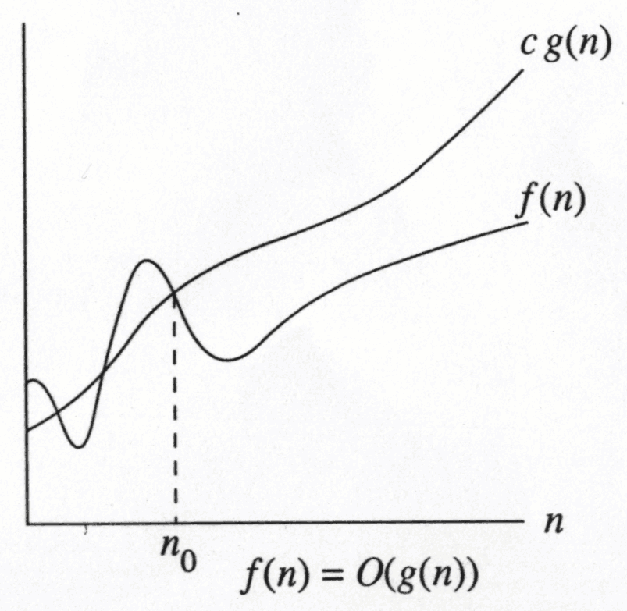
Growth Rate
The idea is to establish a relative order among functions for large n
∃ c , n₀ > 0 such that f(N) ≤ c g(N) when N ≥ n₀
f(N) grows no faster than g(N) for “large” N

Slide 18
Asymptotic notation: Big-Oh
f(N) = O(g(N))
There are positive constants c and n₀ such that
f(N) ≤ c g(N) when N ≥ n₀
The growth rate of f(N) is less than or equal to the growth rate of g(N)
g(N) is an upper bound on f(N)

Slide 19
Big-Oh: example
Let f(N) = 2N². Then
  f(N) = O(N⁴)
  f(N) = O(N³)
  f(N) = O(N²) (best answer, asymptotically tight)

Slide 20
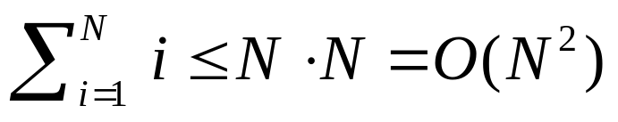
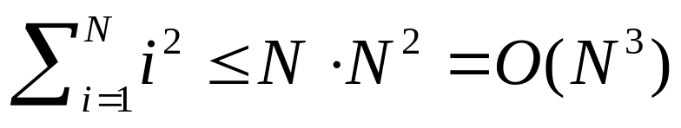
Big Oh: more examples
N² / 2 – 3N = O(N²)
1 + 4N = O(N)
7N² + 10N + 3 = O(N²) = O(N³)
log₁₀ N = log₂ N / log₂ 10 = O(log₂ N) = O(log N)
sin N = O(1); 10 = O(1), 10¹⁰ = O(1)
log N + N = O(N)
N = O(2^{N}), but 2^{N} is not O(N)
2^{10N} is not O(2^{N})

Slide 21
Some rules
When considering the growth rate of a function using Big-Oh
Ignore the lower order terms and the coefficients of the highest-order term
No need to specify the base of logarithm
  Changing the base from one constant to another changes the value of the logarithm by only a constant factor
If T₁(N) = O(f(N) and T₂(N) = O(g(N)), then
  T₁(N) + T₂(N) = max(O(f(N)), O(g(N))),
  T₁(N) * T₂(N) = O(f(N) * g(N))

Slide 22
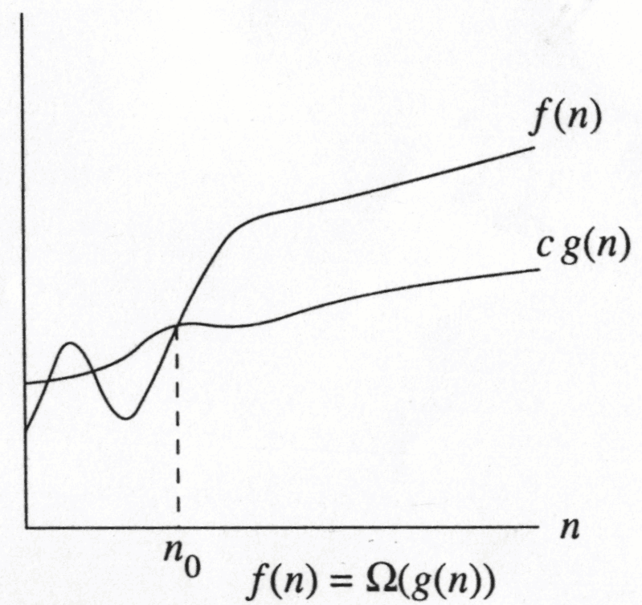
Big-Omega
∃ c , n₀ > 0 such that f(N) ≥ c g(N) when N ≥ n₀
f(N) grows no slower than g(N) for “large” N

Slide 23
Big-Omega
f(N) = Ω(g(N))
There are positive constants c and n₀ such that
f(N) ≥ c g(N) when N ≥ n₀
The growth rate of f(N) is greater than or equal to the growth rate of g(N).

Slide 24
Big-Omega: examples
Let f(N) = 2N². Then
  f(N) = Ω(N)
  f(N) = Ω(N²) (best answer)

Slide 25
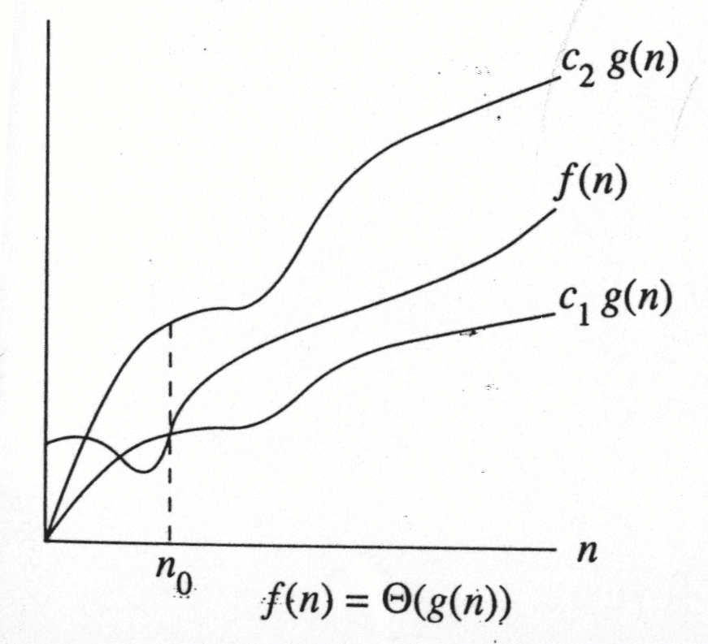
f(N) = Θ(g(N))
the growth rate of f(N) is the same as the growth rate of g(N)

Slide 26
Big-Theta
f(N) = Θ(g(N)) iff
f(N) = O(g(N)) and f(N) = Ω(g(N))
The growth rate of f(N) equals the growth rate of g(N)
Example: Let f(N)=N² , g(N)=2N²
  We write f(N) = O(g(N)) and f(N) = Ω(g(N)), thus f(N) = Θ(g(N)).

Slide 27
Some rules
If T(N) is a polynomial of degree k, then
T(N) = Θ(N^{k}).
For logarithmic functions,
T(log_{m} N) = Θ(log N).

Slide 28
Little-oh
f(N) = o(g(N))
f(N) = O(g(N)) and f(N) ≠ Θ(g(N))
The growth rate of f(N) is less than the growth rate of g(N)

Slide 29
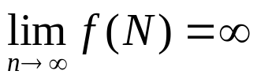
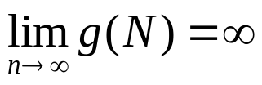
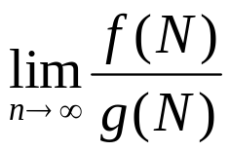
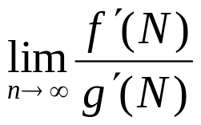
Using L' Hopital's rule
L' Hopital's rule
  If and
  then =
Determine the relative growth rates by using L' Hopital's rule
  compute
  if 0: f(N) = o(g(N))
  if constant ≠ 0: f(N) = Θ(g(N))
  if ∞: g(N) = o(f(N))
  limit oscillates: no relation

Slide 30
Example Functions
sqrt(n) , n, 2n, ln n, exp(n), n + sqrt(n) , n + n²
lim_{n→∝} sqrt(n) /n = 0,
sqrt(n) is o(n)
lim_{n→∝} n/sqrt(n) = infinity,
n is o(sqrt(n))
lim_{n→∝} n /2n = 1/2,
n is θ(2n), Ω(2n)
2n is θ(n), Ω(n)
lim_{n→∝} 2n /n = 2,

Slide 31
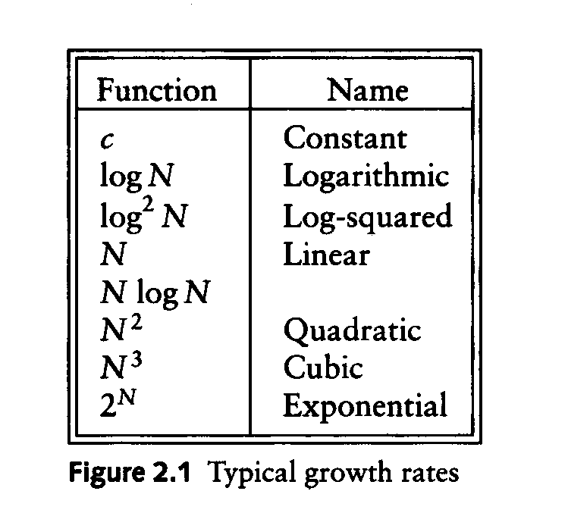
Typical Growth Rates

Slide 32
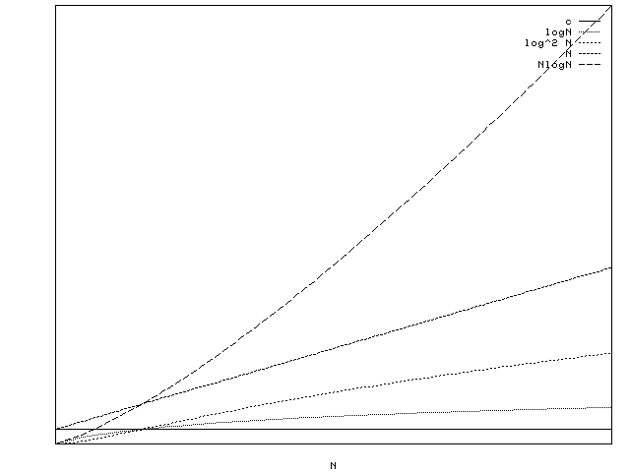

Slide 33
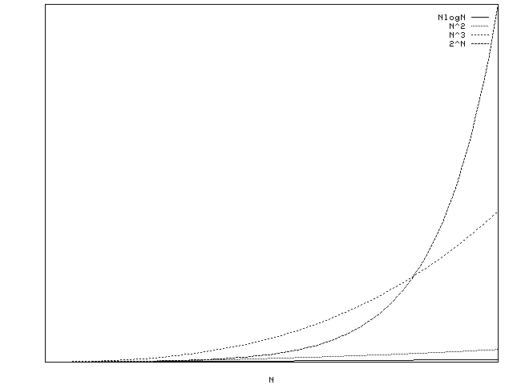

Slide 34
Growth rates …
Doubling the input size
  f(N) = c ⇒ f(2N) = f(N) = c
  f(N) = log N ⇒ f(2N) = f(N) + log 2
  f(N) = N ⇒ f(2N) = 2 f(N)
  f(N) = N² ⇒ f(2N) = 4 f(N)
  f(N) = N³ ⇒ f(2N) = 8 f(N)
  f(N) = 2^{N} ⇒ f(2N) = f²(N)
Advantages of algorithm analysis
  To eliminate bad algorithms early
  pinpoints the bottlenecks, which are worth coding carefully

Slide 35
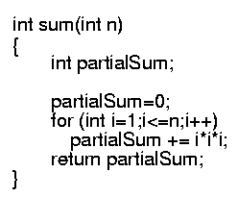
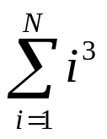
Example
Calculate
Lines 1 and 4 count for one unit each
Line 3: executed N times, each time four units
Line 2: (1 for initialization, N+1 for all the tests, N for all the increments) total 2N + 2
total cost: 6N + 4 ⇒ O(N)
1
2
3
4
1
4N
2N+2
1

Slide 36

General Rules
For loops
  at most the running time of the statements inside the for-loop (including tests) times the number of iterations.
Nested for loops
  the running time of the statement multiplied by the product of the sizes of all the for-loops.
  O(N²)

Slide 37
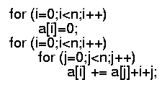
General rules (cont’d)
Consecutive statements
  These just add
  O(N) + O(N²) = O(N²)
If/Else
  never more than the running time of the test plus the larger of the running times of S1 and S2.

Slide 38
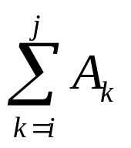
Another Example
Maximum Subsequence Sum Problem
Given (possibly negative) integers A₁, A₂, ...., A_{n}, find the maximum value of
  For convenience, the maximum subsequence sum is 0 if all the integers are negative
E.g. for input –2, 11, -4, 13, -5, -2
  Answer: 20 (A₂ through A₄)

Slide 39
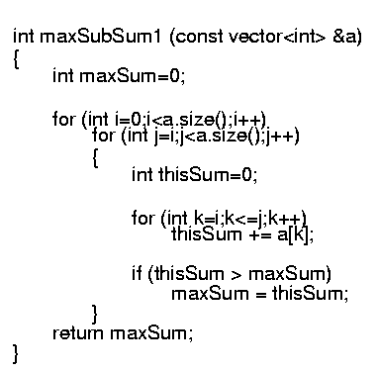
Algorithm 1: Simple
Exhaustively tries all possibilities (brute force)
O(N³)

Slide 40
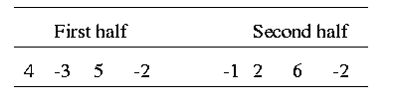
Algorithm 2: Divide-and-conquer
Divide-and-conquer
  split the problem into two roughly equal subproblems, which are then solved recursively
  patch together the two solutions of the subproblems to arrive at a solution for the whole problem
The maximum subsequence sum can be
  Entirely in the left half of the input
  Entirely in the right half of the input
  It crosses the middle and is in both halves

Slide 41
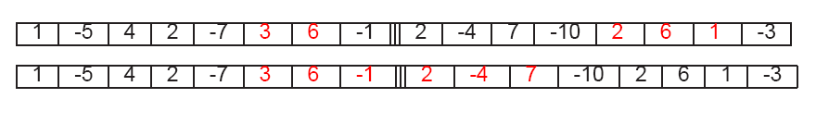
Algorithm 2 (cont’d)
The first two cases can be solved recursively
For the last case:
  find the largest sum in the first half that includes the last element in the first half
  the largest sum in the second half that includes the first element in the second half
  add these two sums together

Slide 42
Example: 8 numbers in a sequence,
4 –3 5 –2 -1 2 6 -2
Max subsequence sum for first half =6 (“4, -3, 5”)
second half =8 (“2, 6”)
Max subsequence sum for first half ending at the last element is 4 (“4, -3, 5, -2”)
Max subsequence sum for sum second half starting at the first element is 7 (“-1, 2, 6”)
Max subsequence sum spanning the middle is 11?
Max subsequence spans the middle “4, -3, 5, -2, -1, 2, 6”
Slides courtesy of Prof. Saswati Sarkar

Slide 43
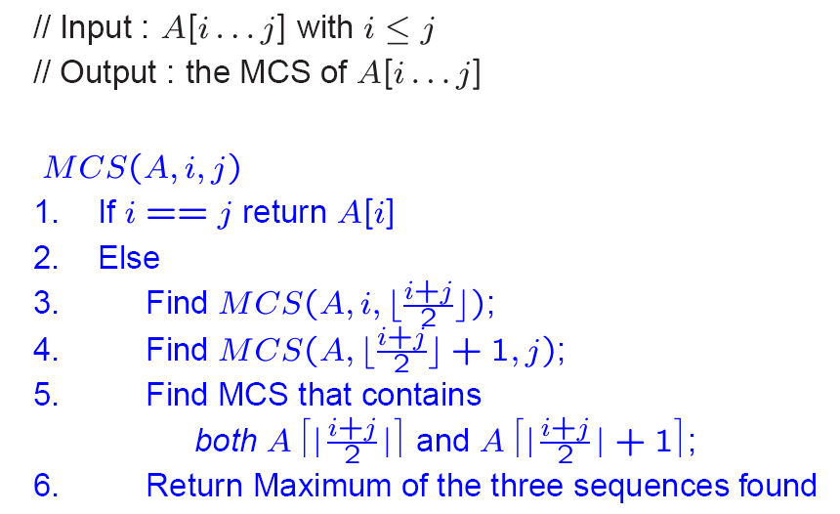
Algorithm 2 …
O(1)
T(m/2)
T(m/2)
O(m)
O(1)

Slide 44
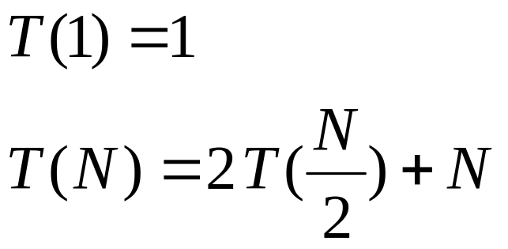
Algorithm 2 (cont’d)
Recurrence equation
  2 T(N/2): two subproblems, each of size N/2
  N: for “patching” two solutions to find solution to whole problem

Slide 45
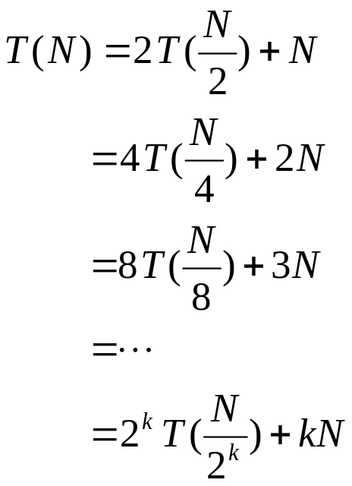
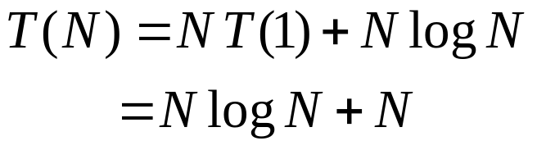
Algorithm 2 (cont’d)
Solving the recurrence:
With k=log N (i.e. 2^{k} = N), we have
Thus, the running time is O(N log N)
  faster than solution 1 for large data sets

