Slide 1
Deletion
9
5
Delete 12
5
12
3
9
Single rotation
3
8
11
1
2
8
11
1
2

Slide 2
Deletion
9
8
Delete 12
5
12
5
9
double rotation
3
8
11
3
6
11
1
6
1

Slide 3
Deletion: extended example
20
Delete 5
10
35
5
15
25
single rotation
40
18
30
45
38
50

Slide 4
… continue to check parent
20
15
35
single rotation
height reduced
10
18
25
40
30
38
45
50

Slide 5
Cont’d
35
20
40
15
25
38
45
10
18
30
50
For deletion, after rotation, we need to continue tracing upward to see if AVL-tree property is violated at other node.

Slide 6
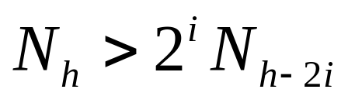
Errors in previous set of notes
Slide 5:
By repeated substitution, we obtain the general form
Slide 20:
Delete a node x as in ordinary binary search tree. Note that the last node deleted is a leaf or a node with one child.

Slide 7
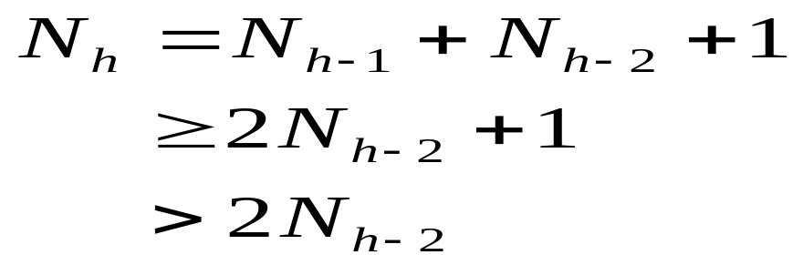
Height of AVL tree
Let x be the root of an AVL tree of height h
Let N_{h} denote the minimum number of nodes in an AVL tree of height h
Clearly, N_{i} ≥ N_{i-1} by definition
We have

Slide 8
Minimum number of nodes
N₂ = 2
N₃ = 4
N₄ = N₂ + N₃ + 1 = 7
N_{h} = N_{h-1} + N_{h-2} + 1

Slide 9
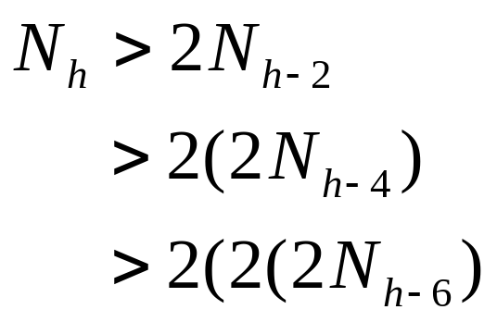
AVL tree
By repeated substitution, we obtain the general form
The boundary conditions are: N₁=1 and N₂ =2.

Slide 10
AVL tree
Solving
N₁=1 and N₂ =2.
If h is even, let i = h/2 – 1. The equation becomes N > 2^{h/2-1} N₂ ⇒ N > 2^{h/2-1} 2 ⇒ h = O(log N)
If h is odd, let i = (h-1)/2. The equation becomes N > 2^{(h-1)/2} N₁ ⇒ N > 2^{(h-1)/2} (1) ⇒ h = O(log N)

