Slide 1
B⁺-Trees
COMP171
Fall 2005

Slide 2
Dictionary for Secondary storage
The AVL tree is an excellent dictionary structure when the entire structure can fit into the main memory.
  following or updating a pointer only requires a memory cycle.
When the size of the data becomes so large that it cannot fit into the main memory, the performance of AVL tree may deteriorate rapidly
  Following a pointer or updating a pointer requires accessing the disk once.
  Traversing from root to a leaf may need to access the disk log₂ n time.
    when n = 1048576 = 2²⁰, we need 20 disk accesses. For a disk spinning at 7200rpm, this will take roughly 0.166 seconds. 10 searches will take more than 1 second! This is way too slow.

Slide 3
B⁺ Tree
Since the processor is much faster, it is more important to minimize the number of disk accesses by performing more cpu instructions.
Idea: allow a node in a tree to have many children.
If each internal node in the tree has M children, the height of the tree would be log_{M} n instead of log₂ n.
  For example, if M = 20, then log₂₀ 2²⁰ < 5.
Thus, we can speed up the search significantly.

Slide 4
B⁺ Tree
In practice: it is impossible to keep the same number of children per internal node.
A B⁺-tree of order M ≥ 3 is an M-ary tree with the following properties:
  Each internal node has at most M children
  Each internal node, except the root, has between ⎡M/2⎤-1 and M-1 keys
    this guarantees that the tree does not degenerate into a binary tree
  The keys at each node are ordered
  The root is either a leaf or has between 1 and M-1 keys
  The data items are stored at the leaves. All leaves are at the same depth. Each leaf has between ⎡L/2⎤-1 and L-1 data items, for some L (usually L << M, but we will assume M=L in most examples)

Slide 5
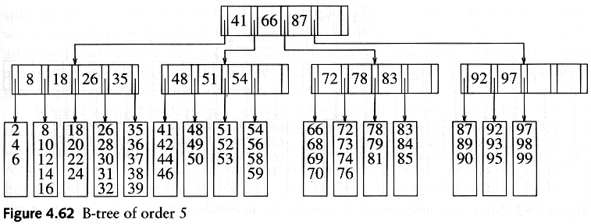
Example
Here, M=L=5
Records are stored at the leaves, but we only show the keys here
At the internal nodes, only keys (and pointers to children) are stored (also called separating keys)

Slide 6
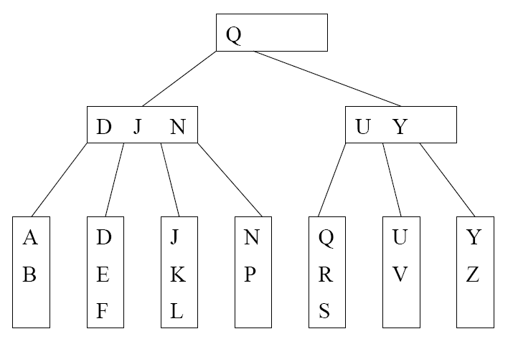
A B⁺ tree with M=L=4
We can still talk about left and right child pointers
E.g. the left child pointer of N is the same as the right child pointer of J
We can also talk about the left subtree and right subtree of a key in internal nodes

Slide 7
B⁺ Tree
Which keys are stored at the internal nodes?
There are several ways to do it. Different books adopt different conventions.
We will adopt the following convention:
  key i in an internal node is the smallest key in its i+1 subtree (i.e. right subtree of key i)
Even following this convention, there is no unique B⁺-tree for the same set of records.

Slide 8
B+ tree
Each internal node/leaf is designed to fit into one I/O block of data. An I/O block usually can hold quite a lot of data. Hence, an internal node can keep a lot of keys, i.e., large M. This implies that the tree has only a few levels and only a few disk accesses can accomplish a search, insertion, or deletion.
B⁺-tree is a popular structure used in commercial databases. To further speed up the search, the first one or two levels of the B⁺-tree are usually kept in main memory.
The disadvantage of B⁺-tree is that most nodes will have less than M-1 keys most of the time. This could lead to severe space wastage. Thus, it is not a good dictionary structure for data in main memory.
The textbook calls the tree B-tree instead of B⁺-tree. In some other textbooks, B-tree refers to the variant where the actual records are kept at internal nodes as well as the leaves. Such a scheme is not practical. Keeping actual records at the internal nodes will limit the number of keys stored there, and thus increasing the number of tree levels.

Slide 9
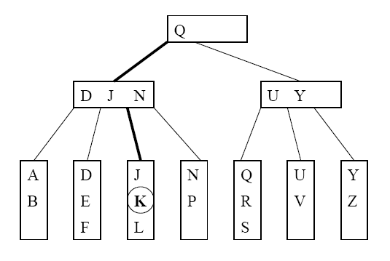
Searching
Suppose that we want to search for the key K. The path traversed is shown in bold.

Slide 10
Searching
Let x be the input search key.
Start the searching at the root
If we encounter an internal node v, search (linear search or binary search) for x among the keys stored at v
  If x < K_{min} at v, follow the left child pointer of K_{min}
  If K_{i} ≤ x < K_{i+1} for two consecutive keys K_{i} and K_{i+1} at v, follow the left child pointer of K_{i+1}
  If x ≥ K_{max} at v, follow the right child pointer of K_{max}
If we encounter a leaf v, we search (linear search or binary search) for x among the keys stored at v. If found, we return the entire record; otherwise, report not found.

Slide 11
Insertion
Suppose that we want to insert a key K and its associated record.
Search for the key K using the search procedure
This will bring us to a leaf x.
Insert K into x
  Splitting (instead of rotations in AVL trees) of nodes is used to maintain properties of B⁺-trees [next slide]

Slide 12
Insertion into a leaf
If leaf x contains < M-1 keys, then insert K into x (at the correct position in node x)
If x is already full (i.e. containing M-1 keys). Split x
  Cut x off its parent
  Insert K into x, pretending x has space for K. Now x has M keys.
  After inserting K, split x into 2 new leaves x_{L} and x_{R}, with x_{L} containing the ⎣M/2⎦ smallest keys, and x_{R} containing the remaining ⎡M/2⎤ keys. Let J be the minimum key in x_{R}
  Make a copy of J to be the parent of x_{L} and x_{R}, and insert the copy together with its child pointers into the old parent of x.

Slide 13
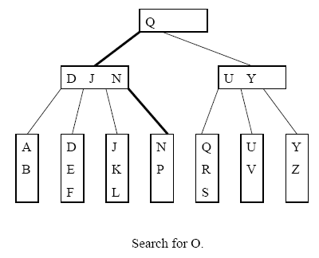
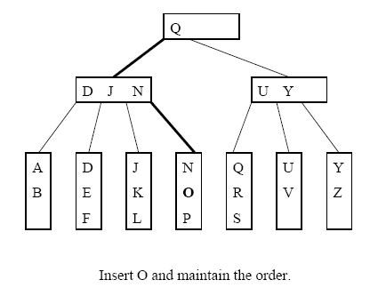
Inserting into a non-full leaf

Slide 14
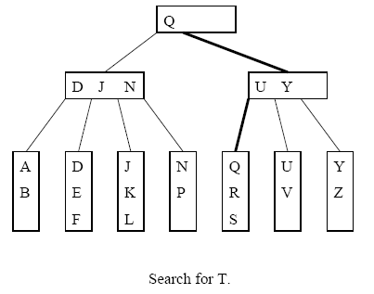
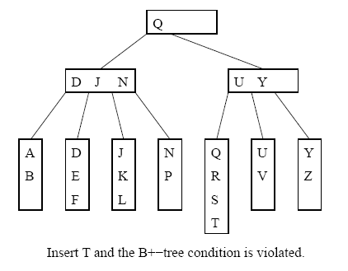
Splitting a leaf: inserting T

Slide 15
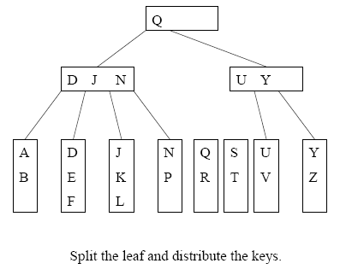
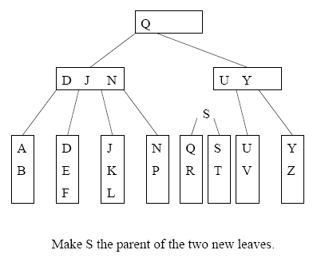
Cont’d

Slide 16
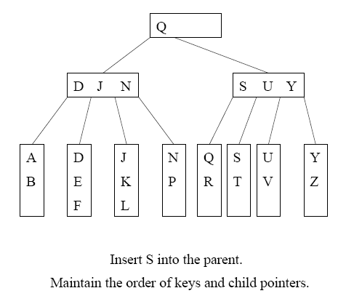
Two disk accesses to write the two leaves, one disk access to update the parent
For L=32, two leaves with 16 and 17 items are created. We can perform 15 more insertions without another split

Slide 17
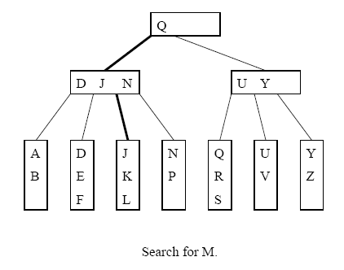
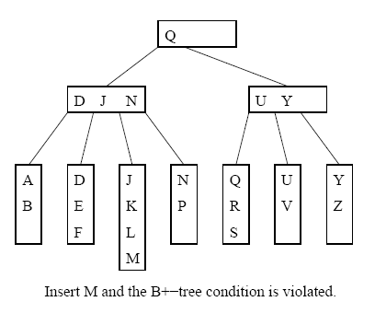
Another example:

Slide 18
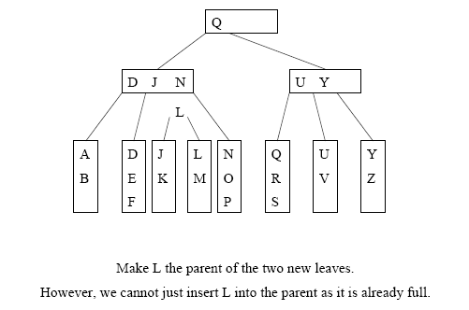
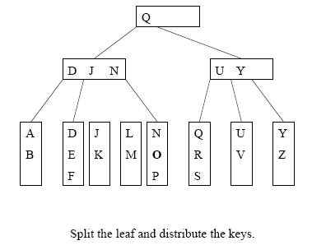
Cont’d
=> Need to split the internal node

Slide 19
Splitting an internal node
To insert a key K into a full internal node x:
Cut x off from its parent
Insert K and its left and right child pointers into x, pretending there is space. Now x has M keys.
Split x into 2 new internal nodes x_{L} and x_{R}, with x_{L} containing the ( ⎡M/2⎤ - 1 ) smallest keys, and x_{R} containing the ⎣M/2⎦ largest keys. Note that the (⎡M/2⎤)th key J is not placed in x_{L} or x_{R}
Make J the parent of x_{L} and x_{R}, and insert J together with its child pointers into the old parent of x.

Slide 20
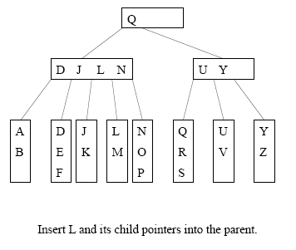
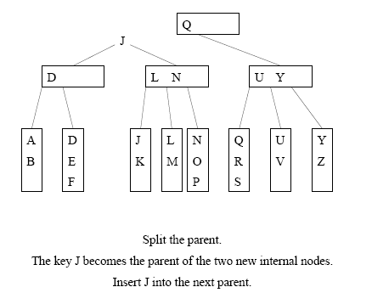
Example: splitting internal node

Slide 21
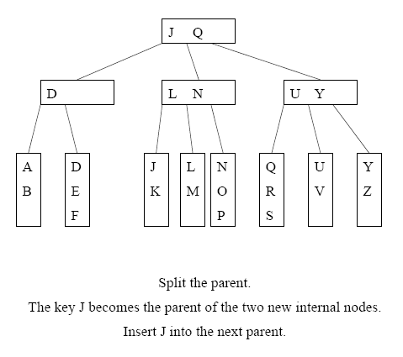
Cont’d

Slide 22
Termination
Splitting will continue as long as we encounter full internal nodes
If the split internal node x does not have a parent (i.e. x is a root), then create a new root containing the key J and its two children

