Slide 1
Connected Components,
Directed graphs,
Topological sort
COMP171
Fall 2005

Slide 2
Application 1: Connectivity
G =
P
Q
N
L
R
O
M
D
s
E
C
A
How do we tell if two vertices
are connected?
F
B
K
G
A connected to F?
A connected to L?
H

Slide 3
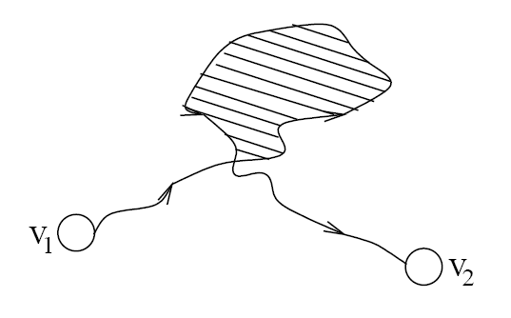
Connectivity
A graph is connected if and only if there exists a path between every pair of distinct vertices.
A graph is connected if and only if there exists a simple path between every pair of distinct vertices (since every non-simple path contains a cycle, which can be bypassed)
How to check for connectivity?
  Run BFS or DFS (using an arbitrary vertex as the source)
  If all vertices have been visited, the graph is connected.
  Running time? O(n + m)

Slide 4
Connected Components

Slide 5

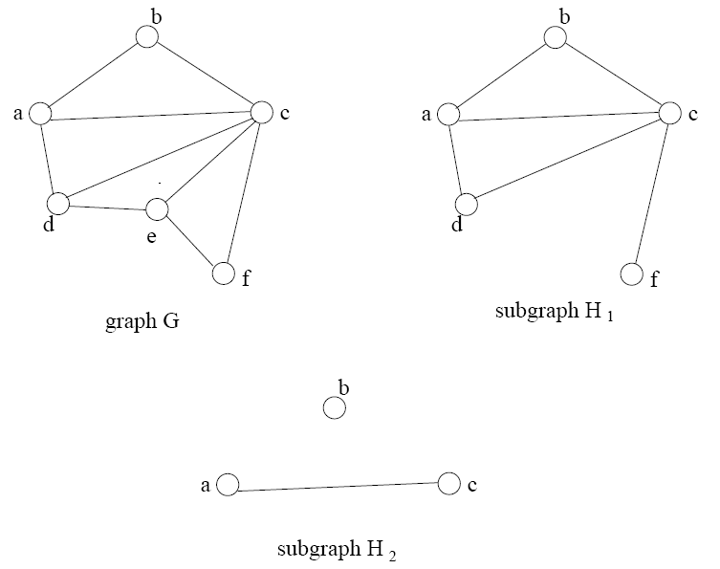
Subgraphs

Slide 6
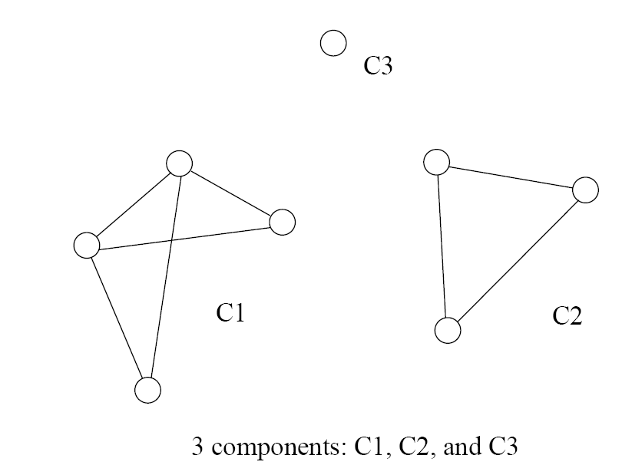
Connected Components
Formally stated:
  A connected component is a maximal connected subgraph of a graph.
  The set of connected components is unique for a given graph.

Slide 7
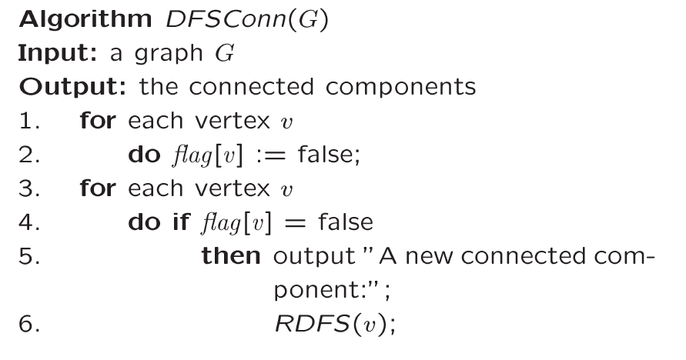
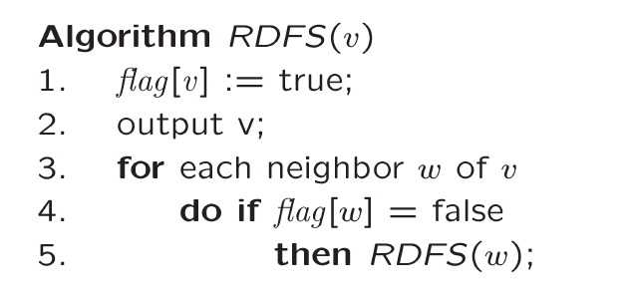
Finding Connected Components
For each vertex
If not visited
Call DFS
This will find
all vertices
connected
to “v” => one
connected component
Basic DFS algorithm.

Slide 8
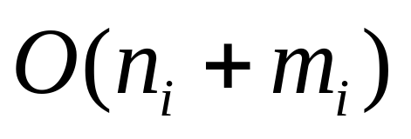
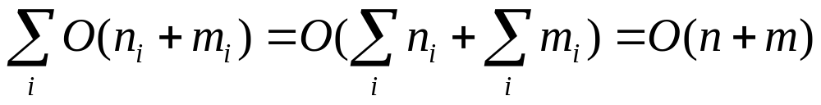
Time Complexity
Running time for each i connected component
Question:
  Can two connected components have the same edge?
  Can two connected components have the same vertex?
So:

Slide 9
Trees
Tree arises in many computer science applications
A graph G is a tree if and only if it is connected and acyclic
  (Acyclic means it does not contain any simple cycles)
The following statements are equivalent
  G is a tree
  G is acyclic and has exactly n-1 edges
  G is connected and has exactly n-1 edges

Slide 10
Tree as a (directed) Graph
Is it a graph?
Does it contain cycles?
(in other words, is it acyclic)
How many vertices?
How many edges?
15
6
18
3
8
30
16

Slide 11
Directed Graph
A graph is directed if direction is assigned to each edge. We call the directed edges arcs.
  An edge is denoted as an ordered pair (u, v)
Recall: for an undirected graph
  An edge is denoted {u,v}, which actually corresponds to two arcs (u,v) and (v,u)

Slide 12
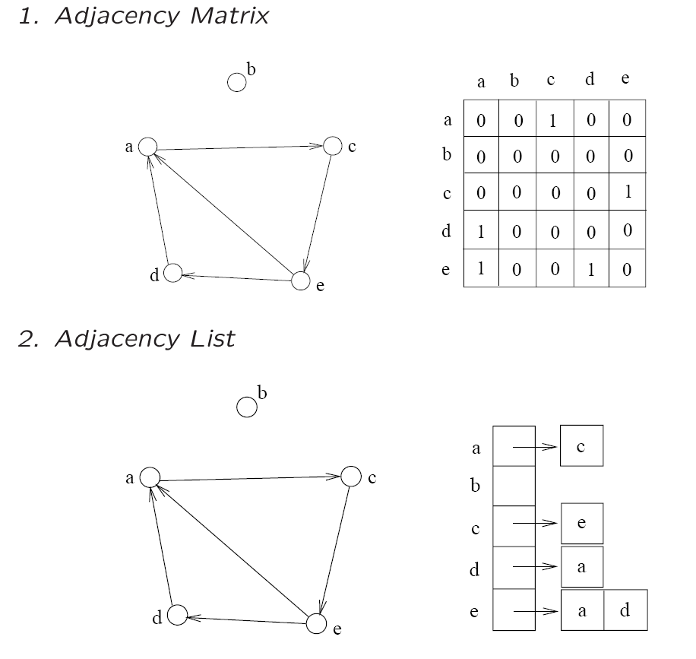
Representations
The adjacency matrix and adjacency list can be used

Slide 13
Directed Acyclic Graph
A directed path is a sequence of vertices
(v₀, v₁, . . . , v_{k})
  Such that (v_{i}, v_{i+1}) is an arc
A directed cycle is a directed path such that the first and last vertices are the same.
A directed graph is acyclic if it does not contain any directed cycles

Slide 14
Indegree and Outdegree
Since the edges are directed
  We can’t simply talk about Deg(v)
Instead, we need to consider the arcs coming “in” and going “out”
  Thus, we define terms
    Indegree(v)
    Outdegree(v)

Slide 15
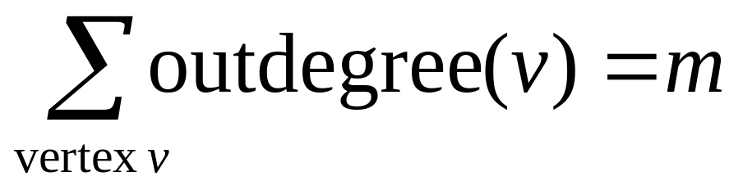
Outdegree
All of the arcs going “out” from v
Simple to compute
  Scan through list Adj[v] and count the arcs
What is the total outdegree? (m=#edges)

Slide 16
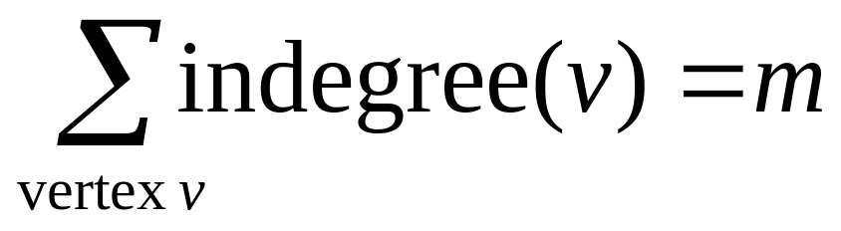
Indegree
All of the arcs coming “in” to v
Not as simple to compute as outdegree
  First, initialize indegree[v]=0 for each vertex v
  Scan through adj[v] list for each v
    For each vertex w seen, indegree[w]++;
    Running time: O(n+m)
What is the total indegree?

Slide 17
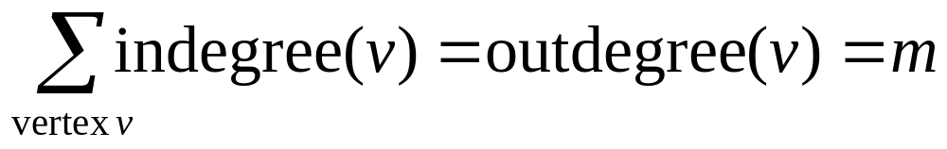
Indegree + Outdegree
Each arc (u,v) contributes count 1 to the outdegree of u and count 1 to the indegree of v.

Slide 18
Example
6
3
Indeg(2)?
Indeg(8)?
Outdeg(0)?
Num of Edges?
Total OutDeg?
Total Indeg?
8
0
7
2
9
1
5
4

Slide 19
Directed Graphs Usage
Directed graphs are often used to represent order-dependent tasks
That is we cannot start a task before another task finishes
We can model this task dependent constraint using arcs
An arc (i,j) means task j cannot start until task i is finished
Clearly, for the system not to hang, the graph must be acyclic.
i
j
Task j cannot start
until task i is finished

Slide 20
University Example
CS departments course structure
Any directed cycles?
₁₀₄
₁₅₁
₁₇₁
₁₈₀
₃₄₂
₂₂₁
₂₀₁
₂₁₁
₂₅₁
₂₇₁
_{M111}
_{M132}
₂₅₂
₂₃₁
₃₀₃
₃₄₃
₂₇₂
₃₆₁
₃₈₁
₃₂₇
₃₄₁
₃₃₆
₃₃₄
₃₆₂
₃₃₂
How many indeg(171)?
How many outdeg(171)?

Slide 21
Topological Sort
Topological sort is an algorithm for a directed acyclic graph
It can be thought of as a way to linearly order the vertices so that the linear order respects the ordering relations implied by the arcs
6
3
For example:
0, 1, 2, 5, 9
0, 4, 5, 9
0, 6, 3, 7 ?
8
0
2
7
9
1
5
4

Slide 22
Topological Sort
Idea:
  Starting point must have zero indegree!
  If it doesn’t exist, the graph would not be acyclic
A vertex with zero indegree is a task that can start right away. So we can output it first in the linear order
If a vertex i is output, then its outgoing arcs (i, j) are no longer useful, since tasks j does not need to wait for i anymore- so remove all i’s outgoing arcs
With vertex i removed, the new graph is still a directed acyclic graph. So, repeat step 1-2 until no vertex is left.

Slide 23
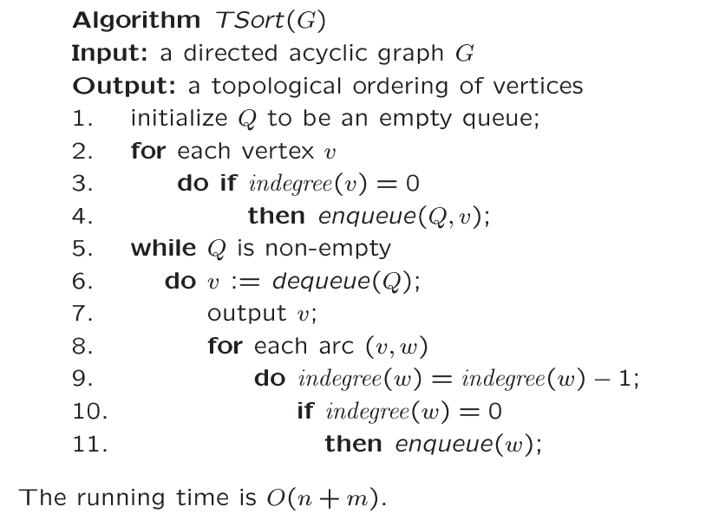
Topological Sort
Find all starting points
Reduce indegree(w)
Place new start
vertices on the Q

Slide 24
Example
Indegree
0
1
2
3
4
5
6
7
8
9
6 | 1 | 4
0
1
2
3
4
5
6
7
8
9
0
1
2
1
1
2
1
1
2
2
2
start
6
3
7 | 5
8
8
5
0
2
7
9
1
9
3 | 2
5
8
4
9
Q = { 0 }
OUTPUT: 0

Slide 25
Example
Indegree
0
1
2
3
4
5
6
7
8
9
6 | 1 | 4
0
1
2
3
4
5
6
7
8
9
0
1
2
1
1
2
1
1
2
2
2
-1
6
3
7 | 5
8
8
5
-1
0
2
7
9
1
9
3 | 2
-1
5
8
4
9
Dequeue 0 Q = { }
-> remove 0’s arcs – adjust
indegrees of neighbors
Decrement 0’s
neighbors
OUTPUT:

Slide 26
Example
Indegree
0
1
2
3
4
5
6
7
8
9
6 | 1 | 4
0
1
2
3
4
5
6
7
8
9
0
0
2
1
0
2
0
1
2
2
2
6
3
7 | 5
8
8
5
0
2
7
9
1
9
3 | 2
5
8
4
9
Dequeue 0 Q = { 6, 1, 4 }
Enqueue all starting points
Enqueue all
new start points
OUTPUT: 0

Slide 27
Example
Indegree
0
1
2
3
4
5
6
7
8
9
6 | 1 | 4
0
1
2
3
4
5
6
7
8
9
0
0
2
1
0
2
0
1
2
2
2
6
3
7 | 5
-1
8
8
-1
5
2
7
9
1
9
3 | 2
5
8
4
9
Dequeue 6 Q = { 1, 4 }
Remove arcs .. Adjust indegrees
of neighbors
Adjust neighbors
indegree
OUTPUT: 0 6

Slide 28
Example
Indegree
0
1
2
3
4
5
6
7
8
9
6 | 1 | 4
0
1
2
3
4
5
6
7
8
9
0
0
1
0
0
2
0
1
2
2
2
3
7 | 5
8
8
5
2
7
9
1
9
3 | 2
5
8
4
9
Dequeue 6 Q = { 1, 4, 3 }
Enqueue 3
Enqueue new
start
OUTPUT: 0 6

Slide 29
Example
Indegree
0
1
2
3
4
5
6
7
8
9
6 | 1 | 4
0
1
2
3
4
5
6
7
8
9
0
0
1
0
0
2
0
1
2
2
2
3
7 | 5
-1
8
8
5
2
7
9
1
9
3 | 2
5
8
4
9
Dequeue 1 Q = { 4, 3 }
Adjust indegrees of neighbors
Adjust neighbors
of 1
OUTPUT: 0 6 1

Slide 30
Example
Indegree
0
1
2
3
4
5
6
7
8
9
6 | 1 | 4
0
1
2
3
4
5
6
7
8
9
0
0
0
0
0
2
0
1
2
2
2
3
7 | 5
8
8
5
2
7
9
9
3 | 2
5
8
4
9
Dequeue 1 Q = { 4, 3, 2 }
Enqueue 2
Enqueue new
starting points
OUTPUT: 0 6 1

Slide 31
Example
Indegree
0
1
2
3
4
5
6
7
8
9
6 | 1 | 4
0
1
2
3
4
5
6
7
8
9
0
0
0
0
0
2
0
1
2
2
2
3
7 | 5
8
8
5
2
7
9
9
-1
3 | 2
5
8
4
9
Dequeue 4 Q = { 3, 2 }
Adjust indegrees of neighbors
Adjust 4’s
neighbors
OUTPUT: 0 6 1 4

Slide 32
Example
Indegree
0
1
2
3
4
5
6
7
8
9
6 | 1 | 4
0
1
2
3
4
5
6
7
8
9
0
0
0
0
0
1
0
1
2
2
2
3
7 | 5
8
8
5
2
7
9
9
3 | 2
5
8
9
Dequeue 4 Q = { 3, 2 }
No new start points found
NO new start
points
OUTPUT: 0 6 1 4

Slide 33
Example
Indegree
0
1
2
3
4
5
6
7
8
9
6 | 1 | 4
0
1
2
3
4
5
6
7
8
9
0
0
0
0
0
1
0
1
2
2
2
3
7 | 5
8
8
5
2
7
9
9
3 | 2
5
8
9
-1
Dequeue 3 Q = { 2 }
Adjust 3’s neighbors
OUTPUT: 0 6 1 4 3

Slide 34
Example
Indegree
0
1
2
3
4
5
6
7
8
9
6 | 1 | 4
0
1
2
3
4
5
6
7
8
9
0
0
0
0
0
1
0
1
1
2
2
7 | 5
8
8
5
2
7
9
9
3 | 2
5
8
9
Dequeue 3 Q = { 2 }
No new start points found
OUTPUT: 0 6 1 4 3

Slide 35
Example
Indegree
0
1
2
3
4
5
6
7
8
9
6 | 1 | 4
0
1
2
3
4
5
6
7
8
9
0
0
0
0
0
1
0
1
1
2
2
7 | 5
8
8
5
2
7
9
9
-1
3 | 2
5
8
-1
9
Dequeue 2 Q = { }
Adjust 2’s neighbors
OUTPUT: 0 6 1 4 3 2

Slide 36
Example
Indegree
0
1
2
3
4
5
6
7
8
9
6 | 1 | 4
0
1
2
3
4
5
6
7
8
9
0
0
0
0
0
0
0
0
1
2
2
7 | 5
8
8
5
7
9
9
3 | 2
5
8
9
Dequeue 2 Q = { 5, 7 }
Enqueue 5, 7
OUTPUT: 0 6 1 4 3 2

Slide 37
Example
Indegree
0
1
2
3
4
5
6
7
8
9
6 | 1 | 4
0
1
2
3
4
5
6
7
8
9
0
0
0
0
0
0
0
0
1
2
2
7 | 5
8
8
5
7
9
9
3 | 2
5
8
9
-1
Dequeue 5 Q = { 7 }
Adjust neighbors
OUTPUT: 0 6 1 4 3 2 5

Slide 38
Example
Indegree
0
1
2
3
4
5
6
7
8
9
6 | 1 | 4
0
1
2
3
4
5
6
7
8
9
0
0
0
0
0
0
0
0
1
1
2
7 | 5
8
8
5
7
9
9
3 | 2
8
9
Dequeue 5 Q = { 7 }
No new starts
OUTPUT: 0 6 1 4 3 2 5

Slide 39
Example
Indegree
0
1
2
3
4
5
6
7
8
9
6 | 1 | 4
0
1
2
3
4
5
6
7
8
9
0
0
0
0
0
0
0
0
1
1
2
7 | 5
8
8
5
7
9
9
3 | 2
8
9
-1
Dequeue 7 Q = { }
Adjust neighbors
OUTPUT: 0 6 1 4 3 2 5 7

Slide 40
Example
Indegree
0
1
2
3
4
5
6
7
8
9
6 | 1 | 4
0
1
2
3
4
5
6
7
8
9
0
0
0
0
0
0
0
0
0
1
2
7 | 5
8
8
5
9
9
3 | 2
8
9
Dequeue 7 Q = { 8 }
Enqueue 8
OUTPUT: 0 6 1 4 3 2 5 7

Slide 41
Example
Indegree
0
1
2
3
4
5
6
7
8
9
6 | 1 | 4
0
1
2
3
4
5
6
7
8
9
0
0
0
0
0
0
0
0
0
1
2
7 | 5
8
8
5
9
9
3 | 2
8
9
-1
Dequeue 8 Q = { }
Adjust indegrees of neighbors
OUTPUT: 0 6 1 4 3 2 5 7 8

Slide 42
Example
Indegree
0
1
2
3
4
5
6
7
8
9
6 | 1 | 4
0
1
2
3
4
5
6
7
8
9
0
0
0
0
0
0
0
0
0
0
2
7 | 5
8
5
9
9
3 | 2
8
9
Dequeue 8 Q = { 9 }
Enqueue 9
Dequeue 9 Q = { }
STOP – no neighbors
OUTPUT: 0 6 1 4 3 2 5 7 8 9

Slide 43
Example
6
3
8
0
2
7
9
1
5
4
OUTPUT: 0 6 1 4 3 2 5 7 8 9
Is output topologically correct?

Slide 44
Topological Sort: Complexity
We never visited a vertex more than one time
For each vertex, we had to examine all outgoing edges
  Σ outdegree(v) = m
  This is summed over all vertices, not per vertex
So, our running time is exactly
  O(n + m)

