Slide 1
Insertion sort,
Merge sort
COMP171
Fall 2005

Slide 2

Insertion sort
1) Initially p = 1
2) Let the first p elements be sorted.
3) Insert the (p+1)th element properly in the list so that now p+1 elements are sorted.
4) increment p and go to step (3)

Slide 3
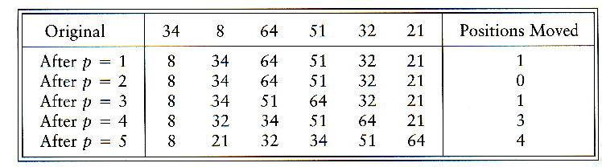
Insertion Sort

Slide 4
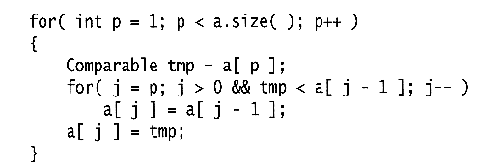
Insertion Sort...
see applet
http://www.cis.upenn.edu/~matuszek/cse121-2003/Applets/Chap03/Insertion/InsertSort.html
Consists of N - 1 passes
For pass p = 1 through N - 1, ensures that the elements in positions 0 through p are in sorted order
  elements in positions 0 through p - 1 are already sorted
  move the element in position p left until its correct place is found among the first p + 1 elements

Slide 5
Extended Example
To sort the following numbers in increasing order:
34 8 64 51 32 21
P = 1; Look at first element only, no change.
P = 2; tmp = 8;
34 > tmp, so second element is set to 34.
We have reached the front of the list. Thus, 1st position = tmp
After second pass: 8 34 64 51 32 21
(first 2 elements are sorted)

Slide 6
P = 3; tmp = 64;
34 < 64, so stop at 3rd position and set 3rd position = 64
After third pass: 8 34 64 51 32 21
(first 3 elements are sorted)
P = 4; tmp = 51;
51 < 64, so we have 8 34 64 64 32 21,
34 < 51, so stop at 2nd position, set 3rd position = tmp,
After fourth pass: 8 34 51 64 32 21
(first 4 elements are sorted)
P = 5; tmp = 32,
32 < 64, so 8 34 51 64 64 21,
32 < 51, so 8 34 51 51 64 21,
next 32 < 34, so 8 34 34, 51 64 21,
next 32 > 8, so stop at 1st position and set 2nd position = 32,
After fifth pass: 8 32 34 51 64 21
P = 6; tmp = 21, . . .
After sixth pass: 8 21 32 34 51 64

Slide 7
Analysis: worst-case running time
Inner loop is executed p times, for each p=1..N
⇒ Overall: 1 + 2 + 3 + . . . + N = O(N²)
Space requirement is O(N)

Slide 8
Analysis
The bound is tight Θ(N²)
That is, there exists some input which actually uses Ω(N²) time
Consider input is a reverse sorted list
  When A[p] is inserted into the sorted A[0..p-1], we need to compare A[p] with all elements in A[0..p-1] and move each element one position to the right
  ⇒ Ω(i) steps
  the total number of steps is Ω(Σ₁^{N-1} i) = Ω(N(N-1)/2) = Ω(N²)

Slide 9
Analysis: best case
The input is already sorted in increasing order
  When inserting A[p] into the sorted A[0..p-1], only need to compare A[p] with A[p-1] and there is no data movement
  For each iteration of the outer for-loop, the inner for-loop terminates after checking the loop condition once => O(N) time
If input is nearly sorted, insertion sort runs fast

Slide 10
Mergesort
Based on divide-and-conquer strategy
Divide the list into two smaller lists of about equal sizes
Sort each smaller list recursively
Merge the two sorted lists to get one sorted list
How do we divide the list? How much time needed?
How do we merge the two sorted lists? How much time needed?

Slide 11
Dividing
If the input list is a linked list, dividing takes Θ(N) time
  We scan the linked list, stop at the ⎣N/2⎦ th entry and cut the link
If the input list is an array A[0..N-1]: dividing takes O(1) time
  we can represent a sublist by two integers left and right: to divide A[left..Right], we compute center=(left+right)/2 and obtain A[left..Center] and A[center+1..Right]

Slide 12
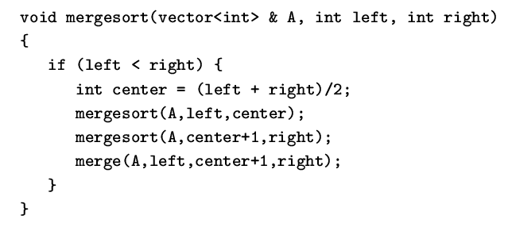
Mergesort
Divide-and-conquer strategy
  recursively mergesort the first half and the second half
  merge the two sorted halves together

Slide 13
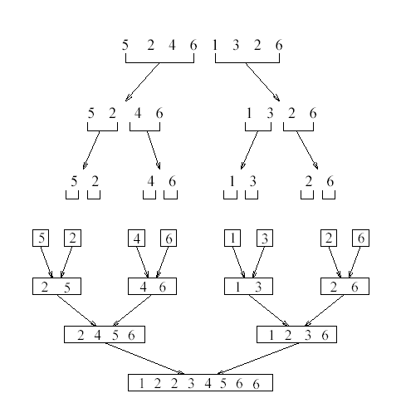
see applet
http://www.cosc.canterbury.ac.nz/people/mukundan/dsal/MSort.html

Slide 14
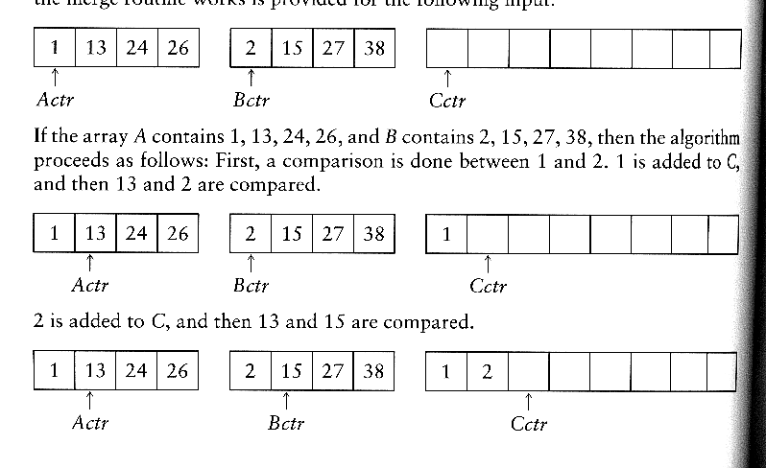
How to merge?
Input: two sorted array A and B
Output: an output sorted array C
Three counters: Actr, Bctr, and Cctr
  initially set to the beginning of their respective arrays
(1) The smaller of A[Actr] and B[Bctr] is copied to the next entry in C, and the appropriate counters are advanced
(2) When either input list is exhausted, the remainder of the other list is copied to C

Slide 15

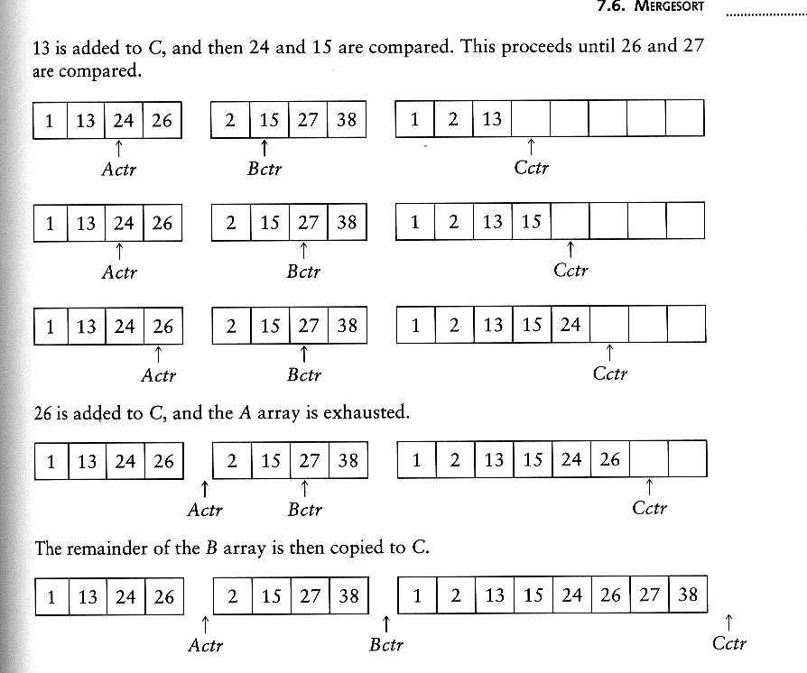
Example: Merge

Slide 16
Example: Merge...
Running time analysis:
  Clearly, merge takes O(m1 + m2) where m1 and m2 are
the sizes of the two sublists.
Space requirement:
  merging two sorted lists requires linear extra memory
  additional work to copy to the temporary array and back

Slide 17
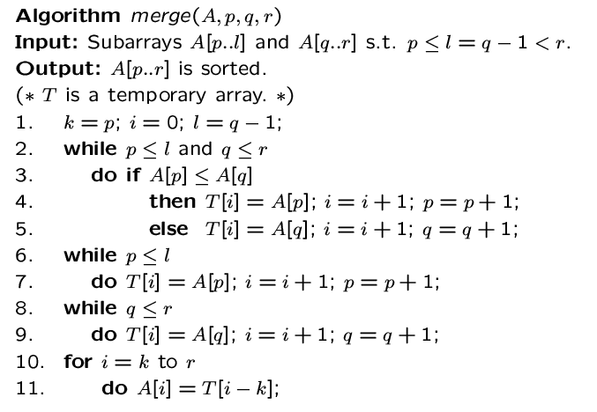

Slide 18
Analysis of mergesort
Let T(N) denote the worst-case running time of mergesort to sort N numbers.
Assume that N is a power of 2.
Divide step: O(1) time
Conquer step: 2 T(N/2) time
Combine step: O(N) time
Recurrence equation:
  T(1) = 1
  T(N) = 2T(N/2) + N

Slide 19
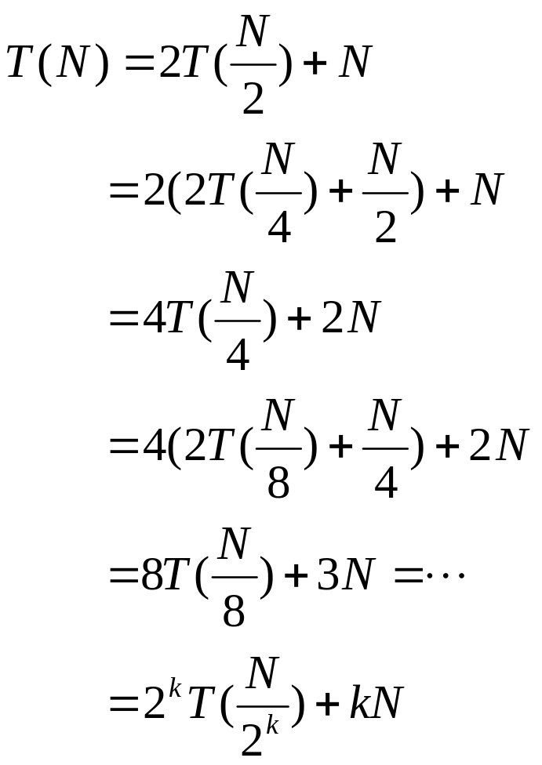
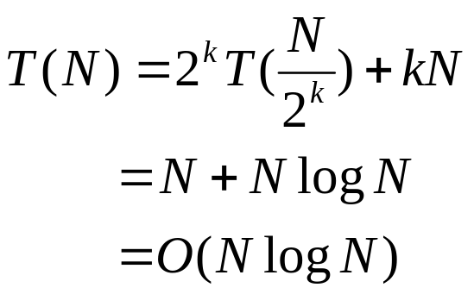
Analysis: solving recurrence
Since N=2^{k}, we have k=log₂ n

Slide 20
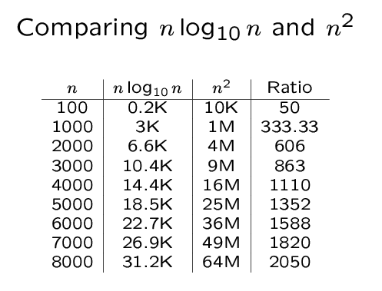

Slide 21
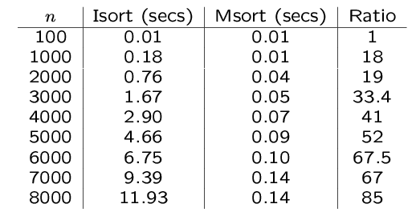
An experiment
Code from textbook (using template)
Unix time utility

