Slide 1
Lists
COMP171
Fall 2005

Slide 2
Outline
Abstract Data Type (ADT)
List ADT
List ADT with Array Implementation
Linked lists
Basic operations of linked lists
  Insert, find, delete, print, etc.
Variations of linked lists
  Circular linked lists
  Doubly linked lists

Slide 3
Abstract Data Type (ADT)
Data type
  a set of objects + a set of operations
  Example: integer
    set of whole numbers
    operations: +, -, x, /
Can this be generalized?
  (e.g. procedures generalize the notion of an operator)
  Yes!
Abstract data type
  high-level abstractions (managing complexity through abstraction)
  Encapsulation

Slide 4
Encapsulation
Operation on the ADT can only be done by calling the appropriate function
no mention of how the set of operations is implemented
The definition of the type and all operations on that type can be localized to one section of the program
If we wish to change the implementation of an ADT
  we know where to look
  by revising one small section we can be sure that there is no subtlety elsewhere that will cause errors
We can treat the ADT as a primitive type: we have no concern with the underlying implementation
ADT → C++: class
method → C++: member function

Slide 5
ADT…
Examples
  the set ADT
    A set of elements
    Operations: union, intersection, size and complement
  the queue ADT
    A set of sequences of elements
    Operations: create empty queue, insert, examine, delete, and destroy queue
Two ADT’s are different if they have the same underlying model but different operations
  E.g. a different set ADT with only the union and find operations
  The appropriateness of an implementation depends very much on the operations to be performed

Slide 6
Pros and Cons
Implementation of the ADT is separate from its use
Modular: one module for one ADT
  Easier to debug
  Easier for several people to work simultaneously
Code for the ADT can be reused in different applications
Information hiding
  A logical unit to do a specific job
  implementation details can be changed without affecting user programs
Allow rapid prototying
  Prototype with simple ADT implementations, then tune them later when necessary
Loss of efficiency

Slide 7
The List ADT
A sequence of zero or more elements
A₁, A₂, A₃, … A_{N}
N: length of the list
A₁: first element
A_{N}: last element
A_{i}: position i
If N=0, then empty list
Linearly ordered
  A_{i} precedes A_{i+1}
  A_{i} follows A_{i-1}

Slide 8
Operations
printList: print the list
makeEmpty: create an empty list
find: locate the position of an object in a list
  list: 34,12, 52, 16, 12
  find(52) → 3
insert: insert an object to a list
  insert(x,3) → 34, 12, 52, x, 16, 12
remove: delete an element from the list
  remove(52) → 34, 12, x, 16, 12
findKth: retrieve the element at a certain position

Slide 9
Implementation of an ADT
Choose a data structure to represent the ADT
  E.g. arrays, records, etc.
Each operation associated with the ADT is implemented by one or more subroutines
Two standard implementations for the list ADT
  Array-based
  Linked list

Slide 10
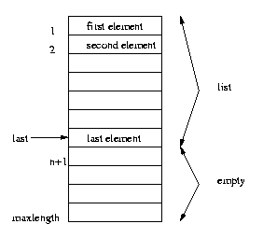
Array Implementation
Elements are stored in contiguous array positions

Slide 11
Array Implementation...
Requires an estimate of the maximum size of the list
  waste space
printList and find: linear
findKth: constant
insert and delete: slow
  e.g. insert at position 0 (making a new element)
    requires first pushing the entire array down one spot to make room
  e.g. delete at position 0
    requires shifting all the elements in the list up one
  On average, half of the lists needs to be moved for either operation

Slide 12
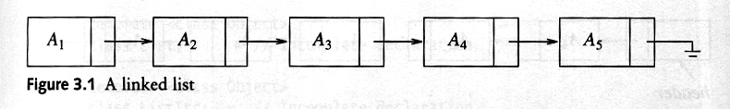
Pointer Implementation (Linked List)
Ensure that the list is not stored contiguously
  use a linked list
  a series of structures that are not necessarily adjacent in memory
Each node contains the element and a pointer to a structure containing its successor
  the last cell’s next link points to NULL
Compared to the array implementation,
  the pointer implementation uses only as much space as is needed for the elements currently on the list
  but requires space for the pointers in each cell

Slide 13
Linked Lists
A
B
C
∅
Head
A linked list is a series of connected nodes
Each node contains at least
  A piece of data (any type)
  Pointer to the next node in the list
Head: pointer to the first node
The last node points to NULL
node
A
data
pointer

Slide 14
A Simple Linked List Class
We use two classes: Node and List
Declare Node class for the nodes
  data: double-type data in this example
  next: a pointer to the next node in the list
class Node {
public:
double data; // data
Node* next; // pointer to next
};

Slide 15
A Simple Linked List Class
Declare List, which contains
  head: a pointer to the first node in the list.
  Since the list is empty initially, head is set to NULL
  Operations on List
class List {
public:
List(void) { head = NULL; } // constructor
~List(void); // destructor
bool IsEmpty() { return head == NULL; }
Node* InsertNode(int index, double x);
int FindNode(double x);
int DeleteNode(double x);
void DisplayList(void);
private:
Node* head;
};

Slide 16
A Simple Linked List Class
Operations of List
  IsEmpty: determine whether or not the list is empty
  InsertNode: insert a new node at a particular position
  FindNode: find a node with a given value
  DeleteNode: delete a node with a given value
  DisplayList: print all the nodes in the list

Slide 17
Inserting a new node
Node* InsertNode(int index, double x)
  Insert a node with data equal to x after the index’th elements. (i.e., when index = 0, insert the node as the first element;
  when index = 1, insert the node after the first element, and so on)
  If the insertion is successful, return the inserted node.
  Otherwise, return NULL.
  (If index is < 0 or > length of the list, the insertion will fail.)
Steps
  Locate index’th element
  Allocate memory for the new node
  Point the new node to its successor
  Point the new node’s predecessor to the new node
index’th element
newNode

Slide 18
Inserting a new node
Possible cases of InsertNode
  Insert into an empty list
  Insert in front
  Insert at back
  Insert in middle
But, in fact, only need to handle two cases
  Insert as the first node (Case 1 and Case 2)
  Insert in the middle or at the end of the list (Case 3 and Case 4)

Slide 19
Inserting a new node
Try to locate index’th node. If it doesn’t exist, return NULL.
Node* List::InsertNode(int index, double x) {
if (index < 0) return NULL;
int currIndex = 1;
Node* currNode = head;
while (currNode && index > currIndex) {
currNode = currNode->next;
currIndex++;
}
if (index > 0 && currNode == NULL) return NULL;
Node* newNode = new Node;
newNode->data = x;
if (index == 0) {
newNode->next = head;
head = newNode;
}
else {
newNode->next = currNode->next;
currNode->next = newNode;
}
return newNode;
}

Slide 20
Inserting a new node
Node* List::InsertNode(int index, double x) {
if (index < 0) return NULL;
int currIndex = 1;
Node* currNode = head;
while (currNode && index > currIndex) {
currNode = currNode->next;
currIndex++;
}
if (index > 0 && currNode == NULL) return NULL;
Node* newNode = new Node;
newNode->data = x;
if (index == 0) {
newNode->next = head;
head = newNode;
}
else {
newNode->next = currNode->next;
currNode->next = newNode;
}
return newNode;
}
Create a new node

Slide 21
Inserting a new node
Node* List::InsertNode(int index, double x) {
if (index < 0) return NULL;
int currIndex = 1;
Node* currNode = head;
while (currNode && index > currIndex) {
currNode = currNode->next;
currIndex++;
}
if (index > 0 && currNode == NULL) return NULL;
Node* newNode = new Node;
newNode->data = x;
if (index == 0) {
newNode->next = head;
head = newNode;
}
else {
newNode->next = currNode->next;
currNode->next = newNode;
}
return newNode;
}
Insert as first element
head
newNode

Slide 22
Inserting a new node
Node* List::InsertNode(int index, double x) {
if (index < 0) return NULL;
int currIndex = 1;
Node* currNode = head;
while (currNode && index > currIndex) {
currNode = currNode->next;
currIndex++;
}
if (index > 0 && currNode == NULL) return NULL;
Node* newNode = new Node;
newNode->data = x;
if (index == 0) {
newNode->next = head;
head = newNode;
}
else {
newNode->next = currNode->next;
currNode->next = newNode;
}
return newNode;
}
Insert after currNode
currNode
newNode

Slide 23
Finding a node
int FindNode(double x)
  Search for a node with the value equal to x in the list.
  If such a node is found, return its position. Otherwise, return 0.
int List::FindNode(double x) {
Node* currNode = head;
int currIndex = 1;
while (currNode && currNode->data != x) {
currNode = currNode->next;
currIndex++;
}
if (currNode) return currIndex;
return 0;
}

Slide 24
Deleting a node
int DeleteNode(double x)
  Delete a node with the value equal to x from the list.
  If such a node is found, return its position. Otherwise, return 0.
Steps
  Find the desirable node (similar to FindNode)
  Release the memory occupied by the found node
  Set the pointer of the predecessor of the found node to the successor of the found node
Like InsertNode, there are two special cases
  Delete first node
  Delete the node in middle or at the end of the list

Slide 25
Deleting a node
int List::DeleteNode(double x) {
Node* prevNode = NULL;
Node* currNode = head;
int currIndex = 1;
while (currNode && currNode->data != x) {
prevNode = currNode;
currNode = currNode->next;
currIndex++;
}
if (currNode) {
if (prevNode) {
prevNode->next = currNode->next;
delete currNode;
}
else {
head = currNode->next;
delete currNode;
}
return currIndex;
}
return 0;
}
Try to find the node with its value equal to x

Slide 26
Deleting a node
int List::DeleteNode(double x) {
Node* prevNode = NULL;
Node* currNode = head;
int currIndex = 1;
while (currNode && currNode->data != x) {
prevNode = currNode;
currNode = currNode->next;
currIndex++;
}
if (currNode) {
if (prevNode) {
prevNode->next = currNode->next;
delete currNode;
}
else {
head = currNode->next;
delete currNode;
}
return currIndex;
}
return 0;
}
prevNode
currNode

Slide 27
Deleting a node
int List::DeleteNode(double x) {
Node* prevNode = NULL;
Node* currNode = head;
int currIndex = 1;
while (currNode && currNode->data != x) {
prevNode = currNode;
currNode = currNode->next;
currIndex++;
}
if (currNode) {
if (prevNode) {
prevNode->next = currNode->next;
delete currNode;
}
else {
head = currNode->next;
delete currNode;
}
return currIndex;
}
return 0;
}
head
currNode

Slide 28
Printing all the elements
void DisplayList(void)
  Print the data of all the elements
  Print the number of the nodes in the list
void List::DisplayList()
{
int num = 0;
Node* currNode = head;
while (currNode != NULL){
cout << currNode->data << endl;
currNode = currNode->next;
num++;
}
cout << "Number of nodes in the list: " << num << endl;
}

Slide 29
Destroying the list
~List(void)
  Use the destructor to release all the memory used by the list.
  Step through the list and delete each node one by one.
List::~List(void) {
Node* currNode = head, *nextNode = NULL;
while (currNode != NULL)
{
nextNode = currNode->next;
// destroy the current node
delete currNode;
currNode = nextNode;
}
}

Slide 30
Using List
6
7
5
Number of nodes in the list: 3
5.0 found
4.5 not found
6
5
Number of nodes in the list: 2
result
int main(void)
{
List list;
list.InsertNode(0, 7.0); // successful
list.InsertNode(1, 5.0); // successful
list.InsertNode(-1, 5.0); // unsuccessful
list.InsertNode(0, 6.0); // successful
list.InsertNode(8, 4.0); // unsuccessful
// print all the elements
list.DisplayList();
if(list.FindNode(5.0) > 0) cout << "5.0 found" << endl;
else cout << "5.0 not found" << endl;
if(list.FindNode(4.5) > 0) cout << "4.5 found" << endl;
else cout << "4.5 not found" << endl;
list.DeleteNode(7.0);
list.DisplayList();
return 0;
}

Slide 31
Variations of Linked Lists
Circular linked lists
  The last node points to the first node of the list
  How do we know when we have finished traversing the list? (Tip: check if the pointer of the current node is equal to the head.)
A
B
C
Head

Slide 32
Variations of Linked Lists
Doubly linked lists
  Each node points to not only successor but the predecessor
  There are two NULL: at the first and last nodes in the list
  Advantage: given a node, it is easy to visit its predecessor. Convenient to traverse lists backwards
∅
A
B
C
∅
Head

Slide 33
Array versus Linked Lists
Linked lists are more complex to code and manage than arrays, but they have some distinct advantages.
  Dynamic: a linked list can easily grow and shrink in size.
    We don’t need to know how many nodes will be in the list. They are created in memory as needed.
    In contrast, the size of a C++ array is fixed at compilation time.
  Easy and fast insertions and deletions
    To insert or delete an element in an array, we need to copy to temporary variables to make room for new elements or close the gap caused by deleted elements.
    With a linked list, no need to move other nodes. Only need to reset some pointers.

Slide 34
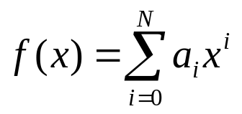
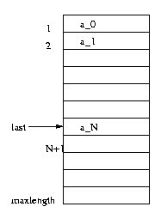
Example: The Polynomial ADT
An ADT for single-variable polynomials
Array implementation

Slide 35
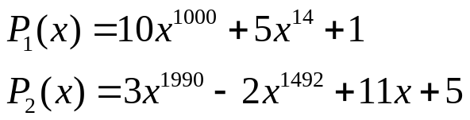
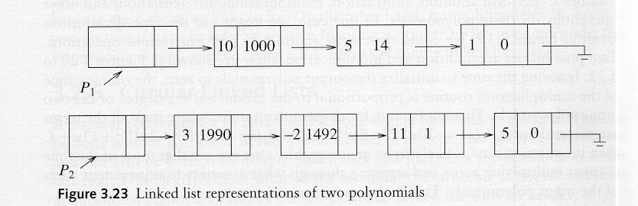
The Polynomial ADT…
  Acceptable if most of the coefficients A_{j} are nonzero, undesirable if this is not the case
  E.g. multiply
    most of the time is spent multiplying zeros and stepping through nonexistent parts of the input polynomials
Implementation using a singly linked list
  Each term is contained in one cell, and the cells are sorted in decreasing order of exponents

