Slide 1
String Matching
COMP171
Fall 2005

Slide 2
Pattern Matching
Given a text string T[0..n-1] and a pattern P[0..m-1], find all occurrences of the pattern within the text.
Example: T = 000010001010001 and P = 0001, the occurrences are:
  first occurrence starts at T[1]
  second occurrence starts at T[5]
  third occurrence starts at T[11]

Slide 3
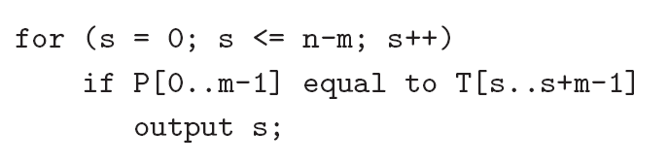
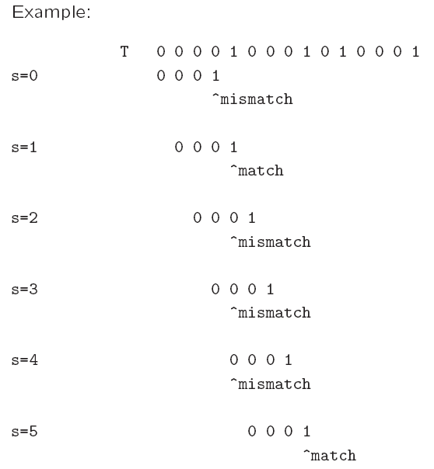
Naïve algorithm
Worst-case running time = O(nm).

Slide 4
Rabin-Karp Algorithm
Key idea:
  think of the pattern P[0..m-1] as a key, transform (hash) it into an equivalent integer p
  Similarly, we transform substrings in the text string T[] into integers
    For s=0,1,…,n-m, transform T[s..s+m-1] to an equivalent integer t_{s}
  The pattern occurs at position s if and only if p=t_{s}
If we compute p and t_{s} quickly, then the pattern matching problem is reduced to comparing p with n-m+1 integers

Slide 5
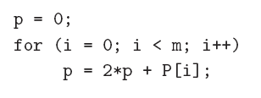
Rabin-Karp Algorithm …
How to compute p?
  p = 2^{m-1} P[0] + 2^{m-2} P[1] + … + 2 P[m-2] + P[m-1]
Using horner’s rule
This takes O(m) time, assuming each arithmetic operation can be done in O(1) time.

Slide 6
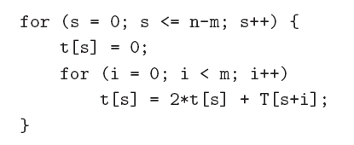
Rabin-Karp Algorithm …
Similarly, to compute the (n-m+1) integers t_{s} from the text string
This takes O((n – m + 1) m) time, assuming that each arithmetic operation can be done in O(1) time.
This is a bit time-consuming.

Slide 7
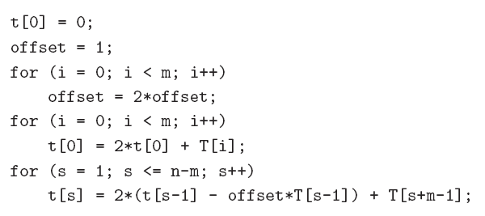
Rabin-Karp Algorithm
A better method to compute the integers is:
This takes O(n+m) time, assuming that each arithmetic operation can be done in O(1) time.

Slide 8
Problem
The problem with the previous strategy is that when m is large, it is unreasonable to assume that each arithmetic operation can be done in O(1) time.
  In fact, given a very long integer, we may not even be able to use the default integer type to represent it.
Therefore, we will use modulo arithmetic. Let q be a prime number so that 2q can be stored in one computer word.
  This makes sure that all computations can be done using single-precision arithmetic.

Slide 9
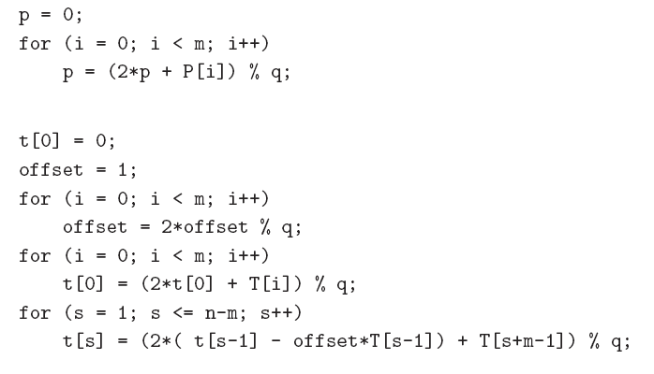

Slide 10
Once we use the modulo arithmetic, when p=t_{s} for some s, we can no longer be sure that P[0 .. M-1] is equal to T[s .. S+ m -1 ]
Therefore, after the equality test p = t_{s}, we should compare P[0..m-1] with T[s..s+m-1] character by character to ensure that we really have a match.
So the worst-case running time becomes O(nm), but it avoids a lot of unnecessary string matchings in practice.

Slide 11
Boyer-Moore Algorithm
Basic idea is simple.
We match the pattern P against substrings in the text string T from right to left.
We align the pattern with the beginning of the text string. Compare the characters starting from the rightmost character of the pattern. If fail, shift the pattern to the right, by how far?

Slide 12
Boyer-Moore Algorithm
Suppose we are comparing the last character P[m-1] of the pattern with some character T[k] in the text.
  If P[m-1] ≠ T[k], then the pattern does not occur here
Case (1): if the character T[k] does not appear in P at all, we should shift P all the way to align P[0] with T[k+1]
  and match P[m-1] with T[k+m] again. This saves a lot of character comparisons.
Case (2): if the character T[k] appears in P, then we should shift P to align the rightmost occurrence of this character in P with T[k].

Slide 13
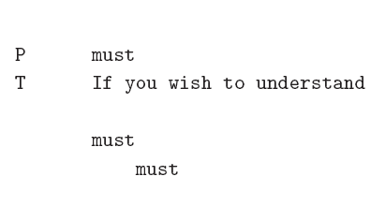
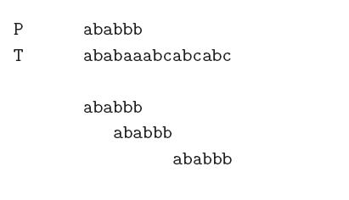
Examples
Case (1)
Case (2)
Case (1)

Slide 14
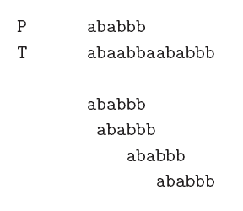
If the last character P[m-1] of the pattern matches with T[k], then we continue scanning P from right to left and match with T.
If we find a complete match, we are done.
Otherwise (case (3)), whenever we fail to find a complete match, we should always shift P to align the next rightmost occurrence of P[m-1] in P with T[k] and try again
Case (3)
Case (2)
Case (2)

Slide 15
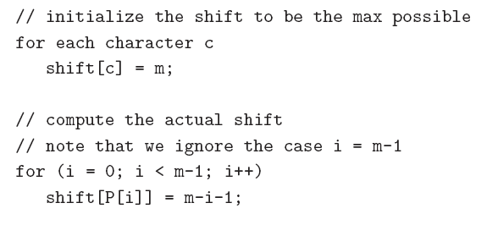
Boyer-Moore algorithm
To implement, we need to find out for each character c in the alphabet, the amount of shift needed if P[m-1] aligns with the character c in the input text and they don’t match.
This takes O(m + A) time, where A is the number of possible characters. Afterwards, matching P with substrings in T is very fast in practice.

