Slide 1
Pattern Matching II
COMP171
Fall 2005

Slide 2
A Finite Automaton Approach
A directed graph that allows self-loop.
Each vertex denotes a state and each directed edge is labeled by an input item.
The directed edge stands for a transition from one state to another.
  E.g., a directed edge labelled a connecting vertex v to vertex w, means that if we are at state v and see the input item a, then we should transit to state w. We write δ(v,a) = w. That is, δ is called the state transition function.
There is a unique start state and a unique final state.

Slide 3
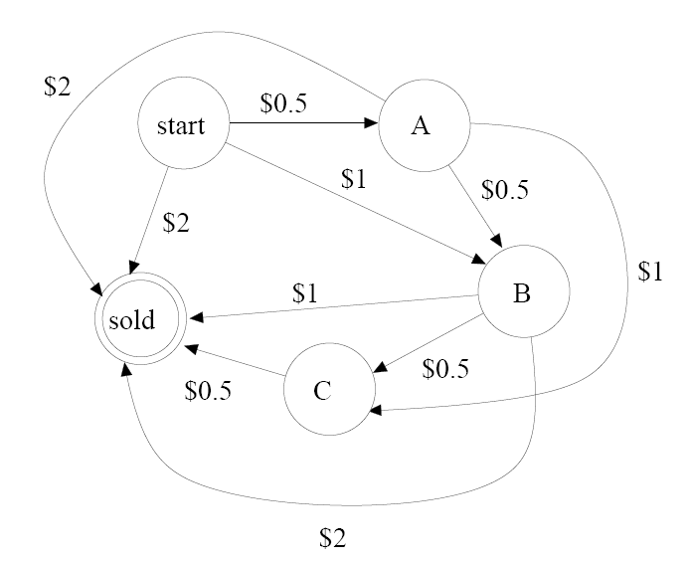
Example: a vending machine

Slide 4
Sometimes, an edge is labelled with more than one input item. This means we will make the same transition if we see any one of the input items indicated.
We can think of the finite automaton as a machine. So the operation begins at the start state. When it reaches the final state, it stops running.

Slide 5
Pattern Matching Automaton
Other than the start state, the label of each vertex is the prefix of the pattern that has been successfully matched so far.
The final state stands for a complete match.
The label of an edge is the next character in the input text.
  E.g., suppose that there is a transition from v to u, labeled 0, and there is another transition from v to w, labeled 1. This means that if we are at state v and the next character read is 0, we transit to state u; if the next character read is 1, we transit to state w.

Slide 6
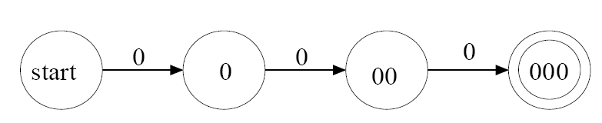

Automaton Construction example
A partially defined automaton for matching the pattern P = 000 looks like:
How should we define the remaining transitions?

Slide 7
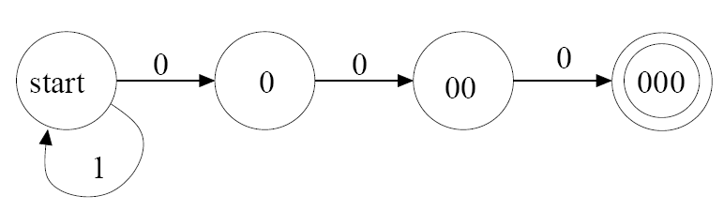
If we are at the start state and we see 1, then we have no progress at all because we do not have any match with any character in P. So δ(start,1) = start

Slide 8
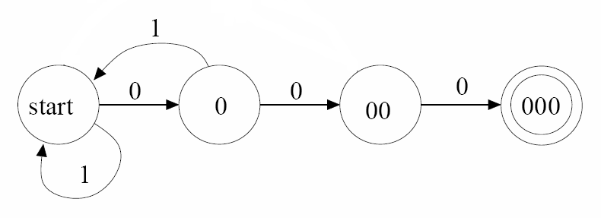
If we are at state 0 and we see 1, then we have to start matching all over again at the character after 1 in the input text. So δ(0,1) =start.

Slide 9
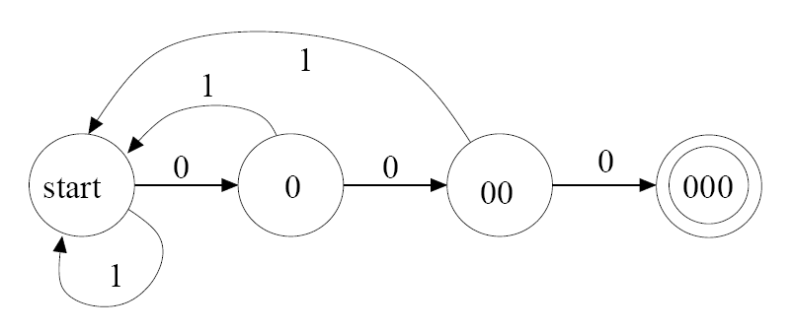
If we are at state 00 and we see 1, then we have to start the matching all over again at the character after 1 in the input text. So δ(00,1) =start.
The same reasoning works for the state 000 as well.
1

Slide 10
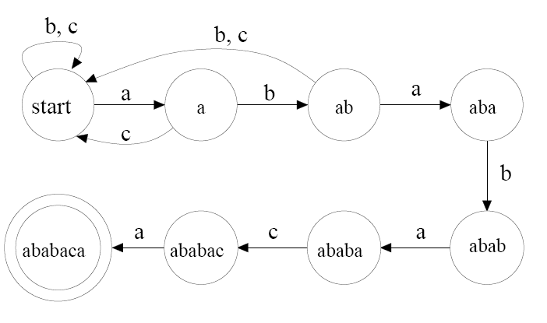

A more interesting example
Construct an automaton for matching the pattern P = ababaca
We start with the following partially defined automaton.

Slide 11
When we are at state a and see a, we should go to the state a. So δ(a,a) = a.
When we are at state aba and see c, we should go to the start state. So δ(aba,c) = start. But when we are at state aba and see an a, we should go to the state a
When we are at state abab and see b or c, we should go to the state start. So δ(abab,b) = δ(abab,c) = start.

Slide 12
Suppose that we use s_{k} to denote the state which is the prefix of P with k characters.
In general, if we are at state s_{k}, we see a character c, which is a mismatch, then we should go back to the state s_{j} such that the string s_{j} is a suffix of the string s_{k} c. Moreover, j is clearly less than k but we should also choose the largest j possible.
This corresponds to shifting the pattern P to the right by the smallest amount so that some prefix of the pattern P still gives us a partial match. This avoids missing any occurrence of the pattern P.
Therefore, for this example, δ(ababa,a)= a, δ(ababa,b) = abab, δ(ababac, b) = start, and δ(ababac,c) = start

Slide 13
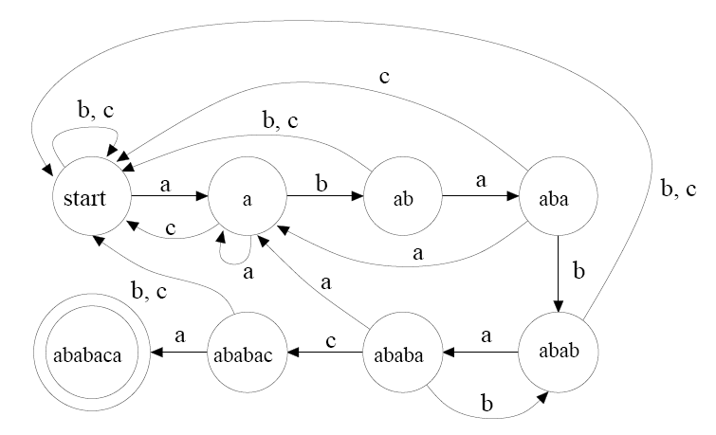

Slide 14
This rule can be made more general: δ(s_{k},c) = s_{j} where j is the largest integer no more than k+1 so that s_{j} is a suffix of s_{k} c. Then this rule also captures the setting of transitions of the partially defined automaton that we started with. That is, this rule captures the setting of all transitions.

Slide 15
What if we want to find all the occurrences of the pattern P, instead of just the first occurrence?
Then we should define transitions out of the final state as well.
  That is, the machine should continue to run even when it reaches the final state. But whenever the machine reaches the final state, it denotes the discovery of another occurrence of the pattern P.

Slide 16
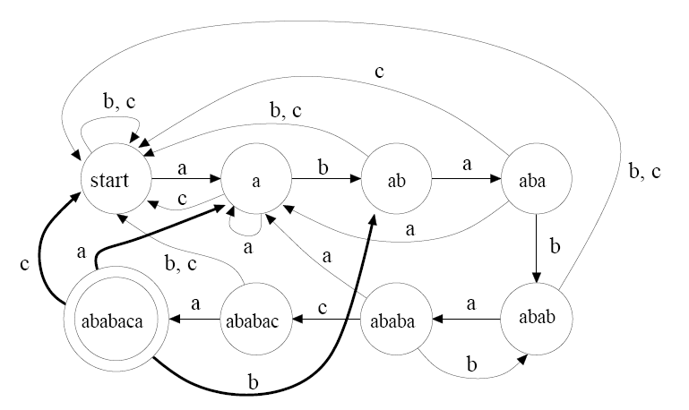

Slide 17
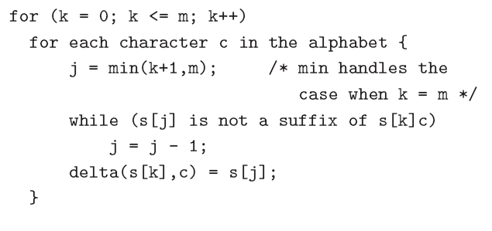
Computing the state transition function
We use s[0] to denote the start state. It also denotes the empty string.
We use s[k] to denote the state s_{k} and the string s_{k} for 1 <= k <= m

Slide 18
Let A be the size of the alphabet. The inner while-loop iterates O(m) times, but the suffix condition testing takes O(m) time.
The inner for-loop iterates A times and the outer for-loop iterates m+1 times. So the total running time is O(m³ A).
The subsequent pattern matching takes O(n) time as we spend O(1) at each character in the input text.

