Slide 1
Part II: Counting
Page <number>
Basic Counting: Principles
Lists, Permutations, and Subsets
Binomial Coefficients
Pigeonhole Principle

Slide 2
L04: Basic Counting
Page <number>
Objectives
  Counting: What and Why?
  Basic principles of counting
Reading
  SDB, pp. 31-38

Slide 3
Outline
Page <number>
Introduction to Counting
The Sum Principle
  Principle through an example
  Set-Theoretic concepts and Notations
  Summing consecutive integers
The Product Principle
  The principle
  An application: Two-Elements subsets

Slide 4
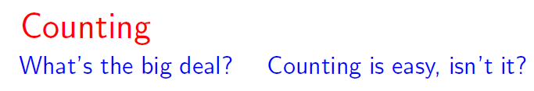


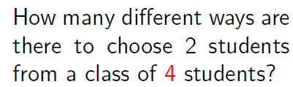


Page <number>

Slide 5
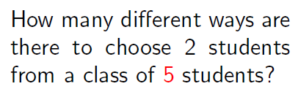

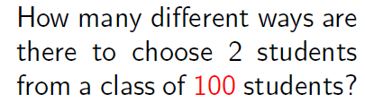


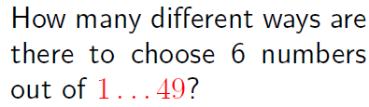


Page <number>

Slide 6
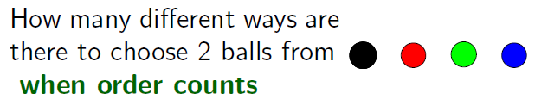

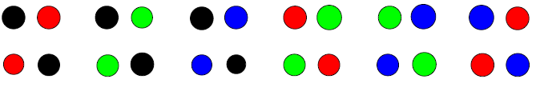
Page <number>

Slide 7


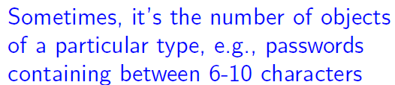
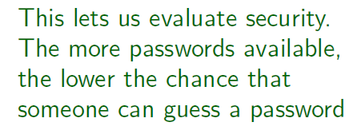
Page <number>

Slide 8
Outline
Page <number>
Introduction to Counting
The Sum Principle
  Principle through an example
  Set-Theoretic concepts and Notations
  Summing consecutive integers
The Product Principle
  The principle
  An application: Two-Elements subsets

Slide 9
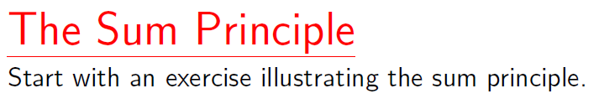

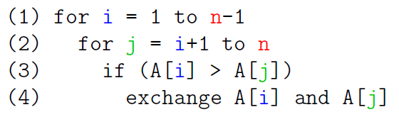
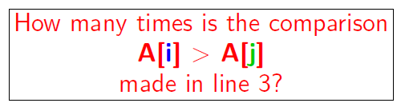
Page <number>

Slide 10
Selection Sort Comparison Counting
# of comparisons:
i=1: n-1
i=2: n-2
…..
i=n-1: 1
Total # of comparisons = (n-1)+(n-2)+…+1
2
n
1
3
… …
n-1
2
n
1
3
… …
n-1
2
n
1
3
… …
n-1

Slide 11

Sum Principle
S
# of comparisons:
i=1: n-1
i=2: n-2
…..
i=n-1: 1
Total # of comparisons = (n-1)+(n-2)+…+1
2
n
=|S₁|
1
3
… …
n-1
=|S₂|
2
n
1
3
… …
n-1
2
n
=|S_{n-1}|
1
3
… …
n-1

Slide 12
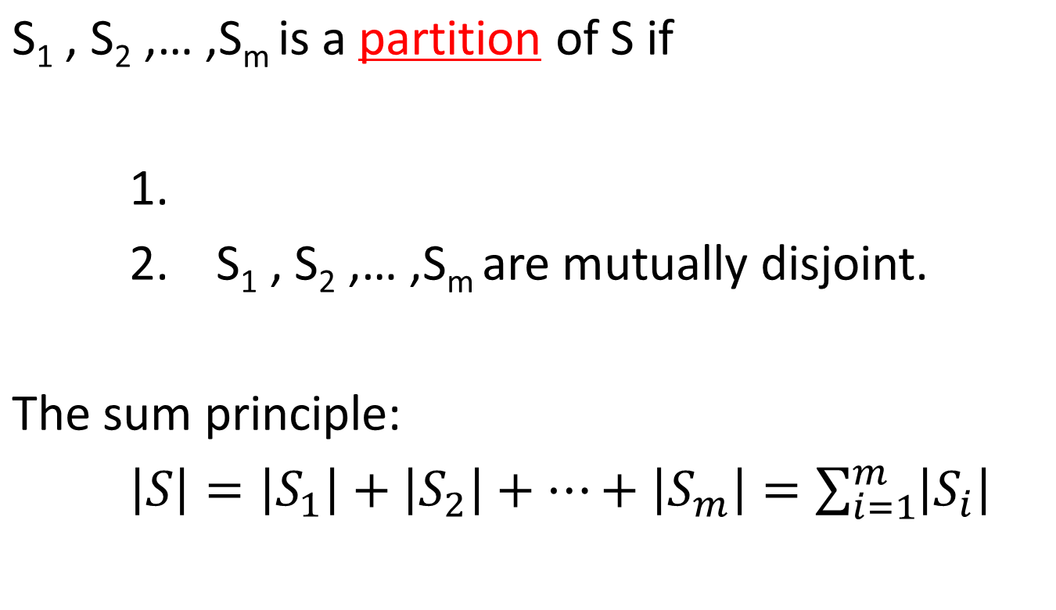

Sum Principle in Abstract
S₄
S₂
S₃
S₁
… …
S_{i}: blocks subsets
Abstraction: From Concrete example to General Principle

Slide 13
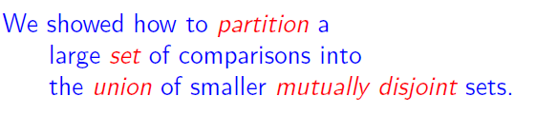
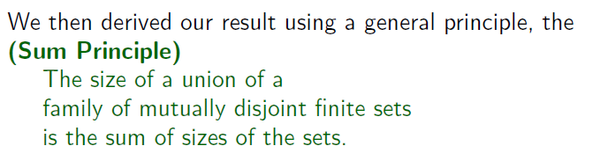

Page <number>
Set-Theoretical Concepts in Sum Principle

Slide 14
Outline
Page <number>
Introduction to Counting
The Sum Principle
  Principle through an example
  Set-Theoretic concepts and Notations
  Summing consecutive integers
The Product Principle
  The principle
  An application: Two-Elements subsets

Slide 15




Page <number>
{p|p an UST student who takes 91M to school}

Slide 16

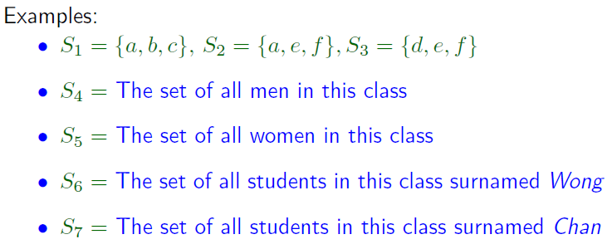

Page <number>

Slide 17
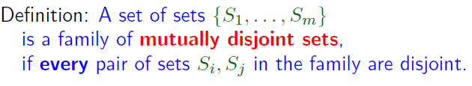
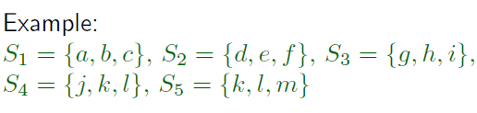






Page <number>

Slide 18





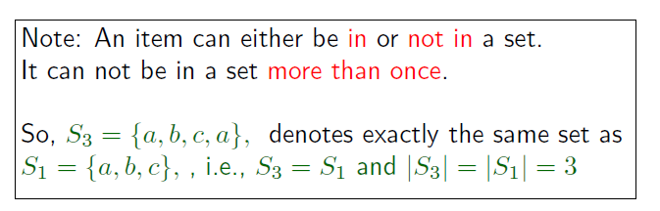
Page <number>

Slide 19
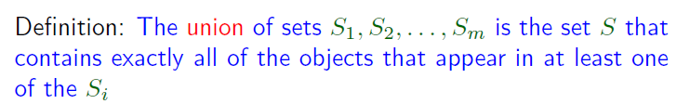



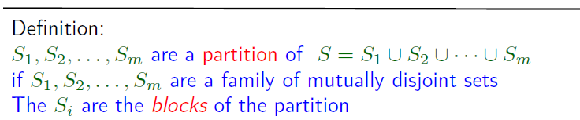



Page <number>

Slide 20
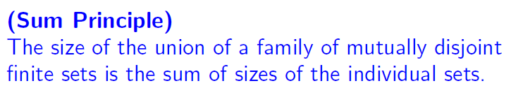
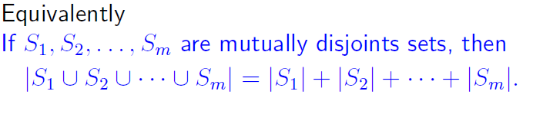
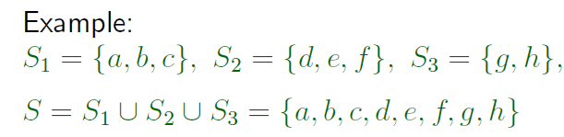


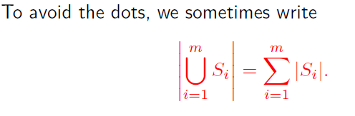
Page <number>

Slide 21
Outline
Page <number>
Introduction to Counting
The Sum Principle
  Principle through an example
  Set-Theoretic concepts and Notations
  Summing consecutive integers
The Product Principle
  The principle
  An application: Two-Elements subsets

Slide 22
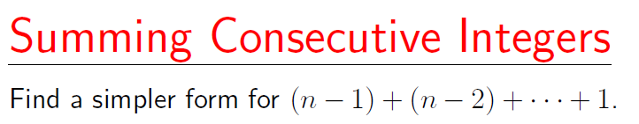



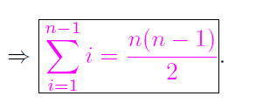

Page <number>

Slide 23
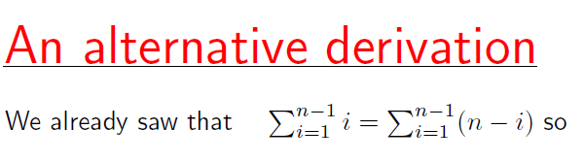


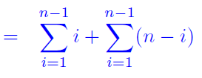


Page <number>

Slide 24
Outline
Page <number>
Introduction to Counting
The Sum Principle
  Principle through an example
  Set-Theoretic concepts and Notations
  Summing consecutive integers
The Product Principle
  The principle
  An application: Two-Elements subsets

Slide 25
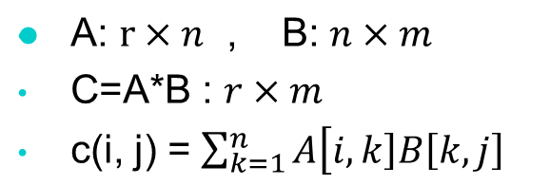
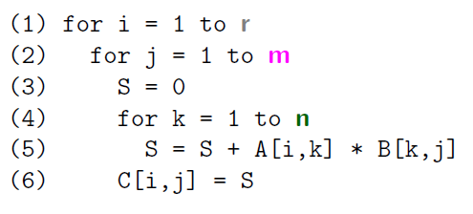
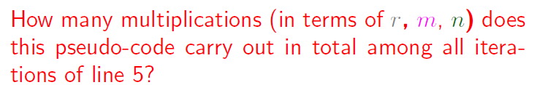
Matrix Multiplication
Page <number>

Slide 26
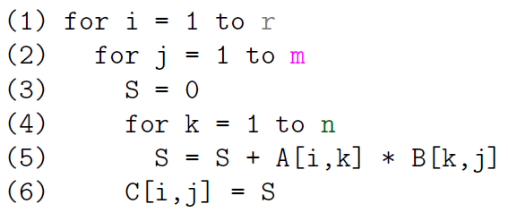









Page <number>

Slide 27


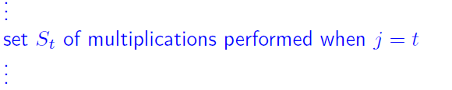
Page <number>

Slide 28


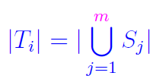

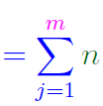


Page <number>

Slide 29
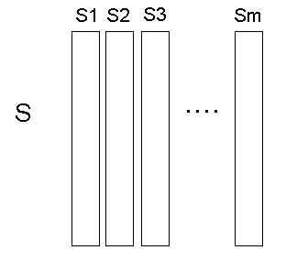

Product Principle in General
Page <number>
Si and Sj are disjoint, |Si| = n
S = S1 U S2 U … U Sm
|S| = m |Si| = mn

Slide 30
Outline
Page <number>
Introduction to Counting
The Sum Principle
  Principle through an example
  Set-Theoretic concepts and Notations
  Summing consecutive integers
The Product Principle
  The principle
  An application: Two-Elements subsets

Slide 31

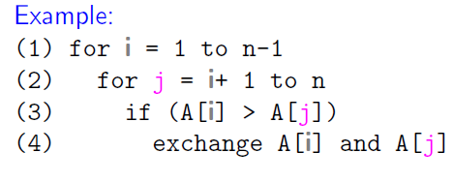
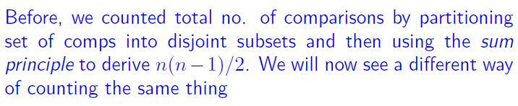
Page <number>

Slide 32
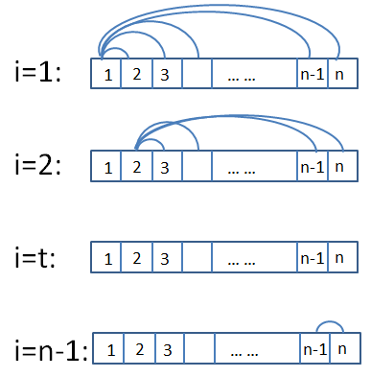



Page <number>

Slide 33


First: Ordered Pairs
Page <number>

Slide 34




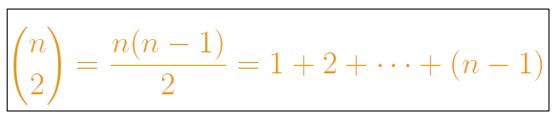
Now: Two-Element Subsets
Page <number>

Slide 35
Outline
Page <number>
Introduction to Counting
The Sum Principle
  Principle through an example
  Set-Theoretic concepts and Notations
  Summing consecutive integers
The Product Principle
  The principle
  An application: Two-Elements subsets

