Slide 1
Part III of Course: Probability
Chapter 5 of SDB
L08 – L12

Slide 2
L08: Introduction to Probability
Page <number>
Why study probability
Three basic concepts in probability theory
  Sample space
  Events
  Probability distributions
Complementary Probabilities
Uniform distribution
Examples:
  Hashing
  Birthday paradox

Slide 3

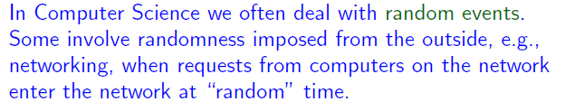
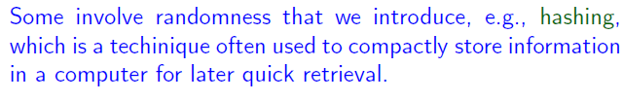
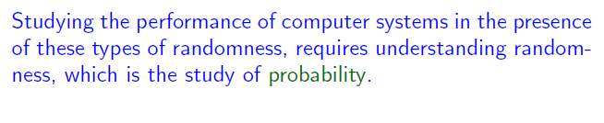
Page <number>

Slide 4

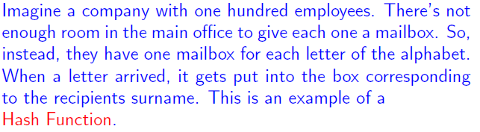
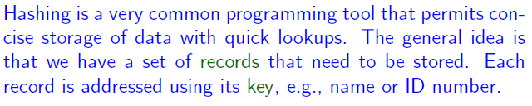
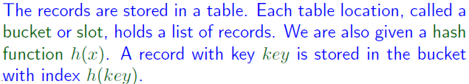
Page <number>

Slide 5

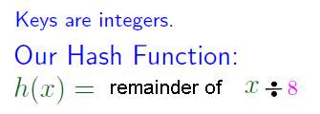
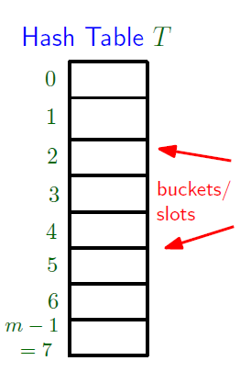





Page <number>

Slide 6







Page <number>

Slide 7
What is a good hashing function
University stores student records using hashing
Key: Digits of telephone number
  Method1: first four digits
  Method 2: last four digits
Which one is better?

Slide 8
Page <number>
Outline
Why study probability
Three basic concepts in probability theory
  Sample space
  Events
  Probability distributions
Complementary Probabilities
Uniform distribution
Examples:
  Hashing
  Birthday paradox

Slide 9
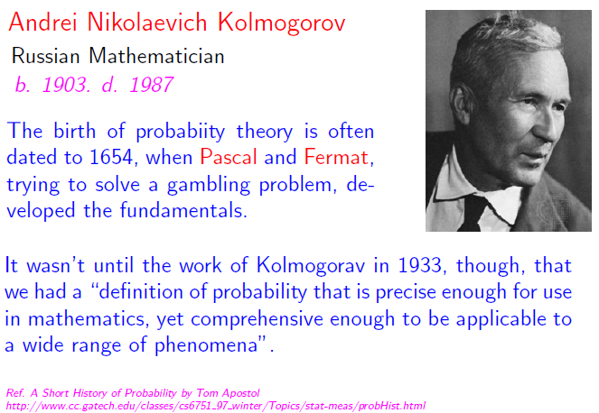
Page <number>

Slide 10




Random Experiments
Page <number>
Probability associated with a process with uncertain outcomes
  Often kept implicit

Slide 11
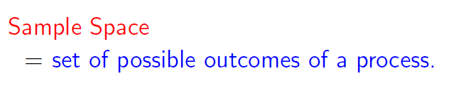
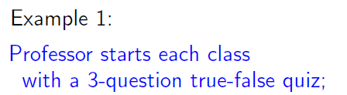

Page <number>

Slide 12
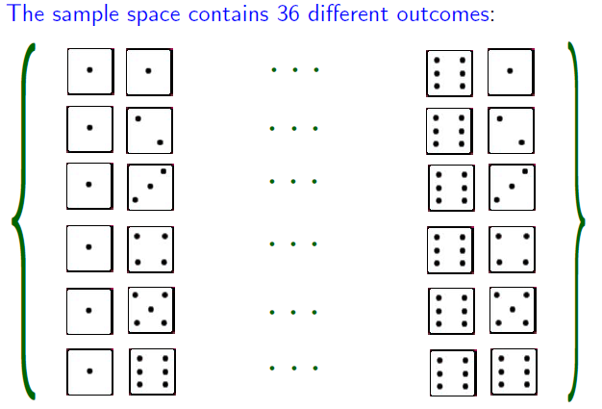
Page <number>

Slide 13
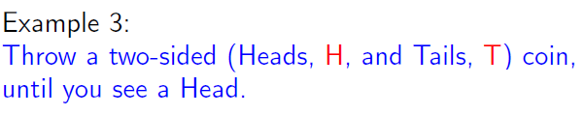

Page <number>

Slide 14

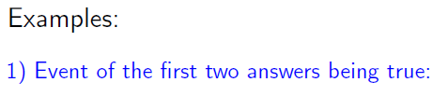


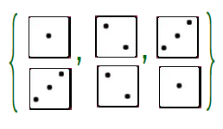


Page <number>

Slide 15

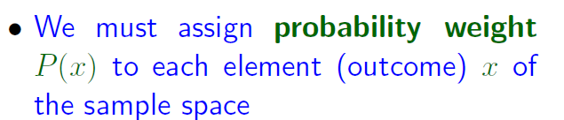



Page <number>

Slide 16
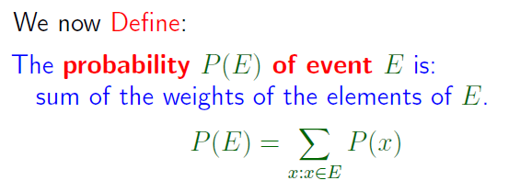

Page <number>

Slide 17



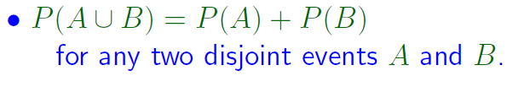
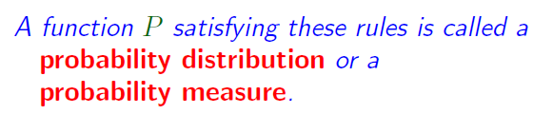
Page <number>

Slide 18


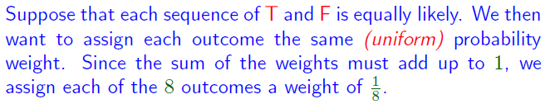


Page <number>

Slide 19




Page <number>

Slide 20

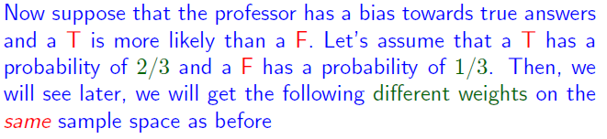



Page <number>

Slide 21


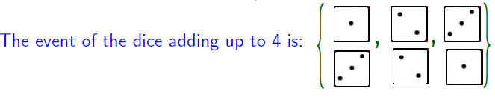

Page <number>

Slide 22



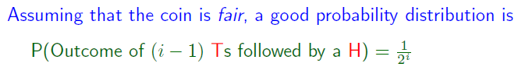

Page <number>

Slide 23

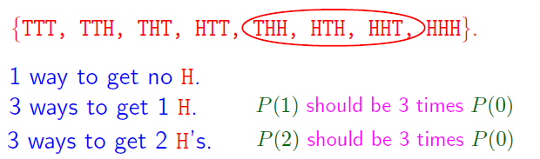
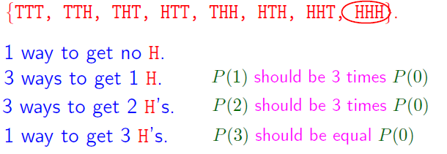
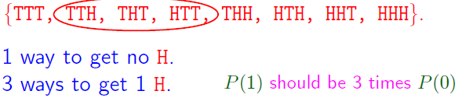
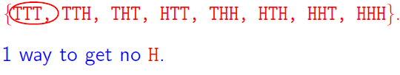
Different Sample Spaces for Same Process
Process: flip one coin 3 times
First sample space: Each outcome has probability 1/8
Alternative sample space:

Slide 24
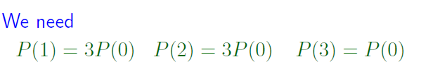



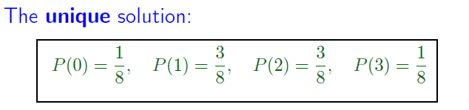

Probability for Alternative Sample Space
Page <number>

Slide 25
Summary
Page <number>
Probability associated with a process with uncertain outcomes
  Often kept implicit
Sample space: set of all possible outcomes
Event: subset of sample space
Probability distribution: weight for each element

Slide 26
Page <number>
Outline
Why study probability
Three basic concepts in probability theory
  Sample space
  Events
  Probability distributions
Complementary Probabilities
Uniform distribution
Examples:
  Hashing
  Birthday paradox

Slide 27

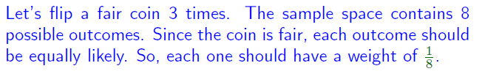
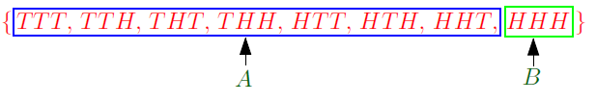






Page <number>

Slide 28
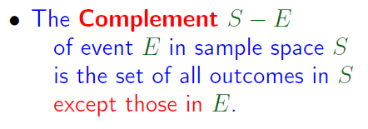
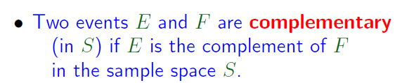



Page <number>

Slide 29
Page <number>
Outline
Why study probability
Three basic concepts in probability theory
  Sample space
  Events
  Probability distributions
Complementary Probabilities
Uniform distribution
Examples:
  Hashing
  Birthday paradox

Slide 30

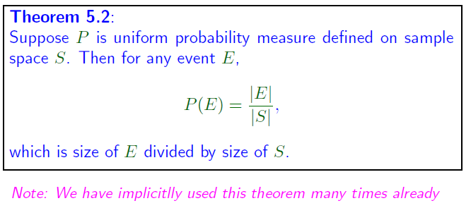
Page <number>

Slide 31

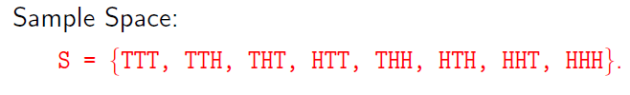



Page <number>

Slide 32

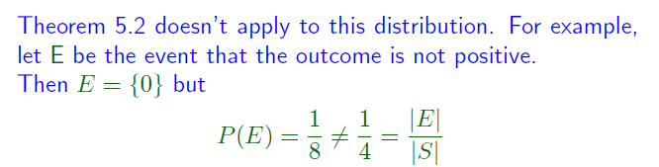
Page <number>

Slide 33
Page <number>
Outline
Why study probability
Three basic concepts in probability theory
  Sample space
  Events
  Probability distributions
Complementary Probabilities
Uniform distribution
Examples:
  Hashing
  Birthday paradox

Slide 34
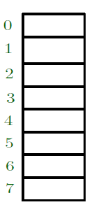
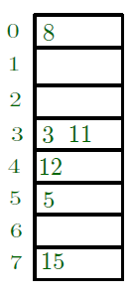
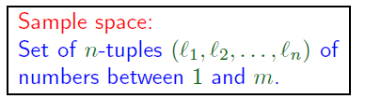
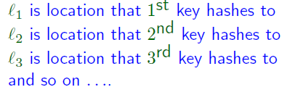


Probability and Hashing
Process
  n keys, m locations
  Each key is assigned to a location randomly

Slide 35


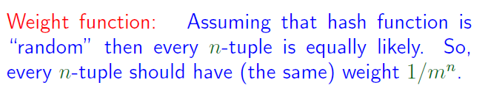
Page <number>

Slide 36




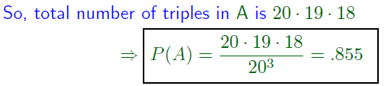
Page <number>

Slide 37


Page <number>

Slide 38



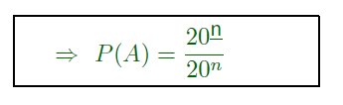
Page <number>

Slide 39
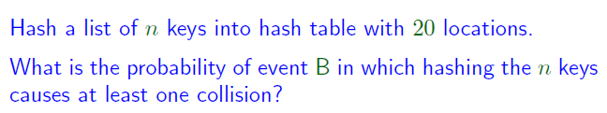
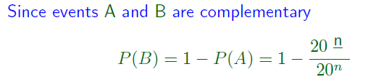
Page <number>

Slide 40
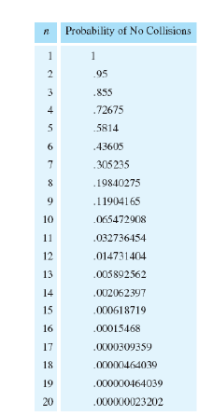
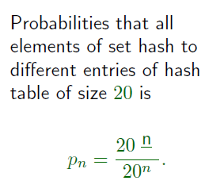
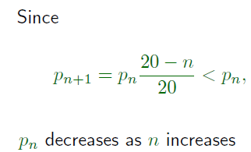
Page <number>

Slide 41
Page <number>
Outline
Why study probability
Three basic concepts in probability theory
  Sample space
  Events
  Probability distributions
Complementary Probabilities
Uniform distribution
Examples:
  Hashing
  Birthday paradox

Slide 42


Example: Birthday Paradox
Page <number>
General question: What is the probability is this event?

Slide 43



Example: Birthday Paradox
Page <number>
Process:
  Randomly draw n numbers from [1, 365]
Sample space:

Slide 44



Example: Birthday Paradox
Page <number>

Slide 45

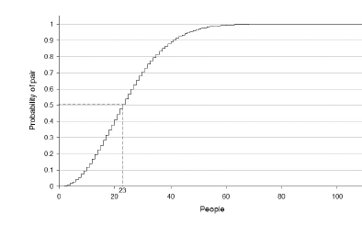
Example: Birthday Paradox
Page <number>

Slide 46
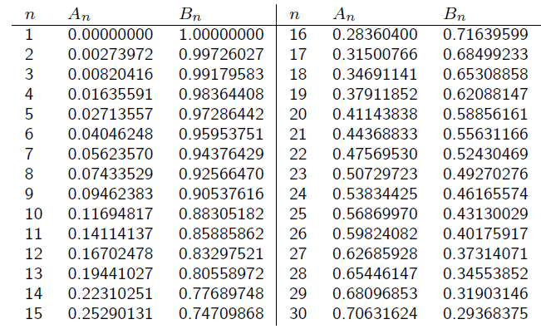
Example: Birthday Paradox
Page <number>

