Slide 1
L09: Probability of Unions of Events
Page 1
Objective:
  The inclusion-exclusion principle for probability
Reading:
  SDB: 292-300

Slide 2
Outline
The inclusion-exclusion principle
An example
Proof of the principle

Slide 3

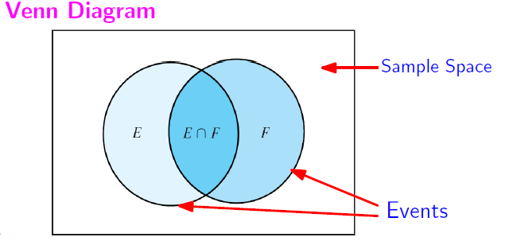

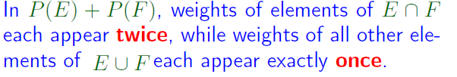
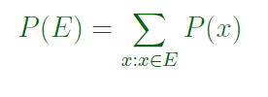
Page <number>

Slide 4
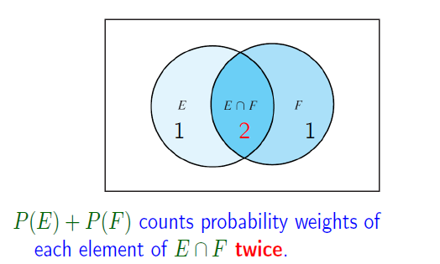


Slide 5
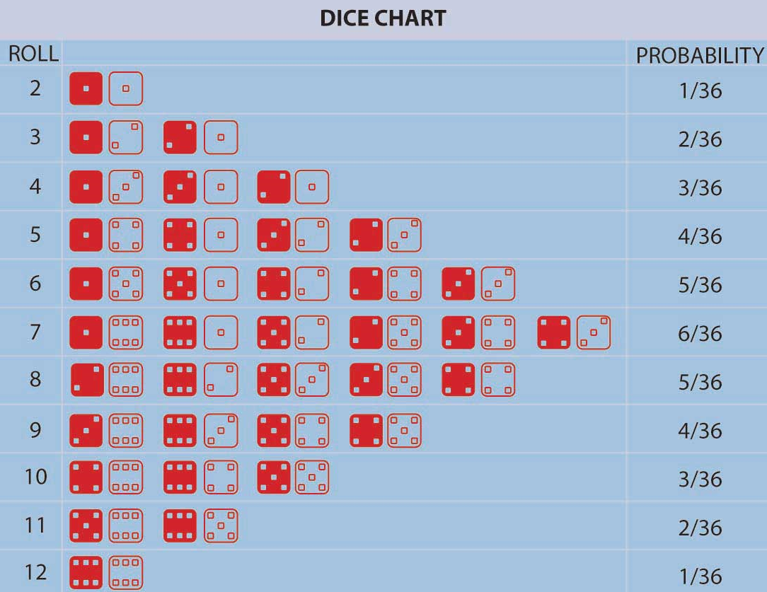







Example: Roll Two Dice
Page <number>

Slide 6
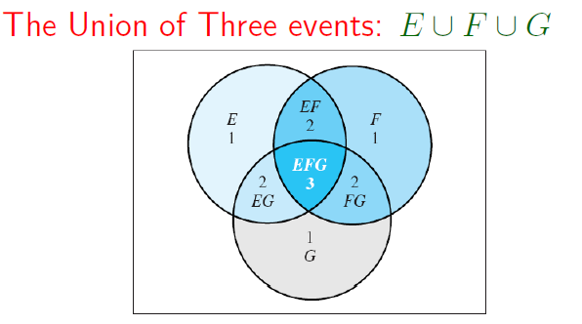

Page <number>

Slide 7
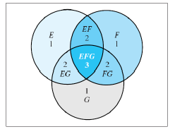




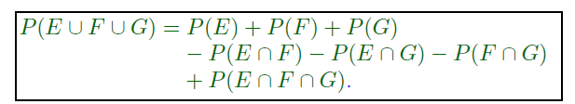
Page <number>

Slide 8
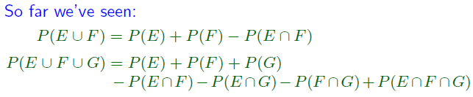

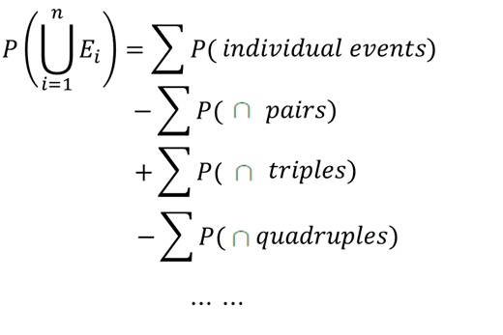
Page <number>

Slide 9
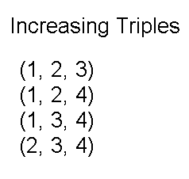
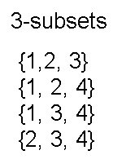
Increasing Triples Revisited
Page <number>
Fact from L02:
# of (i,j,k) s.t. 1≤i<j<k≤n
= # of 3-element subsets from {1,2,…n}

Slide 10

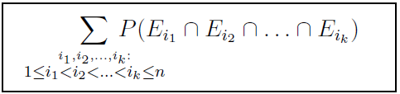
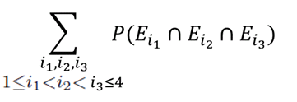




Notation
Page <number>

Slide 11




Notation
k=1
k=2
k=3
k=4

Slide 12
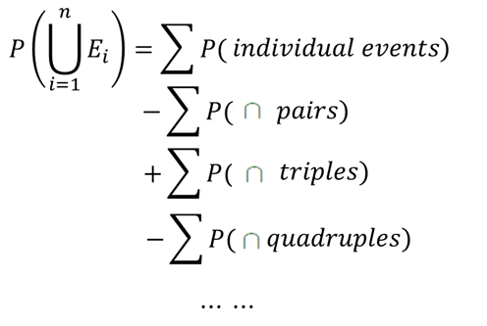
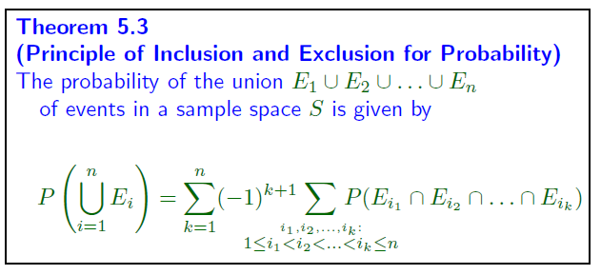
Page <number>

Slide 13
Outline
The inclusion-exclusion principle
An example
Proof of the principle

Slide 14
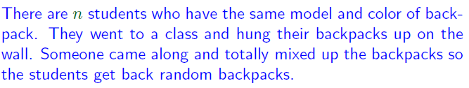
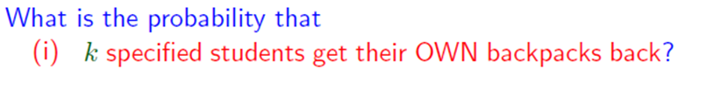
Example: Backpack
Page <number>

Slide 15


Backpack Problem
Page <number>
1-to-1:
Different students get back different backpacks
Onto:
Every backpack is taken

Slide 16



Backpack Problem
Page <number>
The process:
Students getting back backpacks

Slide 17
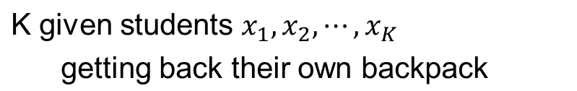

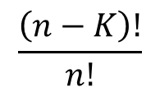



Backpack
Page <number>
First Event
# of such outcomes:
(n-K)!

Slide 18


Backpack
Page <number>

Slide 19


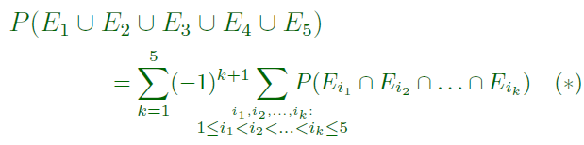
Page <number>

Slide 20
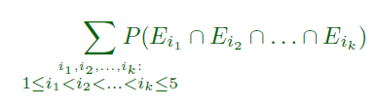

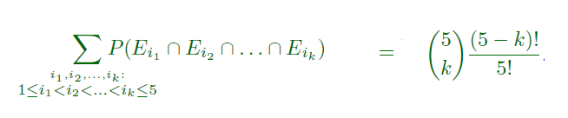
Page <number>

Slide 21



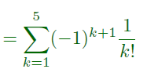


Slide 22
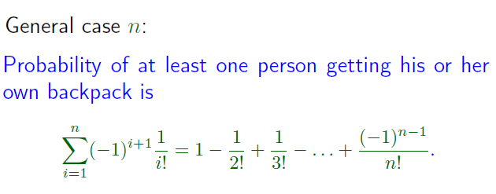
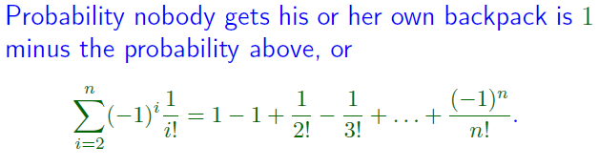
2nd event
Page <number>
3rd event

Slide 23
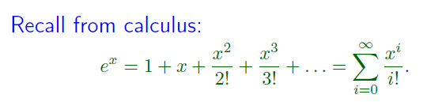
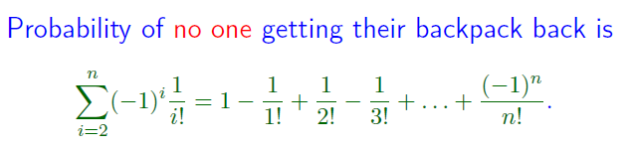

Page <number>

Slide 24
Outline
The inclusion-exclusion principle
An example
Proof of the principle

Slide 25
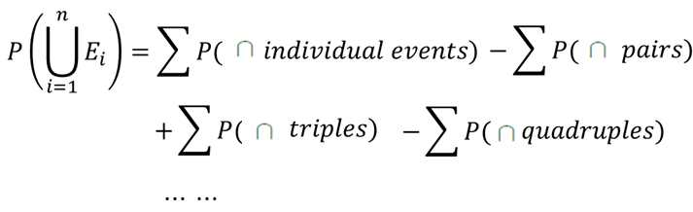


Combinatorial Proof of Theorem 5.3
Page <number>
Program 5.3
  p=0
  For each non-empty subset A of events
    q = prob of intersection of events in A
    If |A| is odd, p = p + q
    If |A| is even, p = p - q
  return p
Another way to state Theorem 5.3
  Program 5.3 returns the probability of union of all the events

Slide 26
Combinatorial Proof of Theorem 5.3
Page <number>
Base case: n=1
  Trivially true
Induction hypothesis
  In case of n-1 or fewer events
    Program 5.3 returns probability of union of all the events
Induction step
  Consider case of n events: E1, E2, …, En

Slide 27
Combinatorial Proof of Theorem 5.3
Page <number>
Case of n events: Split non-empty subsets into three groups
  G1: All those not containing En
  G2: {En}
  G3: All those containing En except the singleton subset {En}
By Induction hypothesis
  On G1, Program 5.3 obtains P(E1 U … U En-1)
  On G2, Program 5.3 obtains P(En)
  On G3,
    Program 5.3 obtains a value that is the negation of the value obtained on all subsets of these n-1 events:
      E1 /\ En, E2 /\ En, …, En-1 /\ En
    So, Program 5.3 obtains
      -P( (E1 /\ En) U … U ( En-1 /\ En) ) = - P( (E1 U … U En-1) /\ En)

Slide 28
Combinatorial Proof of Theorem 5.3
Page <number>
The overall value returns by Program 5.3 in the case of n events is
P(E1 U … U En-1)
+ P(En)
- P( (E1 U … U En-1) /\ En)
= P(E1 U … U En-1 U En)
(induction hypothesis)
The theorem is Proved.

Slide 29
Example: n=4
n=4: E1, E2, E3, E4
G1:
  {E1}, {E2}, {E3}, {E1, E2}, {E1, E3}, {E2, E3}, {E1, E2, E3}
  On these subsets, Program 5.3 returns P(E1 U E2 U E3) by i.h.
G2:
  {E4}
  On this subset, Program returns P(E4).

Slide 30
Example: n=4
G3:
  {E1, E4}, {E2, E4}, {E3, E4}, {E1, E2, E4}, {E1, E3, E4}, {E2, E3, E4}, {E1, E2, E3, E4}
  On these subsets, Program 5.3 returns –P( (E1 U E2 U E3) /\ E4)
  Here are the reasons:
    Let Hi = Ei /\ E4
    Consider G3’: {H1}, {H2}, {H3}, {H1, H2}, {H1, H3}, {H2, H3}, {H1, H2, H3}
    By i.h., Program 5.3 returns P( H1 U H2 U H3) = P( (E1 U E2 U E3) /\ E4)
    Use q(S) to denote the result Program 5.3 gets on a subset S.
    Then, q({E1, E4},) = -q({H1}), q({E2, E4},) = -q({H2}), …
    The above conclusion follows.

Slide 31

Algebraic Proof of Theorem 5.3
Page <number>

Slide 32
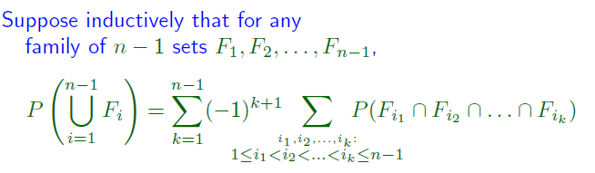

Page <number>

Slide 33
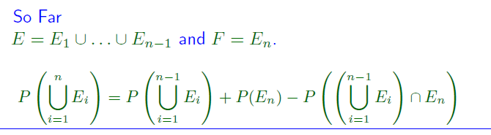

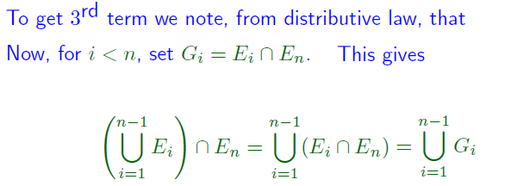
Page <number>

Slide 34
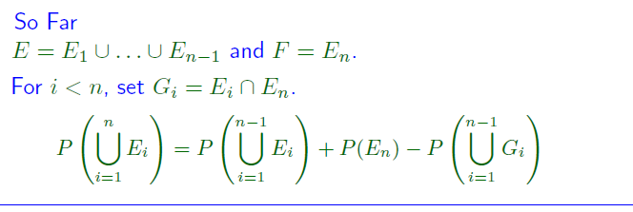
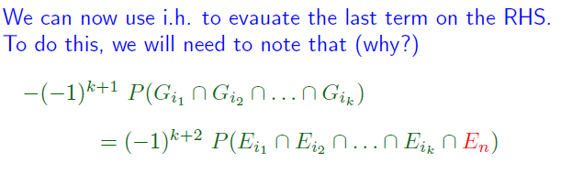
Page <number>

Slide 35
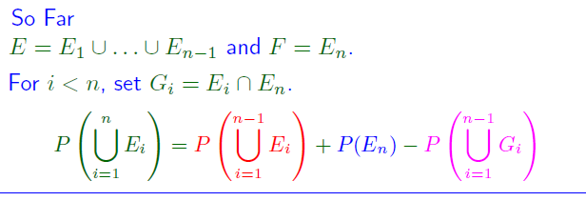
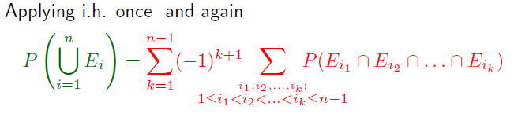

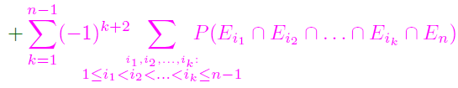
Page <number>

Slide 36

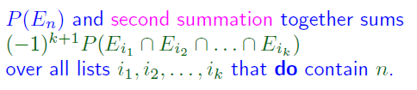
Page <number>

Slide 37
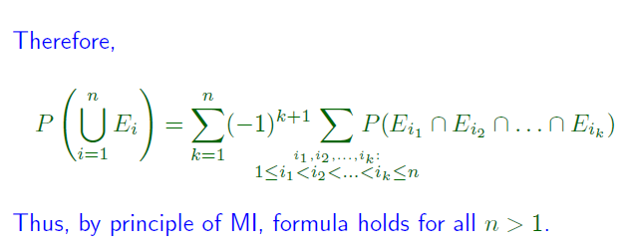
Page <number>

