Slide 1
L12: Random Variables: Independence and Variance
Page 1
Independence of RVs
  Distribution Functions of RVs
  Independence between RVs
  Expectation of product of independent RVs
Variance of RV
  Definition and Examples
  Additivity
  Standard deviation
Central limit theorem

Slide 2
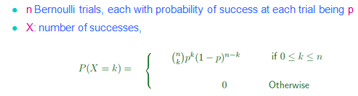
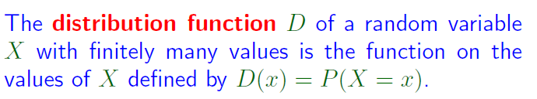
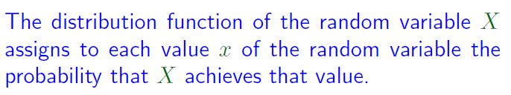
Distribution Functions of RVs
Page <number>
P(X=k) viewed as a function of k: The distribution function of X.
In general

Slide 3
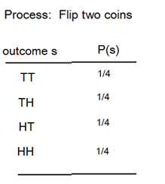
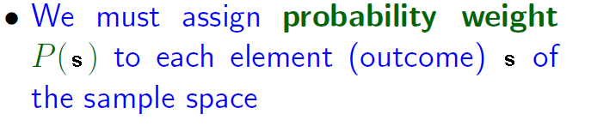
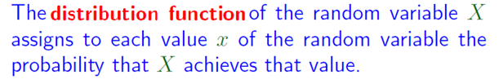
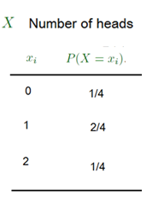
Probability Weight and Distribution Function
Page <number>

Slide 4

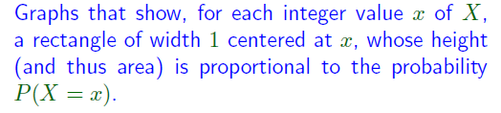
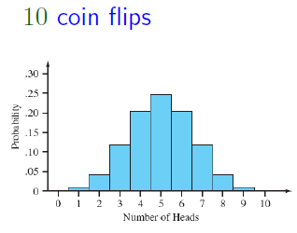
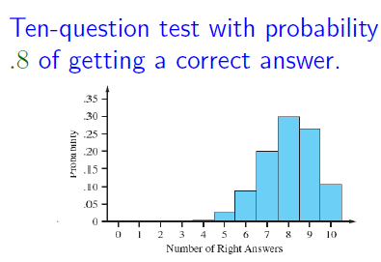
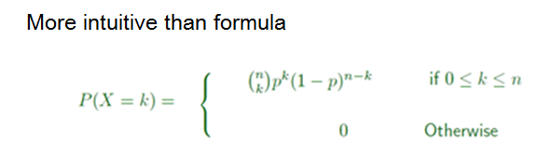
Distribution Functions of RVs
Page <number>

Slide 5


Distribution Functions of RVs
Page <number>
For coin example
  D(1, 9) = P(1 <= X <=9 ) ~= 1

Slide 6
Outline
Page <number>
Independence of RVs
  Distribution Functions of RVs
  Independence between RVs
  Expectation of product of independent RVs
Variance of RV
  Definition and Examples
  Additivity
  Standard deviation
Central limit theorem

Slide 7
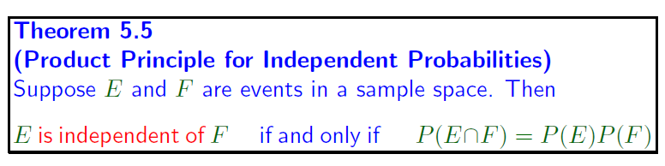

Independence Between Events
E is independent of F
    If P(E|F) = P(E)
  The information that “Event F occurred” does not change the probability of E

Slide 8

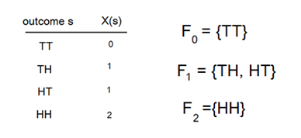

Random Variable and Event
Page <number>
Given a rand variable, we can define many different events

Slide 9
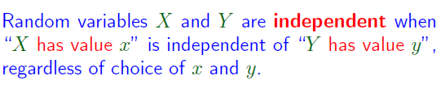
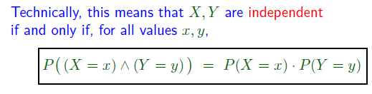
Independence between RVs
Page <number>

Slide 10
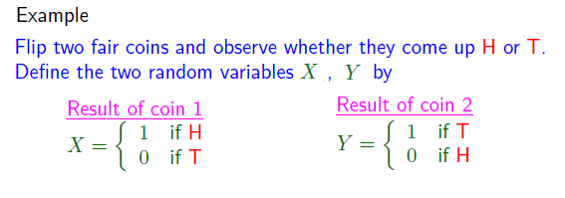
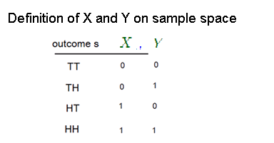



Independence between RVs
Page <number>

Slide 11



Page <number>
Independence between RVs

Slide 12
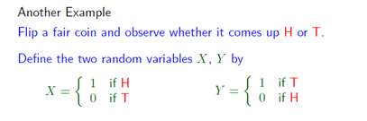




Independence between RVs
Page <number>
No need to further check
  P(X=0, Y=1) ?= P(X=0)P(Y=1)
  P(X=1, Y=0) ? = P(X=1)P(Y=0)
  P(X=1, Y=1) ?= P(X=1)P(Y=1)

Slide 13
Independence between RVs
Page <number>
Draw two cards from a deck of 52 cards
  X: number on first card
  Y: number on second card
  X and Y are independent when drawing with replacement
  X and Y are not independent when drawing without replacement

Slide 14
Outline
Page <number>
Independence of RVs
  Distribution Functions of RVs
  Independence between RVs
  Expectation of product of independent RVs
Variance of RV
  Definition and Examples
  Additivity
  Standard deviation
Central limit theorem

Slide 15
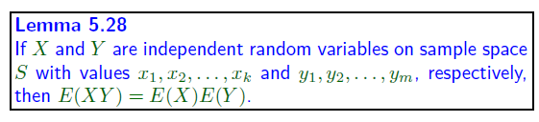
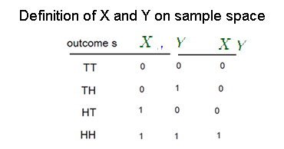




Independence and Expectation
Page <number>

Slide 16
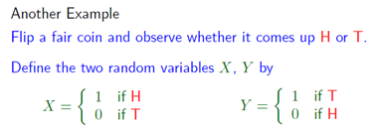

Independence and Expectation
Page <number>

Slide 17











Page <number>

Slide 18


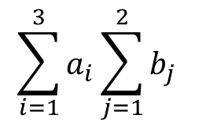

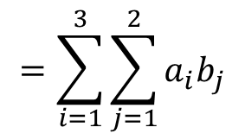
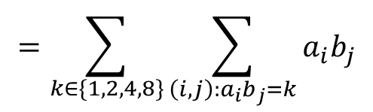
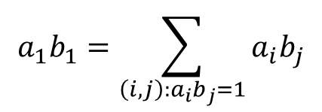
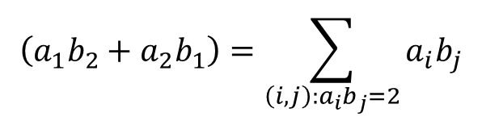

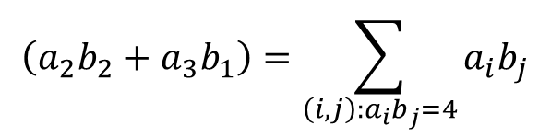
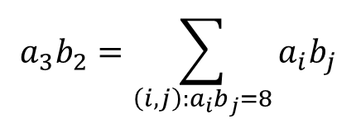
Page <number>
Analogy for proof of Lemma 5.28
1 2 2 4 4 8

Slide 19
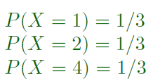
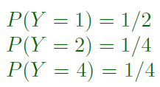


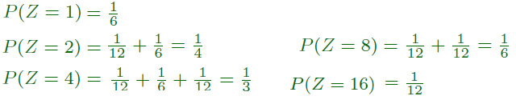
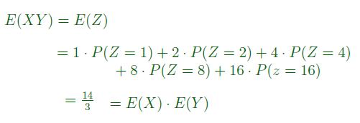
Illustrating Proof via Example
Page <number>

Slide 20










Illustrating Proof via Example
Page <number>

Slide 21
Outline
Page <number>
Independence of RVs
  Distribution Functions of RVs
  Independence between RVs
  Expectation of product of independent RVs
Variance of RV
  Definition and Examples
  Additivity
  Standard deviation
Sum of independent RVs

Slide 22


Variance of RVs
Page <number>
Probability starts with a process whose outcome is uncertain
Sample space: the set of all possible outcomes
A random variable (RV) is a function defined on the sample space
Different runs of the process might yield different outcomes
The RV might take different values in different runs
  In other words, the value of RV varies across different runs
Some RVs vary more and some vary less
  Number of heads in 1 coin flip
  Number of heads in 10 coin flips
  Number of heads in 100 coin flips

Slide 23




Variance of RVs
Page <number>
Variance of an RV X
  Measures how much it varies (across different runs of process)
  Relative to the mean value

Slide 24



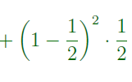


Page <number>

Slide 25







Page <number>

Slide 26
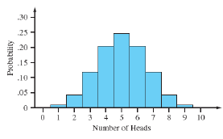
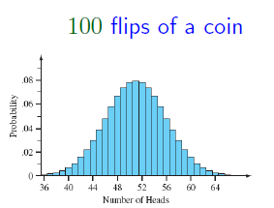
Which RV vary the most?
Page <number>
Flip fair coin
Number of heads in 1 flip
Number of heads in 10 flips
Number of heads in 100 flips
Variance
  1/4
  10/4
  100/4

Slide 27
Outline
Page <number>
Independence of RVs
  Distribution Functions of RVs
  Independence between RVs
  Expectation of product of independent RVs
Variance of RV
  Definition and Examples
  Additivity
  Standard deviation
Central limit theorem

Slide 28

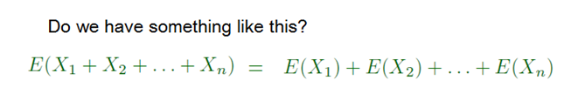
Calculating Variance
Page <number>

Slide 29
Example 1: We have already seen
Page <number>
Number of heads in n flips
  n=1: X1
  n=10
  (x1+X2+…+X10)
  n=100
  (X1+X2+…+X100)
Variance
  1/4
  10/4 = 10 * 1/4
  100/4 = 100 * 1/4
Additivity is true here.

Slide 30


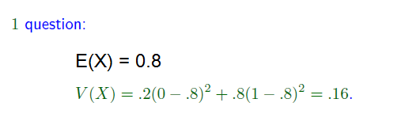




Page <number>
Additivity is true here.

Slide 31
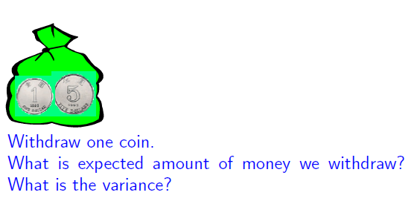
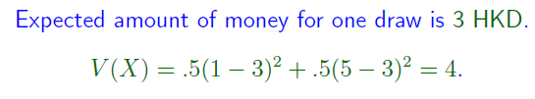
Example 3 (Counter Example)
Page <number>

Slide 32



Example 3 (Counter Example)
Page <number>

Slide 33
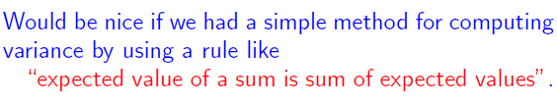


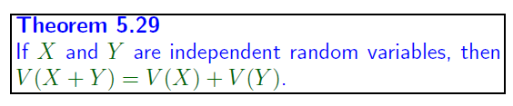
Page <number>

Slide 34




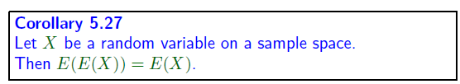

Two Lemmas
Page <number>

Slide 35
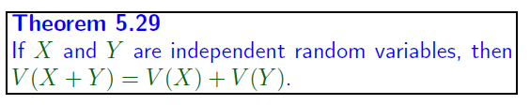






Page <number>

Slide 36




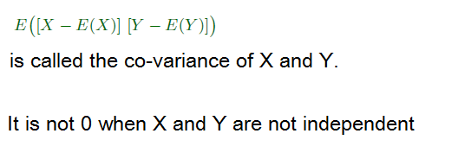
Page <number>

Slide 37








An Application of Theorem 5.29
Page <number>

Slide 38
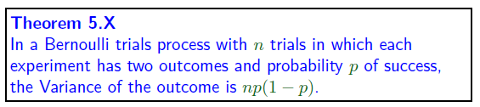





A Corollary
Page <number>

Slide 39
Outline
Page <number>
Independence of RVs
  Distribution Functions of RVs
  Independence between RVs
  Expectation of product of independent RVs
Variance of RV
  Definition and Examples
  Additivity
  Standard deviation
Central limit theorem

Slide 40

Standard Deviation
Page <number>
Standard deviation is another measure of how much a rv varies or how much a distribution spread out
It is the square root of variance.
Next page
  Shows several distributions, variances and standard deviations
  Highlights the differences between variance and standard deviation

Slide 41
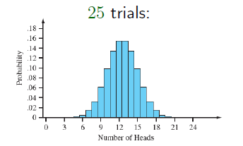







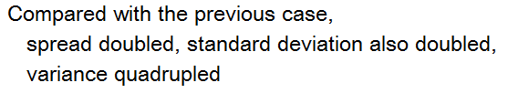
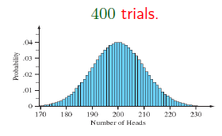



Distributions, Variances, and Standard Deviations
Page <number>

Slide 42
Distributions, Variances, and Standard Deviations
Page <number>
The examples on the previous page show
  Standard deviation is a natural measure of “spread” of distribution
Variance is easier to manipulate mathematically. Will see this in further study of probability theory and statistics.

Slide 43
Outline
Page <number>
Independence of RVs
  Distribution Functions of RVs
  Independence between RVs
  Expectation of product of independent RVs
Variance of RV
  Definition and Examples
  Additivity
  Standard deviation
Central limit theorem

Slide 44
A Pattern
Page <number>
If we flip of a coin a large number of times,
  “The number of heads” has bell-shaped distribution.
This phenomenon is not unique to coin flipping

Slide 45
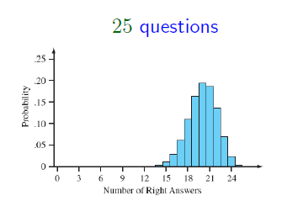
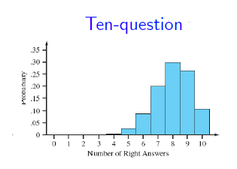



Test with .8 probability of getting correct answer
Page <number>

Slide 46





Page <number>

Slide 47


Page <number>

Slide 48


Normal Distribution
Page <number>

Slide 49



Page <number>

Slide 50




Page <number>

