Slide 1
L15: The RSA Algorithm
Page <number>
Objective:
  Present the RSA Cryptosystem
  Prove its correctness
  Discuss related issues
Reading
  Textbook, pp. 123-143

Slide 2
The RSA Algorithm
Page <number>
Exponentiation mod n
The RSA Cryptosystem
Correctness
  Fermat’s Little Theorem
  Decipherability of RSA
  Security of RSA
Calculating exponentiation mod n efficiently
The Chinese Remainder Theorem

Slide 3



Exponentiation mod n
Encryption with addition and multiplication mod n
  Easy to break
RSA: use exponentiation mod n

Slide 4
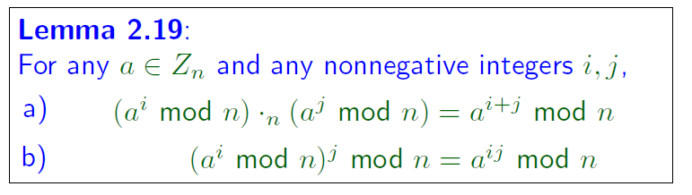







Exponentiation mod n

Slide 5


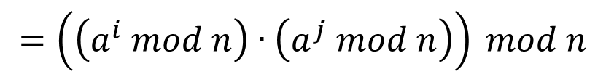


Proof of Lemma 2.19

Slide 6


Page <number>
Proof of Lemma 2.19
j terms

Slide 7
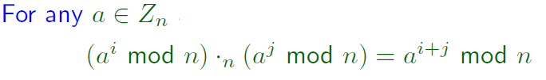

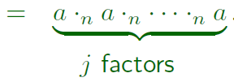

Corollary of Lemma 2.19

Slide 8
Page <number>
The RSA Algorithm
Exponentiation mod n
The RSA Cryptosystem
Correctness
  Fermat’s Little Theorem
  Decipherability of RSA
  Security of RSA
Exponentiation mod n efficiently
The Chinese Remainder Theorem

Slide 9
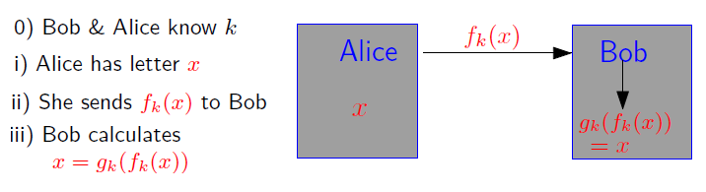


Drawback of Private-Key Cryptosystem
Page <number>

Slide 10

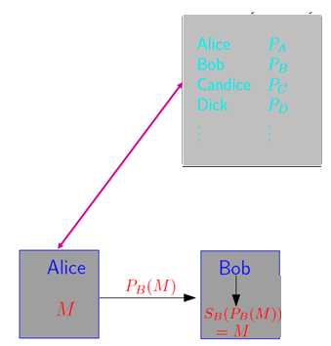



Public-Key Cryptography
decipherability
security
This is not easy.

Slide 11
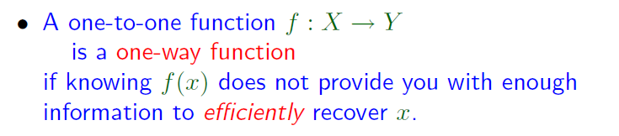




One-Way Function

Slide 12
RSA Algorithm
Builds a one-way function using
  Exponentiation mod n
  Prime numbers
  gcd
  Multiplicative inverse

Slide 13
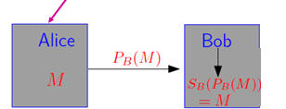
RSA Algorithm
Questions to answer
How to generate the public key: PB ?
How to generate the secrete key: SB ?
How to encrypt plaintext M using PB ?
How to decrypt ciphertext PB(M) using SB ?

Slide 14



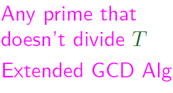



RSA Algorithm

Slide 15







RSA Example
Key generation

Slide 16

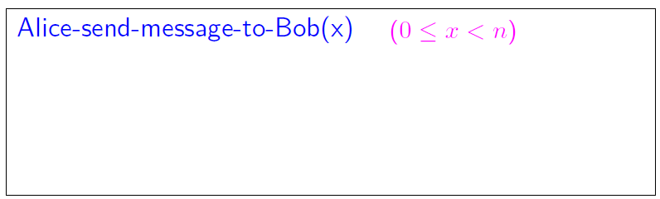


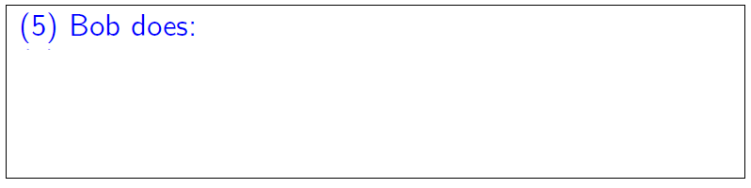


RSA Algorithm

Slide 17









RSA Example
Encryption and decryption

Slide 18

Page <number>
The RSA Algorithm
Exponentiation mod n
The RSA Cryptosystem
Correctness
  Fermat’s Little Theorem
  Decipherability of RSA
  Security of RSA
Exponentiation mod n efficiently
The Chinese Remainder Theorem
decipherability
security
This is not easy.

Slide 19
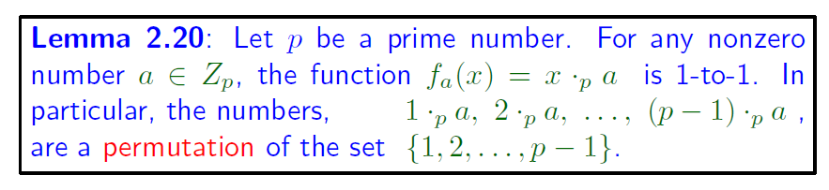

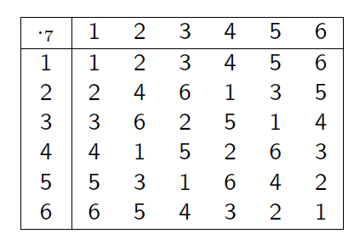

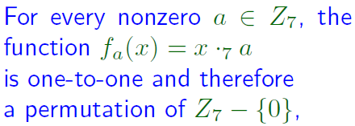
A Lemma
Page <number>

Slide 20





Page <number>
Proof : By contradiction
Assume f_{a} not 1-to-1, exist
Contradiction!
f_{a} must be 1-to-1

Slide 21
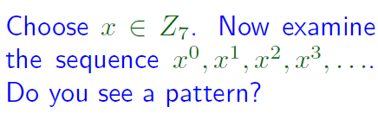
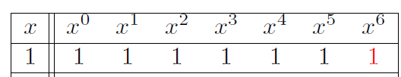




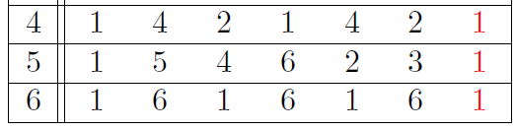
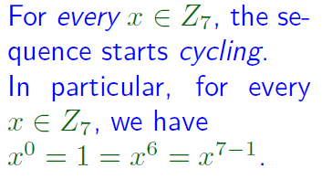
Page <number>
Fermat’s Little Theorem
3⁴ mod 7 =
((3³ mod 7) · 3) mod 7 =
4
3⁵ mod 7 =
((3⁴ mod 7) · 3) mod 7 =
5
3⁶ mod 7 =
((3⁵mod 7) · 3) mod 7 =
1

Slide 22
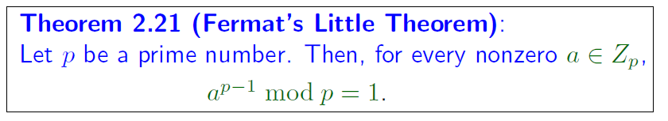






Page <number>

Slide 23
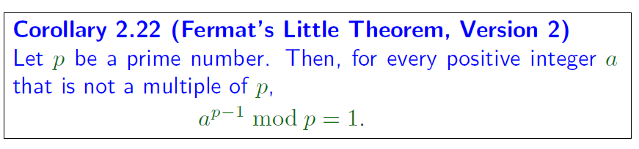

Page <number>
a^{p-1} mod p = (a mod p)^{p-1} mod p
= 1
What if a is a multiple of p?

Slide 24
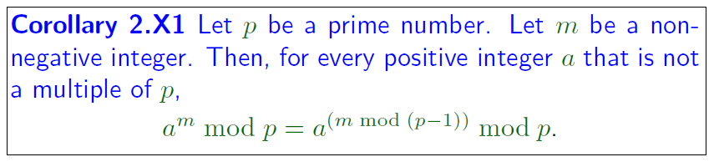






Page <number>
Simplifies computation

Slide 25






Page <number>

Slide 26
Page <number>
The RSA Algorithm
Exponentiation mod n
The RSA Cryptosystem
Correctness
  Fermat’s Little Theorem
  Decipherability of RSA
  Security of RSA
Exponentiation mod n efficiently
The Chinese Remainder Theorem

Slide 27
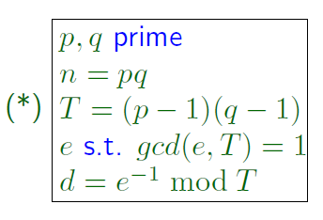
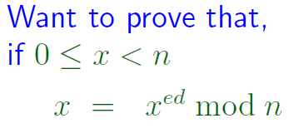
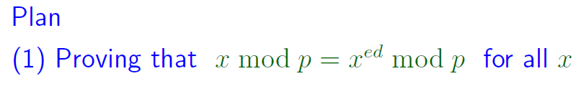

Decipherability
Page <number>

Slide 28
Step1 Show ( 1)
x mod p = x^{ed} mod p
d = e⁻¹ mod T
=> ed mod T = 1
=> ed = 1+kT
= 1+k (p-1) (q-1)
x^{ed} mod p = x^{1+k(p-1) (q-1)} mod p
= x ( x^{k(q-1)} ) ^{(p-1)} mod p
= x · w^{p-1} mod p
= x · (w^{p-1} mod p) mod p (*)
Proof:
W

Slide 29








Page <number>
Step1 show ( 1)
x mod p = x^{ed} mod p
Proof（cont'd）
x^{ed} mod p = x · (w^{p-1} mod p) mod p (*)
Case1: w is not multiple of p
Case2: w is a multiple of p
( )+( ) =>

Slide 30


Decipherability
Page <number>

Slide 31
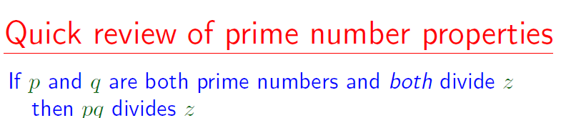
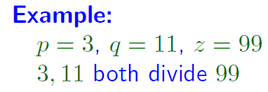
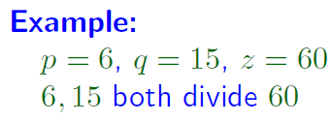

Page <number>

Slide 32
Page <number>
RSA Corredness Proof: Step 3
① x mod p = x^{ed} mod p
② x mod q = x^{ed} mod q
① => (x^{ed} -X) mod p = 0
=> p x^{ed} -X (*)
② => (x^{ed} -X) mod q = 0
=> q x^{ed} -X (**)
(*)+|(**)+property of prime mumbers
=> p q x^{ed} -X
Show: ① + ② =>
x = x^{ed} mod n , n=p q
Proof:

Slide 33
Show: ① + ② =>
x = x^{ed} mod n , n=p q
Proof:(cont'd)
pq x^{ed} - x
=> x^{ed} - x = k p q
=> x^{ed} = k n + x
(0 ≤ x < n)
=> x^{ed} mod n = x
= kn
Step 3 completed

Slide 34
Decipherability Proved!
Page <number>

Slide 35
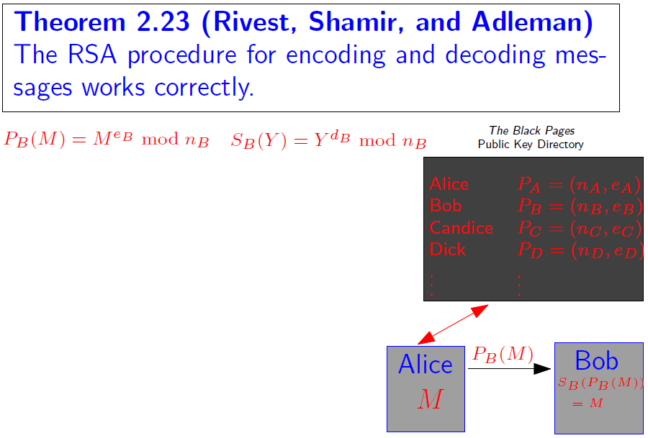
Page <number>

Slide 36
Page <number>
The RSA Algorithm
Exponentiation mod n
The RSA Cryptosystem
Correctness
  Fermat’s Little Theorem
  Decipherability of RSA
  Security of RSA
Exponentiation mod n efficiently
The Chinese Remainder Theorem

Slide 37
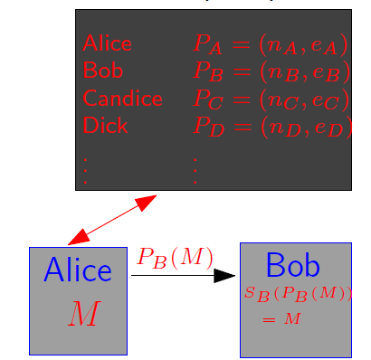
Is RSA Secure?
* Bob: Publishes e, n
* Alice: Sends y = x^{e} mod n
* Bob: Decodes y^{d} mod n = x
* Adversary can get: e, n might also get y
* Why is it hard for adversary to recover x ?
— No, known quick way to reverse x^{e} mod n
i.e. "e^{th} roots mod n"
— How about: n => p , q => d
No known quick way to factor large integers

Slide 38




Page <number>
Is RSA Secure?

Slide 39
Page <number>
The RSA Algorithm
Exponentiation mod n
The RSA Cryptosystem
Correctness
  Fermat’s Little Theorem
  Decipherability of RSA
  Security of RSA
Exponentiation mod n efficiently
The Chinese Remainder Theorem

Slide 40
Exponentiation mod n efficiently
Page <number>
* Key operation of RSA: a^{e} mod n
* Suppose:
a ~ 150 digits
e ~ 120 digits , e≈10¹²⁰
n ~ 150 digits
* Methods:
① Calculate a^{e}
② Take mod n
Problem: 10² =100 , 1 + 2 digits
10³ =1000 , 1 + 3 digits
10^{k} 1 + k digits
a^{e} ＞ 10e 1+e digits
Too long to fit in computer
≈1+10¹²⁰ digits

Slide 41
Exponentiation mod n efficiently
Page <number>
* Methods 2:
a³ mod n = a ( a² mod n ) mod n
a⁴ mod n = a ( a³ mod n ) mod n
a⁵ mod n = a ( a⁴ mod n ) mod n
........
a^{e} mod n = a ( a^{e-1} mod n ) mod n
Results ＜ n , fit in computer
Problem ?
10¹²⁰ steps!

Slide 42







Exponentiation mod n efficiently
Page <number>

Slide 43






Exponentiation mod n efficiently
Page <number>

Slide 44




Complexity of Repeated Squaring
Page <number>

Slide 45




Repeated Squaring Example
Page <number>
Write down sequence of powers of 2
  2, 4, 8, 16, 32, 64, 128, 256, 504, 1024 : 2^n
  1, 2, 3, 4, 5, 6, 7, 8, 9, 10 : n
Write e as sum of those powers
  1052 = 1024 + 16 + 8 + 4
Get the k’s

Slide 46
Page <number>
The RSA Algorithm
Exponentiation mod n
The RSA Cryptosystem
Correctness
  Fermat’s Little Theorem
  Decipherability of RSA
  Security of RSA
Exponentiation mod n efficiently
The Chinese Remainder Theorem

Slide 47
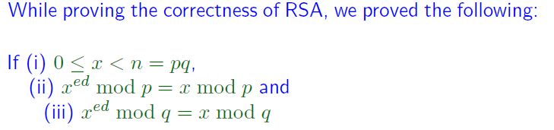


The Chinese Remainder Theorem

Slide 48
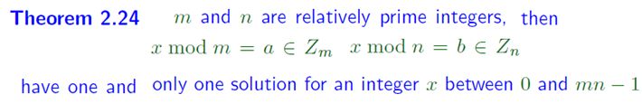
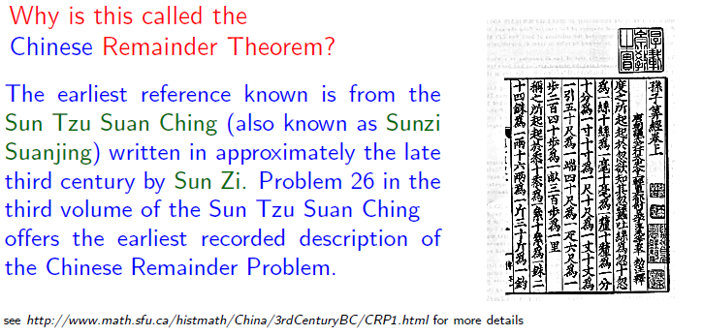
The Chinese Remainder Theorem
Key Point: Determine x from its reminders

Slide 49
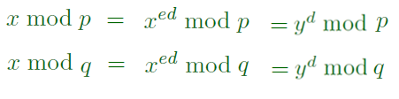
The Chinese Remainder Theorem & RSA
Decryption: Recover original message x from ciphertext y
Why possible?
  We can determine the reminders of x from the ciphertext y
  By CRT, we can determine x from the reminders.
Next slide: A more detailed argument

Slide 50



The Chinese Remainder Theorem & RSA
Let 0 <= x < n be the original message, and
a = x mod p; b = x mod q
By definition, x is a solution to the follow equations:
y mod p = a; y mod q = b (*)
From first two steps of the proof, we have
So, is also a solution to the equations in (*).
By Theorem 2.24 , we must have

Slide 51

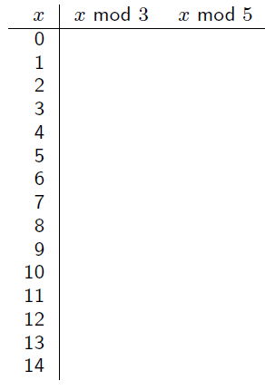




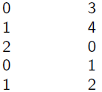
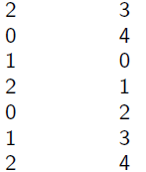
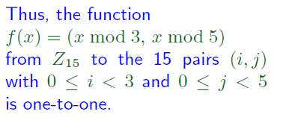

The Chinese Remainder Theorem

Slide 52






The Chinese Remainder Theorem

Slide 53










The Chinese Remainder Theorem

Slide 54
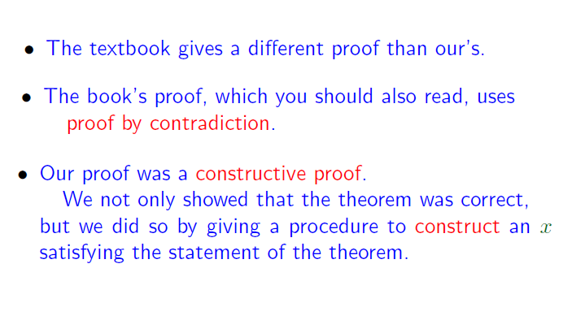

Slide 55


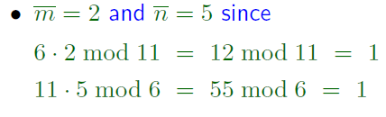






The Chinese Remainder Theorem

