Slide 1
Overview of Part 5
Page <number>
Relating
Theme:
Small problems
Big problems
Proof techniques using
Small → Big relationships
+ proof by smallest counter example
+ proof by induction
Problem solving techniques using
Small → Big relationships
+ recursion
+ divide & conquer
Running time of those techniques
+ recurrence

Slide 2
L16: Introduction to Induction
Page <number>
Objective
  Making use of small~big problem relationships in proofs
Outline
  Proof by smallest counterexample
  Weak induction
  Strong induction
Reading:
  Textbook: 191-202

Slide 3
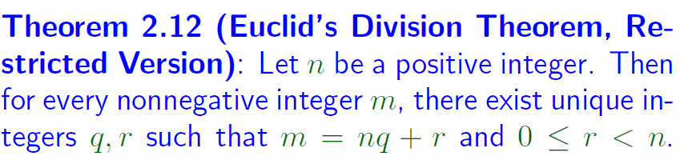
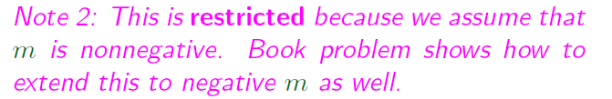
Euclid’s Division Theorem
Page <number>

Slide 4

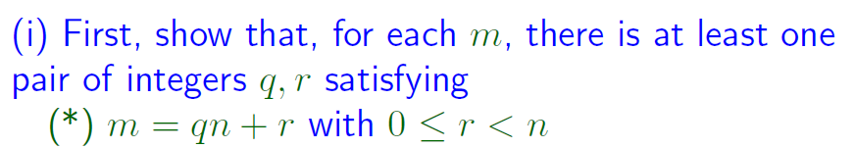

Euclid’s Division Theorem
Page <number>

Slide 5

Page <number>
Need to prove: For any m ≥ 0 ,
Exist q & r , s. t . m = qn + r ( 0 ≤ r ＜ n)
* Proof by contradiction
* Assume exists m ≥ 0 , s . t .
m = qn + r ( * )
Not true for any q , r ( 0 ≤ r ＜ n )
Choose the smallest such m
  Equation (*) not true for m and any q, r
  Equation (*) true for m’ <m and some q, r
* Two cases: m ＜ n , m ≥ n

Slide 6
Page <number>
* If m ＜ n ,
m = 0 · n + m ( 0 ≤ m ＜ n )
( q = 0 , r = m ) Satisfies
m = qn + r ( 0 ≤ r ＜ n )
Contradicts the choice of m !
* If m ≥ n ,
Let m’ = m – n , m’ ≥ 0
m’ < m
There must exist q’ , r’
s. t. m’ = q’ n + r’ ( 0 ≤ r’ ＜ n )
=> m – n = q’n + r’
=> m = ( 1 + q’ ) n + r’
Contradicts the choice of m !
Proof completed

Slide 7




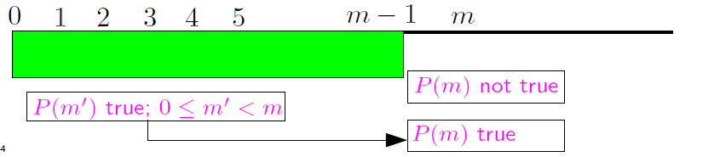
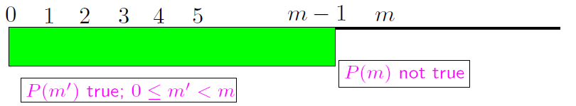
Page <number>
Proof by Smallest Counter Example

Slide 8




Example 1
Page <number>

Slide 9




Example 1 (cont’d)
Page <number>

Slide 10
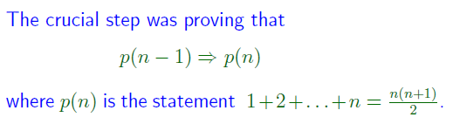
Example 1 (cont’d)
Page <number>

Slide 11





Example 2
Page <number>

Slide 12







Example 2 (cont’d)
Page <number>

Slide 13



Example 2 (cont’d)
Page <number>

Slide 14



A General Principle
Page <number>
What we did:
  Given: (a) p(0) is True; (b) If n>0 , then p(n-1) => p(n)
  Conclusion: p(n) is True for all n >= 0
How we did it: Proof by Smallest Counter Example

Slide 15
Outline
Page <number>
Proof by smallest counterexample
Weak induction
Strong induction

Slide 16

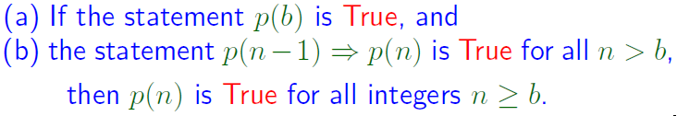
Weak Principle of Math Induction
Page <number>
We have actually proved:

Slide 17
Inductive Proof
Page <number>
Base Case (n=b): Show that p(b) is True
Induction (n>b): Show p(n-1) => p(n)
  Induction Hypothesis
    p(n-1) is True
  Inductive Step:
    p(n) is True
Inductive conclusion:
  p(n) is True for all n>=b

Slide 18













Page <number>

Slide 19
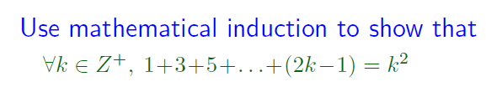







Page <number>

Slide 20










Page <number>

Slide 21
Outline
Page <number>
Proof by smallest counterexample
Weak induction
Strong induction

Slide 22
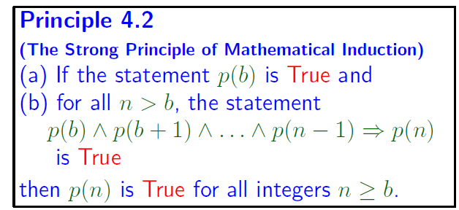
Page <number>

Slide 23
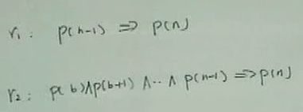
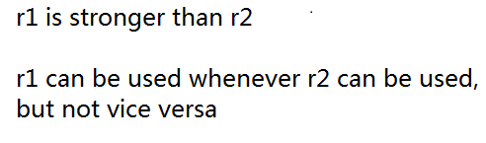
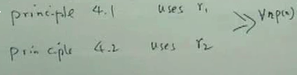
Why Principle 4.2 is stronger than Principle 4.1
Page <number>

Slide 24
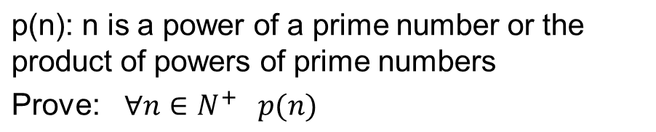
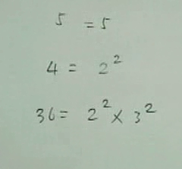

Slide 25





Page <number>
p(b)
Consider n
1. n is prime
p(n) true
p(n)

Slide 26
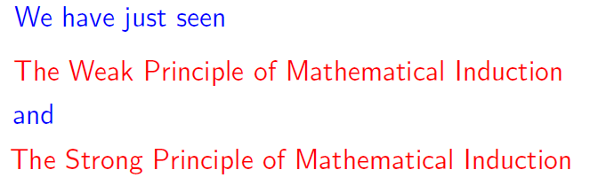

Remarks
Page <number>

Slide 27



Summary
Page <number>

