Slide 1







L18: Recurrences for Divide-and-Conquer
Page <number>
Prob
L17
1
n
1
n
Subs
1
n-1
1
n-1
1
n-1
Prob
1
n
1
n
L18
Subs
1
n/2
n/2+1
n
1
n/2

Slide 2
Outline
Page <number>
D&C Examples
D&C Scenarios and Recurrences
Solving the recurrences
Big-O
Running time in terms of big-O
Three asymptotic behaviors of D&C recurrences
Reading:
  Textbook: 228-240

Slide 3



D&C Example: Merge Sort
Page <number>
7 2 4 3 1 8 6 5
Divide
7 2 4 3
1 8 6 5
Conquer
2 3 4 7
1 5 6 8
Merge
1
2
3 4 5 6
7 8

Slide 4

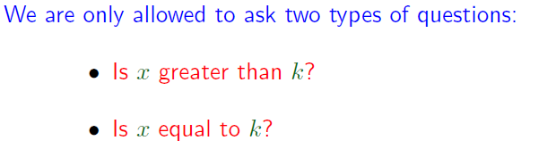
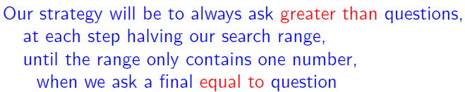
D&C Example: Binary Search
Page <number>

Slide 5










D&C Example: Binary Search
Page <number>

Slide 6





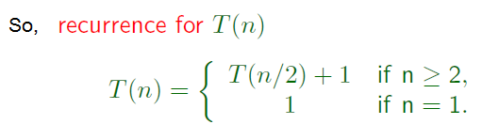
Binary Recurrence
Page <number>

Slide 7

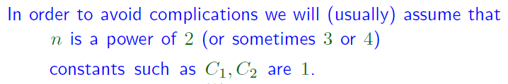

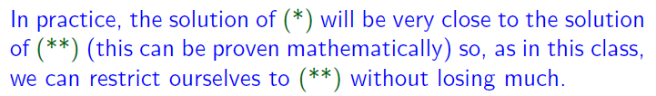
What if n is not a power for 2?
Page <number>
Need ceiling function and deal with recurrences like the following

Slide 8
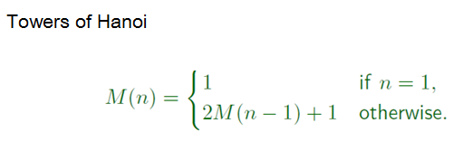
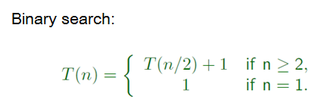

Different Types of Recurrences
Page <number>
Which case takes more time?

Slide 9
Outline
Page <number>
D&C Examples
D&C Scenarios and Recurrences
Solving the recurrences
Big-O
Running time in terms of big-O
Three Asymptotic behaviors of D&C recurrences

Slide 10
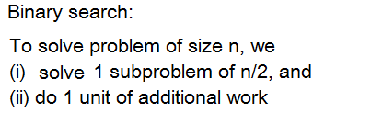

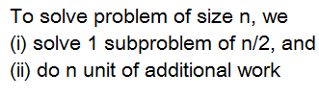

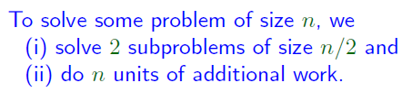





D&C Scenarios and Recurrences
Page <number>

Slide 11
Outline
Page <number>
D&C Example : Binary search
D&C Scenarios and Recurrences
Solving the recurrences
Big-O
Running time in terms of big-O
Three Asymptotic behaviors of D&C recurrences

Slide 12
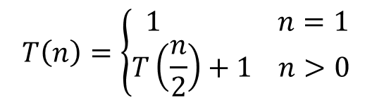




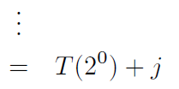

Solving recurrence:
Page <number>

Slide 13
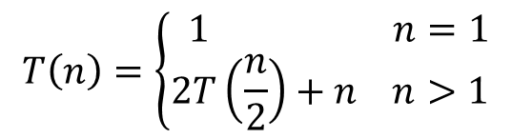







Solving recurrence:
Page <number>

Slide 14
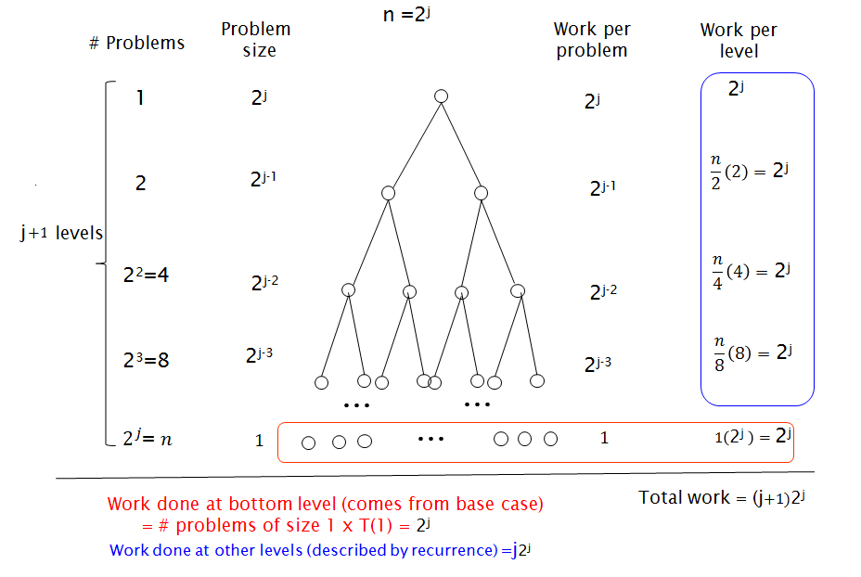
Another Perspective: Recursion Tree
Page <number>

Slide 15
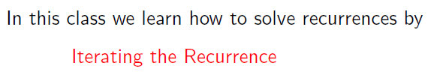

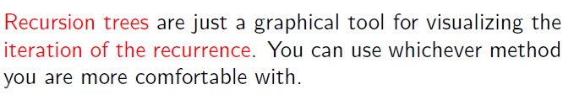
Notes
Page <number>

Slide 16
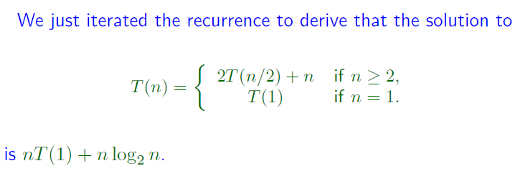
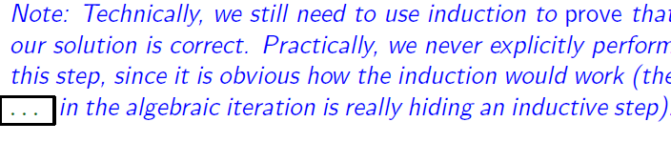
Notes
Page <number>

Slide 17
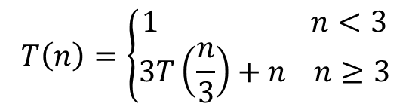





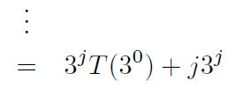


Solving recurrence:
Page <number>

Slide 18
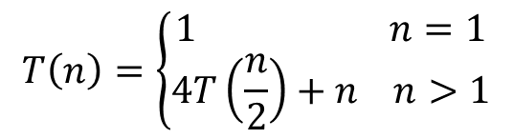







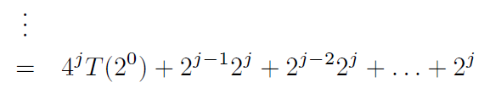


Solving recurrence:
Page <number>

Slide 19
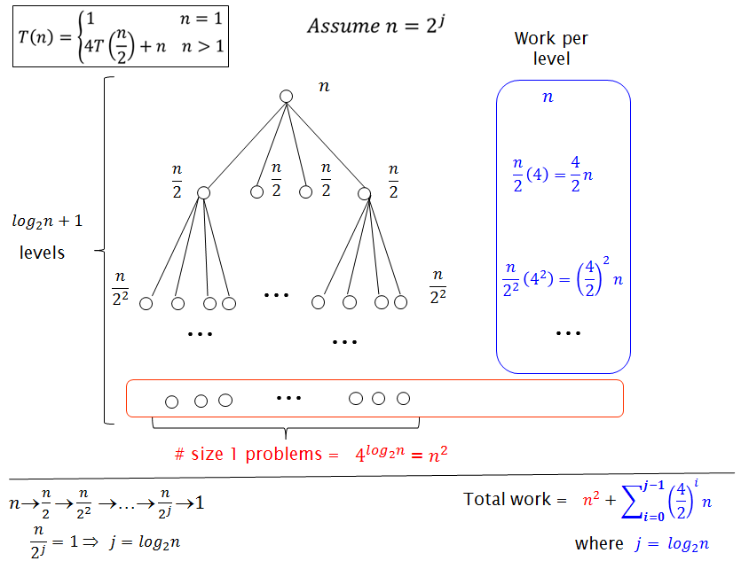
Recursion Tree
Page <number>

Slide 20
Outline
Page <number>
D&C Example : Binary search
D&C Scenarios and Recurrences
Solving the recurrences
Big-O
Running time in terms of big-O
Three Asymptotic behaviors of D&C recurrences

Slide 21




How different are the running times?
Page <number>
To get an clear appreciation of when running time differences that matters, we need big-O notation.

Slide 22
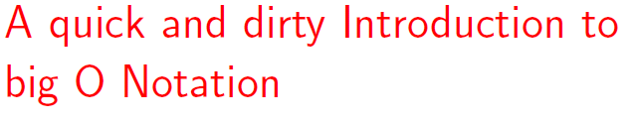
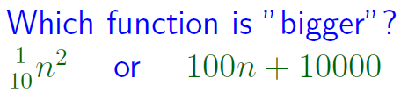

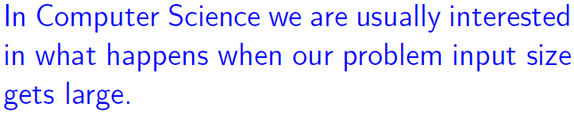

Slide 23
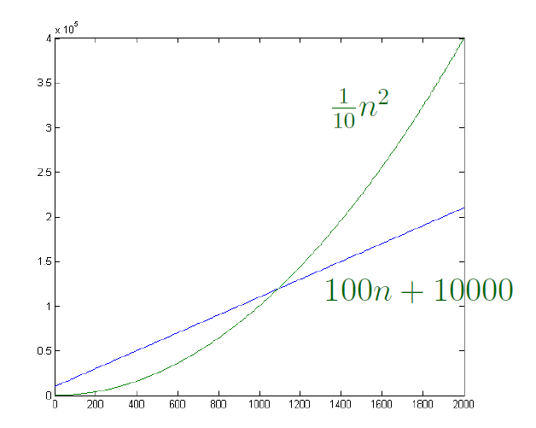
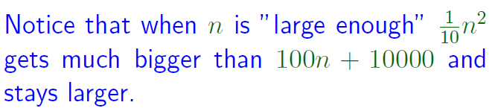

Asymptotically, 100n+10000 is better than

Slide 24



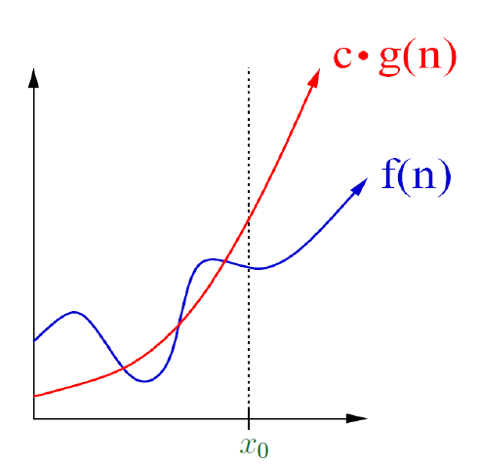



Big-O/Asymptotic Upper Bound
Page <number>
Order of growth of f is upper bounded by order of growth of g.

Slide 25
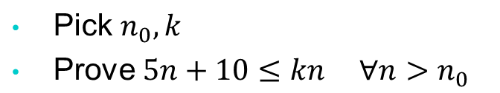
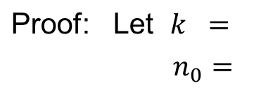




Big-O Example
Page <number>
Show: 5n+10=O(n)
Need to do:
6
10
Therefore, 5n+10=O(n)
Proved.

Slide 26






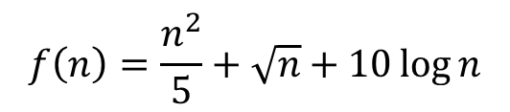


Big-O Examples
Page <number>
g(n)=n²
In all cases, we can say the running time is O(n²).
Convey essential info. & simple.

Slide 27
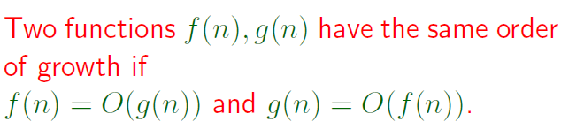
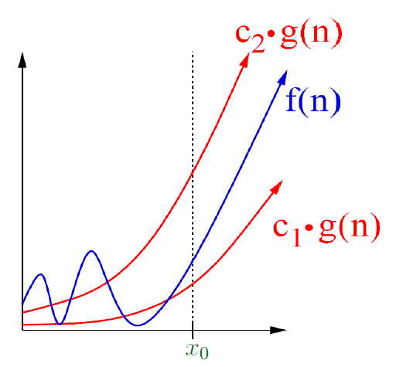
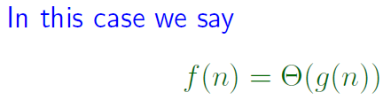
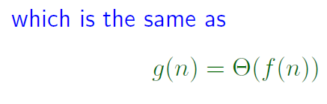
Big-Theta
Page <number>

Slide 28
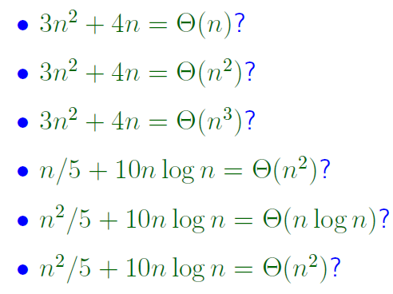






Examples
Page <number>

Slide 29

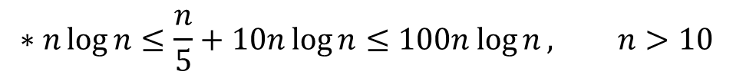


Page <number>
Use of big-O, ϴ
If program has running time 3n²+n
we can simply say: running time is ϴ(n²)
Report dominating term only

Slide 30
Outline
Page <number>
D&C Example : Binary search
D&C Scenarios and Recurrences
Solving the recurrences
Big-O
Running time in terms of big-O
Three Asymptotic behaviors of D&C recurrences

Slide 31








Running time in terms of Big-O
Page <number>

Slide 32
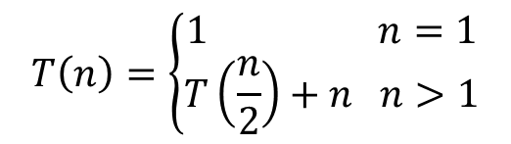



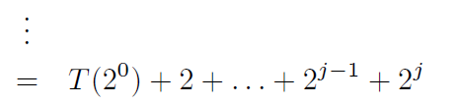


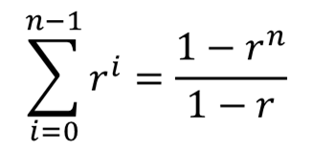
Solving recurrence:
Page <number>
Assume n=2^{j}
Can further simplify using
Instead, get big-O expression directly

Slide 33
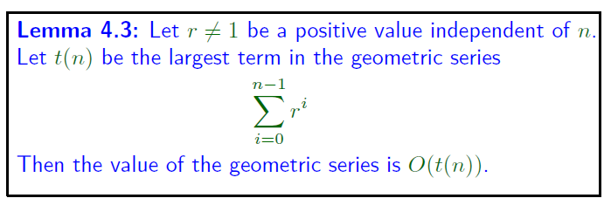








Page <number>

Slide 34










Page <number>

Slide 35



Solving recurrence:
Page <number>
Assume n=2^{j}

Slide 36









Running time in terms of Big-O
Page <number>

Slide 37
Outline
Page <number>
D&C Example : Binary search
D&C Scenarios and Recurrences
Solving the recurrences
Big-O
Running time in terms of big-O
Three Asymptotic behaviors of D&C recurrences

Slide 38





Three Asymptotic Behaviors
Page <number>

Slide 39
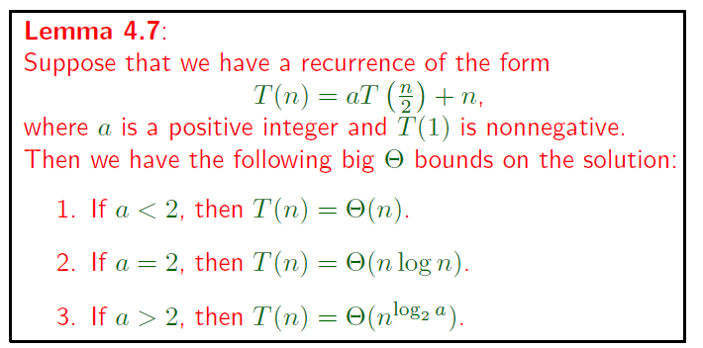

Case 2 proved already.
Page <number>

Slide 40
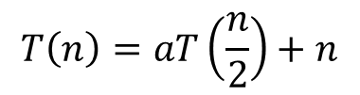














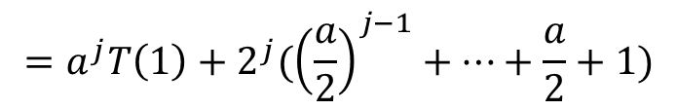
Proof for Cases 1 & 3
Page <number>

Slide 41
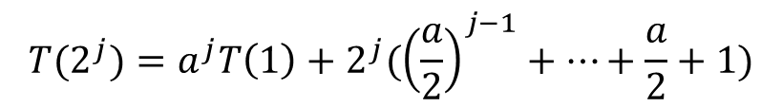




Case 1: a < 2
Page <number>

Slide 42
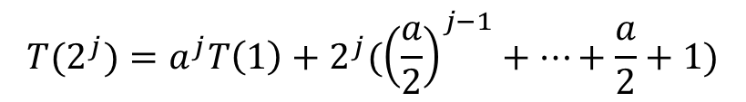
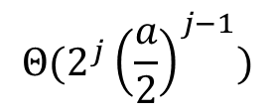

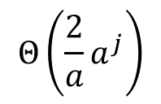






Case 3: a > 2
Page <number>

Slide 43
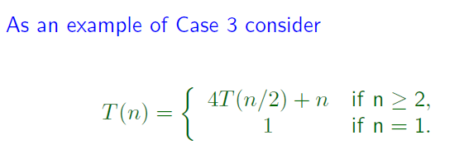




Page <number>

Slide 44


