Slide 1
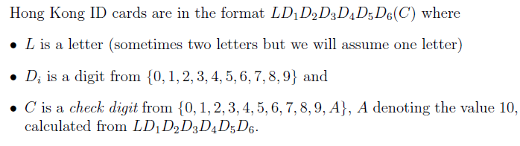
Example: HKID Check Digit
Page <number>
Page <number>
Examples: D246824(8), D246834(5), Z246834(5)

Slide 2
Page <number>
Possible Errors

Slide 3
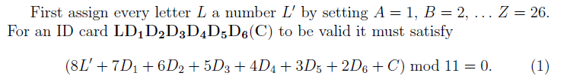






Page <number>
Page <number>
Error Checking

Slide 4





Page <number>
Error Checking
Property 1: The scheme catch all Single Digit Errors.
Proof: Checking equation can be written as

Slide 5




Page <number>
Page <number>
Error Checking
Property 2: The scheme catch all Two Digit Transposition.
Proof:

Slide 6



Page <number>
Page <number>
Page <number>
Error Checking
Question: Why not mod 10?

