Slide 1
L01 Recap: Propositional Logic
A proposition is a declarative statement (i.e., a sentence that declares a fact) that is either true or false, but not both
p: COMP 2711 is an elective course
q: COMP 2711 is an Mathematical course
Logical operators or logical connectives can be used to turn existing propositions into new propositions.
¬p, p ^ q , p ∨ q , p⊕q, p→q , p↔q
Precedence: ¬; ^, ∨ ; →, ↔
Better to use parentheses for clarity, except for ¬

Slide 2
Tautology and Contradiction
A tautology is a compound proposition that is always true, no matter what the truth values of the propositions that occur in it.
A contradiction is a compound proposition that is always false.
A contingency is a compound proposition that is neither a tautology nor a contradiction.

Slide 3
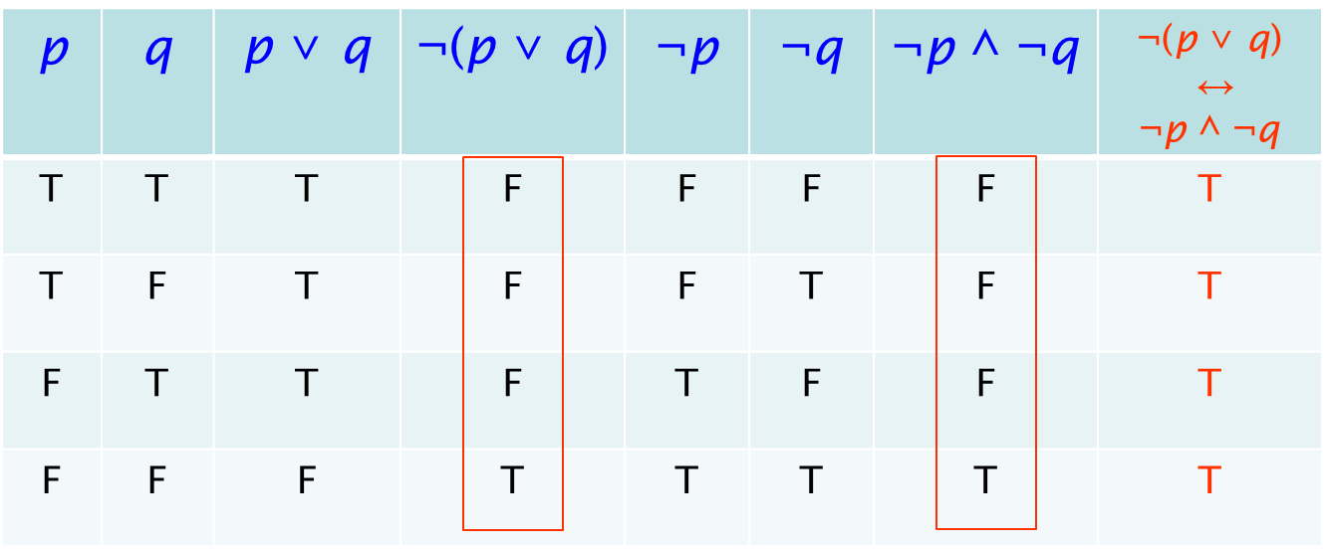
Logical Equivalence
Compound propositions that always have the same truth values are called logically equivalent
p and q are called logically equivalent iff p ↔ q is a tautology.

Slide 4
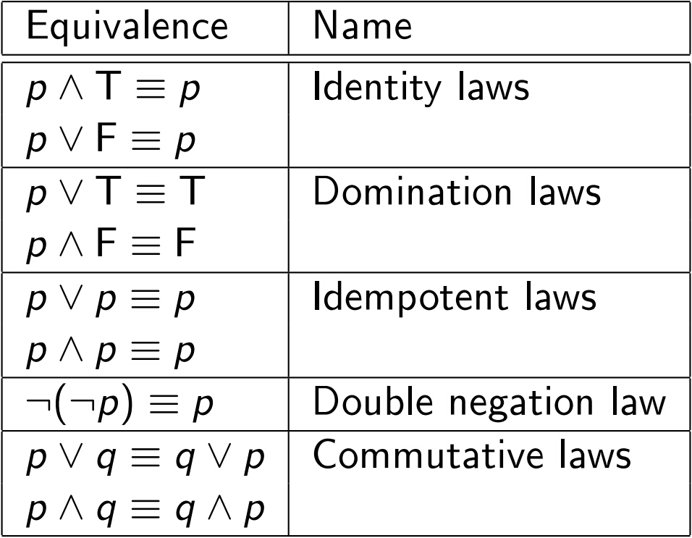
Propositional Equivalences
The following table summarizes the major propositional equivalences:

Slide 5
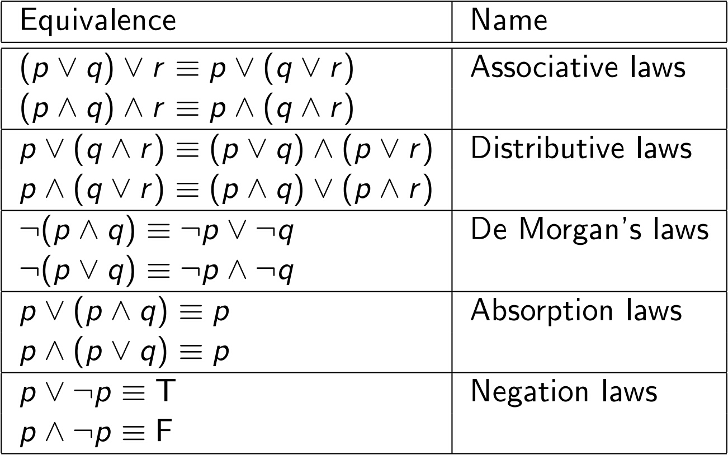
Propositional Equivalences (cont'd)

Slide 6
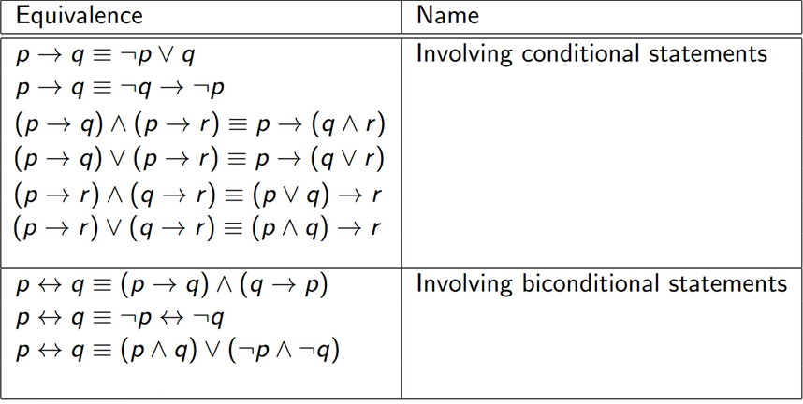
Propositional Equivalences (cont'd)

