Slide 1
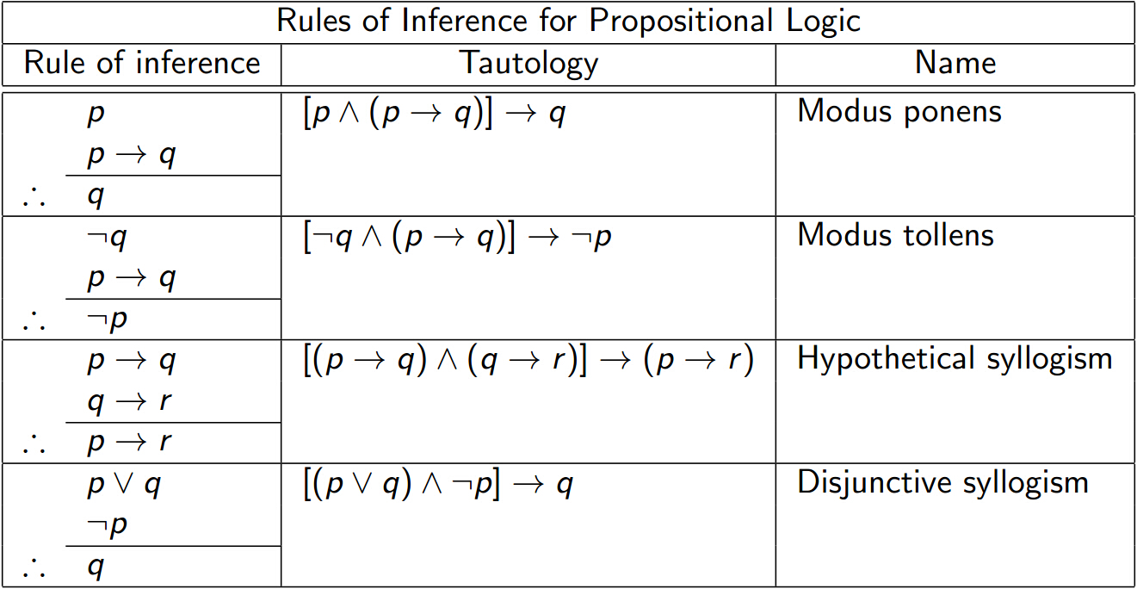
L03 Recap

Slide 2
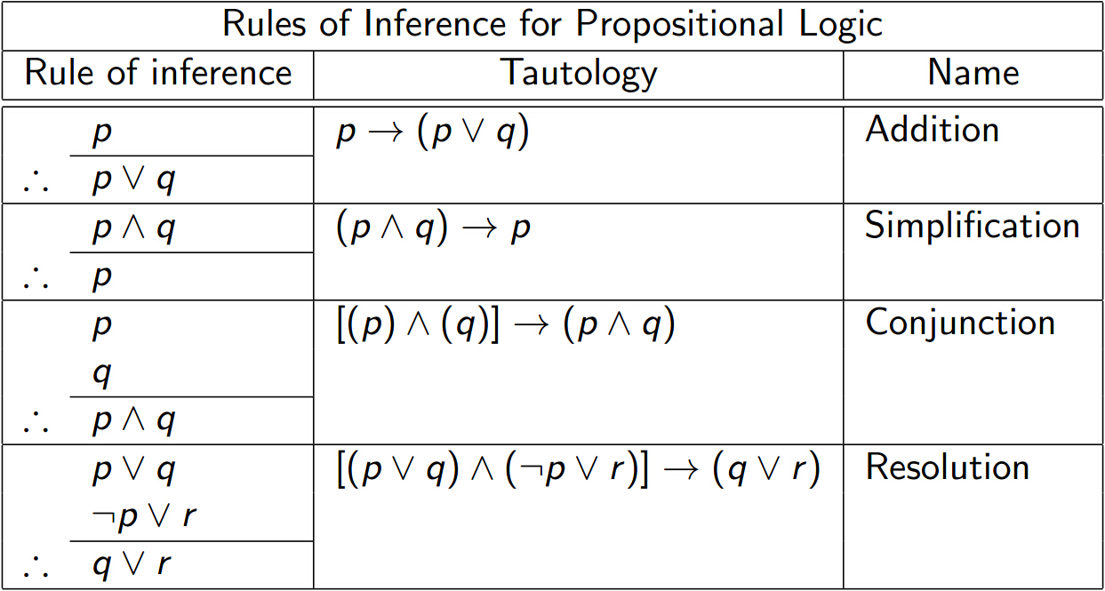

Slide 3
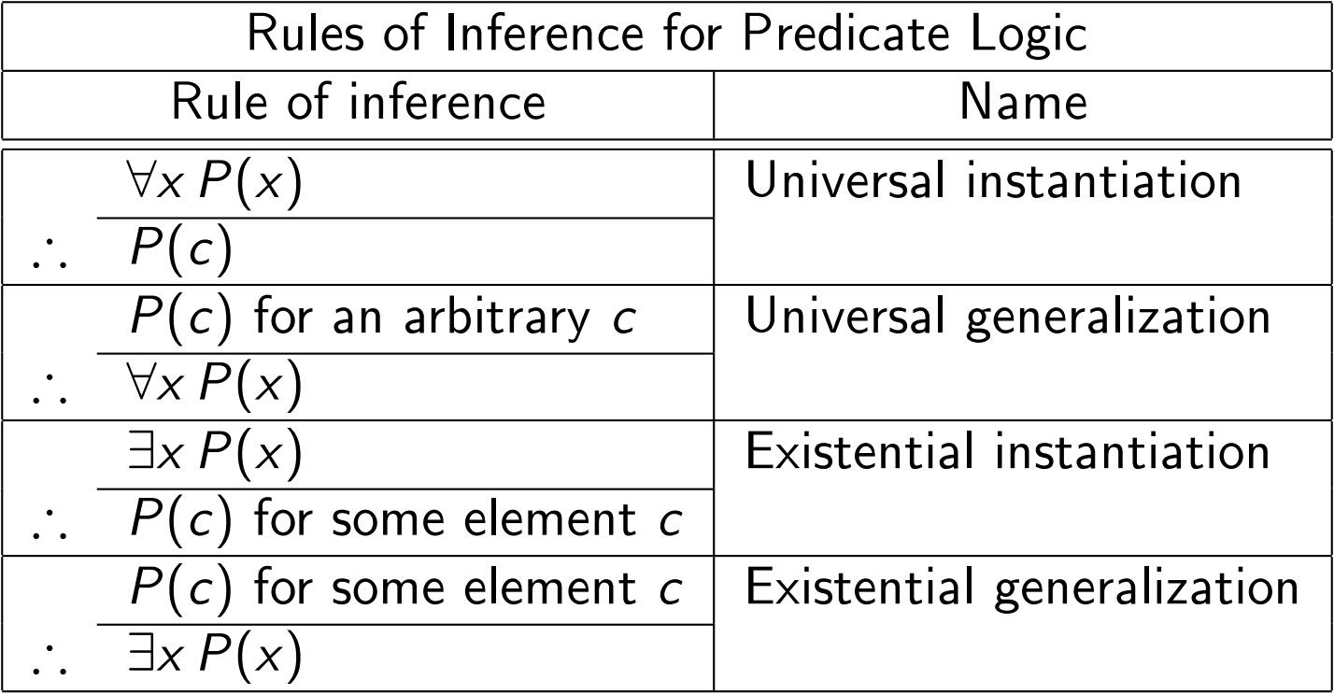

Slide 4
Proofs for p→q
Direct proof: Assume p, derive q
Contrapositive proof: Assume ¬q, derive ¬p
Proof by contradiction: Assume p and ¬q, derive contradiction

Slide 5
Example: Direct Proof doesn’t work
If 3n+2 is odd, then n is odd
Direct Proof:
Suppose 3n+2 is odd.
3n+2 = 2k +1 for some integer k
n = (2k-1)/3
Cannot continue further..
Can be done using Proof by Contraposition

Slide 6
Contrapositive prof
If 3n+2 is odd, then n is odd
Contrapositive Proof:
Assume n is even.
That is, n = 2k for some integer k.
Then, 3n+2 = 6k+2 = 2(3K+1) is even.
This contradicts the premise.
Hence, the statement must be true.

Slide 7
Example: Contrapositive does not work
gcd: greatest common divisor, e.g, gcd(4, 6)=2
Proposition:
Let x, y, z be positive integers such that gcd(x, y)=1
If x=y+z, then gcd(y, z)=1.
Proof by contraposition:
Suppose gcd(y, z)=k, for some integer k>1
Then y=ak, z=bk for some a and b.
Cannot continue further without assuming x=y+z
Can be done using proof by contradiction

Slide 8
Example: Proof by Contradiction
Proposition:
Let x, y, z be positive integers such that gcd(x, y)=1
If x=y+z, then gcd(y, z)=1.
Proof by contradiction:
Assume x=y+z and gcd(y, z)=k for integer K>1.
Then y=ak, z=bk for some a and b,
x=y+z = k(a+b).
Hence, k divides both x and y, contradicting the condition gcd(x, y)=1.
Hence, the statement must be true.

