Slide 1
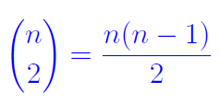

Recap of L04
Page <number>
Sum Principle
  Applied to selection sort
Product Principle
  Applied to matrix multiplication and the next item
Counting ordered pairs:
  n(n-1)
Counting two element-subsets
Set concepts and notations
  Sets, mutually disjoint sets, size, union, partition
  Set does not allow duplicates

Slide 2
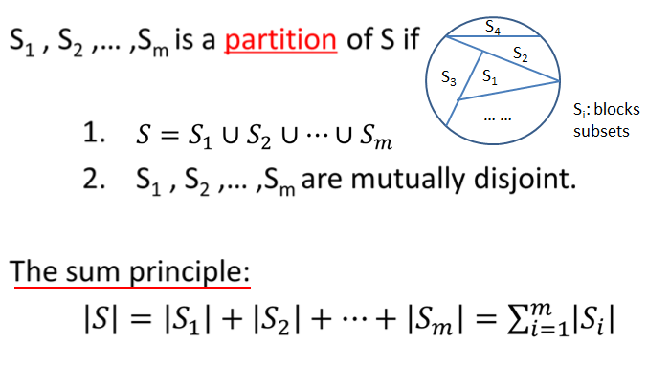
Sum Principle
Page <number>

Slide 3
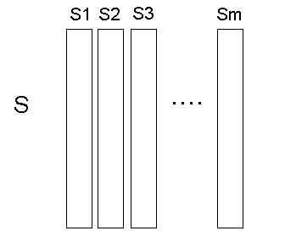
Product Principle
Page <number>
Si and Sj are disjoint, |Si| = n
S = S1 U S2 U … U Sm
|S| = mn

