Slide 1




Recap of L08
Page <number>
Probability associated with a process with uncertain outcomes
  Often kept implicit
Sample space: set of all possible outcomes
Event: subset of sample space
Probability distribution: weight for each element

Slide 2
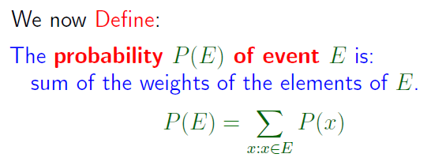


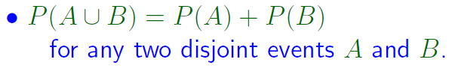
Recap of L08
Page <number>
Kolmogorov Axioms

Slide 3



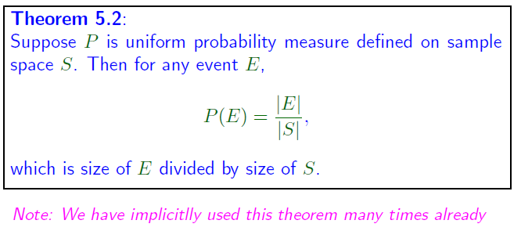
Recap of L08
Page <number>

Slide 4

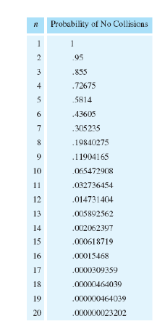
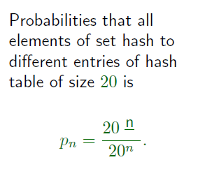
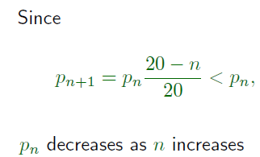
Page 4

Slide 5

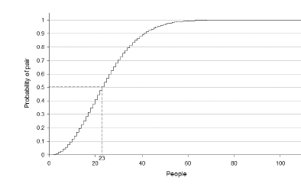
Example: Birthday Paradox
Page 5

